Slide 1


Design, development and deployment of a web‑based interoperable registry for inherited retinal dystrophies in Portugal: the IRD‑PT
In The Name Of God
Fatemeh Shafiee
Dr. Kimiyafar
shafieemf981@mums.ac.ir

Slide 2

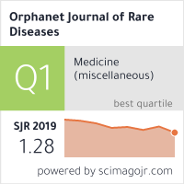
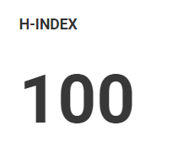
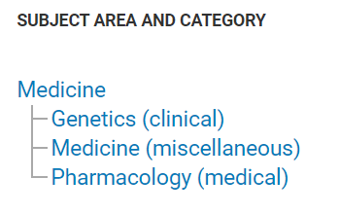

Slide 3
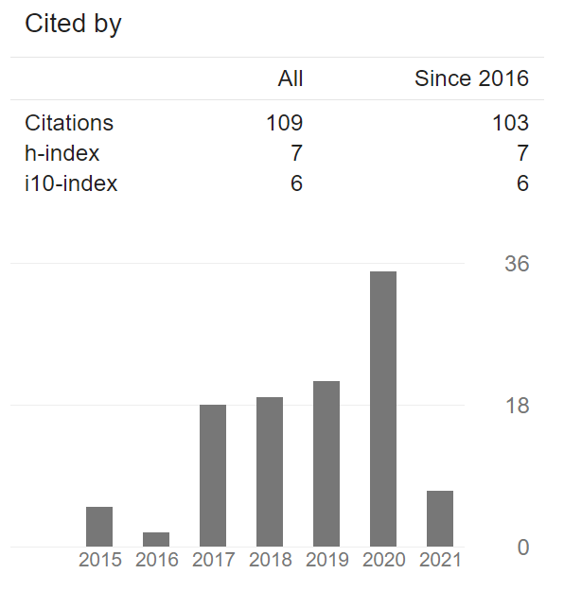
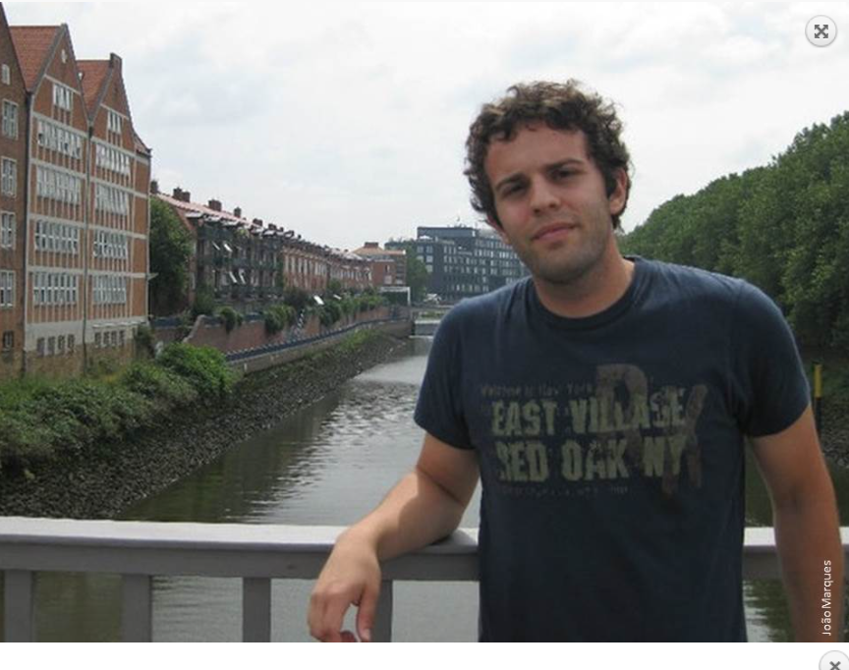
I have a Master Degree in Biochemistry but soon I have changed my focus into bioinformatics applied to sequence analysis.

Slide 4
c
c
c
c
Background
Results
Discussion
Conclusions
Methods
The Agency for Healthcare Research and Quality defines a registry as “an organized system that uses observational study methods to collect uniform data (clinical and other) to evaluate specified outcomes for a population defined by a particular disease, condition, or exposure, and that serves one or more predetermined scientific, clinical, or policy purposes”. Clinical registries have existed for decades in the field of ophthalmology, serving a variety of purposes, which include:
(1) capturing the epidemiologic features of an ocular disease or condition,
(2) tracking outcomes and complications of drugs or procedures,
(3) recording adverse events,
or (4) combinations of the above.

Slide 5
c
c
c
c
Background
Results
Discussion
Conclusions
Methods
In recent years, policy makers started recognizing clinical registries as an important tool for improving the value of healthcare. Outcome data is now used to fill in gaps of evidence that cannot be provided by randomized controlled trials. Furthermore, data from clinical registries is also increasingly being used to facilitate learning networks and to establish research collaborations between scientific researchers, clinicians, industry, regulators, patient organizations, patients and families.
This is especially true for rare diseases where the small number of cases for each disease creates additional barriers in the translational research pathway, and makes identification and establishment of a substantial cohort a very difficult task.

Slide 6
c
c
c
c
Background
Results
Discussion
Conclusions
Methods
Inherited retinal dystrophies (IRDs) are a clinically and genetically heterogenous group of diseases with an estimated prevalence of 1 in 3000 individuals. Despite some common ground, genetic profiles vary considerably among regions and ethnic groups, thus highlighting the importance of obtaining reference population-based data. The presence of founder mutations may greatly contribute for these differences, as observed in a large Israeli population. While local hospital-based registries may provide high quality information and resources, their coverage is usually small. To fully understand the prevalence and genomic landscape of IRDs, we must connect knowledge that is widespread throughout miscellaneous registries.

Slide 7
c
c
c
c
Background
Results
Discussion
Conclusions
Methods
The development of multicenter patient registries and natural history studies promote the generation of scientific knowledge by using real-world data. As rare diseases gain visibility as a public health priority and the marketplace expands, acknowledgement of the importance of building collaborative relationships in rare disease research increases. A national, web-based registry for IRDs is able to empower patients and community organizations, while supporting formal partnerships with investigators and stakeholders in the global aim to develop high-value, high-utility research.

Slide 8
c
c
c
c
Background
Results
Discussion
Conclusions
Methods
When developing a registry, it is essential to ensure that it is ethically governed, user-friendly and designed with maximum sustainability.
This includes the implementation of foundational, structural, semantic, and organizational interoperability processes to optimize the utility of data and allow its linkage to other existing or future registries. By making data computationally accessible, it is possible to bridge compatibility gaps between different hospitals, healthcare systems, registries and languages.

Slide 9
c
c
c
c
Background
Results
Discussion
Conclusions
Methods
Adoption of comprehensive phenotype and rare disease ontologies enables this type of sharing by making data findable, accessible, interoperable, and reusable (FAIR principles).
These features have made Orphanet Rare Disease Ontology (ORDO) a standard for rare disease coding in European health-care systems and led to the widespread adoption of ontologies like the Human Phenotype Ontology (HPO) by global genomics initiatives, like the European Reference Network for Rare Eye Disease (ERN-EYE)

Slide 10
c
c
c
c
Background
Results
Discussion
Conclusions
Methods
The purpose of this study
is to describe the design, development and deployment of a country-wide, web based, user-friendly and interoperable registry for IRDs.

Slide 11
c
c
c
Background
Results
Discussion
Conclusions
Methods
Data capture
The IRD-PT was designed to capture longitudinal data on IRDs.
The data captured by the IRD-PT module is kept to a minimum to deliver an efficient and user-friendly data collecting tool.
The user must complete all the mandatory fields/check all the mandatory boxes in order to save the entry.

Slide 12
c
c
c
Background
Results
Discussion
Conclusions
Methods
However, the system allows editing and/or completion of previously unanswered non-mandatory fields at the user’s convenience.
The list of covered clinical diagnoses is shown on Table 1, while the list of the genes and their respective Ontology of Genes and Genomes (OGG) and Mendelian Inheritance in Man (MIM) numbers are shown on Table 2.

Slide 13
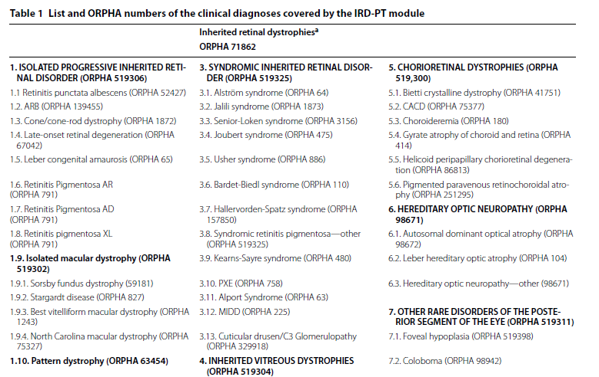
c
c
c
Background
Results
Discussion
Conclusions
The platform allows the selection of more than one diagnosis

Slide 14
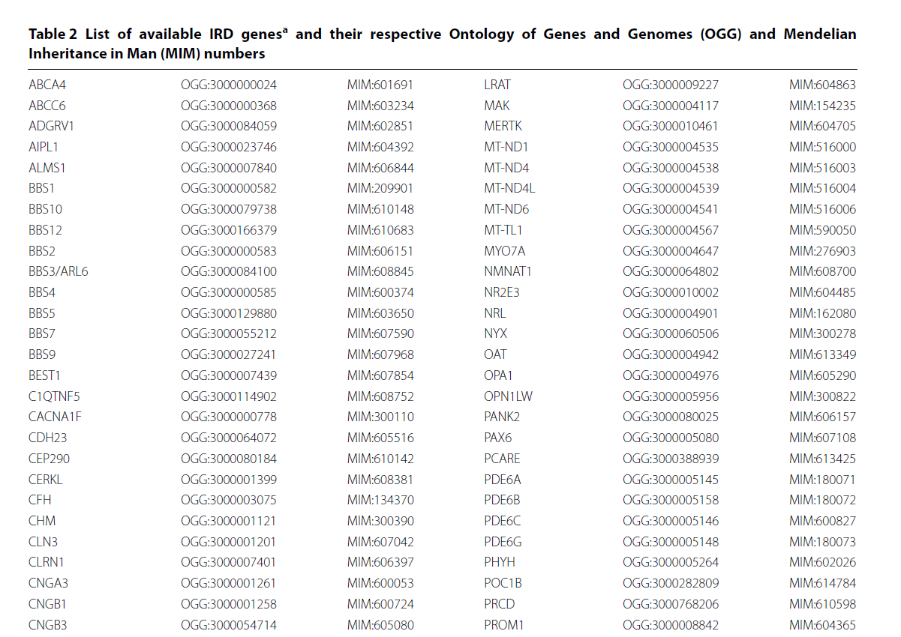
c
c
Background
Results
Discussion
Conclusions

Slide 15
c
c
c
c
Results
Discussion
Conclusions
Methods
Background
Results
Even though inherited optic neuropathies and other genetically-associated retinal diseases (such as Pseudoxanthoma Elasticum-associated retinopathy or isolated foveal hypoplasia) are not IRDs per se, we opted to include them in the registry since these are common diagnoses in an Ophthalmic Genetics clinic.
This is not something previously unseen. In fact, these diseases are also part of the Inherited Retinal Disease Classification proposed by Stone et al.

Slide 16
c
c
c
c
Results
Discussion
Conclusions
Methods
Background
Results
We were able to design an interoperable module by reusing the retina.pt core data elements where appropriate (epidemiological data such as sex, date of birth and patient ID), whilst also incorporating bespoke data elements, sections and forms for the specific field of IRDs (Table 3).
Upon selection of a particular item (clinical diagnosis, signs and symptoms, syndromic features, gene or additional diagnoses), a hyperlink is available to direct the user to the correspondent ontology webpage (ORPHA, HPO, OGG).

Slide 17
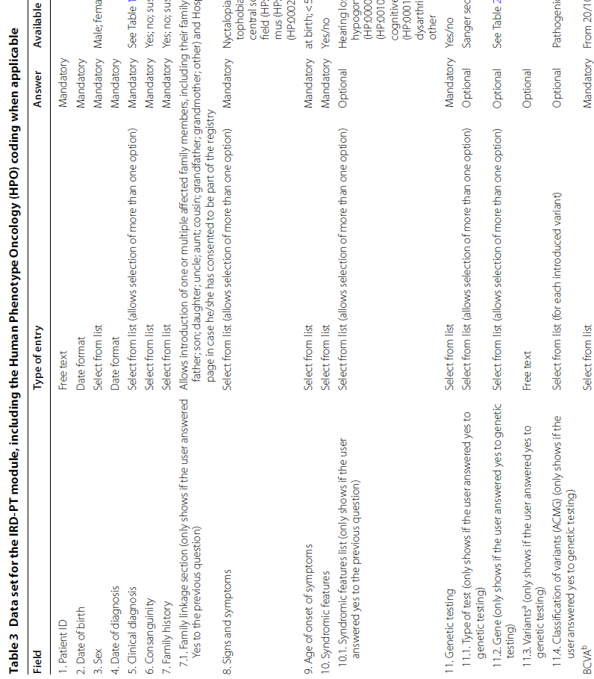
c
c
Background
Results
Discussion

Slide 18
c
c
c
c
Results
Discussion
Conclusions
Methods
Background
Results
The family linkage section allows simple viewing of the details of affected family members that are also part of the registry. At the end of each visit, a free text area is available for comments (follow-up, imaging, prescription, etc.).
Longitudinal data is captured through specific follow-up forms. The platform allows retrospective data introduction. As the program develops, and through alignment with international data collection for IRD clinical registries, the IRD-PT core data set may be modified or extended to include additional key clinical variables.

Slide 19
c
c
c
c
Results
Discussion
Conclusions
Methods
Background
Results
Data analysis and graphical displays
Since the retina.pt was designed to be both a registry and a research tool, data export and analysis features are very important. A search engine that allows data filtering is available for the user to search specific anonymized data, such as the total number of affected patients or the total number of affected families with a certain diseasecausing gene, clinical diagnosis, BCVA level, etc.
Furthermore, the platform offers statistical tools for simple analyses and these are also available for the IRD-PT module (Figs. 1, 2). For more sophisticated analyses, users can export their own data on excel format and analyze it as they see fit. Data are aggregated in an anonymized fashion, without identification of the individual patients

Slide 20
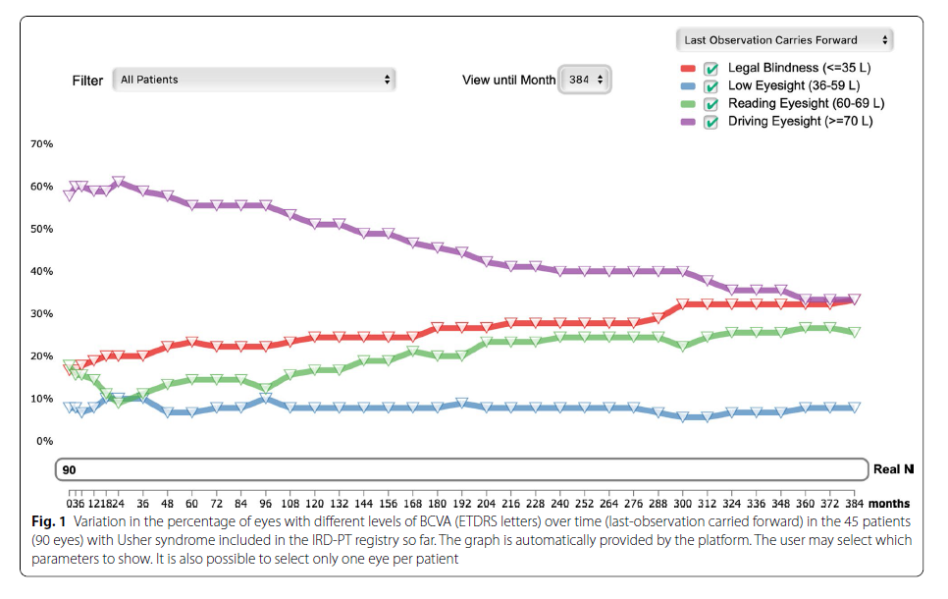
c
c
c
c
Results
Discussion
Conclusions
Methods

Slide 21
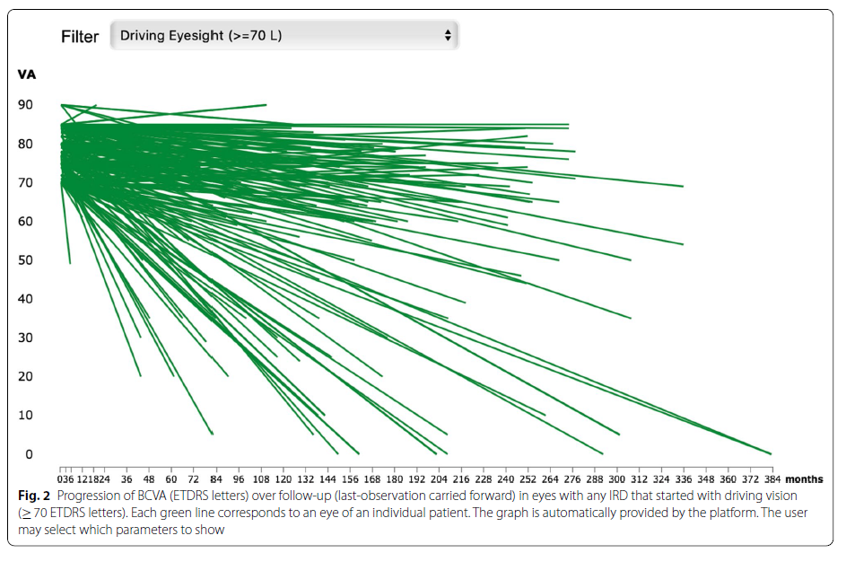
c
c
c
c
Results
Discussion
Conclusions
Methods

Slide 22
c
c
c
c
Results
Discussion
Conclusions
Methods
Background
Results
Participant characteristics
So far, the retina.pt platform has been approved by the Human Research Ethics Committee (HREC)/Institutional Review Board (IRB) of 52 health care providers across Portugal. Each of these hospitals/clinics has established the necessary infrastructure to support rapid rollout of site and patient recruitment, data collection, and data transfer. One-hundred and thirty five users (doctors/investigators) have applied for credentials to access the registry, and 58 of these have already included patient data. To date, there are over 1800 participants (patients) and over 30,000 consultations included in the registry.

Slide 23
c
c
c
c
Results
Discussion
Conclusions
Methods
Background
Results
Centro Hospitalar e Universitário de Coimbra (CHUC), the only Portuguese health care provider (HCP) that is a member of the ERN-EYE, and the largest reference center for IRDs in Portugal. The idea of testing the registry in one dedicated center before its national debut was aimed to identify possible problems during data completion, test the time spent in data entry, and detect information gaps or system inaccuracies. The registry proved fully functional, fast and easy to use. As of April 1st 2020, finalized data from 537 participants were available for this preliminary analysis. Considering the Portuguese population (~ 10 million inhabitants), this number corresponds to roughly 1/6 of the total estimated cases of IRDs in Portugal. The distribution of the clinical diagnoses and their relative frequency among the included participants is shown in Table 4.

Slide 24
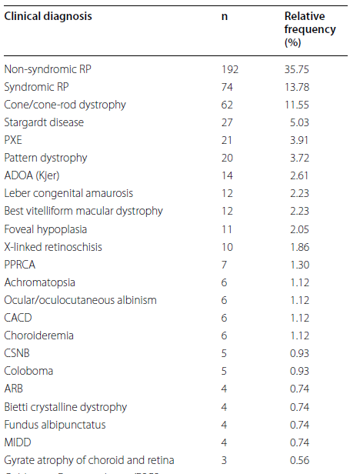
Table 4 Distribution of the clinical IRD diagnoses and their relative frequency among the 537 subjects included in the IRD-PT registry

Slide 25
c
c
c
c
Results
Discussion
Conclusions
Methods
Background
Results
Of all participants included in the IRD-PT registry to date, 57% are women and the mean age at the index visit was 39.27 + 19.03 years. Average baseline BCVA was 54.36 + 27.22 and final BCVA was 47.64 + 28.92 ETDRS letters.

Slide 26
c
c
c
Background
Results
Discussion
Conclusions
Methods
Appropriate design, implementation and deployment of patient registries enables rapid decision making and ongoing data mining, ultimately leading to improved patient outcomes.
In the specific field of rare diseases, the use of registries increases research accessibility for individuals, while providing clinicians/ investigators with a coherent data ecosystem necessary to boost research.
The IRD-PT module of retina.pt will facilitate the efficient capture of accurate, longitudinal, country-wide data for IRDs.

Slide 27
c
c
c
Background
Results
Discussion
Conclusions
Methods
The registry will provide valuable information on disease prevalence, genomic landscape, genotype–phenotype correlations and natural history of IRDs, which is currently an unmet need in Portugal.
Furthermore, the registry will facilitate patient selection for newly approved treatments or enrollment in clinical trials.
The use of a web based data storage system allows the registry to extend recruitment across multiple centers in the country.

Slide 28
c
c
c
c
Background
Results
Discussion
Conclusions
Methods
Discussion
The modular design and scalable nature of the framework used to deploy the IRD-PT registry make it easily adaptable over time, ensuring its long-term sustainability.
Furthermore, the use of domain-specific ontologies adds value to data, through an integrated knowledge base that is searchable and comparable by user and by machines.

Slide 29
c
c
c
c
Background
Results
Discussion
Conclusions
Methods
Discussion
In fact, by resorting to common data elements, core outcome sets, and standardized data structures, the IRD-PT module can support the exchange of data across datasets, facilitating the connection to other registries at an international level.
The interoperability of this registry by means of data harmonization is a key feature pointing to its utility and scalability. Another important issue of a web-based registry is usability, i.e. the capacity of a software system to provide conditions for its users to perform the tasks satisfactorily, effectively, and efficiently.
Ophthalmologists have limited time with patients during office visits, and electronic health record (EHR) use requires a substantial portion of that time, therefore affecting productivity.

Slide 30
c
c
c
c
Background
Results
Discussion
Conclusions
Methods
Discussion
The retina.pt registry combines a user-friendly platform and reduced load of data entry with the possibility to generate a pdf document that can be saved, printed or copied to the hospital EHR system, thus eliminating the need for duplicate records.
Additionally, there is also the possibility of EHR third party applications with structured information to deliver their data directly to specific subfields of the registry, thus enabling a quick fill in process. The detailed information provided on Table 3 regarding data capture for the IRD-PT may be used to modify EHR systems to allow for direct data transfer.
Finally, the versatility of the platform, makes it possible to serve as electronic case report form (eCRF) for upcoming observational, natural-history or post-market authorization studies.

Slide 31
c
c
c
c
Background
Results
Discussion
Conclusions
Methods
The IRD-PT is not exempt of limitations.
An important principle in registry design is to reduce the load of data entry. This does not come without a price.
By limiting the data that is considered mandatory to a minimum, there may be incomplete information/missing data for some included subjects concerning unanswered non-mandatory fields.
Another limitation is that grading systems/levels for the symptoms or degree of impairment are not available. The fact that symptoms are simply marked as present/not present prevents a precise characterization of these symptoms during the disease course.

Slide 32
c
c
c
Background
Results
Discussion
Conclusions
Methods
Finally, since each user is responsible for its own data entry, we cannot be sure about the accuracy of its contents.
This may be particularly problematic when a case is considered molecularly solved or unsolved.
Misinterpretation of the genetic findings is not uncommon, which may lead to selection bias regarding the number of molecularly solved/unsolved cases.

Slide 33
c
c
c
Background
Results
Discussion
Conclusions
Methods
We have described here the principles behind the design, development and deployment of a web-based software tool that forms the basis of a nation-wide registry for IRDs.
The pre-launch of the IRD-PT module in the largest Portuguese referral center for IRDs (CHUC), allowed to test the functionalities of the registry and enroll the first 537 IRD patients, roughly 1/6 of the total estimated cases of IRDs in Portugal.
Now that the module is fully working, recruitment will be extended to other Portuguese hospitals.

Slide 34
c
c
c
Background
Results
Discussion
Conclusions
Methods
Judging from the enthusiasm and adherence observed with the launch of the retina.pt platform, we believe that the IRD-PT registry will be rapidly adopted by the Portuguese ophthalmologists managing IRD patients.
Our hope is to generate important knowledge and collect high-quality data on the epidemiology, genomic landscape, genotype–phenotype correlations and natural history of IRDs in Portugal.
This will both boost and excel clinical research in the field of IRDs in our country, while facilitating patient access to clinical trials or new therapies.

Slide 35
c
c
c
Background
Results
Discussion
Conclusions
Methods
Registry design
The IRD-PT is a clinical/genetic research registry. Its main goal is to create a national, web-based registry of IRDs in Portugal that allows to study their prevalence, genomic profile, genotype–phenotype correlations and natural history.
Also, the registry may assist in the recruitment of participants for new treatments/ clinical trials, and provide support for the establishment of disease-specific standards and care. The IRD-PT registry is included in the retina.pt platform (https ://www.retin a.com.pt), which was developed by the Portuguese Retina Study Group (GER, www.ger-portu gal.com).

Slide 36
c
c
c
c
Background
Results
Discussion
Conclusions
Methods
Methods
The retina.pt registry deployed in 2017 to fulfil a vital component on patient-centered care for retinal diseases. It collects data on individuals diagnosed with retinal diseases, from several sites across Portugal, with over 1800 participants and over 30,000 consultations to date. The IRD-PT is a module interacting with the retina.pt core system.
The core system provides a range of basic functions used for patient data management, while the IRD-PT module provides the user with the functionality to capture data for the specific purpose of IRDs.

Slide 37
c
c
c
c
Background
Results
Discussion
Conclusions
Methods
Methods
Recruitment and informed consent
Both pediatric and adult patients with a genetic and/or clinical diagnosis of IRD living in Portugal and attending Ophthalmology clinics around the country are invited to participate. Participation in the registry is voluntary. Before enrollment, the participant (patient) or their legally authorized representative must provide informed consent for the collection, storage, and use of their personal health data. No costs or compensations are involved for participants or their family members as the data collected in the IRD-PT module refers to information routinely collected by the responsible physician. All included subjects are allowed to withdraw their consent at any time, without providing a reason. This does not impact their regular follow-up at the clinic.

Slide 38
c
c
c
c
Background
Results
Discussion
Conclusions
Methods
Methods
Ethics and regulations
The registry meets the necessary requirements for compliance with the General Data Protection Regulation (GDPR) of the European Union and all approvals were obtained prior to recruiting patients for the registry.
Formal review and approval was obtained from the Portuguese Data Protection Authority (Comissão Nacional de Proteção de Dados—CNPD), HREC of Centro Hospitalar e Universitário de Coimbra (CHUC) and IRB of the Faculty of Medicine of the University of Coimbra (FMUC).

Slide 39
c
c
c
c
Background
Results
Discussion
Conclusions
Methods
Methods
All these independent entities ensured that the study protocol, governance, protections, and methods were ethical and appropriate. Furthermore, each participating core center needs to obtain approval from the respective Ethics Committee.
Documentation of approval from each center is copied to the central governing office to ensure currency of approval is maintained.

Slide 40
c
c
c
c
Background
Results
Discussion
Conclusions
Methods
Methods
All investigators (users) are mandated to sign the Investigator Declaration Form before obtaining credentials to use the registry.
Both the project investigators and their institutions permit project-related monitoring, audits, and regulatory inspections, providing direct access to source data/documents.
This may include, but is not limited to, review by HREC and institutional governance review bodies.

Slide 41
c
c
c
c
Background
Results
Discussion
Conclusions
Methods
Data protection
Proper handling of ethical, legal, social, and privacy issues must be a foundational component of the design, implementation, and long-term sustainability of a patient registry.
As part of the retina.pt, the IRD-PT module was designed to provide maximum data security and patient anonymity.
Several well-defined procedures were put in place to protect individual patient data within the registry study.
Data security, integrity, and availability is monitored and regulated.

Slide 42
c
c
c
c
Background
Results
Discussion
Conclusions
Methods
All data transmissions between the user and the server are encrypted using 128-bit encryption (Secure Sockets Layer). The data are stored and backed up on secure servers at Portugal Telecom—Altice, TEAR 3 certified Datacenter. Anonymity of users is also closely guarded.
Individual users can only see their own data. However, users may find other centers with included data on a specific disease and ask for research collaborations within the platform. Users can withdraw their data from the registry at any time, without providing a reason.

Slide 43
c
c
c
c
Background
Results
Discussion
Conclusions
Methods
Registry interface
Drop-down menus, pop-up explanatory notes, and tabto-jump ensures rapid and user friendly data entry.
Furthermore, retina.pt is a web-based application that is able to run on different server operating systems.
Any device with Internet access and a recent browser can be used to interact with the application. Additional software on the user’s terminal is not required.
When all mandatory fields have been filled, the User can “Finalize” the visit by pressing “Save”.

Slide 44
c
c
c
c
Background
Results
Discussion
Conclusions
Methods
The system has been designed in such a way that it will not allow a visit to be finalized unless all the mandatory fields have been filled and all numerical data fall within prespecified ranges.
Additionally, the platform allows data to be automatically filled in by third party EHR applications with identically structured information, or the possibility of the user to generate a pdf document that can be printed/copied to the hospital EHR system.
Moreover, storage and retrieval of clinical images is possible in the patient-specific page.

Slide 45
c
c
c
c
Background
Results
Discussion
Conclusions
Methods
Data quality
High quality data of rare diseases registries is considered to be one of the most important elements in the establishment and maintenance of a registry.
Quality assurance includes quality improvement activities such as medical, clinical, and record audit and observational studies, to which the ethical principles of research apply.

Slide 46
c
c
c
c
Background
Results
Discussion
Conclusions
Methods
Interoperability
Upon the development of the retina.pt platform, interoperability was a key issue. First, the registry has two available languages to choose from: Portuguese and English. Second, the age-related macular degeneration (AMD) module of retina.pt is already linked to the Fight Retinal Blindness! (FRB!) Project registry and efforts are in place to connect it to the International Consortium for Health Outcomes Measurement (ICHOM) AMD registry.
Third, the platform is serving as the eCRF for an upcoming post-market authorization clinical trial. Rare diseases are a prime example of a research area that can strongly profit from coordination on a European and international scale.

Slide 47
c
c
c
c
Background
Results
Discussion
Conclusions
Methods
To allow interoperability of the IRDPT module with other IRD registries across the world, all the diseases are coded accordingly to ICD9, ICD10, ICD11, and ORDO (ORPHA codes) numbers.
Furthermore, the genes are coded according to the OGG and MIM, and patient signs and symptoms are coded according to HPO.
This is in accordance with the eye-specific dataset of the Clinical Patient Management System (CPMS) of the ERN-EYE. Notably, ORDO, HPO, OGG and MIM are open-access, interoperable, community-driven, available in multiple languages and regularly updated.

Slide 48
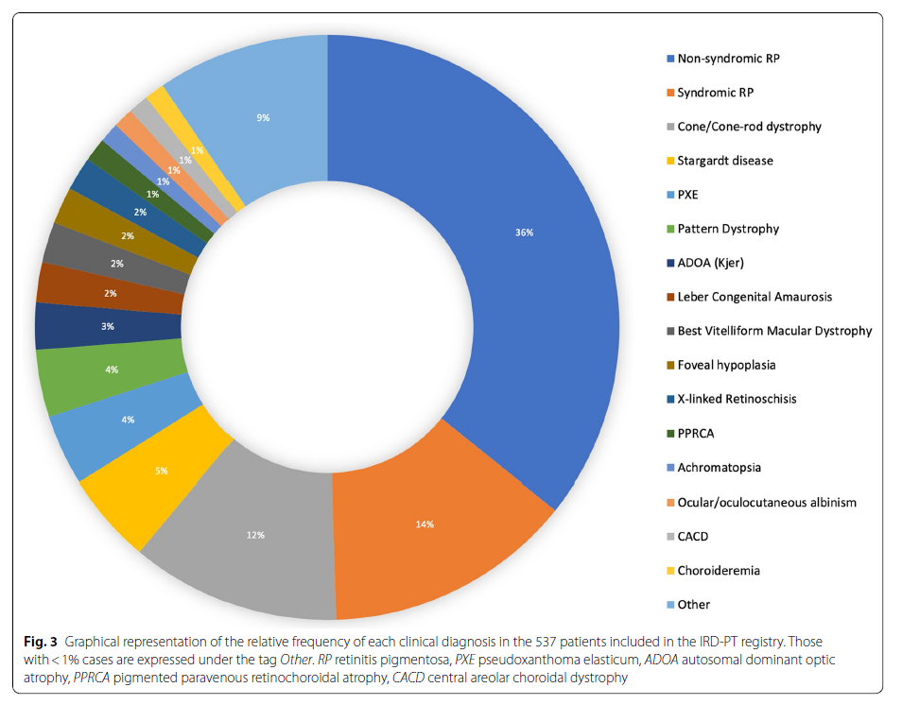
c
c
c
Background
Results
Discussion
Conclusions
Fig. 3 Graphical representation of the relative frequency of each clinical diagnosis in the 537 patients included in the IRD-PT registry. Those with < 1% cases are expressed under the tag Other. RP retinitis pigmentosa, PXE pseudoxanthoma elasticum, ADOA autosomal dominant optic atrophy, PPRCA pigmented paravenous retinochoroidal atrophy, CACD central areolar choroidal dystrophy

Slide 49
عنوان ارائه
Thanks for your attention

