Slide 1


Significance Of Health Information Technology(HIT) In Context To COVID-19 Pandemic: Potential Roles And Challenges
In The Name Of Allah
Lecture Name: Haniye Tafaghodi
Supervisor Name: Dr.Masoume Sarbaz
Email Address: Tafaghodikh1@mums.ac.ir

Slide 2

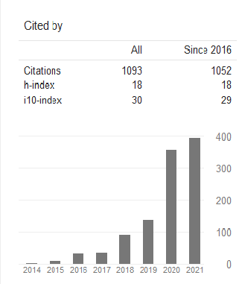

Significance Of Health Information Technology(HIT) In Context To COVID-19 Pandemic: Potential Roles And Challenges

Slide 3

Significance Of Health Information Technology(HIT) In Context To COVID-19 Pandemic: Potential Roles And Challenges

Slide 4
Introduction
In the present COVID-19 pandemic, where medical consultation became quite tough for everyone, and especially for the patients, HIT has emerged as a very imperative game-changer by offering its extended services to the physicians, healthcare staff, patients, etc.
Privacy of records, level of care, interactive consultation, proper communication, etc. are the principal features offered with the use of HIT concept in the COVID-19 pandemic.

Slide 5
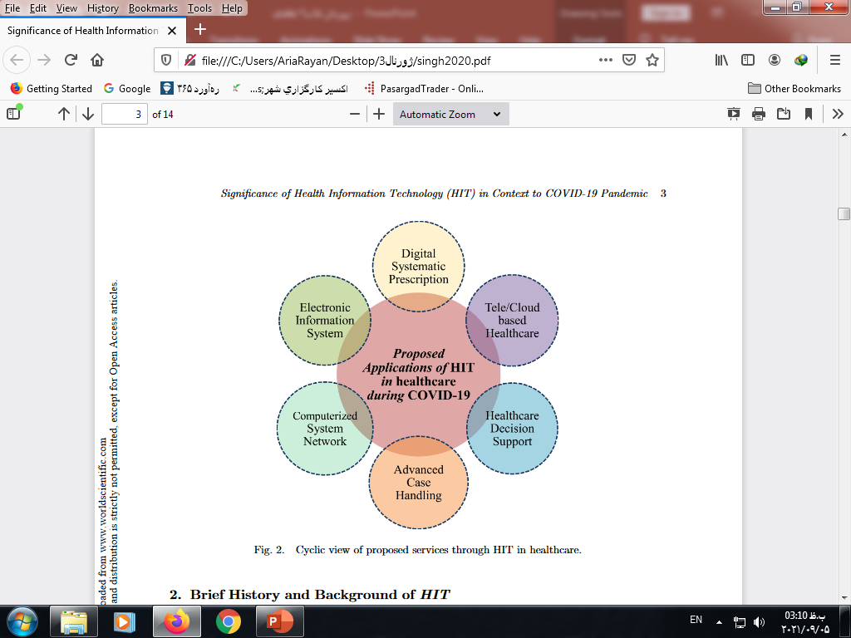
Introduction
Figure 1 explicates about the suitable proposed applications of HIT in healthcare during the COVID-19 pandemic.
Figure 1: Cyclic view of proposed services through HIT in healthcare.

Slide 6
Process Work-Flow of HIT in Healthcare During COVID-19
The proposed HIT concept’s effectiveness can be realized in healthcare during this COVID-19 time by adequately understanding its devoted process flow chart.
Figure 2 elaborates a process flow diagram for exploring the working culture/environment while implementing HIT culture in healthcare during this COVID-19 period.

Slide 7
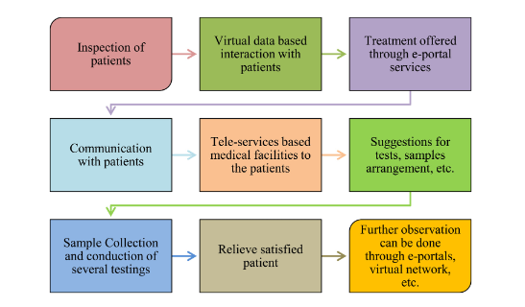
Process Work-Flow of HIT in Healthcare During COVID-19
Fig. 2. Work-process flow for realizing HIT in healthcare during COVID-19.

Slide 8
Impact of HIT in Healthcare During COVID 19 Crisis
HIT concepts include various electronic-based-services, smart healthcare, EHR, etc. that enable the medical professionals, healthcare staff, and patients to come together to help and cooperate through several techniques.
The medical decision support, bar-coding techniques , e-portal services, etc. are a few of the majorly proposed tactics that offer specific services in healthcare during the pandemic period like COVID-19
In these proposed impacts of HIT, the support and services offered for remote patients are more vital and crucial.

Slide 9
Table 1. Impacts of HIT in healthcare during COVID-19 period
Influences/Impacts | Sl No.
Conversion into Electronics-based Services to Patients | 1
Medical Decision Support | 2
E-sign-off tools | 3
Medication based on Bar-coding | 4
Automated medicine dispensing tactic | 5
Techniques for preventing surgical items | 6
E-patient portals | 7
Tele-based-medicine | 8
Synchronous telehealth | 9
E-incident reporting | 10

Slide 10
Role and Applications of HIT in Emergency Healthcare Patient Care During COVID-19 Pandemic
Based on the study conducted in the USA, we identified that HIT facilities include the digital services for handling the data, reports, information, etc. as well the advanced medical services to the patients.
It starts with the digital prescription to the patients and moves ahead with the electronic-based medicine dispensing facilities and also covers the medical administration record handling through the properly planned network of advanced system channels.

Slide 11
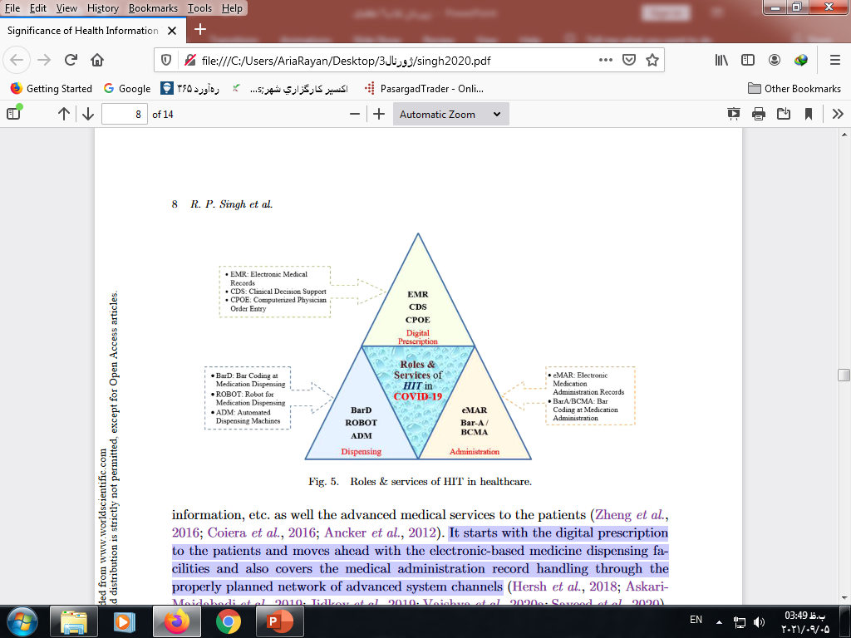
Role and Applications of HIT in Emergency Healthcare Patient Care During COVID-19 Pandemic
Fig. 3. Roles & services of HIT in healthcare.

Slide 12
Challenging Issues and Future Scope of the Study
There are some challenging issues, when realizing this approach in providing treatment to the patients during the time of COVID-19. These issues, including global/local acceptance of interoperability culture, depend on the medical professionals and hospitals’ agreement to agree upon sharing the forwarding/referred patient's records, data, etc.

Slide 13
Challenging Issues and Future Scope of the Study
Smart and connected healthcare network is always challenging for implementing HIT facilities
Data safety and security are other points where proper safeguarding needs to be designed for the highly confidential information shared in the cloud-based channel.

Slide 14
Conclusion
The proposed HIT approach seems a supportive tool for the patients in the currentCOVID-19 period.
It employs cloud-based data-sharing platforms, where the needed person, physician, patients, etc.
It enables the poor and remotely located patients to get appropriate treatment/services by having virtual interactive sessions.

Slide 15
Conclusion
HIT enables the interoperability culture in an existing healthcare trend/atmosphere worldwide.
Tele-based medicine facilities are also one of the best impacts of the HIT for healthcare survivors during this pandemic. The proposed concept of HIT may help in tracking and monitoring of old-patients, persons in remote locations for their medical facility requirements.

Slide 16

با تاخیر
1400/02/20

Slide 17
عنوان ارائه
Thank you for your attention
Email Address: Tafaghodikh1@mums.ac.ir

