Slide 1



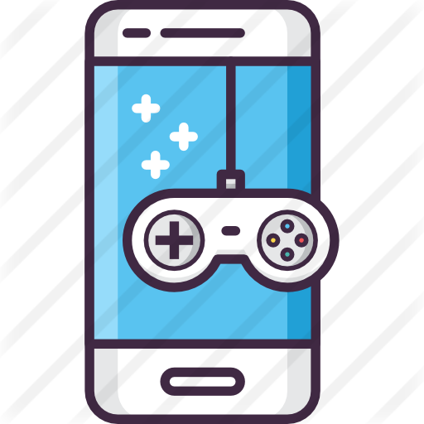
Precourse preparation using a serious smartphone game on advanced life support knowledge and skills: randomized controlled trial
In the name of God
Seyyedeh Fatemeh Mousavi
Dr Kimiafar
Mousavibf992@mums.ac.ir

Slide 2




journal's specifications
journal's specifications
Title
Journal of Medical Internet Research
Discussion &
Conclusions0
Introduction
Strength & Limitation
Objectives
Methods
Results
Impact Factor
5.03 (2019)
Indexing
ISI, Scopus, PubMed, DOAJ
Slide NO 2
Precourse preparation using a serious smartphone game on advanced life support knowledge and skills:
randomized controlled trial
Seyyedeh Fatemeh Mousavi

Slide 3
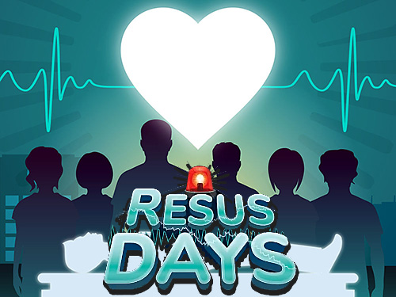
Introduction
Introduction
Advanced Life Support (ALS), widely accepted as the gold standard of care in patients with cardiopulmonary arrest
In order to maximize learning outcomes, the current American Heart Association guidelines for cardiopulmonary resuscitation (CPR) recommend students prepare in advance for the ALS training course
Discussion &
Conclusions0
Methods
Strength & Limitation
Objectives
Results
Introduction
prior work in Basic Life Support (BLS) training has demonstrated the benefits of serious games as a method for pretraining among medical students
there has been no evidence demonstrating the benefits of precourse training when taken in conjunction with a conventional ALS training program
Resus Days is a serious smartphone game developed by a Thai physician using standard ALS guidelines and is available online
The aim of the game is to familiarize students with the ALS algorithms for cardiac arrest and periarrest scenarios, leading to shorter knowledge acquisition time
Slide NO 3
Precourse preparation using a serious smartphone game on advanced life support knowledge and skills:
randomized controlled trial
Seyyedeh Fatemeh Mousavi

Slide 4


Objectives
Objectives
compare the effects of a brief precourse ALS preparation using a serious smartphone game on student knowledge, skills, and perceptions in this area with those of conventional ALS training alone
Discussion &
Conclusions0
Methods
Strength & Limitation
Results
Objectives
Introduction
Objectives
Slide NO 4
Precourse preparation using a serious smartphone game on advanced life support knowledge and skills:
randomized controlled trial
Seyyedeh Fatemeh Mousavi

Slide 5
Methods
Methods
This was a prospective, randomized controlled parallel group trial in a tertiary university hospital in Thailand.
by the Khon Kaen University institutional committee for ethics in human research and registered with the Thai Clinical Trials Registry
Study
Design
Discussion &
Conclusions0
Results
Strength & Limitation
Objectives
Methods
Introduction
Objectives
Written informed consent was obtained from each participant prior to enrollment.
fifth-year medical students at the Khon Kaen University Faculty of Medicine who attended the ALS training
course offered by the faculty’s CPR unit in April 2019
not having participated in any type of ALS course in the past
ever having played Resus Days
After enrollment, participants were randomly assigned to one of two groups (control group or game group) at a 1:1 allocation ratio based on a computer-generated random number list
Participants &
Randomization
Slide NO 5
Precourse preparation using a serious smartphone game on advanced life support knowledge and skills:
randomized controlled trial
Seyyedeh Fatemeh Mousavi

Slide 6
Methods
Methods
The sample size for analysis of covariance of two levels and two covariates was determined based on our pilot data using power analysis.
The power analysis was determined using an alpha of .05 and power of 0.80. This resulted in an estimated desired effect sample size of at least 22 subjects in each group.
Sample Size
Calculation
Discussion &
Conclusions0
Results
Strength & Limitation
Objectives
Methods
Introduction
Objectives
Prior to any intervention, we tested students’ baseline ALS knowledge using a multiple-choice pretest.
Students in the game group then played Resus Days using their own smartphone for 1 hour in normal mode.
After this, students in both groups attended an ALS training course taught by CPR instructors.
Students in the game group were allowed to play Resus Days as much as they wished during the 2-day ALS training course.
Study
Interventions
Slide NO 6
Precourse preparation using a serious smartphone game on advanced life support knowledge and skills:
randomized controlled trial
Seyyedeh Fatemeh Mousavi

Slide 7
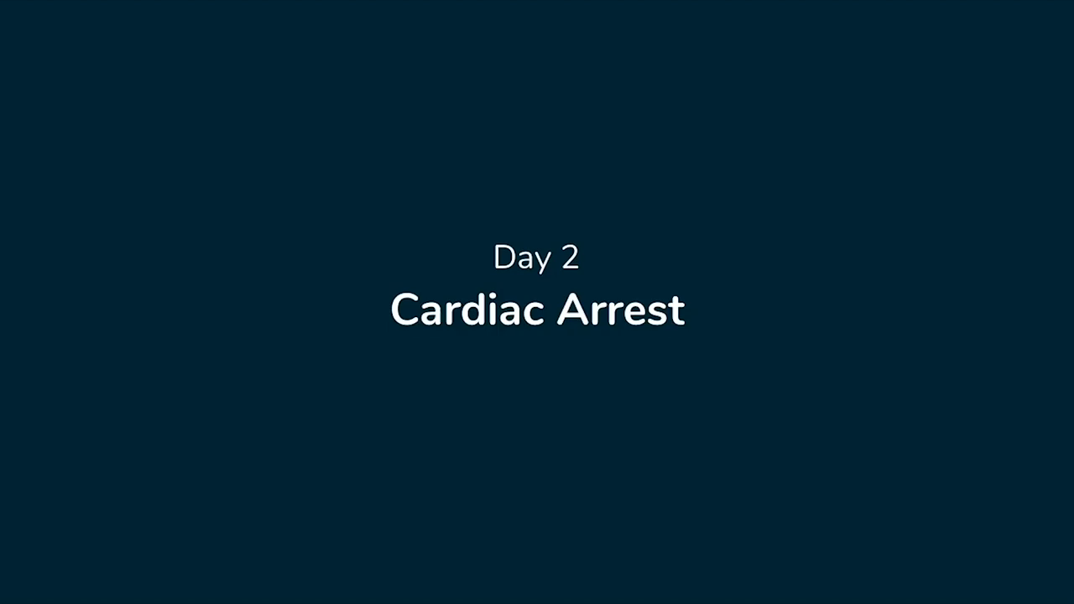
Methods(Game Description)
Methods(Game Description)
Discussion &
Conclusions0
Results
Strength & Limitation
Objectives
Methods
Introduction
Objectives
Slide NO 7
Precourse preparation using a serious smartphone game on advanced life support knowledge and skills:
randomized controlled trial
Seyyedeh Fatemeh Mousavi

Slide 8
Method) Advanced Life Support Training Course(
Method) Advanced Life Support Training Course(
first day of the program
6 hours of lectures
ALS training course
2 days
second day of the program
8 hours of hands-on workshops
Discussion &
Conclusions0
student-to-instructor ratio
1:6 At the end of the course
Results
Strength & Limitation
Objectives
Methods
Introduction
Objectives
student ALS knowledge was reassessed
using multiple-choice questions in accordance with ALS guidelines
their practical skills were evaluated individually
by examiners blinded to group allocation
to assess student attitudes and perceptions regarding both the course and the game
We used a questionnaire
Slide NO 8
Precourse preparation using a serious smartphone game on advanced life support knowledge and skills:
randomized controlled trial
Seyyedeh Fatemeh Mousavi

Slide 9
Methods
(Assessment of Learning Outcomes, Attitudes, and Perceptions)
Methods
(Assessment of Learning Outcomes, Attitudes, and Perceptions)
Discussion &
Conclusions0
Results
Strength & Limitation
Objectives
Methods
Introduction
Objectives
Questionnaire Regarding Participant Attitudes and Perceptions
Knowledge Test
Advanced Life Support Skill Tests
Game Score
1. to assess knowledge of the ALS algorithm
2.to assess general ALS knowledge
Each student was given a series of three different 5-minute megacode simulated ALS scenarios, and was evaluated by certified ALS course providers
1.rate their attitudes and perceptions regarding the game on a scale of 1 to 10
2.An open-ended question
score from 0 (if the patient died) to 3 (if patient survived and the most appropriate treatments were prescribed) for each scenario.
Slide NO 9
Precourse preparation using a serious smartphone game on advanced life support knowledge and skills:
randomized controlled trial
Seyyedeh Fatemeh Mousavi

Slide 10

Methods(Statistical Analysis)
Methods(Statistical Analysis)
Categorical variables were expressed as frequencies and percentages
Continuous data were expressed as means and standard deviations
Differences between groups in terms of baseline characteristics were compared using an independent sample t test.
Discussion &
Conclusions0
Results
Strength & Limitation
Objectives
Methods
Introduction
Objectives
An analysis of covariance model was used to compare posttest scores between the two groups adjusted for baseline score measurements
The Pearson chi-square test was used to compare the skill-test pass rate and other binary variables
The correlation between game scores before ALS training and knowledge pretest scores and between game scores post-ALS training and knowledge posttest scores were analyzed using Pearson correlation coefficients
All data analyses were performed using Stata version 10 (StataCorp LLC).
Slide NO 10
Precourse preparation using a serious smartphone game on advanced life support knowledge and skills:
randomized controlled trial
Seyyedeh Fatemeh Mousavi

Slide 11

Participants assessed for eligibility (N= 106)
Resuls
Ineligible (n=1) Experience playing Resus Day
Participant included and randomized (N=105)
Allocated to game group (n=52)
Allocated to control group (n=53)
Pretest (knowledge test)
Approximately 1 hour of gameplay (Resus Days) prior to traditional lecture and allowed to play as much as they wished during the training course
Discussion &
Conclusions0
Strength & Limitation
Objectives
Results
Methods
Introduction
Objectives
One-day traditional lecture (6-hour)
One-day instructor-led ALS course (8-hour)
Posttest(knowledge test and skill test)
Analysis(n=52)
Analysis(n=53)
Slide NO 11
Precourse preparation using a serious smartphone game on advanced life support knowledge and skills:
randomized controlled trial
Seyyedeh Fatemeh Mousavi

Slide 12
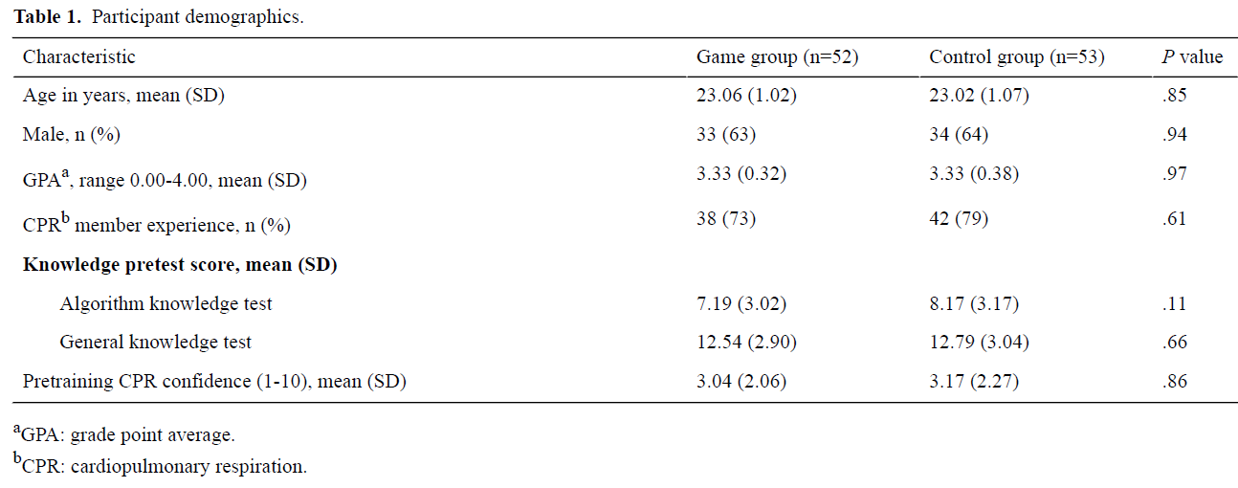
Results
Participant demographics.
Discussion &
Conclusions0
Strength & Limitation
Objectives
Results
Methods
Introduction
Objectives
Slide NO 12
Precourse preparation using a serious smartphone game on advanced life support knowledge and skills:
randomized controlled trial
Seyyedeh Fatemeh Mousavi

Slide 13
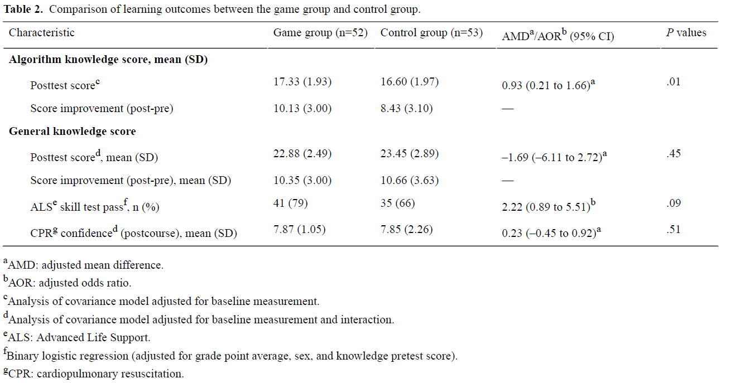
Results
Comparison of learning outcomes between the game group and control group.
Discussion &
Conclusions0
Strength & Limitation
Objectives
Results
Methods
Introduction
Objectives
Slide NO 13
Precourse preparation using a serious smartphone game on advanced life support knowledge and skills:
randomized controlled trial
Seyyedeh Fatemeh Mousavi

Slide 14
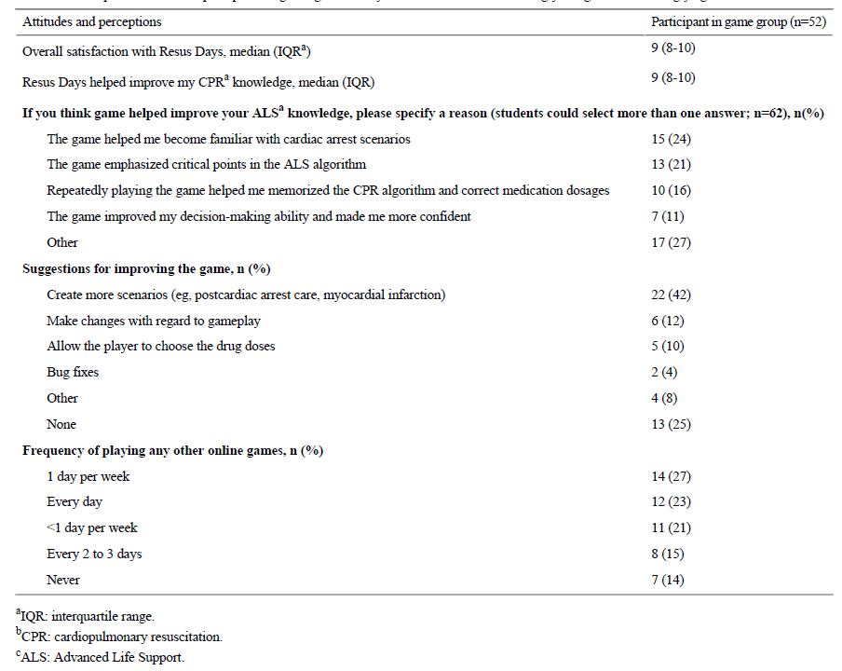
Participant attitudes and perceptions regarding Resus Days based on a score of 1=strongly disagree to 10=strongly agree
Results
Discussion &
Conclusions0
Strength & Limitation
Objectives
Results
Methods
Introduction
Objectives
Slide NO 14
Precourse preparation using a serious smartphone game on advanced life support knowledge and skills:
randomized controlled trial
Seyyedeh Fatemeh Mousavi

Slide 15
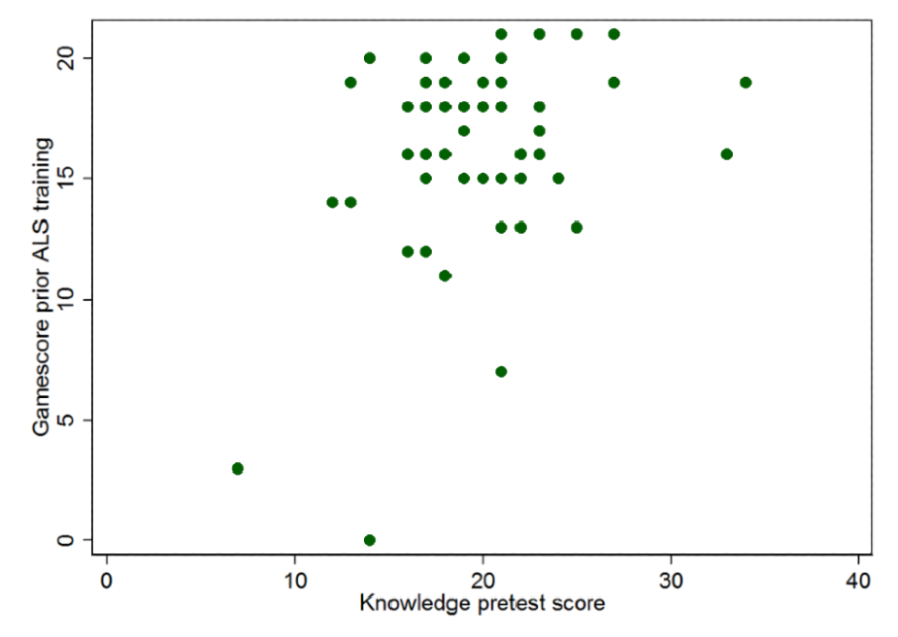
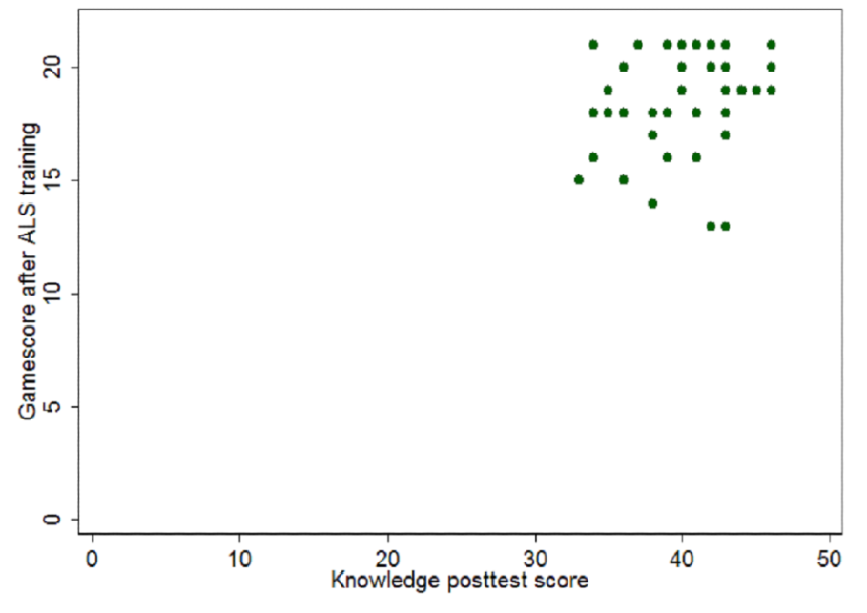
Results
Correlation between game score before & after Advanced Life Support training and knowledge pretest score was low (P=.01, r=.37).
Discussion &
Conclusions0
Strength & Limitation
Objectives
Results
Methods
Introduction
Objectives
Slide NO 15
Precourse preparation using a serious smartphone game on advanced life support knowledge and skills:
randomized controlled trial
Seyyedeh Fatemeh Mousavi

Slide 16
Discussion
Discussion
the game group had a higher pass rate on the ALS skill test and indicated greater satisfaction with their training
The game group exhibited clear improvement with regard to ALS algorithm knowledge. They also demonstrated improvements in terms of skill, but not to a statistically significant extent.
Strength & Limitation
Objectives
Several studies have reported beneficial effects of game-based training on medical student learning outcomes
Methods
Objectives
Results
Introduction
Discussion &
Conclusions
A large number of the medical students in our study had positive attitudes about Resus Days, indicating that the game helped them become more familiar with various cardiac arrest scenarios prior to the ALS training course.
Another interesting finding was the low correlation between student game scores and their knowledge scores.
Although it was only an add-on intervention, the observed benefits demonstrated the ability of gamified training to improve a complicated medical course.
Slide NO 16
Precourse preparation using a serious smartphone game on advanced life support knowledge and skills:
randomized controlled trial
Seyyedeh Fatemeh Mousavi

Slide 17

Conclusions
Conclusions
Our results demonstrate that incorporating a serious smartphone game (Resus Days) in medical students’ ALS training leads to
better algorithm knowledge scores than conventional training alone
Strength & Limitation
Objectives
Methods
Objectives
Results
In addition, students in the game group indicated high satisfaction with their training.
Introduction
Discussion &
Conclusions
Although there was no significant difference between the two groups in terms of their pass rates on the ALS skills test,
those who trained using the serious game tended to do better.
Slide NO 17
Precourse preparation using a serious smartphone game on advanced life support knowledge and skills:
randomized controlled trial
Seyyedeh Fatemeh Mousavi

Slide 18
Strength
Strength
the first to demonstrate the effectiveness of ALS pretraining using a smartphone game and addresses the feasibility of gamified learning in training students to treat highly complicated medical conditions
1
Objectives
2
Methods
we used a game that is available in an online store and therefore available to anyone with access to a compatible device.
Objectives
Results
Introduction
Strength &
Limitation
Discussion &
Conclusions0
3
as our study was a randomized controlled trial, differences in baseline characteristics between students in the game and control groups were limited.
4
we performed a comparison of gamified learning with a standard ALS training course that was provided by certified CPR providers and that met international standards.
Slide NO 18
Precourse preparation using a serious smartphone game on advanced life support knowledge and skills:
randomized controlled trial
Seyyedeh Fatemeh Mousavi

Slide 19
Limitations
Limitations
1
this was a single-center study, which limits the generalizability of the results.
2
we evaluated students based on their knowledge scores, which are imperfect indicators of how someone will perform in real-world scenarios.
3
the sample size was only large enough to evaluate student knowledge scores and not their results on the ALS skill test.
Objectives
Methods
Objectives
Results
Introduction
Strength &
Limitation
Discussion &
Conclusions0
4
It is unclear how effective this kind of gamified learning would be in an older population such as senior doctors.
5
we did not have specific protocol and did not collect any data regarding the frequency of gameplay during the 2-day training.
6
the content in this game was developed by an individual physician based on standard guidelines, not by a content expert or trusted organization.
Slide NO 19
Precourse preparation using a serious smartphone game on advanced life support knowledge and skills:
randomized controlled trial
Seyyedeh Fatemeh Mousavi

Slide 20
My view
My view & future study
1
If game-based learning is to replace conventional ALS lectures, a randomized controlled trial using a well-designed game may be necessary.
2
Create disposable software installation code
Objectives
Methods
Objectives
Results
Introduction
Strength &
Limitation
Discussion &
Conclusions0
3
Designing a Cross over Randomized Controlled trial to control ethical issues
4
Design a dynamic application to monitor the number of hours of game use
Slide NO 20
Precourse preparation using a serious smartphone game on advanced life support knowledge and skills:
randomized controlled trial
Seyyedeh Fatemeh Mousavi

Slide 21

«thanks for your attention»
Any Questions :) ?
Seyyedeh Fatemeh Mousavi
Mousavibf992@mums.ac.ir

