Slide 1


In the name of God
Designing Data Elements and Minimum Data Set (MDS) for Creating the Registry of Patients with Gestational Diabetes Mellitus
Lecturer Name: Reyhane Norouzi Aval
Supervisor Name: Dr.Khalil Kimiafar
Email Address: Nourozir9@mums.ac.ir

Slide 2

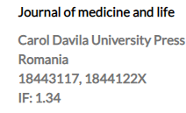
Journal Information
CiteScore: 1.90
H-index: 30
Q1
Indexed in PubMed-Scopus

Slide 3
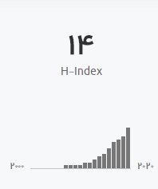
Author’s Information
Dr.Maryam Ahmadi
Professor of Health Information Management
School of Health Management & Information Sciences
Iran University of Medical Sciences

Slide 4

Keywords
Gestational diabetes mellitus (GDM)
Minimum data set (MDS)
Registry

Slide 5
Outline
Introduction
Objective
Method
Result
Discussion
Conclusion

Slide 6

Introduction
Gestational diabetes mellitus (GDM) is an increase in a person’s level of blood sugar.
GDM is either initiated or diagnosed during pregnancy. In both cases, the pre-gestational and GDM are followed by unwanted complications that can bring about short-term and long-term consequences for mothers and their infants .
This disease is an increasing health problem in all communities, and it is considered as one of the most prevalent complications of pregnancy.

Slide 7
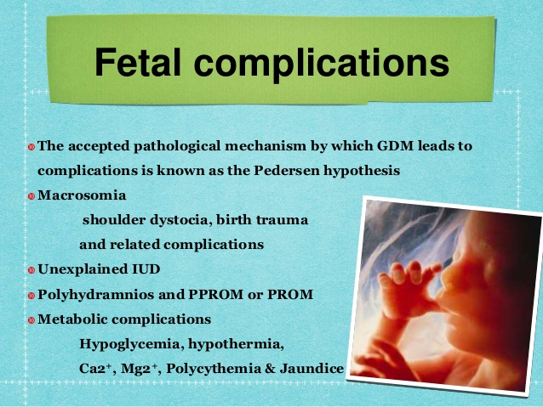
Introduction
The mother’s unwanted complications include:
abortion, preterm birth, preterm delivery pain, preeclampsia, cesarean delivery, and increased length of hospitalization, up to seven days or more.
The unwanted complications for the infants include:
congenital anomalies, high birth weight, birth injuries, neonatal jaundice, low Apgar score, need for neonatal resuscitation, hospitalization in critical care nursing, and increased hospitalization length up to 7–13 days.
Mothers with type 1 diabetes are dealing with a higher cesarean rate, high blood pressure, and preterm birth.
Mothers with type 2 diabetes will suffer from a higher rate of stillbirth

Slide 8
Introduction
The significance of data collection in GDM indicates the increasing awareness of short-term and long-term effects of this disease for both mothers and infants.
Given the importance of the target population i.e. promoting the health quality of pregnant women and controlling and treating GDM is of high significance .
A minimum data set for reporting diabetes during pregnancy will result in a better understanding and monitoring of risk factors and their results, including different types of GDM.

Slide 9
Introduction
The main advantages of applying a minimum data set are the formation of information policy, as well as monitoring the health systems and providing the possibility of further studies for researchers.
These data are finally regulated and presented in the form of statistical information, reports, hospitalization trend analysis, daily health services on a national macro level based on the care providers, and financial goals .
Furthermore, in order to create a system that is completely compatible with data exchange, it is primarily required to agree on the data elements set .
The agreement for creating and applying a minimum data set will allow policymakers, planners, software experts, and health data managers to know what data should be collected in the information system while they start designing a system.

Slide 10

Introduction
There are numerous problems in our country including:
Lack of attention to the registration of data related to pregnancy cares
Existence of duplicate data elements on health forms
Lack of timely access to medical records
Lack of integrated data systems in medical centers
Lack of standard minimum data sets .
For having electronic data and saving at databases, it is essential to use an MDS

Slide 11
Introduction
In their study titled “Results of the first recorded evaluation of a national GDM mellitus register: Challenges in screening, registration, and follow-up for diabetes risk”, Boyle et al. state that the registration of a large number of patients in the Australian GDM registry will result in the provision of:
Sufficient and accurate data for finding the risk factors,
Having an early diagnosis
Improving screening goals
Improving treatment results
Correcting the lifestyle

Slide 12
Introduction
Creating a minimum data set for collecting integrated and standard data is the most important measure to be taken .
According to Common Clinical Data Set by The Office of the National Coordinator for Health Information Technology
Demographic data
Clinical data
Procedures data
Medications data
Identifier data related to patients should be gathered.

Slide 13
Introduction-Objective
At present, there is no summary of the information related to patients with GDM in the form of minimum data set for Iran.
Thus, the present study aims at creating a minimum set of administrative, clinical, and pharmaceutical data of GDM.
It is also attempted to apply the same data with purposes of:
Research
Education
Pregnant women’s health status monitoring
Prevention
Control of this disease by using its statistical results.

Slide 14
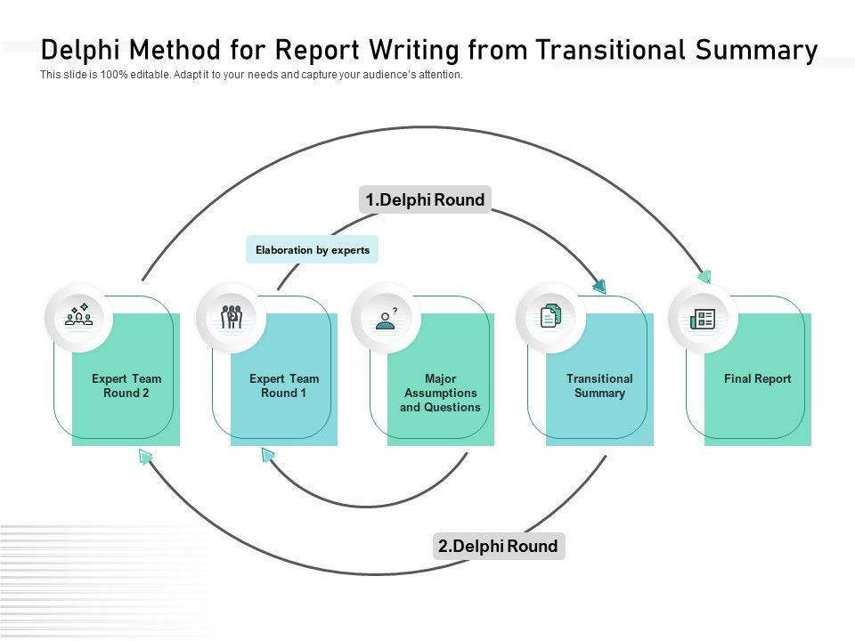
Methods
The present study is an applied one conducted in two stages with a qualitative Delphi method in 2018.
In the first step, a review of the literature was conducted to retrieve related data resources.
The resources included:
Articles
Reports
Forms available on the internet.
In this step, a checklist was also used for the extraction of data elements.

Slide 15





Methods (2)
Searching the articles was conducted on Elsevier, Scopus, PubMed, SID, MagIran, ProQuest databases as well as Google Scholar search engine from 2007-2017.

Slide 16

Methods(3)
All articles related to minimum data set, registry, and common data elements of GDM were examined and the main data elements were extracted.
All the relevant literature was retrieved and evaluated based on the inclusion criteria:
English language
Full text
The articles, whose full texts were impossible to access , were excluded.
Then their desired data elements were entered into the checklist.
Materials relevant to the subject were found using a search strategy (Figure 1).

Slide 17
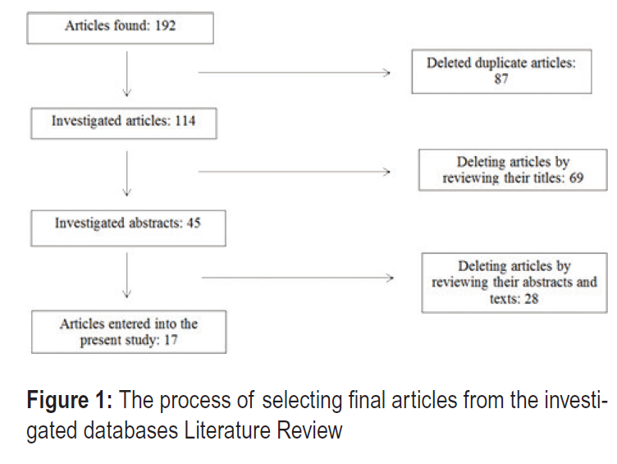
Methods (4)

Slide 18
Methods (5)
Data was also collected from medical records of patients hospitalized due to GDM in Shahid Akhbarabadi Hospital, and Arash Women’s Hospital, Medical records of these patients contained clinical, demographic, and discharge documents that were completed and archived.
In order to validate the study, medical records of the patients of Mahdiyeh Educational, which is a specialized hospital in obstetrics and gynecology were studied as well.
In hospitals, 10 medical records in each O14 category related to GDM based on (ICD-10) were randomly selected.
In addition, data elements of emergency forms in hospitals were studied. In order to extract the data elements from the sources listed above, a checklist was used .

Slide 19
Methods(6)
Collected data were divided into clinical, administrative, and pharmaceutical categories using a checklist.
Then, extracted data elements from the literature review and patient medical records, in Iran, were combined and the final content of the checklist was constructed .

Slide 20
Methods(7)
The administrative data were classified into four categories.
Moreover, the clinical and pharmaceutical data were classified in 19 and two categories, respectively.
The questionnaire was constructed using the data elements of the mentioned checklist.
The questionnaire was composed of five columns with, strongly agree, agree, neutral, disagree and strongly disagree in front of each data element. At the end of each section, a blank row was considered for adding necessary data elements by experts.
Content validity of the questionnaire was evaluated by four experts, including two health information management experts, and two obstetrics and gynecology specialists.
Test– retest reliability (with a 10-day interval) was performed to determine the reliability of the questionnaire.

Slide 21
Methods(8)
The collected data was analyzed using SPSS 19, and a Spearman’s rank correlation coefficient of 84% was achieved.
To determine the final data elements of the MDS of the registry related to GDM, data elements were chosen by 20 samples of attending experts through the Decision Delphi technique in two rounds .
As many as 40 questionnaires were distributed among the experts of the four fields in two rounds (20 questionnaires in the first round and 20 questionnaires in the second round). All of the 40 questionnaires were completed and collected. Table 1 shows the attending experts demographic characteristics.

Slide 22
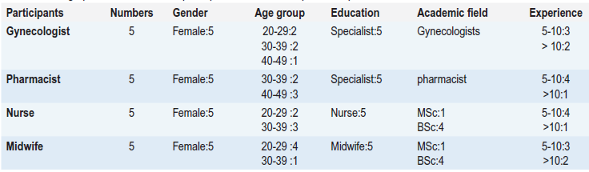




Methods(9)
Demographic characteristics of participants in decision Delphi technique

Slide 23
Methods(10)
The criteria for selecting the experts were being a faculty member and having at least five years’ experience in pregnancy diseases in clinical environments and hospitals.
The second group was also required to consist of faculty members working in medical centers and having at least five years’ experience.
The third and fourth groups were nurses and midwives working in maternity hospitals with at least five years’ experience.

Slide 24
Methods(11)
The criteria for the acceptance of data elements in the final MDS, was the agreement level of experts.
Elements with agreement levels less than 50% were excluded at the first round,
50–75% agreement levels entered the second round, and agreement levels more than 75% were accepted in the first round of the Delphi technique.
In the second round, an agreement level of 75% was considered on each data element.
In the end, final data elements of the MDS were achieved in two rounds .

Slide 25

Findings
In the first round of Delphi, the experts agreed upon 20% of the administrative elements, 51% of the clinical elements, and 100% of the pharmaceutical elements (Figure 2).
However, in the second round of Delphi, the experts agreed upon 80% of the administrative elements and 77% of the clinical elements (Figures 3).

Slide 26
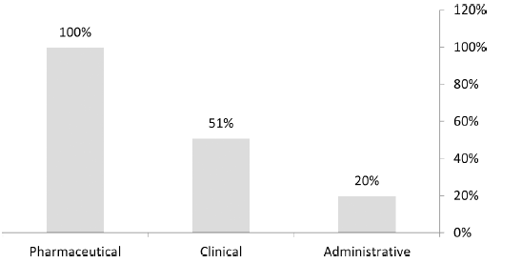
Findings
Figure 2: The percentage of the experts’ agreement in the first round of Delphi

Slide 27
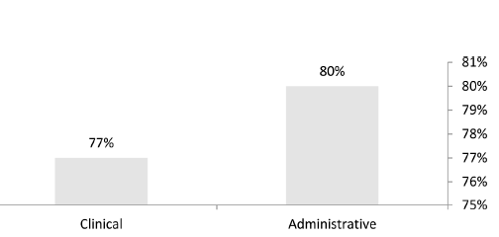
Findings
Figure 3: The percentage of the experts’ agreement in the second round of Delphi

Slide 28
Findings
The MDS of GDM was divided into three categories:
administrative with four sections
clinical with 18 sections
pharmaceutical with two sections.
The total number of final data elements for administrative, clinical and pharmaceutical categories was 43, 246 and12, respectively.
After applying two rounds of the decision Delphi technique, the final data elements for administrative, clinical, and pharmaceutical categories were 35, 199 and12, respectively (Tables 2–4).

Slide 29
Findings
In the end, the administrative data elements were categorized in four sections- demographic, healthcare provider, admission and its frequency, and patient indicators.
The clinical data elements were categorized into 19 sections, viz., diagnostic data, symptoms, previous medical history and risk factors, family history, history of previous deliveries, physical and clinical examinations, vaginal examinations, disease prognosis in case of delivery, laboratory data, counseling, permission for treatment and surgery, the current status of pregnancy, pregnancy result, prenatal and postpartum care for women with GDM, anesthesia data, sonography data, blood sugar chart, data related to the diabetic mother’s infant, and the mother’s discharge data.

Slide 30
Findings
Finally, the experts agreed upon as many as 18 sections including 199 data elements. Given the experts’ lack of agreement, family history section and its data elements were removed (Table 6).
The pharmaceutical data elements were categorized into two sections, i.e., used drugs and substance use dependence, and drugs used related to diabetes. The experts agreed upon as many as 12 data elements, and they were used in the final MDS

Slide 31
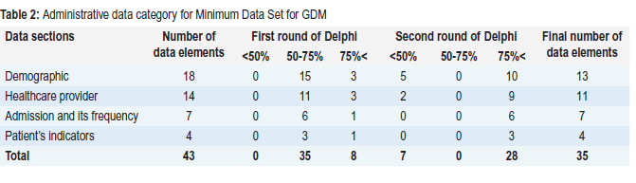
Administrative data category

Slide 32
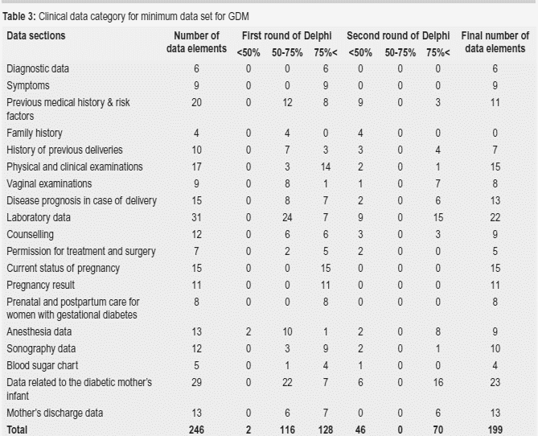
Clinical data category

Slide 33
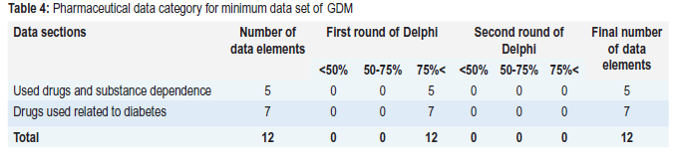
Pharmaceutical data category

Slide 34
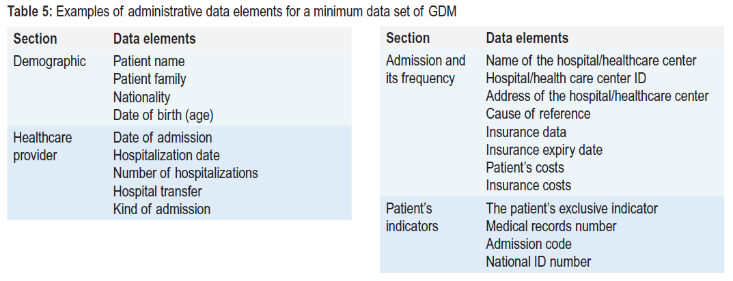

Slide 35
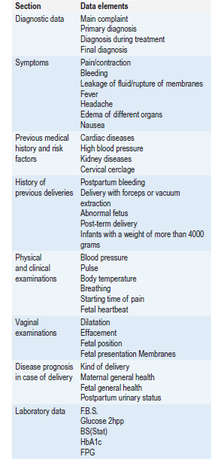
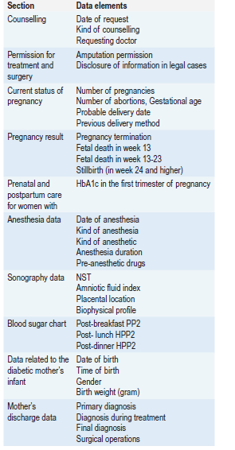

Slide 36
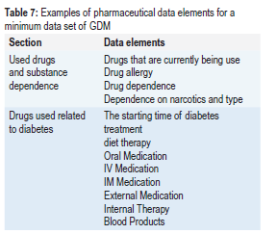

Slide 37
Discussion
In Australia, the Australian Institute of Health and Welfare has initiated the project of “The Pregnant Women’s Dataset” in the form of a minimum data set.
One of the most important parts of the present project is collecting minimum data acquired from screening and caring for pregnant mothers with GDM.
In this data bank, the data are collected regarding the :
type of diabetes (type 1, type 2, and gestational)
kind of pharmaceutical treatment
lifestyle
diet
sports
lifestyle management.
The data related to some of the aforementioned elements are the same as those of the present study.

Slide 38
Discussion
Sadoughi et al. (2015) have conducted an applied study titled “Minimum data sets of perinatal period for Iran: A Delphi study”.
In their study, the minimum data sets of the perinatal period were collected by investigating the minimum data sets of the selected countries, viz., Australia, Canada, New Zealand, the USA, England, and Iran through applying library resources. Then, the recommended minimum data set was validated by providing the experts with a questionnaire .
The findings of the present study indicated that creating a minimum data set for GDM collects the data related to monitoring blood sugar and the fetal/neonatal status and provides them for the planners and beneficiaries to use them in electronic health records’ design and in future studies.

Slide 39

Conclusion
developing the project of disease registration system, registry system of GDM
The minimum data set of GDM will result in the collection of :
The national data about the incidence and prevalence of the disease
Care strategies and techniques
Treatment provided for GDM patients.
minimum data set, key data
By accessing high-quality health data, improve the caring services for patients .

Slide 40
Conclusion
Exchanging integrated health data
Designing the web-based electronic records corresponding to the social and health conditions
Quick access to accurate and comprehensive data of GDM .

Slide 41
عنوان ارائه
Thanks for Your Attention
Reyhane Norouzi Aval
Nourozir9@mums.ac.ir

