Slide 1


A Hospital Discharge Summary Quality Improvement Program Featuring Individual And Team-based Feedback And Academic Detailing
باسمه تعالی
نام ارائه دهنده: فاطمه صادقی
استاد راهنما: سرکار خانم دکتر فضایلی
آدرس ایمیل ارائه دهنده:
sadeghif992@mums.ac.ir

Slide 2
About Journal
The American Journal of the Medical Sciences
Impact Factor 1.911
H- Index 81
Indexed in ISI, Scopus, PubMed, Embase

Slide 3
Introduction
The hospital discharge summary is a key document meant to facilitate communication between inpatient and outpatient providers and has the potential to ameliorate the risk for problematic care transitions. Unfortunately, a large body of evidence has documented deficiencies in discharge summary timeliness and quality.
Discharge summaries are an important component of hospital care transitions typically completed by interns in teaching hospitals. However, these documents are often not completed in a timely fashion or do not include pertinent details of hospitalization.

Slide 4
Introduction
In fact, a recent study indicates that resident physicians perceive the need for more formal training about the hospital discharge process including the documentation of discharge plans. Thus, quality improvement efforts designed to increase summary timeliness and quality must focus on intern and resident physicians.
A few studies have demonstrated effective strategies to improve summary quality. For example, using a template while dictating discharge summaries was associated with improved quality, as measured by a score assessing the inclusion of key elements, exclusion of unnecessary information, clarity of style and consistency of the document.

Slide 5
The purpose of this program was to develop and implement a comprehensive evidence-based discharge summary quality improvement initiative to improve overall summary timeliness and quality. We hypothesized that combining team-based feedback on discharge summaries provided to inpatient ward teams with a discharge summary curriculum and individual feedback would facilitate program reach and adoption.

Slide 6
Methods
Setting and Participants
Our discharge summary improvement program was developed for internal medicine (IM) interns and upper level residents at the Medical University of South Carolina (MUSC). At the time of program implementation, the IM residency program had a total of 96 residents (35 1st year and 61 upper level) across categorical and combined medicine-pediatrics and medicine-psychiatry programs.
Trainees rotated on 4 inpatient general IM ward teams, each consisting of 1 attending physician, 1 upper-level resident physician and 2 intern-level physicians. All interns and residents participated in continuity clinic, located adjacent to the hospital.

Slide 7
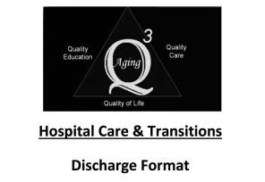
Methods
Program Development and Objectives
This program was a subproject of a larger grant initiative funded by the Donald W. Reynolds Foundation called Aging Q3, Quality Education, Quality Care, Quality of Life. The Care Transitions focus was 1 of 16 geriatric conditions described by Wenger and Shekelle15 in the Assessing Care of Vulnerable Elders project. Initially, we convened a multidisciplinary working resident physicians, education specialists, a nurse, a social worker and a clinical pharmacist.

Slide 8
The working group defined specific learning objectives for program participants.
These included attitudinal objectives such as appreciating the importance of timely, comprehensive discharge summaries as a tool for preventing care-transition related adverse events in the elderly.
Knowledge objectives included knowing local and national policies with respect to timing of discharge summary completion. Participants were also expected to learn the elements of a comprehensive discharge summary and the proper format and style to generate concise readable documents. The primary skills requiring demonstration were the ability to construct a discharge summary reflective of standardized quality criteria and the ability to critique a discharge summary according to these criteria.

Slide 9
Methods
Program Components
The major components of our program were provision of a discharge summary curriculum (including residents’ lecture with subsequent on-line availability); dissemination of a discharge summary template card; provision of individual and team-based feedback on discharge summaries and academic detailing in the inpatient and outpatient settings.

Slide 10
Methods
Discharge Summary Curriculum
After performing a literature review, our working group prepared an initial 60-minute lecture with accompanying slides that were delivered at program initiation. Lecture topics included Accreditation Council for Graduate Medical Education (ACGME) core competencies (i.e., patient care, professionalism and systems-based practice), evidence and practice guidelines for the preparation of discharge summaries, relevant local and national regulations, key components of high-quality summaries and baseline performance data gleaned from preliminary chart abstractions.
In addition, we presented this project including its rationale, components and procedures to IM attending physicians and nurses before program initiation. The lecture was 1st delivered to all IM residents in attendance at a “noon conference” seminar.

Slide 11
Methods
Discharge Summary Template Card
Our working group also developed a pocket-sized laminated discharge summary template card to be used by trainees while planning and dictating discharge summaries (Figure 1). The card included 26 items including many elements traditionally associated with discharge summaries and all discharge summary elements required by the Joint Commission for the Accreditation of Healthcare Organizations (JCAHO) and a number of elements found in hospital medicine and geriatric practice guidelines.

Slide 12
Methods
Items were divided into 4 sections including (1) preliminary information, (2) admission information, (3) hospital course and (4) discharge information.
We distributed laminated discharge summary template cards to all IM residents and interns and 4th year medical student clerks rotating on general medicine during the intervention period. We left extra cards in clinical areas and in a resident library located in the hospital and frequented by trainees rotating in the hospital.

Slide 13
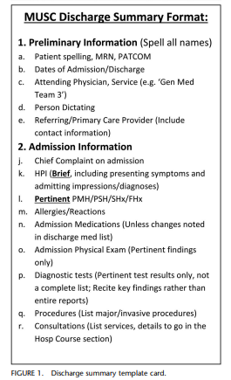
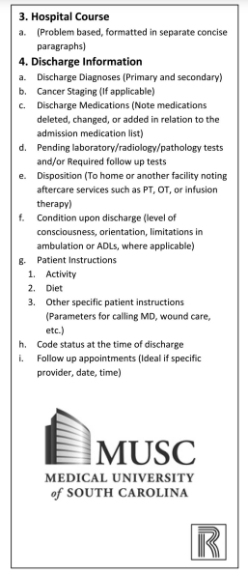
Methods

Slide 14
Methods
Individual Discharge Summary Feedback
Starting with a previously published instrument for objective discharge summary assessment, our working group heavily adapted the earlier instrument and scoring rubric for use at our facility. We used an iterative consensus building approach through 5 rounds of development to determine which elements were deemed most important for inclusion in the scoring instrument. Our final version included 16 items, and scores for individual domains were weighted based on perceived importance such that a total discharge summary was calculable, which totaled 100 points.

Slide 15
For feedback purposes, each summary was assigned a letter grade based on the traditional “A, B, C” scale by the working group member scoring the document. Before program initiation, we presented the grading instrument to residency program and hospital leaders to ensure acceptability and buy-in. Finally, we pretested the instrument with multiple sample discharge summaries to ensure adequate interrater reliability and to ensure the feasibility of chart abstraction. After the study, team members became familiar with the scoring instrument, it took approximately 5 minutes to evaluate each discharge summary.

Slide 16
In addition to the “kick-off” lecture described above, we also held a separate, intern-only, learning experience hosted by 5 IM attending physicians. During this session, each intern reviewed 3 previously graded discharges summaries with 1 attending. Trainees were encouraged to self-reflect on their performance, and together the attending and intern negotiated goals for improvement, which were recorded on a “Prescription for Improvement” card given to the intern at the end of the encounter. Interns not able to attend this coaching session were approached individually by participating attending physicians afterward. In-person attendance, online viewing of lecture materials, intern participation in individual feedback sessions and academic detailing encounters were all documented.

Slide 17
Methods
Team-based Feedback
During the 3 months of the initial program, study team members graded 1 randomly selected discharge summary for each of the 4 general medicine teams per week using our standardized discharge summary evaluation instrument. A physician member of the study team then presented a graded summary to each of the attending physicians on the IM ward teams. Both physicians reviewed the summary to establish agreement regarding its deficiencies. The inpatient ward attending then reviewed the discharge summaries with his or her team. A paper card was used to document the team-based feedback encounter. Discharge summaries were subsequently discarded (consistent with Health Information Portability and Accountability Act [HIPAA] regulations). This team-based feedback session took approximately 5 to 10 minutes with each team, 1 day per week.

Slide 18
Methods
Academic Detailing
To extend the reach of this educational program, we also designed academic detailing exercises. Academic detailing strategies have been used extensively by pharmaceutical companies and other entities to improve product utilization and/or guideline adherence. During the 3-month implementation interval, nurses in our IM outpatient clinic were queued to question patients about recent hospital admissions. Nurses placed printed copies of summaries for patients recently discharged from the hospital on the patients’ charts, and these were provided to resident physicians for review.

Slide 19
During “sign-out” with the clinic attending, residents were encouraged to evaluate the discharge summary regarding its timeliness and quality. Because it is likely that the inpatient discharging resident was not the same resident seeing the patient in clinic, this allowed residents to review discharge summaries written by their peers. Attending physicians then detailed the resident regarding the key components of high quality discharge summaries. If a resident had no patients with recent hospitalizations, then nurses provided a sample discharge summary for review and detailing with the clinic attending.

Slide 20
We also offered brief academic detailing encounters to interns and residents in the inpatient setting. Using a case-based format, physicians from our working group gave a series of brief 3- to 5-minute presentations at an established IM morning report conference. These detailing presentations were designed to highlight tips for improving discharge summary quality. For example, in 1 installment, the leader presented an excerpt from an actual discharge summary that did not contain a discharge medication list, and trainees were asked to “diagnose” the problem with that summary. After identifying the problem, 3 subsequent slides outlined the importance of medication reconciliation in care transitions, presented baseline data on resident performance documenting medication lists in discharge summaries and suggested best practices for including medications in discharge summaries.

Slide 21
Methods
Program Evaluation
We chose to use the RE-AIM framework of Glasgow et al for program planning and evaluation. RE-AIM is an acronym that stands for Reach, Effectiveness, Adoption, Implementation and Maintenance. In addition to objective measures of program effectiveness described in the results section, we measured program reach by tracking the number, type and intensity of teaching contacts with residents. We also measured adoption of discharge summary template usage.

Slide 22
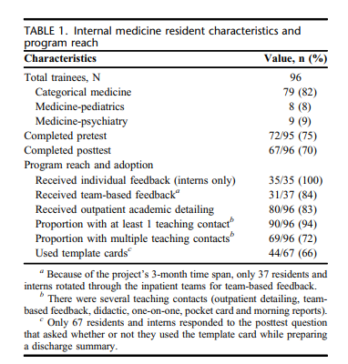
Results
Table 1 illustrates the characteristics of the residency program and the reach of our intervention. All interns received individual feedback.
In addition, 90% (55/61) of upper-level residents received at least 1 teaching contact with an attending physician. Furthermore, 72% (69/96) of interns and residents received multiple teaching contacts allowing for reinforcement of key messages. Over 70% of trainees completed the online pretest and posttest surveys. Posttest results showed that 66% of trainees used a template card while preparing their discharge summary. Over 90% of the discharge summaries were graded by 2 members of the working group (R.N.A. and J.M.). The discharge summary grading instrument had suitable interrater reliability with a k statistic of 0.72.

Slide 23
Results
Table 2 illustrates objective discharge summary scores for the 35 interns during the 3 months before (total of 103 observations) and during the 3 months after program implementation (104 observations). Based on a traditional letter grade system, average discharge summary scores for interns were in the C range (70.3%) at baseline, but scores improved a letter grade to the B range after curriculum implementation (posttest mean 5 82.9%, P 5 0.0001). Scores for specific discharge summary components improved significantly for 7 of 13 elements. Domain scores for 5 components were unchanged. Scores for discharge diagnoses decreased significantly (1.74 to 1.13, P , 0.0001). The proportion of discharge summaries receiving the highest available score increased for most summary domains. In particular, the inclusion of high-quality hospital courses (+21%), discharge medication lists (+37%), patient instructions (+16%) and tests pending at discharge (+40%) all increased.

Slide 24
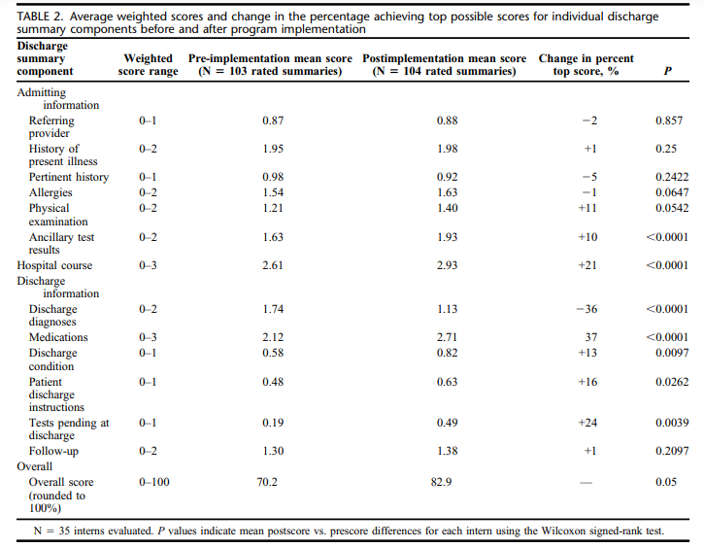

Slide 25
Discussion
Our results further support the use of individual feedback as a successful strategy in such programs. We also found that team-based feedback and academic detailing strategies to be feasible and well-tolerated adjunctive strategies in the program. In general, trainees were very receptive. As 1 intern physician commented, “This is really helpful. No one has ever taught me how to do a discharge summary before.”
During the implementation period, we found that the use of a theoretical framework for program planning and evaluation improved overall implementation success. We were able to engage 100% of intern physicians for individual feedback. In addition, all 12 IM teams on the inpatient general IM inpatient service over 3 months received team-based feedback during program implementation.

Slide 26
Discussion
As with many quality improvement initiatives, program maintenance has proven to be the most challenging aspect of program success. However, through careful planning and coordination with hospital and residency program leaders, several program components have been extended during the ensuing 3-year period. The discharge summary lecture has been updated and is now included in a broader intern-focused “Intern-101” curriculum delivered in a noon-conference setting early each academic year (i.e., August or September). The curriculum has been adapted for 4th year medical students as well.

Slide 27
Discussion
We also modified the discharge summary grading procedure by distributing the grading instrument to interns as “prework” before the scheduled noon-conference lecture with instructions for the interns to print and grade 1 of their discharge summaries before the lecture. Chief medical residents have individual samples on hand to distribute to participants when necessary. During the learning session, interns review their graded discharge summaries with attending physicians and develop mutually negotiated goals for improvement.

Slide 28
Discussion
Team-based feedback and academic detailing have proven more difficult program elements to sustain. Informal feedback from outpatient attending physicians who provided academic detailing indicates that this exercise was not deemed as relevant in the outpatient setting, and it soon gave way to other teaching priorities.
Several inpatient providers have indicated that they continued to use team-based feedback, but the practice has not been consistently applied. Had there been better structures to promote ongoing grading and distribution of discharge summaries, we may have seen improved maintenance of this strategy. Nevertheless, we found that team-based feedback was feasible and less labor intensive than providing individual feedback.

Slide 29
Discussion
We estimate that it took approximately 2 hours per week to locate and grade 4 discharge summaries and to distribute them to inpatient attending physicians. Summaries could be graded by nonclinical personnel after proper training.
Our results indicate that a combination of strategies enabled broad reach. Thus, hospitals or training programs wishing to extend program reach might consider adding academic detailing and/or team based feedback as additional strategies to their discharge summary improvement efforts.

Slide 30
Limitation
First, we were not able to randomize participants to separate intervention and control arms. Instead, we chose a single arm pre-post quasi-experimental design given that our primary focus was on quality improvement. Nevertheless, it is possible that discharge summary scores may have improved by chance or as part of the natural progression of intern maturation. Future research could examine how maturation during internship, or the development of bad habits, may affect discharge summary quality throughout the course of the academic year.

Slide 31
Limitation
Second, though we initially planned to evaluate the impact of team-based feedback on resident physicians as a secondary outcome, we found that upper level residents in our sample dictated too few summaries to perform this analysis. Thus, our program was underpowered to detect a difference between residents receiving team-based feedback and those who did not.
Third, because we intentionally engaged in multiple educational strategies, it is likely that there was significant contamination between different upper level resident groups. (i.e., team-based feedback versus none).

Slide 32
However, despite its limitations, our experiences in implementing this discharge summary quality improvement program were positive and associated with significant improvements in the quality of summaries prepared by interns, the group preparing the vast majority of summary documents at our institution. Care transitions should continue to be an area of intense interest to hospitals and healthcare organizations given the current regulatory environment. We and other groups have argued that accountability in this area should focus on additional metrics beyond hospital readmission rates, and it is possible that discharge summary content and timeliness may become care transitions quality measures in the future.

Slide 33
عنوان ارائه
با تشکر از توجه شما
نام ارائه دهنده: فاطمه صادقی
ایمیل ارائه دهنده
sadeghif992@mums.ac.ir

