Slide 1



Effects of training physicians in electronic prescribing in the outpatient setting on clinical, learning and behavioural outcomes: a cluster randomized trial
In the name of God
Neda Borhani Moghani
Dr Meraji
BorhaniN2@mums.ac.ir

Slide 2


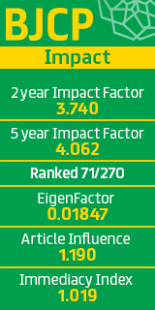
journal's specifications
title British Journal of Clinical Pharmacology
Impact Factor 3.740(2019)
Indexing ISI,Scopus,Pubmed,Embase
H-Index 137

Slide 3

Introduction
√
Electronic prescribing systems are developed and refined to improve medication safety. An important aim of these systems is to reduce the number of adverse drug events (ADEs). Such systems may reduce the number of ADEs by decreasing the number of administrative medication errors, such as illegible handwriting, errors in the route of administration and dispensing errors, as well as therapeutic medication errors, including unnoticed or inadequately managed drug–drug interactions (DDIs), overlooked contraindications and allergies, under- or overdosing, duplicate therapy and undertreatment.
However, such a system in itself is not sufficient to eliminate errors, and can even induce new errors.
3

Slide 4

Introduction
√
The outpatient setting is especially challenging because there is limited time available to obtain a complete overview of the patient’s medication. Moreover, patients often use multiple medications, prescribed by different physicians and dispensed by more than one pharmacy.
Research has shown that incorrect medication overviews in electronic prescribing systems predisposes to a higher risk of ADEs.
√
4

Slide 5

Introduction
The optimal strategy for training physicians to use electronic prescribing systems remains unclear.
A systematic review suggests that a combination of classroom-based training, computer-based training and feedback would be appropriate.
However, the evidence for this is limited and does not provide concrete directions for training content and a didactic approach.
5

Slide 6

Introduction
We used a human factors method, a so-called task-analysis, to design an educational intervention. With this, we aimed to equip physicians with the skills and knowledge necessary for appropriate use of systems for electronic prescribing, and ultimately aimed to increase medication safety.
We evaluated the effects of a task analysis-based educational intervention in the outpatient setting on (the potential consequences of) medication discrepancies and on learning and behavioural outcomes, compared with the usual educational approach.
Medication discrepancies were the primary outcome.
6

Slide 7

Methods
A two-arm cluster randomized trial was performed with the objective of demonstrating superiority of the task analysisbased educational intervention. Physicians were the unit of analysis.
Patients visiting a participating physician during the study period were in the same cluster. A cluster design was adopted because the intervention was targeted at the level of physicians, and primary outcomes were measured on the level of patients.
Trial design
√
√
7

Slide 8
Methods
Participants and setting
Eligible physicians worked as specialists and residents (specialty traninees, in the UK) of internal medicine or related specialties (including geriatrics, rheumatology, gastroenterology, cardiology or pulmonology) for at least 4h a week in the outpatient clinics of one of the two participating academic hospitals in the Netherlands: the University Medical Centre Utrecht (UMCU) and the Erasmus Medical Centre (EMC) Rotterdam.
Electronic prescribing systems were available in the two participating hospitals. UMCU used the ChipSoft hospital information system (ChipSoft BV, Amsterdam, the Netherlands), in which prescribing is fully integrated into the electronic health record. EMC used iSoft Medicator (Computer Sciences Corporation, Groningen, the Netherlands), which is partly integrated into the electronic health record.
√
√
8

Slide 9
Methods
Participants and setting
√
BoWritten consent was obtained from participating physicians after an oral explanation of the study.
Patients were included if they were aged >18 years, and visited one of the participating physicians during the study period. Directly after completion of the educational intervention, consecutive patients of the enrolled physicians were invited to participate.
At the same time, patients of physicians in the control group were invited to enroll in the study.
Patients could only participate once in the study.
9

Slide 10
Methods
Intervention
The task analysis-based educational intervention consisted of a 1-h small-group session, with facilitators introducing and discussing the importance of appropriate use of electronic prescribing systems. In this session, physicians discussed the importance of recording all current medication in the electronic prescribing system, and had the opportunity to discuss perceived challenges and share solutions.
E-learning was introduced to each physician in an individual half-hour session.
Physicians completed the e-learning modules in their own time and pace, in 2–6 h.
10

Slide 11
Methods
Intervention
The modules were focused on increasing both practical skills (e.g. how to record a prednisone tapering scheme in the system) and cognitive skills (e.g. what to record in the system when patients tell you that they no longer use a certain drug).
E-learning modules were tailored to physicians’ needs by allowing the latter to choose their own starting level, and choose to practise at this level or move to the next level. Points for continuing medical education were granted if 70% of the e-learning questions were answered correctly.
The control group received the ‘usual approach’. This typically consists of an approximately 1-h introduction into the electronic prescribing system based on exercises in a computer room, with the opportunity to ask questions to a pharmacy technician. This had already taken place before the study period and had not been standardized across hospitals and physicians.
11

Slide 12
Methods
Outcomes
Table 1 describes outcome measures. The primary outcome was the proportion of medication discrepancies per physician, defined as discrepancies between medications registered by physicians in the electronic medication system and medications reported by patients.
Patient data were collected by a telephone survey .
The possible clinical consequences of the identified medication discrepancies were estimated by the proportion of patients per physician with at least one missed drug–drug interaction (DDI) with the potential for causing a clinically relevant ADE.
√
12

Slide 13
Methods
The clinical guideline for management of DDIs was used to classify potential clinical consequences of DDIs into six levels of severity, from A (potentially resulting in a minor ADE) to F (potentially resulting in a fatal ADE).
To measure learning outcomes, we assessed knowledge and skills 1 year after the intervention in both study arms, using an electronic multiple choice test.
Participants ‘passed’ when 55% of the questions were answered correctly.
13

Slide 14
Methods
Behavioural outcomes were measured by asking patients whether their physician had obtained a medication overview and had provided them with a medication summary.
To measure determinants that might have influenced behaviour, physicians completed an electronic survey on their attitudes on electronic prescribing systems, the perceived social norm concerning the appropriate use of electronic prescribing systems, and self-efficacy.
14

Slide 15
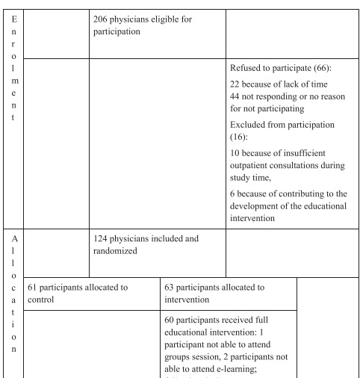
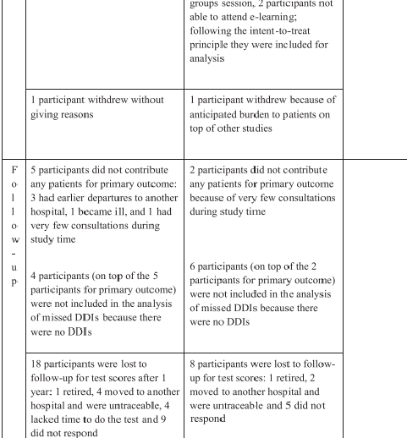
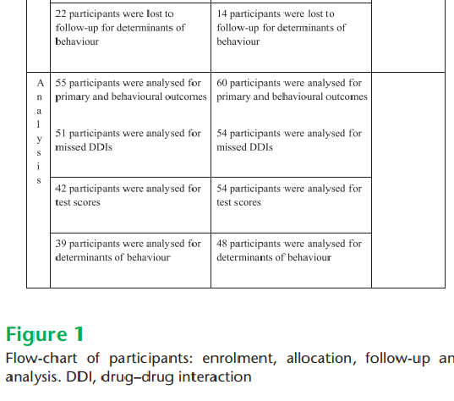
Methods
15

Slide 16
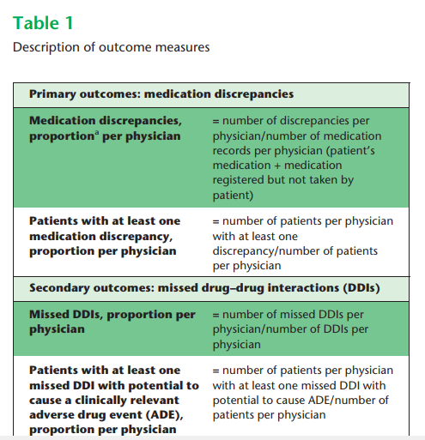
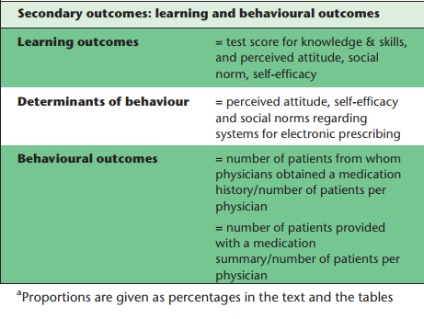
Methods
16

Slide 17
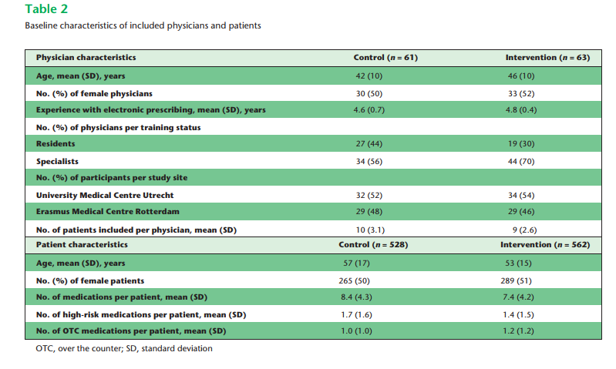
Methods
17

Slide 18
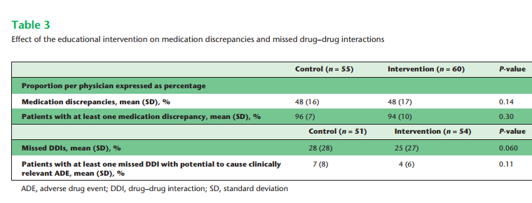
Methods
18

Slide 19
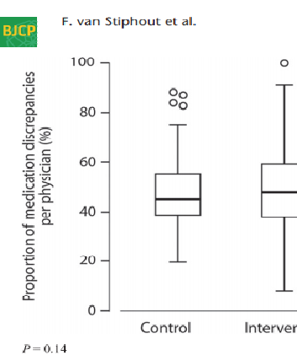
Methods
Effect of task analysis-based intervention on medication discrepancies.
19

Slide 20
re
Result
A total of 206 physicians were invited to participate, of whom 124 (60%) agreed and were included in the study.
√
The main reason to refuse participation was lack of time.
√
The included physicians were randomized and 115 were evaluated in the final analysis; two participants withdrew from the study, and seven participants had no enrolled patients .
√
A total of 1094 patients were included[almost 10 patients per physician (range 1–14)]
√
20

Slide 21
re
Result
Physicians in both study arms had a median of 5 years’ experience of using systems for electronic prescribing (Table 2).
√
Prior to the study, all physicians had received a 1-h introduction in using the electronic prescribing system, usually provided by a pharmacy technician.
√
The included patients used a median of eight medications (range 1–28) in the intervention group and six (range 1–25) in the control group, and one over-the-counter (OTC) medication in both study groups (range: intervention, 0–5; control, 0–14)
√
21

Slide 22
re
Result
A mean of 48% of the registered medications per physician were discrepant with the medications that their patients reported using. These percentages did not differ between study arms (P = 0.14) or study sites (Table 3; Figure 2).
This concurs with the observation that 94% of the patients per physician in the intervention group and 96% in the control group had one or more medication discrepancy (P = 0.30).
The percentage discrepancies showed a wide range, varying from 9% to 100% for individual physicians.
Neither the number of included patients per physician nor the number of medications per patient was related to the percentage discrepancies.
Medication discrepancies and potential clinical consequences
√
√
√
√
22

Slide 23
re
Result
Medication discrepancies and potential clinical consequences
Of the medication discrepancies, 70% were omissions (i.e. the patient was taking medications not registered in their medication record) and 30% were additions (i.e. the patient did not take medications that were registered in the medication record).
Eight percent of the medication discrepancies concerned high-risk medications and 30% involved OTC medications.
These numbers did not differ between study arms.
√
√
√
23

Slide 24
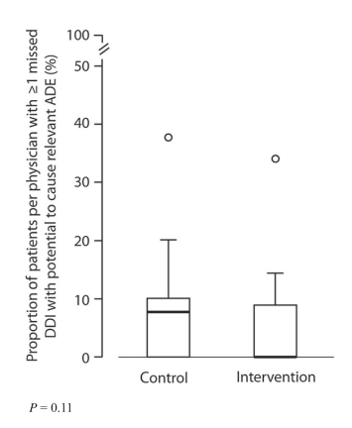
re
Result
Effect of task analysis-based intervention on missed drug–drug interactions (DDIs) with the potential to cause clinically relevant adverse drug events (ADEs).
24

Slide 25
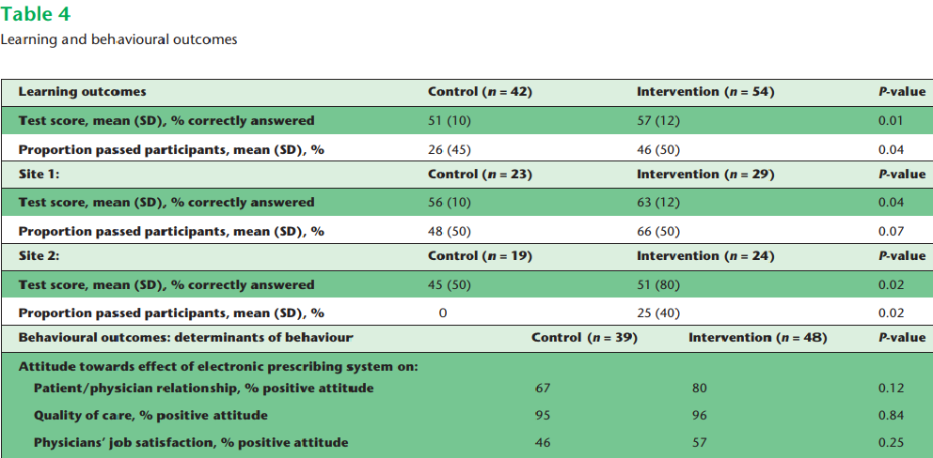
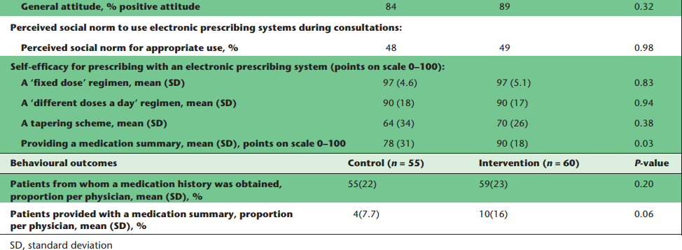
re
Result
25

Slide 26
re
Result
√
Of the drug–drug interactions (DDI), 25% per physician were missed owing to omissions in the electronic medication record in the intervention group, and 28% in the control group (P = 0.06).
A mean of 4% of the patients per physician had one or more missed DDIs with the potential to cause a clinically relevant ADE in the intervention group, and 7% in the control group (P = 0.11) (Table 3).
√
26

Slide 27
re
Result
Learning and behavioural outcomes
The percentages of correctly answered questions on the test for knowledge and skills were higher in the intervention group (57%) compared with the control group (51%; P = 0.01).
Differences between study sites were remarkable:
on one site, 66% passed in the intervention group, compared with 25% on the other site (Table 5). Physicians provided a medication summary to 10% of their patients in the intervention group, compared with 2% in the control group (P = 0.06).
√
√
27

Slide 28
re
Result
Learning and behavioural outcomes
Physicians in the intervention group perceived a higher level of self-efficacy for providing patients with a medication summary (90 points vs. 78 points out of 100; P = 0.03).
Other determinants of behaviour were similar for both study groups (Table 4).
Overall satisfaction with the educational intervention was rated as good; 73% of the participants were satisfied with the starting level, 83% were satisfied with the elearning structure and 70% actively used the knowledge and skills thereby obtained in their professional practice.(Table 6).
√
√
28

Slide 29
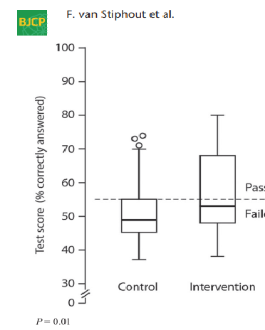
re
Result
Effect of task analysis-based intervention on knowledge and skills
29

Slide 30
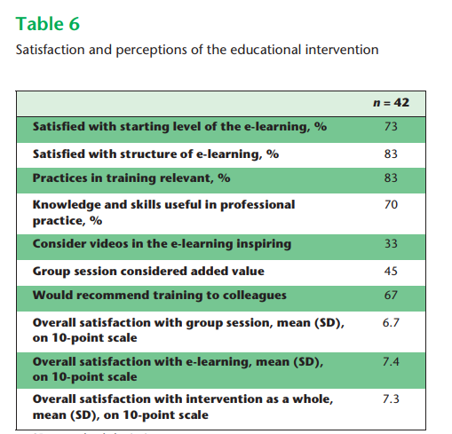
re
Discussion
30

Slide 31
re
Discussion
√
The task analysis-based educational intervention equipped outpatient physicians with the skills and knowledge to use electronic prescribing systems appropriately, as reflected by higher test scores in favour of the intervention group.
However, the ultimate goal to decrease the number of medication discrepancies and their consequences was not reached.
This was the first randomized trial to evaluate the effects of education on medication discrepancies in electronic medication records, and on learning and behaviour, which was an important strength of the study.
√
√
31

Slide 32

re
Discussion
√
As our focus was on electronic prescribing as a process and not merely as a technical act, our findings make a contribution to the discussion on how to train physicians in the appropriate use of electronic prescribing systems.
However, the result should be interpreted in the light of several limitations.
√
32

Slide 33
re
Discussion
First, actual ADEs could not be assessed.
Secondly, although the nature of the trial did not allow for the blinding of physicians, they were not fully informed about the trial’s outcomes.
Lastly, we focused on medication discrepancies because correct registration is the starting point of all other advantages of electronic prescribing. However, other effects of electronic prescribing were not assessed, such as reducing the number of administrative errors, or of overlooked contraindications or allergies.
limitations
√
√
√
33

Slide 34

re
Discussion
To understand why medication discrepancies were not influenced by the educational intervention, we need to know which factors influence human, and thus physicians’, behaviour.
According to the theory of planned behaviour and reasoned action, physicians have a higher intention (motivation) for appropriate use of electronic systems when: physicians evaluate the behaviour as positive and important (attitude), they think their significant others want them to use the system appropriately (subjective norm), and they believe they are able to perform this behaviour (self-efficacy).
34

Slide 35
re
Discussion
Physicians also need knowledge and skills, and a facilitating environment. It is therefore hard to understand why the intervention did not decrease the number of medication discrepancies.
First, we tried to influence, but probably overestimated, the potential effect of the educational intervention on attitude, perceived social norm and self-efficacy . We might even have overestimated the effect on knowledge and skills.
Our results were comparable with those of other studies with a primary focus on training knowledge and skills, in that an influence on skills was observed but the effects on relevant clinical outcomes were difficult to detect.
√
35

Slide 36
re
Discussion
Secondly, the frequency and length of the educational intervention might need to increase, to achieve a greater effect. However, there is a precarious balance between the time investment needed for real learning and the willingness to make, and viability of, this investment, given the other responsibilities physicians have.
Thirdly, we may have underestimated the relative contribution of environmental factors on physicians’ behaviour. Unpublished data from the present trial revealed no significant correlations between the proportion of medication discrepancies and physicians’ demographics, attitudes, perceived social norm, self-efficacy, and knowledge and skills.
√
√
36

Slide 37
re
Discussion
Participating physicians were relatively experienced in electronic prescribing.
We hypothesize that the training will be more effective with less experienced physicians but, on the basis of our data, we are not able to substantiate this hypothesis. The limited length of consultations and the system’s interface were probably strong barriers for appropriate use.
37

Slide 38
re
Discussion
The present study highlights the magnitude of the problem of medication discrepancies and missed DDIs.
With few exceptions, the medication records of more than 1000 patients, under the care of 115 physicians, showed at least one discrepancy with their actual medication use.
Can it be justified not to train physicians in the appropriate use of electronic prescribing systems?
This would be tantamount to concluding that electronic prescribing systems are irreparably unintuitive, and that the duration of consultations is so limited that errors will occur regardless of training.
38

Slide 39

re
Discussion
In the ideal scenario, we invest in more intuitive electronic prescribing systems, tailored to patients’ characteristics and physicians’ needs; systems facilitating the recording of accurate information about patients’ medication; or in supporting outpatient physicians to obtain a correct medication overview by pharmacy technicians.
One of the current initiatives in the Netherlands is a system by which medical data are exchanged electronically between healthcare providers.
This takes place via a ‘national switch point’(NSP), which provides a reference index for routing, identifying, authenticating, authorizing and logging.
The NSP can be likened to an air traffic control tower which regulates the exchange of patient data between healthcare providers.
39

Slide 40
re
Discussion
This system has the potential further to improve future prescribing. However, even then, physicians will need to accept the importance of increasing medication safety by appropriate use of electronic prescribing systems, and the knowledge and skills to do so.
The current intervention may improve this situation by making available real-life examples of missed DDIs.
Paying physicians to use such systems appropriately does not provide them with the necessary knowledge and skills.
40

Slide 41

re
Discussion
Any success in decreasing the number of medication discrepancies will most likely be due to a combination of educational and environmental factors.
With electronic prescribing systems rapidly increasing in number, it will become particularly important for physicians to have the knowledge and skills to use them. The present study showed that the acquisition of knowledge and skills can be achieved by a task analysis-based educational intervention.
41

Slide 42

عنوان ارائه
Thanks for Your Attention
BorhaniN2@mums.ac.ir

