Slide 1


Mobile Health Apps That Help With COVID-19 Management: Scoping Review
In the name of God
Motahareh siasar
Dr Meraji
siahsarm992@mumc.ac.ir

Slide 2

journal's specifications
title JMIR nursing2020
Impact Factor 4.31
Indexing MEDlINE,pubmed,pubmed central,scopus

Slide 3
Introduction
The novel coronavirus, severe acute respiratory syndrome coronavirus 2(SARS-CoV-2) manifests the coronavirus disease (COVID-19) and was first identified in Wuhan, China in December 2019.
It first presented as severe cases of pneumonia of unknown origin and was identified as a coronavirus in January 2020.

Slide 4
Introduction
As of August 1, 2020, there were over 17.9 million cases recorded and over 680,000 deaths due to COVID-19
As COVID-19 spread worldwide into countries with differenthealth systems and responses, the number of infected casesconstantly changed. To control its spread, several prevention strategies were adopted by various countries. These strategies included self-isolation and quarantine for individuals who were suspected cases of infection or showed mild symptoms
During the first wave of COVID-19, various mobile health (mHealth) apps were rapidly developed in response to tackle the virus

Slide 5
introduction
The first national app was developed in Singapore, which used Bluetooth technology for contact tracing. If someone was in close proximity with an infected individual, the app would send a push notification to alert them of possible COVID-19 infection and further suggest that they undergo testing
Symptom monitoring apps have also emerged in response to COVID-19. These apps commonly collect information about the user’s health by posing a list of questions related to symptom identification, from which a differential diagnosis is made

Slide 6
intruduction
The importance of credible information that can be provided in a timely manner to the public has in part been addressed by some of the information providing apps developed for COVID-19. Information providing apps give details about the coronavirus, disease, good hygiene practices, and guidelines to follow, like social distancing and the importance of wearing face masks
However, during the initial stages of the pandemic, the mHealth markets saw the emergence of developers who were trying to take advantage of the situation by creating fake apps as well as ransomware apps that mandated users to transfer money and threatened deletion of the phone’s storage if money was not transferred

Slide 7
intruduction
Amid the rapidly evolving COVID-19 environment, mHealth apps have been playing an important role in mitigating the COVID-19 response, but to date, there has not been any overview and comparisons of the mHealth apps that have been developed to combat this pandemic
The aim of this review is to scope the evidence base for articles that described apps that were developed in response to the COVID-19 pandemic. This paper categorizes and compares the available apps by providing a description of these apps, their purposes, and the features employed. A recommendation of useful features is also provided for developers and interested stakeholders

Slide 8
Methods
extension for scoping reviews The search period for information was from March 25, 2020, to May 5,2020, when the outbreak rapidly spread to all parts of the world, including the United States
Google search, Google Scholar, Scopus, and PubMed were used to find apps specificfor each country. Considering the rapid pace of articles beingpublished onCOVID-19, Google Scholar, Scopus, and PubMedwere selected, as these were common databases used by clinicians and would encompass a broad scope of journal articlesthat would be relevant to clinical and public health practices.The keywords used were: “coronavirus,” “COVID-19,” “nCOV19,” “contact tracing,” “information providing apps,” “symptom tracking,” “mobile apps,” “mobile applications,” “smartphone,” “mobile phone,” and “mHealth,” and the country names from the top 10 countries that had the greatest number of COVID-19 cases as of April 27, 2020.

Slide 9
Methods
These countries were China, France, Germany, Iran, Italy, Russia, Spain, Turkey, the United Kingdom, and the United States Another 9 countrieswere added to the list, as they were among the first in releasing apps specific for COVID-19 based on articles found during the initial stages of the research from the period of March 25, 2020,to April 1, 2020. These countries included Hong Kong, Iceland,India, Indonesia, Malaysia, Poland, Singapore, South Korea, and Taiwan.

Slide 10
Methods
Articles from December 9,2019, to May 5, 2020, were included.
Apps that were not relevant to the disease and those that were in a language other than English were excluded. If the articles had limited information about the app, such as type of feature used, a second Google search was conducted with the specific app-related parameters to source for further information. This ensured that a complete profile of each app was obtained

Slide 11

Result
A total of 46 articles that described apps from 19 differentcountries were reviewed. Most of the articles were from news sites, health care organizations, and government sites. The majority (13/19, 68.4%) of the countries studied either already had contact tracing apps or the apps were unde development, followed by symptom monitoring apps (6/19,31.6%). There was 1 app from Malaysia that had both symptom monitoring and information providing abilities
Some countries like Italy, France, Germany, and 1 app from Malaysia were in the process of developing apps for contact tracing

Slide 12
Result
Of all the apps evaluated (N=29), there were 14 (48%) apps on contact tracing alone
1 (3%) app with both contact tracing and quarantine features
6 (21%) apps purely for enforcing quarantine (n=15 for contact tracing, n=7 for quarantine)

Slide 13
Result
5 (17%) apps on symptom monitoring alone
1 (3%) app with symptom monitoring feature and for research purposes
1 (3%) app having both symptom monitoring and information provision feature

Slide 14
Result
There were 20 (69%)apps released from governments
3 (10%) from private organizations
3 (10%) from universities

Slide 15
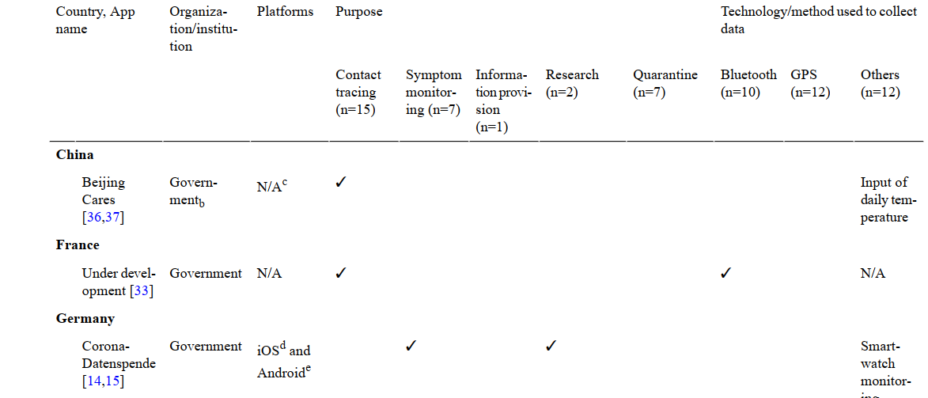
Result

Slide 16
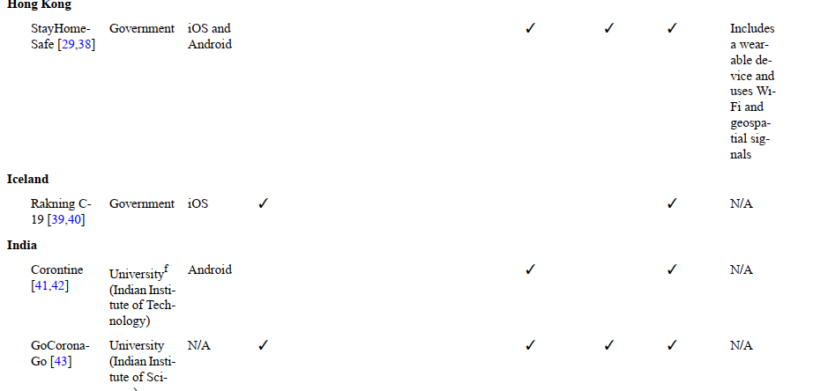
hhhbb
Result

Slide 17
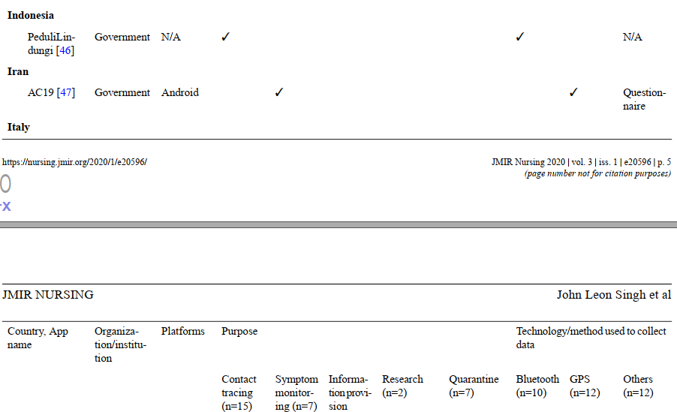
Result

Slide 18
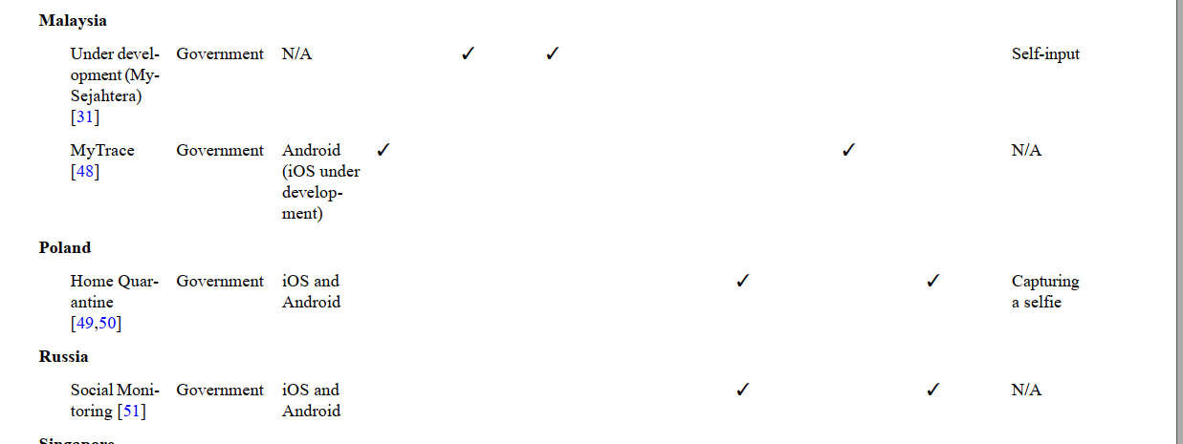
Result

Slide 19
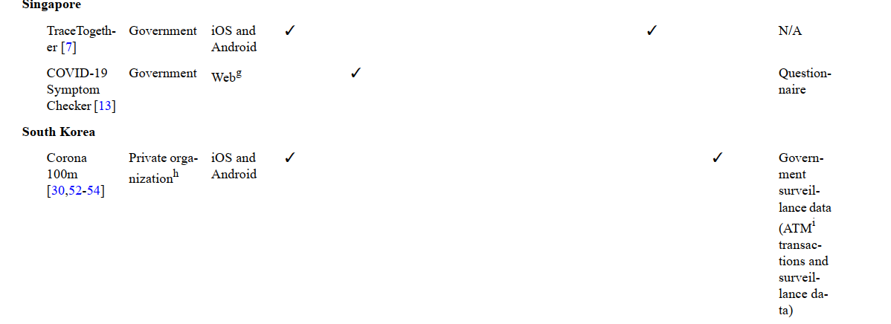
Result

Slide 20
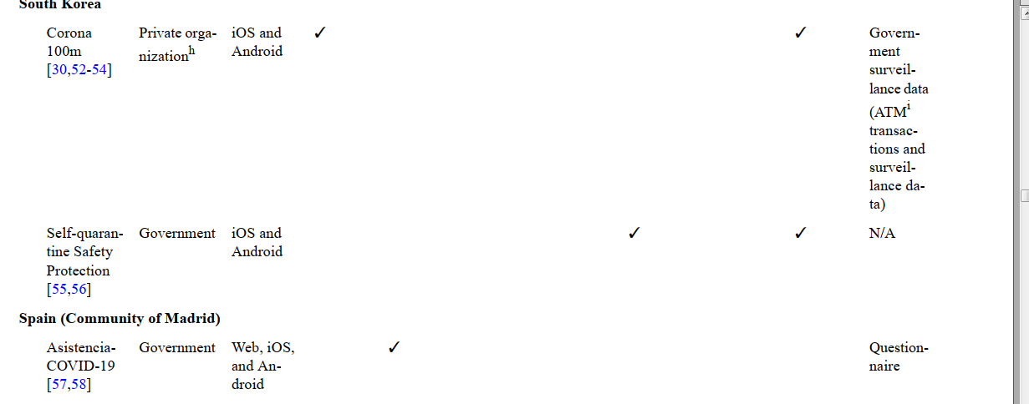
Result

Slide 21
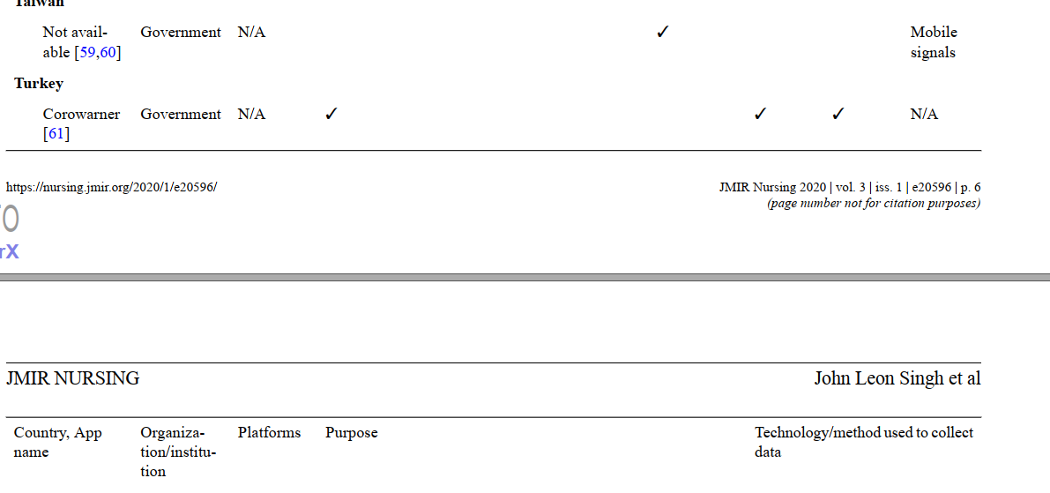
Result

Slide 22
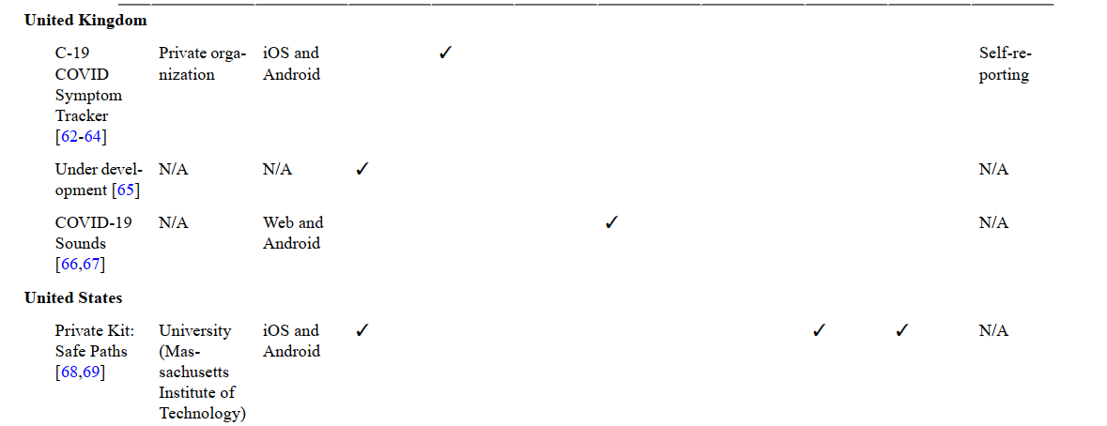
Result

Slide 23
Result
Contact Tracing Apps
There were many varieties of contact tracing apps. China was the first country to develop an app specific for contact tracing by using sophisticated tracking and surveillance methods They involved tracking of infected individuals and their contacts, while others were allowed to carry on with their normal lives
Of the 15 contact tracing apps analyzed, 6 (40%) apps had used GPS technology. South Korea’s Corona 100m app used data such as the user’s last GPS history and a range of information from government information systems, surveillance footageand credit card transactions

Slide 24
Result
The most common method for contact tracing apps was Bluetooth (n=9, 60%). These apps anonymously notified healthy individuals if they had been in close contact with an infected individual. This was in contrast to other techniques, such as the one used by China, using strict surveillance methods that raised privacy concerns since the technologies could track the person’s location and obtain personal data as well. GPS and Bluetooth were used in combination by three contact tracing apps released by the United States, India, and Turkey
All these apps were either supported by the government or from recognized health organizations after restrictions were imposed by the Apple and Google Play Stores.

Slide 25
Result
In addition to contact tracing apps, various countries have also come up with quarantine apps to ensure that quarantine measures are being followed. For example, geofencing apps enforce the quarantine by using mobile phone signals and GPS to track the movements of users. The concept is to create a virtual fence
around people’s houses so that when they disobey the regulations and go outside their houses, the authorities will be notified .One of the countries that has adopted this technique is India ,Taiwan also uses the same technology to geofence affected individuals who are required to self-isolate or quarantine at home
Quarantine Apps

Slide 26
Result
Symptom Monitoring Apps
One of the global apps for symptom monitoring is the iPhone and web-based COVID-19 Screening Tool app developed by Apple This is available for all iPhone users, irrespective of their location. Furthermore, countries such as Spain, the United Kingdom, Germany, Singapore, and Malaysia have also developed symptom monitoring apps
apps identify if the user is experiencing symptoms related to COVID-19. If the user’s responses indicate that the user may have COVID-19, they are provided with simple management advice to follow. Generally, these apps pose a series of diagnostic questions that include symptoms like fever, type of cough, body aches, contact with any infected individual, and recent travel, among others, which help identify via a back end algorithm whether the user is suspected to have COVID-19

Slide 27
re
Result
United Kingdom’s symptom monitoring app, called C-19 COVID Symptom Tracker was made by a private developer .It was highly welcomed by the public with 2,979,018 contributors as of May 6, 2020 The app was also helpful in identifying that 1 in 10 people in the United Kingdom had coronavirus symptoms In addition, Spain’s app could also alert officials on whether quarantine measures were being followed by the public in an area
An advanced variation of symptom monitoring apps is Germany’s Corona-Datenspende app,which uses smartwatches or smart bands to collect data on the user’s biometrics such as temperature and pulse that are then assessed for possible COVID-19 infections.

Slide 28
re
Result
imilarly, the COVID-19 Sounds App is a web-based app developed in the United Kingdom that is able to record a user’s cough sounds and detect whether the user is infected with the coronavirus based on machine learning of their cough sounds.
Among all the symptom monitoring apps reviewed in this study, besides the apps from Germany and the United Kingdom that were able to automatically monitor and record the patient’s health parameters, all of the other apps involved manual recording of symptoms or answering questionnaires provided by the app. Another app, called AC19, was released by the Iranian government in the Android app store for symptom monitoring but was later found to be using GPS technology to track suspected infected individuals.

Slide 29
re
Result
This app was found to be linked to a suspicious app developer company that had a history of developing other apps that collected and provided data to Iranian intelligence agencies. The app was later banned from the Google Play store but is still available through the developer’s website and other third-party app stores

Slide 30
re
Result
Information Providing Apps
Various governmental organizations and health agencies have used social media platforms like Facebook, WhatsApp, Instagram, and Twitter to provide specific information about COVID-19 to the public. Although these platforms have app functionalities, Facebook, Instagram, and Twitter can also be used on a browser, and thus, information provision is not just limited to mobile app users
WhatsApp has been widely popular and is one of the main methods of providing information on COVID-19 in many countriees

Slide 31
re
Discussion
From our review, contact tracing, symptom monitoring, and information providing apps were the key types of apps that had been developed for the management of COVID-19, with the majority being developed by health organizations and governments
Not surprisingly, most of the apps identified from our review were for contact tracing. These apps were developed to alleviate the time and resources required for the manual contact tracing process, which could be channeled to other resources instead

Slide 32

re
Discussion
The advantage of using GPS surveillance methods was the accuracy of the user’s identification. China’s method of data collection was deemed to be intrusive, as it invaded the privacy of individuals. However, this method was effective in identifying individuals who had breached the quarantine laws. Hence, it was welcomed by the general public in China, and they supported the government on its efforts to reduce the transmission of infection. Although this method could work in China, it could not be

Slide 33
re
Discussion
Bluetooth-enabled contact tracing was the most popular method, since only when users had crossed paths would they have been detected, and data was not transferred and stored to any online serve
A well-designed Bluetooth-enabled contact tracing app was first by Singapore, which was later shared to the rest of developed, This helped other countries roll out similar apps at a faster rate

Slide 34
re
Discussion
. Germany used an interesting and different approach of wearable devices for the automatic monitoring of vitals. The public acceptance of this technology is yet to be studied.

Slide 35
re
Discussion
Furthermore, the majority of the contact tracing apps only register nearby users every 5 minutes and, hence, may have the possibility of missing out individuals.
The range of Bluetooth is also farther than the recommended 1.5 meters advised by the WHO, thus giving rise to the possibility of over reporting the number of cases, especially in multistory buildings where the Bluetooth signal can pass through the walls

Slide 36
re
Discussion
the United Kingdom had opted for a “centralized” approach, where information would be stored and analyzed online, and notifications sent out based on interactions ,Although the centralized approach would pose a privacy risk, officials justified that this data would be helpful to identify trends of the disease spread. However, there was concern regarding privacy by the general public, and the app did not function properly on iPhone devices during testing. Therefore, the United Kingdom government has subsequently decided to use the Apple and Google Bluetooth app to aid in its development, resulting in the app being decentralized as well

Slide 37
re
Discussion
Symptom monitoring apps were also useful in identifying disease trends and possible infection zones. Although most countries developed symptom monitoring apps based on manual
input of symptoms and questionnaires, the symptom monitoring app developed in Germany could automatically collect the user’s vitals such as temperature and pulse, thus identifying patients who are symptomatic and possible infection zones through an interactive map
This pandemic has also rapidly enhanced the uptake of telehealth systems in many countries. When combined with the use of wearable devices, it may be possible to conduct home screening and remote monitoring of COVID-19 symptoms through other integrated features such as mobile doctors or telehealth system

Slide 38
re
Discussion
Our review managed to identify certain apps that had integrated information providing features with the other contact tracing and symptom monitoring features. Another popular method to disseminate COVID-19–related information was through social media platforms such as WhatsApp.
Given the high rates of social media use, using social media channels to provide factual COVID-19 information would likely ensure the rapid and widespread access to relevant health information

Slide 39
re
Discussion
Combined with the fact that these apps are harnessed by various governments to provide reliable information about COVID-19, information such as advice to follow and precautions to take to prevent or avoid the spread of COVID-19 can be disseminated to the public in “chunks” as an educational resource, as well as to clarify their doubts. By combining with other features, a multipurpose app that provides all information and services about COVID-19 will potentially be attractive to users and the public

Slide 40

عنوان ارائه
Thanks for Your Attention
siahsarm992@mums.ac.ir

