Slide 1


Development a national minimum data set (MDS) of the information management system for disability in Iran
In the name of God
Seyyedeh Fatemeh Mousavi
Supervisor: Dr Khalil Kimiafar
Mousavibf992@mums.ac.ir
05-10-2021

Slide 2



Journal's specifications
Impact Factor
CiteScore
2.056 (2019)
3.09
Published in
Disability and Health Journal
Quartile
2019
Q2
Indexing
H-index
ISI, Scopus, PubMed, Embase
36
Objectives
Methods
Discussion & Conclusion
Strength & Limitation
Introduction
Results
Slide 1
Development a national minimum data set (MDS) of the information management system for disability in Iran
Seyyedeh Fatemeh Mousavi

Slide 3

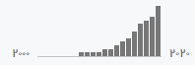
Journal's specifications
Author’s Information
Dr Maryam Ahmadi
Professor of Health Information Management
School of Health Management & Information Sciences
Iran University of Medical Sciences
H-Index
14
Objectives
Methods
Discussion & Conclusion
Strength & Limitation
Introduction
Results
Slide 2
Development a national minimum data set (MDS) of the information management system for disability in Iran
Seyyedeh Fatemeh Mousavi

Slide 4
Disability is an inevitable part of human life and almost everyone, whether temporarily or permanently, may experience it in their life
01
b.
About 15% of the people in the world have experienced disability and about 3% of them have severe disabilities
disability may lead to serious consequences such as unemployment, lack of income, restrictions in social relationships, and psychological disorders
02
b.
Women, poor, unemployed, and older people are more susceptible to disability
Although Soltani et al. reported a decreasing trend of disability in Iran from about 4% in 1997 to 1.3% in 2011, the general trend of disability is increasing in the whole world
02
b.
including Iran which can be explained by such factors as population aging
Objectives
Methods
Discussion & Conclusion
Strength & Limitation
Introduction
Results
Slide 3
Development a national minimum data set (MDS) of the information management system for disability in Iran
Seyyedeh Fatemeh Mousavi

Slide 5
The World Health Organization (WHO) has defined disability as
“an umbrella term, covering impairments, activity limitations, and participation restrictions. An impairment is a problem in body function or structure; an activity limitation is a difficulty encountered by an individual in executing a task or action; while a participation restriction is a problem experienced by an individual in involvement in life situations”.
Objectives
Methods
Discussion & Conclusion
Strength & Limitation
Introduction
Results
Slide 4
Development a national minimum data set (MDS) of the information management system for disability in Iran
Seyyedeh Fatemeh Mousavi

Slide 6
1
According to a WHO estimate, Iran will face an increase in the aging population in the next decades in such a way that the elderly will comprise about 25% of the population in 2050.
2
People with disabilities need high quality data, respectable communication, and new information technologies for their empowerment.
3
However, limited information is available about disabilities in low-income and middle-income countries.
4
A minimum data set (MDS) provides a standardized set of data elements that should be collected to enable data audit and benchmarking.
Objectives
Methods
Discussion & Conclusion
Strength & Limitation
Introduction
Results
Slide 5
Development a national minimum data set (MDS) of the information management system for disability in Iran
Seyyedeh Fatemeh Mousavi

Slide 7
Developing an MDS is the front line of data standardization, data use in different decision making processes, and data comparability at national and international levels.
Therefore, an MDS is an essential tool for data management in any health information system such as Electronic Disability Records (EDRs).
EDR
EDR
medical
occupational
financial
health support
accommodation
Objectives
Methods
Discussion & Conclusion
Strength & Limitation
Introduction
Results
Slide 6
Development a national minimum data set (MDS) of the information management system for disability in Iran
Seyyedeh Fatemeh Mousavi

Slide 8
The main challenge
there is no established national minimum data set (MDS) for disability, which is an obstacle to developing a national EDR for Iran in order to collect comprehensive and uniform data on disability for various purposes.
Objectives
Methods
Discussion & Conclusion
Strength & Limitation
Introduction
Results
Slide 7
Development a national minimum data set (MDS) of the information management system for disability in Iran
Seyyedeh Fatemeh Mousavi

Slide 9


This study was conducted to develop a national MDS for
disability to facilitate the development of a national EDR for Iran.
Objectives
Methods
Discussion & Conclusion
Strength & Limitation
Introduction
Results
Slide 8
Development a national minimum data set (MDS) of the information management system for disability in Iran
Seyyedeh Fatemeh Mousavi
9

Slide 10
cross-sectional study
Collect data from available sources
Prepare a checklist
Prepared MDS with two rounds of Delphi
01
02
03
04
05
Systematic review
Preparing a questionnaire
Objectives
Methods
Discussion & Conclusion
Strength & Limitation
Introduction
Results
Slide 9
Development a national minimum data set (MDS) of the information management system for disability in Iran
Seyyedeh Fatemeh Mousavi

Slide 11
Data were collected from the people with disabilities data bank:
State Welfare Organization of Iran available at “payment.behzisti.net”
data elements of the Iranian Ministry of Health and Medical Education (MOHME)
national electronic health records system (abbreviated as SEPAS in Persian)
integrated health system (abbreviated as SIB in Persian)
The sources were continuously reviewed at this step until data saturation was achieved, and no more new data elements emerged from the sources.
Collect data from available sources
01
Objectives
Methods
Discussion & Conclusion
Strength & Limitation
Introduction
Results
Slide 10
Development a national minimum data set (MDS) of the information management system for disability in Iran
Seyyedeh Fatemeh Mousavi

Slide 12
Data were collected from the people with disabilities data bank:
Applied search terms were
All publications up until March 2017 were searched in:
Persian databases:
MagIran
Scientific Information Database (SID)
Irandoc
English databases:
Scopus
PubMed
Web of Science
Google search engine
Minimum data set form
MDS
minimum data set
disability registry form
Disability
disability record
02
Systematic review
Objectives
Methods
Discussion & Conclusion
Strength & Limitation
Introduction
Results
Slide 11
Development a national minimum data set (MDS) of the information management system for disability in Iran
Seyyedeh Fatemeh Mousavi

Slide 13
total
1442 papers
duplicates
236 papers
Inclusion criteria:
full-text articles in either English or Persian
languages related to the disability domain with a
clearly stated purpose published up until March 2017.
Exclusion criteria:
articles published in languages other than English and Persian
the articles whose full-text were impossible to access, reports and forms retrieved from personal weblogs, letters to editors.
1206 remaining papers
1144 were excluded after reviewing their titles and abstracts
Minimum data set form
MDS
minimum data set
disability registry form
Disability
disability record
02
Remaining 62 papers were scrutinized
Systematic review
34 met the inclusion criteria
Objectives
Methods
Discussion & Conclusion
Strength & Limitation
Introduction
Results
Slide 12
Development a national minimum data set (MDS) of the information management system for disability in Iran
Seyyedeh Fatemeh Mousavi

Slide 14
Prepare a checklist
The extracted data elements form the two previous stages were combined and a final checklist was constructed.
Generally, 488 data elements were extracted from the data bank and information systems related to disability in Iran and the literature review. The data elements were then recorded in the final checklists.
03
Objectives
Methods
Discussion & Conclusion
Strength & Limitation
Introduction
Results
Slide 13
Development a national minimum data set (MDS) of the information management system for disability in Iran
Seyyedeh Fatemeh Mousavi

Slide 15
In the fourth step, a questionnaire was constructed using the data elements of the final checklist.
The questionnaire consisted of 8 → administrative and 10 → clinical categories.
The questionnaire was composed of three columns:
‘‘yes’’ (consisting of two parts: mandatory or optional)
‘‘no’’ in front of each data element.
A blank row was considered for adding necessary data elements by experts.
04
The content validity of the questionnaire was evaluated by 5 experts:
2 health information management experts
1 PhD in medical informatics
2 experts from the State Welfare Organization.
Preparing a questionnaire
Test-retest (at a 10-day interval) was done to determine the reliability of the questionnaire.
The collected data were analyzed using SPSS 16, and the questionnaire had a Cronbach's alpha of 0.86.
Objectives
Methods
Discussion & Conclusion
Strength & Limitation
Introduction
Results
Slide 14
Development a national minimum data set (MDS) of the information management system for disability in Iran
Seyyedeh Fatemeh Mousavi

Slide 16
1
Purposive sampling was used to select 24 experts for Delphi. The criterion for the selection of experts was knowledge and experience in the field of disability or recording of disability.
Prepared MDS with two rounds of Delphi
Data elements with:
less than 50% agreement →excluded in the first round
50e75% agreement →entered the second round
more than 75% agreement→ accepted in the first round of the Delphi technique.
In the second round, an agreement level of 75% was considered for each data element.
05
2
Objectives
Methods
Discussion & Conclusion
Strength & Limitation
Introduction
Results
Slide 15
Development a national minimum data set (MDS) of the information management system for disability in Iran
Seyyedeh Fatemeh Mousavi

Slide 17
Total number
an administrative category with 8 sections
133
The MDS of disability was divided into
a clinical category with 10 sections
355
Mandatory cases
130 data elements for administrative category
60
After applying 2 rounds of the decision Delphi technique
345 data elements for clinical category
178
Objectives
Methods
Discussion & Conclusion
Strength & Limitation
Introduction
Results
Slide 16
Development a national minimum data set (MDS) of the information management system for disability in Iran
Seyyedeh Fatemeh Mousavi

Slide 18
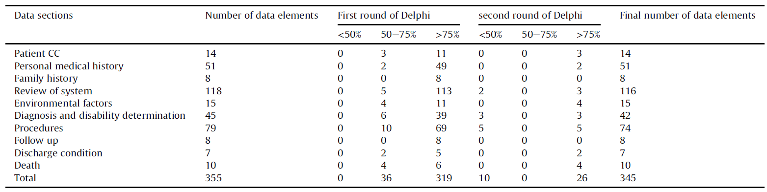
Clinical data category for minimum data set for disability
Objectives
Methods
Discussion & Conclusion
Strength & Limitation
Introduction
Results
Slide 17
Development a national minimum data set (MDS) of the information management system for disability in Iran
Seyyedeh Fatemeh Mousavi

Slide 19
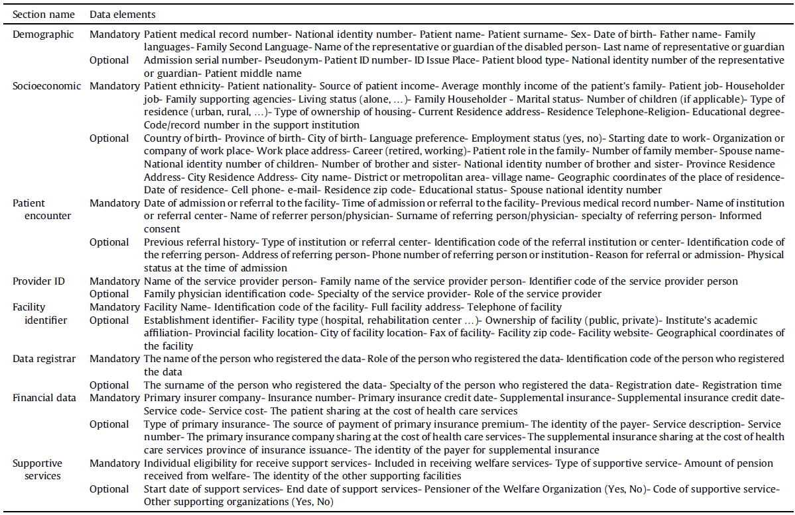
Administrative data elements for a minimum data set for disability
Objectives
Methods
Discussion & Conclusion
Strength & Limitation
Introduction
Results
Slide 18
Development a national minimum data set (MDS) of the information management system for disability in Iran
Seyyedeh Fatemeh Mousavi

Slide 20
According to a WHO report in 2018, over a billion people in the world suffer from at least one form of disability.
✓
According to the United Nations reports in 2015, the prevalence of disability in the Iranian population is estimated at 1.5%
✓
physical disorders (48.3%), mental disorders (25.8%), voice and speech disorders (10.1%), blindness (7.9%), and deafness (7.9%) are the most common types of disability in the Iranian population.
✓
Moradi et al. reported that 1.4% of the Iranian people have at least one type of disability.
✓
Lack of disability data, especially in developing countries, is the most common obstacle to policymaking and development of programs for disability management based on evidence-based, accurate, and reliable data,
✓
Objectives
Methods
Discussion & Conclusion
Strength & Limitation
Introduction
Results
Slide 19
Development a national minimum data set (MDS) of the information management system for disability in Iran
Seyyedeh Fatemeh Mousavi

Slide 21
Quality data plays a key role in decision-making and planning in health information systems and poor data increase medical errors and decrease the efficiency of health care services.
✓
The MDS of disability was divided into administrative and clinical categories with eight and ten sections, respectively.
✓
Administrative data include patient demographics as well as healthcare provider and insurance data. Thus, this category of data could be used to determine healthcare costs, disability benefits and insurance claims.
✓
Collecting quality clinical data for health care institutions is crucial to evaluating the quality of care, improving its associated standards, and making correct diagnosis and treatment decisions.
✓
Objectives
Methods
Discussion & Conclusion
Strength & Limitation
Introduction
Results
Slide 20
Development a national minimum data set (MDS) of the information management system for disability in Iran
Seyyedeh Fatemeh Mousavi

Slide 22
Conclusion
1
This study showed lack of comprehensive and uniform data elements of disability in Iran
2
Therefore, a MDS was developed for disability in Iran as a starting point for standardizing the disability data and developing an EDR.
3
A MDS has the potential to standardize the data and overcome the problem of low-quality disability data in Iran through providing consistent, complete and uniform data elements.
4
Thus, this MDS is useful in determining of disability, benefits, in policy-making and effective planning for providing persons with disability with more efficient and cost effective services.
Objectives
Methods
Discussion & Conclusion
Strength & Limitation
Introduction
Results
Slide 21
Development a national minimum data set (MDS) of the information management system for disability in Iran
Seyyedeh Fatemeh Mousavi

Slide 23
Strength & Limitation
Strength 1
Strength 1
Limitation 3
the designed MDS can help to clarify and harmonize the concept of disability and to collect accurate and comprehensive data of the persons with disabilities for use in planning, policy-making and provision of health care services to these people.
the designed MDS may not cover all specific needs of all centers related to disability given the nature of the MDS, which is a minimum data set of essential data in a specific field.
Strength 2
Limitation4
Limitation 3
Strength 2
Lack of involving of patients with disability as one the main beneficiaries of the MDS was a limitation of the present study, as considering the opinions of people with disability in the MDS could further improve the MDS comprehensiveness and quality.
Although the developed MDS for disability is rather similar to most previous MDS in some sections, it contains specific data elements that could provide comprehensive data elements required by disability information systems and can be useful in meeting the needs of the disability data users.
Limitation 4
Objectives
Methods
Discussion & Conclusion
Strength & Limitation
Introduction
Results
Slide 22
Development a national minimum data set (MDS) of the information management system for disability in Iran
Seyyedeh Fatemeh Mousavi

Slide 24
One of the advantages of this study is determining the mandatory and optional data at the initial design stage
My view
Objectives
Methods
Discussion & Conclusion
Strength & Limitation
Introduction
Results
Slide 23
Development a national minimum data set (MDS) of the information management system for disability in Iran
Seyyedeh Fatemeh Mousavi

Slide 25
Future Studies
Designing ICF-based disability datasets for a variety of major diseases or injuries leading to disability
Designing a national registration system for disability information in Iran
Evaluating the acceptance of electronic records of the disabled from the perspective of the disabled community
Assess the needs of users of electronic records of the health of the disabled
Design and implementation of self-management and disability support application or Portal
Objectives
Methods
Discussion & Conclusion
Strength & Limitation
Introduction
Results
Slide 24
Development a national minimum data set (MDS) of the information management system for disability in Iran
Seyyedeh Fatemeh Mousavi

Slide 26
THANK YOU FOR Attention

