Slide 1



Evaluation of Transition to Electronic Prescriptions in
Turkey: Perspective of Family Physicians
In the name of God
Neda Borhani Moghani
Dr Meraji
BorhaniN2@mums.ac.ir

Slide 2


Journal specification
Impact Factor
5.007
H Index
30
Index scopus,Pubmed,MedLin
International Journal of Health Policy and Management (IJHPM)
Published
2018
Index
Web of Science Scopus,Pubmed,MedLine

Slide 3



Health information technology includes a variety of technologies that enable the management and transfer of information for patients, service providers, insurers,
payment institutions and all other groups related to health and healthcare.
The utilization of information technologies in healthcare services can make potential contributions to enhancing service quality, safety, efficiency and reducing costs both for patients and service providers.
Although such contributions have been reported, technology usage by physicians and hospitals is still at a low level.
In Turkey, the Health Transformation Program, which includes initiatives for increasing the utilization of information technologies in the provision of health services, aims to “put into practice the e-transformation project in the field of health” and, in this context, to standardization, and classification of information systems, and the integration and active use of data gathered from different institutions.

Slide 4


Electronic prescription (e-prescription) is one of the important steps taken to use information systems in the field of health in terms of facilitating communication between institutions in prescription processes, increasing patient safety and satisfaction .
In addition, information technology plays a key role in providing better and safer care, and transformation of health services.
That is why information technologies are highly important in generating e-prescriptions.
Despite the potential advantages, launching new applications such as e-prescriptions does not mean that it can be successfully implemented. Human factors can play an important role in the success of the new technology, and user satisfaction is one of them. It is important for users to be satisfied with the new system to implement the system successfully.

Slide 5


Electronic prescription (e-prescription) systems have become increasingly widespread in developing countries in recent years. Health systems where there is a clear hierarchical structure and where healthcare is managed by a single authority are more successful in e-prescription adoption.
In order for e-prescription applications to work well, it is important to set standards for data entry fields in e-prescription software.
These standards will ensure that the prescription is created in a clear and complete manner and will prevent physicians from filling data entry fields in different ways.
E-prescription is defined by the Social Security Institution (SSI) in Turkey as “prescriptions generated by physicians on the systems of the health service providers in accordance with the definitions and announcements of the SSI, and are electronically recorded in the MEDULA [Medikal Ulak] system and given the electronic prescription number.

Slide 6


conducted
2011
Pilot implementation
2012
Was extended to the whole country by the SSI
1 july 2012
Became compulsory
15 January 2013

Slide 7


The introduction of e-prescriptions has been successful, as indicated by the fact that in the first half-period of the implementation 65% of all prescriptions were generated electronically, and 105 200 physicians obtained institutional passwords in order to create e-prescriptions.
The SSI has been conducting the application of e-prescriptions on the system of MEDULA which is an integrated system including the General Health Insurance (GHI) and healthcare facilities in order to gather billing data electronically and make service payments without interfering with internal processes.
For example, before the e-prescription application, SSI required that the paper prescriptions be delivered to the institution within a certain period of time, checked if the prescription was signed and if the medications were appropriate.
With the application of e-prescriptions, however, these procedures can be easily carried out through the system.

Slide 8
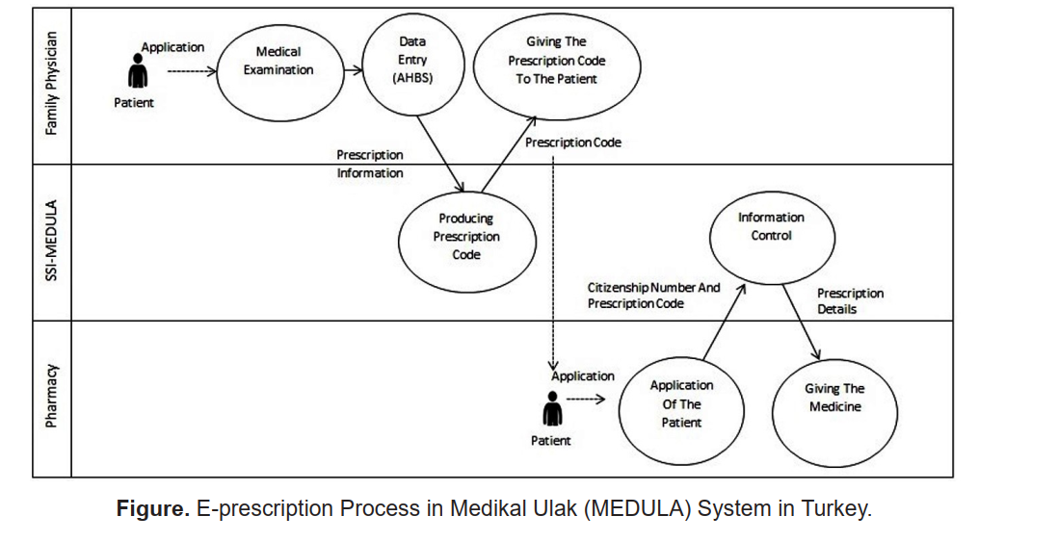

Slide 9
MEDULA
The system involves the use of patient information and is available to physicians, pharmacies, and hospitals.
Pharmacies, health centers, diagnostic and treatment centers and public and private hospitals have been integrated into MEDULA via web services.
MEDULA system which provides accurate and practical communication between health service providers and SSI acts jointly with the GHI, the Central Population Affairs System (Mernis) and the Ministry of Health.
The integration of the MEDULA system with other institutions also provides the physician with information regarding the patient.
By this means, when the physician enters a patient’s identification number into the system for e-prescription, the patient’s identification information from the Mernis system appears on the screen.
In addition, the physician can see the information regarding the patient’s social security on the screen.

Slide 10

In the process of healthcare service providing, which starts with the patient’s visit to the family physician, the
physician logs into AHBS, using their institutional password obtained from the SSI.
E-prescriptions are generated by accessing the patient’s information in MEDULA using the citizenship number of the patient.
A code for the generated prescription is provided by the MEDULA system and this code is given to the patient by the physician. The patient can then obtain their medicine from any pharmacy of their choice.
While family physicians are the first step in the e-prescription process at the primary level, SSI forms the second step by generating, transmitting and controlling the prescription code, and pharmacies form the last step of the system as users of the e-prescription codes.

Slide 11

This study, which was carried out in the first months of the implementation of the e-prescription system in Turkey , intended to provide information about the functionality of the implementation to the decision makers in Turkey and in other countries planning to apply e-prescription systems.
Specific aims of this study are to:
1. Determine the positive effects of e-prescriptions on the procedures of family physicians that provide primary healthcare services,
2. Determine the problems involved in e-prescription writing,
3. Determine the level of satisfaction of family physicians with the application of e-prescriptions.

Slide 12



Data Collection Tool
A questionnaire developed specifically for this research was used in the study.
To begin with, 30 family physicians were interviewed face-to-face about the e-prescribing system they used; the convenience of the system, the challenges they have experienced and their satisfaction with the system.
A data collection tool was generated by the authors using these interviews as well as SSI communiqué on healthcare practices, and informational correspondences for the use of e-prescribing written by the SSI and Public Health Agency of Turkey.
the questionnaire was limited to only 8 questions. Then the questionnaire was pilot tested.
the questions related to age, years of experience as a physician, number of e-prescriptions written daily, and time taken to write an e-prescription, the following questions were also included a 5-point Likert-type question to determine the satisfaction level of physicians with the application of e-prescriptions, and 2 questions to determine the positive effects of e-prescriptions on physicians’ processes and whether problems with e-prescriptions were experienced.

Slide 13


Population and Sampling
In May 2013, when the research was conducted, 20 450 family physicians were working in Turkey.
In May 2013, when the research was conducted, 20 450 family physicians were working in Turkey.
No sample was selected and it was aimed to include as many family physicians as possible in the study.
The participants represent the
family practitioner population in terms of age and gender
distribution.
Data were collected using e-mails of family physicians.
Data were collected using e-mails of family physicians.
The questionnaire form was forwarded once to all family physicians via e-mail and responses were archived to be evaluated.
The questionnaire form was forwarded once to all family physicians via e-mail and responses were archived to be evaluated.
A total of 1534 family physicians (7.5%) participated in the study.
70.3% (1078) of the family physicians participating in the survey were male and 29.7% (456) were female.
70.3% (1078) of the family physicians participating in the survey were male and 29.7% (456) were female.
The average age of family physicians participating in the survey was 41.

Slide 14


Data Analysis
Professional and demographic information and the level of satisfaction with the application of e prescriptions of the family physicians in the research were analyzed using descriptive statistics such as mean, standard deviation , frequency, and percentage.
Significance testing (t test) of the difference between 2 means was conducted in order to evaluate.
Each response given by physicians to these questions were evaluated and content analysis was conducted.
Responses that express the same problem or positive effect were grouped under the same heading.
Microsoft Excel was used to classify the answers to the open-ended questions related to the positive effects and the problems experienced in relation to the application of e-prescriptions. The Statistical Package for the Social Science for Windows (SPSS 20.0) was used to perform the statistical analyses.

Slide 15

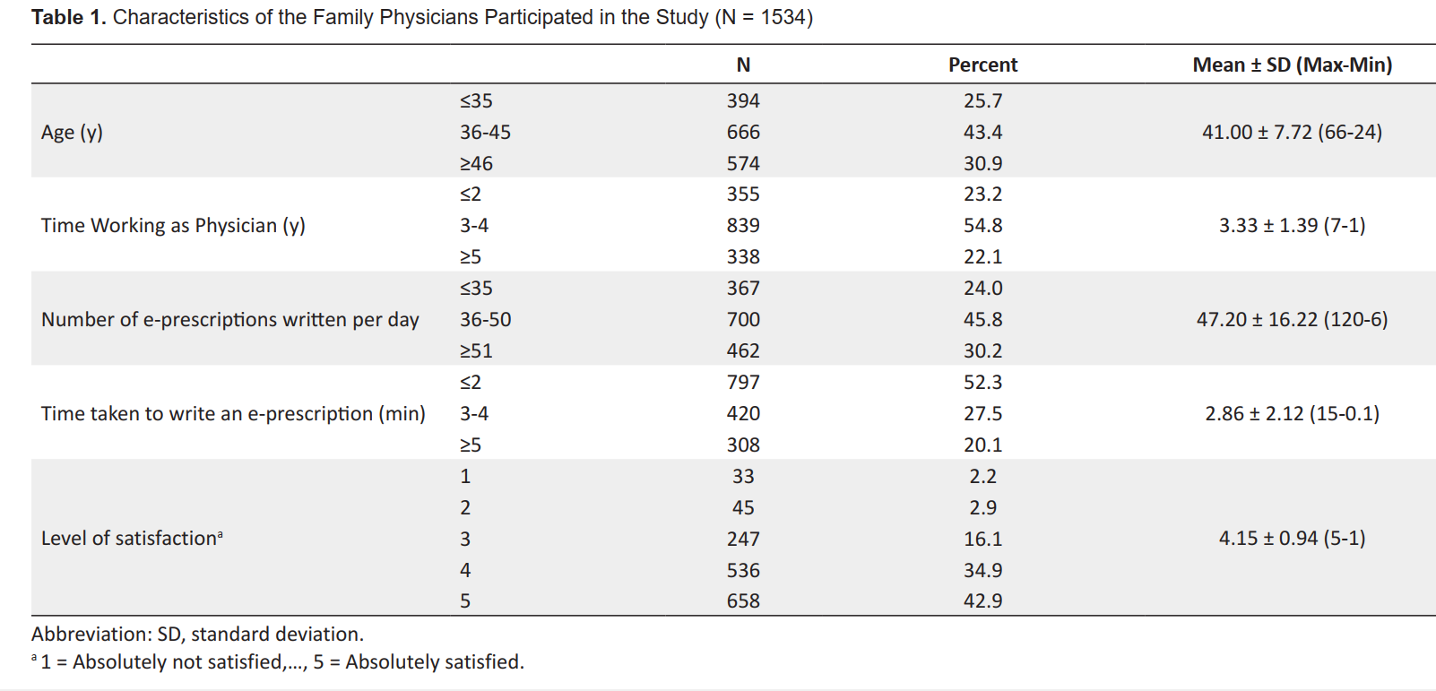

Slide 16
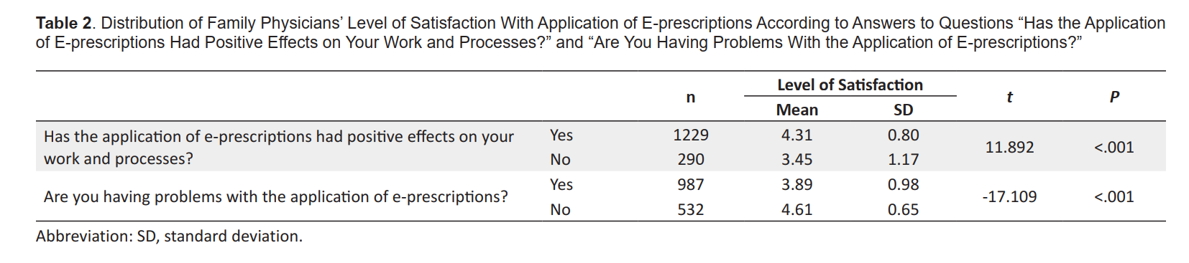

Slide 17



The higher number of physicians answering “yes” to both questions suggests that although family physicians have problems with the application of e-prescriptions they also think that e-prescriptions have positive effects. This demonstrates that e-prescription practice is beneficial but open to improvements.
1
2
The high level of satisfaction of family physicians who report no problems suggests that satisfaction would generally increase if the problems with the application of e-prescriptions were eliminated

Slide 18

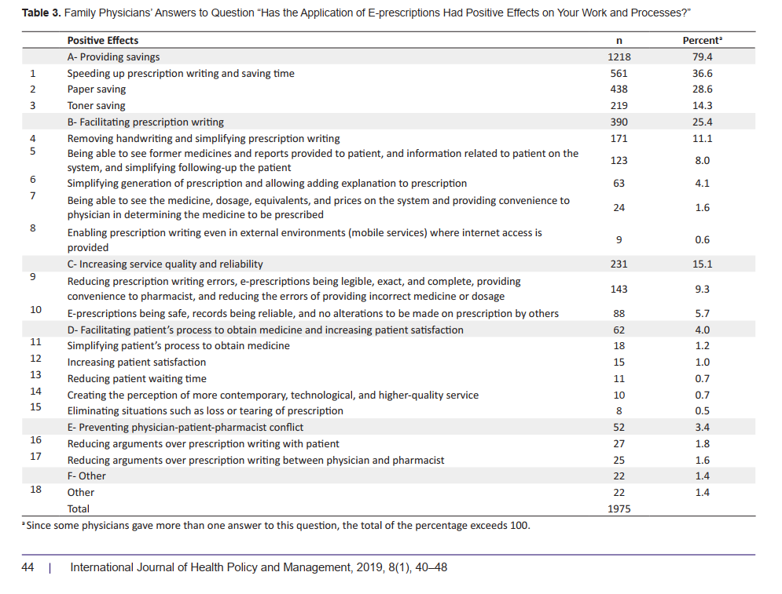

Slide 19
1
Most of the surveyed physicians (79.4%) stated that e-prescription application saves time, paper and toner.
1
One in 4 physicians pointed out that e-prescribing facilitated prescription writing.
2
3
e-prescription application increases the quality and reliability of service, increases patient satisfaction and prevents conflicts between physician patient and pharmacist about prescribing.

Slide 20
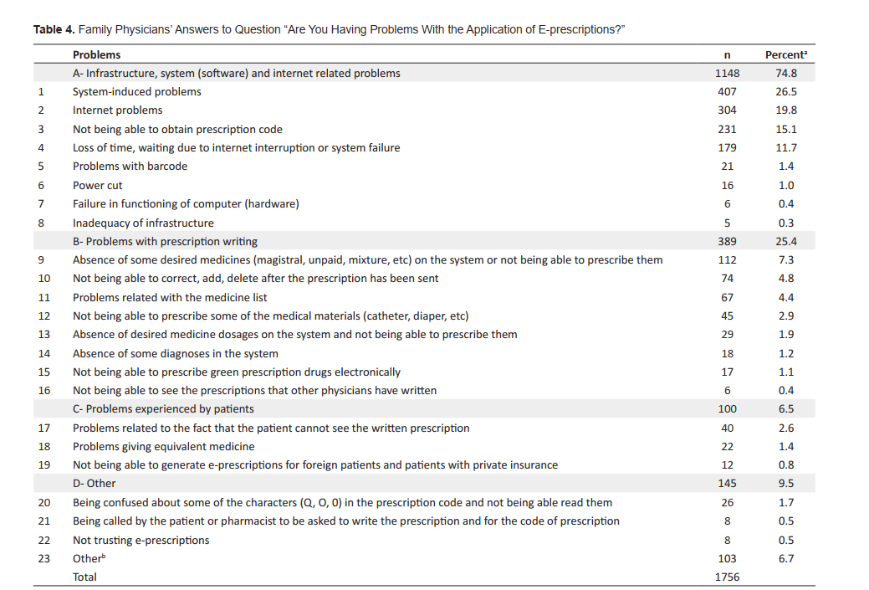

Slide 21
An important part of the complaints consisted of system-induced problems. More than a quarter (26.5%)
of the family physicians in the research complained about system-induced problems such as slow working of the system, stopping of the system from time to time.
1
Internet-related problems were also important. The implementation of e-prescription through the internet network requires the establishment of a robust internet infrastructure. Interrupting or slowing down the connection to the Internet hinders e-prescription application.
2
problems with regard to prescription writing (stemming from reasons such as absence of some desired medicines on the system or not being able to prescribe them; not being able to correct, add,
delete after the prescription has been sent; absence of some medicines, medicine dosages or diagnosis in the system) were among the most common complaints.
3

Slide 22


In this study, family physicians’ opinions on e-prescription were evaluated.
Despite some problems with e-prescription practice, it was found that a significant portion of family physicians were satisfied with e-prescription.
When analyzing the studies conducted in other countries on e-prescriptions, it was seen that the level of satisfaction with e-prescriptions is quite high.
The family physicians in the present study drew attention to the benefits of the application of e-prescriptions in terms of patients and pharmacists. In previous studies, it was found that not only physicians, but also patients and pharmacists were satisfied with the application of e-prescriptions.

Slide 23

In the studies by Tan et al in Singapore and Jariwala et al in America, it was determined that 87% of physicians and 83% of e-prescribers were satisfied with the application of e prescriptions, respectively.
In studies conducted in Sweden, Austria, and England, it was found that a significant proportion of physicians think that the application of e-prescriptions is beneficial. Moreover, in a study by Gider et al with 248 physicians in Turkey, 62% of the physicians supported the application of e-prescriptions.

Slide 24
speeding up prescription writing and saving time.(this study and Gimenes and Miasso in Brazil)
saving on paper and toner are among the issues that the family physicians point out most frequently
E-prescriptions Positive Effects
in different studies e-prescriptions have been found to be more cost-effective than paper prescriptions.
the errors in generating prescriptions have reduced with the application of e prescriptions(this study and Gimenes and Miasso in Brazil
In the study by Gider el al in Turkey nearly half of the participating physicians were found to believe that the application of e-prescriptions made a positive contribution to patient safety(This study and Gimenes and Miasso in Brazil)
A percentage of the physicians in the research also indicated that e-prescriptions have reduced the arguments between patient and physician and between pharmacist and physician(Gider et al in Turkey)
physicians can easily access information on previous medicines and tests in the system might provide the chance to pre-assess a treatment to be prescribed, in addition to preventing the repetition of tests
Reducing patient waiting time, creating the perception of a high-quality service, removing the problem of tearing or loss of paper prescriptions, reducing medicine or dosage errors , simplifying the process for patients to obtain their medicines, and general increase in patient satisfaction can be counted as benefits for the patient.
E-prescriptions being exact, complete, and legible, and reducing arguments with physicians over prescription writing can be considered benefits of the application of e-prescriptions for the pharmacist

Slide 25
The most common complaints of the family physicians were failure to obtain an internet connection, slowness of the connection, disconnection, and failure to obtain mobile internet services.
E-prescription the problem
the internet was dependency (This study and Gimenes and Miasso)
failure of the computer (hardware) and insufficiency of the infrastructure
dependency on computers (Gimenes and Miasso)
Loss of time and waiting were found to be among the most common complaints in this study Slowness or failure in obtaining an internet connection, failure in functioning of computer (hardware), failure in functioning of the program (software) developed for e-prescribing, and the user lacking information may cause loss of time
providing training to new physicians in the application of e-prescriptions reduced errors in e-prescription writing and speeded up the process(craxford et al)
failure in generating e-prescriptions for foreign patients and patients with private insurance, failure in prescribing some medical equipment, some medicines not being available or not being able to prescribe them, existence of medicines in the system that are not available on the market, not being able to see prescriptions written by other physicians, unpaid medicines not being stated, and not being able to make corrections, additions, or deletions after sending an e-prescription

Slide 26
The study results are limited to the evaluations of the participating family physicians.
However it was shown that the participants was broadly representative of the family practitioner population.
Since this study was carried out via e-mail, the number of questions were kept low and several socio demographic characteristics of the participants were not asked.
Open-ended questions, however, provided in depth information on family physicians’ experiences with the effects of e-prescription.

Slide 27

Future studies
Future studies with more questions , including location of the physicians, may be conducted by other survey methods to gain more insight.
In-depth interviews may be conducted with fewer physicians to be identified by stratified sampling according to geographical distribution.
It is also suggested that further research be conducted with other parties involved in the application of e prescriptions such as patients, pharmacists, and administrators in order to extend the scope and the validity of the results of this research.

Slide 28


When the statements of the family physicians about the benefits and problems related to the application of e-prescriptions are considered together, it can be seen that some statements are counted as both benefit and complaint.
Statements such as saving time/loss of time, simplifying the correction of prescription/not being able to make correction on prescription, and e-prescriptions being safe/not trusting e-prescriptions are examples illustrating this point.
It is understood from this, some problems experienced in the application of e-prescriptions (eg , problem of waiting) become an advantage (eg , facilitation of prescription writing and saving time with the application of e-prescriptions) in a well functioning implementation of e-prescriptions.
Moreover, the mean level of satisfaction of the family physicians that did not experience problems with the application of e-prescriptions , was found to be higher in comparison to that of those who did experience problems.
According to this, by eliminating the problems encountered in the application of e-prescriptions , the level of related satisfaction might increase.

Slide 29

عنوان ارائه
Thanks for Your Attention
BorhaniN2@mums.ac.ir

