Slide 1


Satisfaction with online learning in the new normal: perspective of students and faculty at medical and health sciences colleges
باسمه تعالی
نام ارائه دهنده: فاطمه صادقی
استاد راهنما: سرکار خانم دکتر فضایلی
آدرس ایمیل ارائه دهنده:
sadeghif992@gmail.com

Slide 2


Impact Factor 3.298
H- Index 29
Indexed in ISI, Scopus, PubMed, DOAJ

Slide 3


Due to safety measures as a result of COVID-19, online learning has become a useful and practical tool for curriculum delivery worldwide.
Advantages of online learning for learners
Easy accessibility to knowledge
Proper content delivery
Content standardization
Personalized instruction
Self-pacing
Interactivity
Increased convenience

Slide 4
Although online learning is the only available solution during the COVID-19 pandemic, student and faculty satisfaction is crucial for a successful and effective learning process.
Student and faculty satisfaction can be define as attitude resulting from an evaluation of educational experience, facilities and services.
The definition of satisfaction in online learning is complex and multidimensional and includes many factors, such as communication, student participation in online discussions, flexibility, workload, technology support, instructor pedagogical skills, and feedback.

Slide 5

There is a growing body of literature showing that satisfaction has a positive relationship with student engagement and academic performance. The quality of learning is based on faculty and student satisfaction along with learning effectiveness, access and institutional cost-effectiveness.
Other studies have reported that measuring student satisfaction in online learning is a significant aspect of successfully promoting educational processes for institutions, faculty and learners.
Satisfaction with online learning in the new normal: perspective of students and faculty at medical and health sciences colleges

Slide 6

Factors affecting student and faculty satisfaction with online learning
three main categories
faculty, interactivity, and technology
students, instructor, and institution
Student and faculty satisfaction are interrelated, as student satisfaction is affected by interaction and technology, which require more effort from faculty to engage the students online besides the necessity of adequate techno-pedagogical skills.

Slide 7
new normal
COVID-19 came abruptly with little or no preparation in place in many countries. The educational system during the COVID-19 era is characterized by a ‘new normal’. The term ‘new normal’ is described in the Urban Dictionary (2009) as a situation that occurs after an intense change. It was first used in the business field and other contexts to describe previously atypical life situations that have become typical.

Slide 8


This study aimed to identify factors affecting student and faculty satisfaction with online learning during the COVID-19 pandemic.

Slide 9

A cross-sectional study was conducted at Medical and Health Sciences Colleges between April and May 2020.
An online questionnaire, along with the study information sheet and consent form, was sent to the expected participants in the Medical and Health Sciences Colleges.
The sample size was 370 students and 81 faculty and was calculated using the formula of a finite population; the margin of error was set as 5%, and the confidence level was 95%. We used pre-validated questionnaires to measure student and faculty satisfaction with online learning

Slide 10

The questionnaire was organized into two parts – socio-demographic information and satisfaction with online learning – using different satisfaction scales.
Questionnaires were sent to expectant participants by email along with the study information sheet. Participants were informed that participation in the study was voluntary and that they could withdraw from the study at any time without any consequences. Online consent was received from all participants, and they were provided with contact information if they wanted to clarify doubts or ask questions. All data were coded to ensure anonymity.

Slide 11

The students’ satisfaction questionnaire
The faculty satisfaction questionnaire
It consisted of 24 items categorized into the following subscales: instructor, technology, course setup, interaction, outcomes and overall satisfaction. The questionnaire used a five-point Likert scale, ranging from 1 (strongly disagree) to 5 (strongly agree).
It consisted of 28 items, categorized into the following subscales: student, instructor and institution. The questionnaire used a four-point Likert scale, ranging from 1 (strongly disagree) to 4 (strongly agree).

Slide 12

SPSS was used for statistical analysis. Descriptive statistics were used to analyze the responses to the satisfaction scales.
An independent sample t-test was used to compare the mean scores of the satisfaction subscale with gender and previous experience among faculty and students. The significance level was set at a p-value of less than 0.05. Student and faculty responses to the open-ended questions were analyzed using the thematic analysis method.

Slide 13

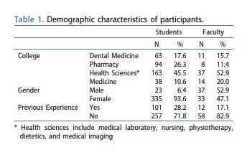
Three hundred and fifty-eight responses out of 370 were received from students, a response rate of 97.8%, comprised of 335 (93.6%) female and 23 (6.4%) male students.
Seventy faculty responses were received, giving a response rate of 86.4%.

Slide 14
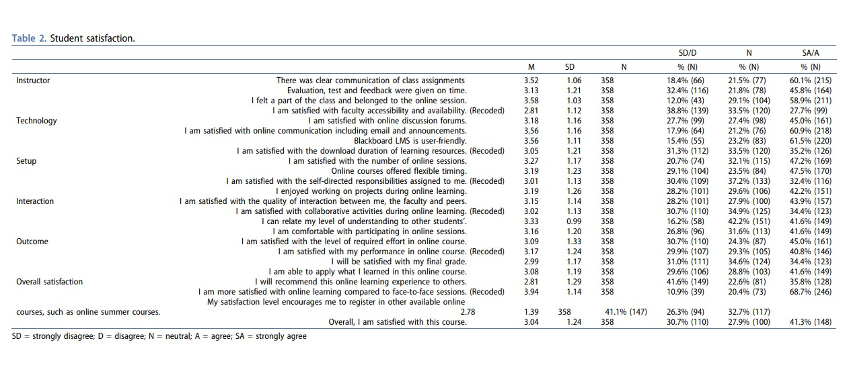

Slide 15
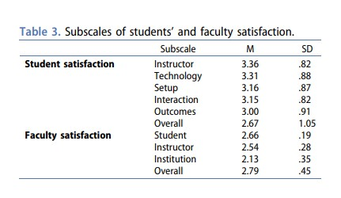
The subscales of student satisfaction revealed a mean score of less than 3.4 out of 5 in all subscales. The instructor subscale yielded the highest mean score (M = 3.36 ± 0.82), followed by the technology subscale (M = 3.31 ± 0.88) .
Evaluating the overall faculty satisfaction with subscales revealed that all subscales had a mean score of less than 2.8 out of 4. The student subscale yielded the highest mean score (M = 2.66 ± 0.19) of all subscales.

Slide 16
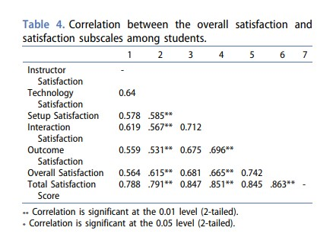
The correlation between the overall satisfaction and subscales among students reveals a significant correlation between the overall satisfaction of students with technology (r = 0.615, p = .000) and interaction (r = .665, p = .000).

Slide 17

An independent t-test was conducted to compare student satisfaction with previous experience in online learning. The results suggest that previous experience in online learning does not affect satisfaction, as there were no statistically significant differences between students who had previous experience (75.5 ± 17.17) compared to students with no experience (77.07 ± 13.48), t(150.88) = .86, p = .394.
Similarly, the results suggest that gender does not affect student satisfaction, as there was no statistically significant difference between male (76.17 ± 18.94) and female students (76.64 ± 14.30), t (356) = .15, p = .88.

Slide 18
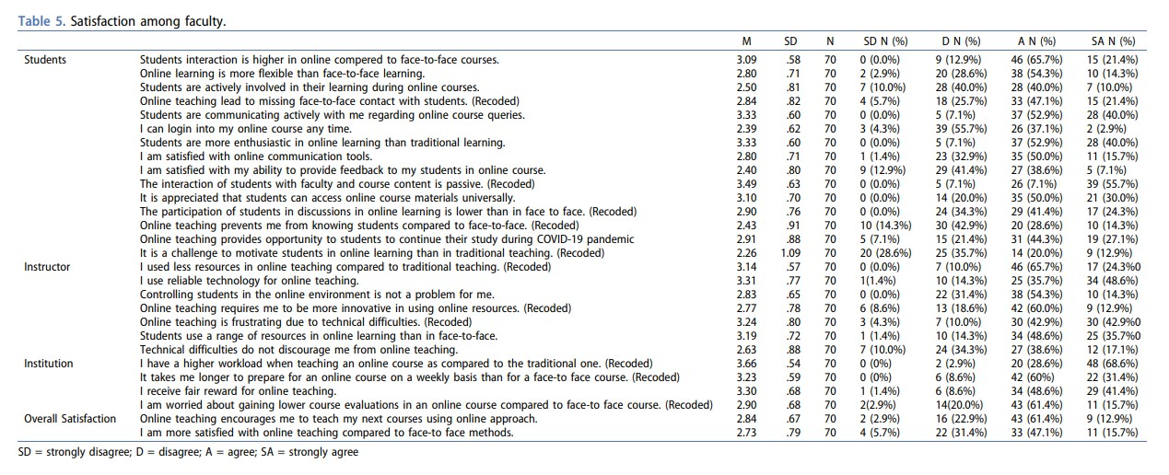

Slide 19

An independent t-test was conducted to compare faculty satisfaction with previous experience with online learning. The results suggest that previous experience did not affect satisfaction, as there was no statistically significant difference between faculty with previous experience (83.5 ± 11.37) and faculty with no experience (82.09 ± 7.71), t(68) = .530, p = .073.
Similarly, the results suggest that gender does not affect faculty satisfaction, as there was no statistically significant difference between males (82.00 ± 9.41) and females (82.70 ± 7.12), t (68) = .35, p = .25.
An independent-samples t-test was conducted to compare satisfaction scores between faculty and students. The results suggest statistically significant differences between students (76.61 ± 14.61) and faculty (82.33 ± 8.36), t(164) = 5.71, p = .000.

Slide 20

Thematic analysis of the open-ended questions
One hundred twenty-six students and fifteen faculty responded to the open-ended questions.
The thematic network illustrates the three key themes and demonstrates the subthemes for both students and faculty (Figure 1). The network has three levels of themes: study-load and workload, enhancing engagement, and technical issues. Finally, the defined themes were named SWEET (Figure 1).

Slide 21
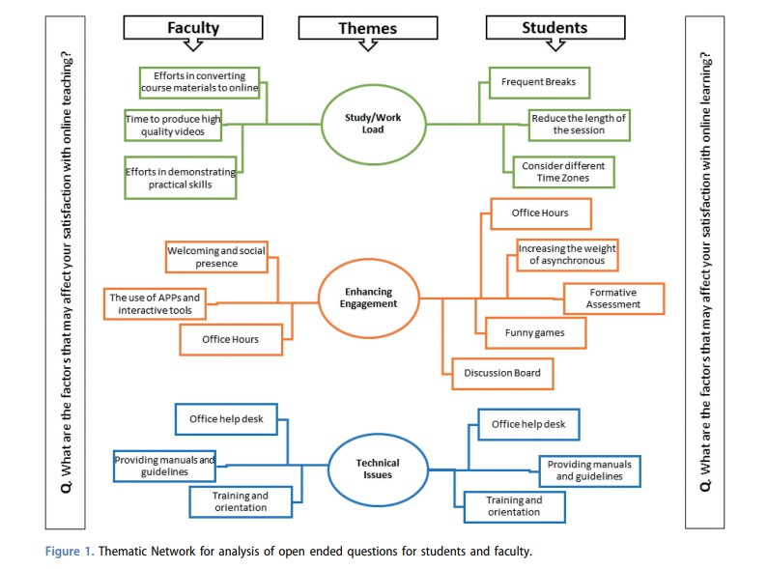

Slide 22

The current study revealed that more than two-thirds of the students were less satisfied with online learning. Our findings might be due to personality, self-efficacy, and expectations related to the design and delivery of online learning and teaching, as reported in a previous study. Another factor for decreased satisfaction could be attributed to the sudden shift to online delivery of the curriculum due to COVID-19, in which there was no adequate time for preparation, accompanied by the stressful working conditions of the pandemic itself.
The current study shows that students’ overall satisfaction correlated with technology satisfaction, and the most reported area of dissatisfaction was related to accessibility and availability of the instructor.

Slide 23

In the current study, one-third of students were also dissatisfied with the amount of time taken to download resources. Many authors have reported that technical difficulties could lead to an ineffective learning experience, even using the best-designed online course.
In the current study, students agreed they were satisfied with the flexibility offered during online learning, and more than three-quarters of faculty thought it was valuable for students to have access to online courses worldwide.

Slide 24

In the current study, students and faculty reported they were satisfied with the communication and communication tools they used during online learning. Tennyson and Hsia (2010) found that student–faculty interaction sustains a supportive learning environment, improves students’ performance, and elevates student satisfaction . Moreover, Cidral et al. (2018) concluded that the instructor’s availability was crucial for the triumph of online learning.
Therefore, students might have adequate experience and better satisfaction in online classes when institutions provide sufficient online resources and technical support to enhance student-instructor interaction.

Slide 25

The current study demonstrates that students and faculty considered feedback during online learning to be useful and timely. Nevertheless, students suggested that adding online office hours would be beneficial to communication with their teachers. Effective feedback and communication from faculty compensate for the lack of face-to-face interaction and engage students in online learning.
More than one-third of the students (41.6%) were satisfied with peer interaction and 45% of students were satisfied with online discussions, compared to 65.7% of faculty who thought that the participation of students in online discussions is lower than in face-to-face classes.

Slide 26

The findings of the current study could be beneficial for planning, designing and delivering online learning activities, and it could increase student and faculty satisfaction with online courses and, consequently, the quality of learning. Correspondingly, it would be advantageous in increasing student engagement.

Slide 27

To increase satisfaction and future improvement
Combination of synchronous and asynchronous online approaches, incorporating different applications with the learning management systems used to engage students in online learning.
Constructive and timely feedback on student performance is essential to enhancing their satisfaction with online learning.
Training of faculty and orientation of students in addition to IT support will improve the satisfaction of both students and faculty.
Finally, Institutional support, including organizational policy, incentives and faculty development, will enhance faculty satisfaction with online teaching.

Slide 28


One of the current study’s strengths is that it reports satisfaction with online learning from two perspectives: student and faculty. This study highlighted common factors affecting student and faculty satisfaction with online learning in the new normal. The study further compared the satisfaction of both students and faculty.
The limitation of this study is the use of a self-assessment questionnaire. Further analysis is required to provide an in-depth exploration of factors affecting satisfaction. The use of a comprehensive qualitative approach, including a focus group discussion and interviews, might be of help.

Slide 29


Online learning has been a useful and practical tool for curriculum delivery during COVID-19. Effective communication and flexibility afforded during online learning have been linked with increasing student satisfaction. Challenges facing students were the long duration of learning sessions and technology.
On the other hand, technical assistance and students’ enthusiasm enhanced faculty satisfaction with online teaching. Higher workload, longer preparation time, and technical problems were challenges reported by faculty.

Slide 30
عنوان ارائه
با تشکر از توجه شما
نام ارائه دهنده: فاطمه صادقی
ایمیل ارائه دهنده:
sadeghif992@gmail.com

