Slide 1


In The Name Of God
Development, Implementation and First Evaluation of an
Online Portal to Promote the Mental Health of University
Students
Reyhane Norouzi Aval
Nourozir9@mums.ac.ir
Dr. Kimiafar

Slide 2

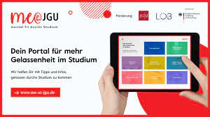
Introduction:
The time spent at university is an important developmental phase and holds many challenges for the students transitioning from adolescence to young adulthood.
A review on qualitative research concerning college student stressors found eight major categories:
relationships( family, peer, faculty)
lack of resources ( time, money, support)
living up to expectations
academic themes ( coursework, exams)
environment (unfamiliar)
diversity (ethnicity, disability)
transitioning to the university setting

Slide 3
Introduction:
A nationwide online survey at German universities with 18,214 participants identified exams, assignments, workload and meeting one’s own expectations as most common stressors among higher education students.
Having a mental disorder can lead to a reduced ability to perform and study, which could result in interruptions, delays and even discontinuation of studies.
College students with mental disorders are twice as likely as other students to drop out without graduating.
a substantial proportion of the students with mental disorders who continue their studies experience a negative impact on academic performance due to their mental problems.

Slide 4
Introduction:
In Germany, according to health insurance company data, about 17–22% of students suffer from a mental disorder .
Matching these results, the number of clients at the Mental Health Services for Students at JGU has been rising continuously over the last years despite decreasing student numbers.

Slide 5
Introduction:
In order to help students to complete their studies successfully, the promotion of their mental health is of particular importance to the universities’ counseling centers.
Using internet-based interventions to treat various mental disorders as well as to promote mental health for different psychological problem areas has been successfully implemented for the general population.
Programs directed at reducing students’ distress and promoting mental health typically include:
psychoeducation and exercises on the topics of activity and mood
motivation
dealing with thoughts and feelings
social relationships
stress management
perfectionism and self-esteem

Slide 6
Introduction:
The aim of this study
develop an open and easily accessible online portal
(me@JGU) to promote student’s mental health by helping them deal with common college students’ stressors.
promote the students’ resources and self-help skills by teaching strategies for dealing with difficult (study-relevant) situations and critical life events.

Slide 7
Methods: Phases Development ,Implementing And Evaluation
Development
Implementing
Evaluation

Slide 8
Methods: Development
named the website “me@JGU mental fit durchs Studium”,
Translates to staying mentally healthy during your studies!
literature research to identify typical stressors among university students and online interventions for mental health in student populations.
addressed the needs of the students
assessed the current mental health of the students
asked about typical stressful events in everyday university life and the students

Slide 9
Methods: Development
focused on the most common student stressors:
academic themes (i.e., exams, assignments, workload, organizing studies)
relationships
transitioning to university
living up to one’s own expectations

Slide 10
Methods: Development
In the next step, the contents and the website were developed. The chapters were then gradually published on the website, evaluated, and revised.
At the end of the development process, the online portal consisted of eight chapters.

Slide 11
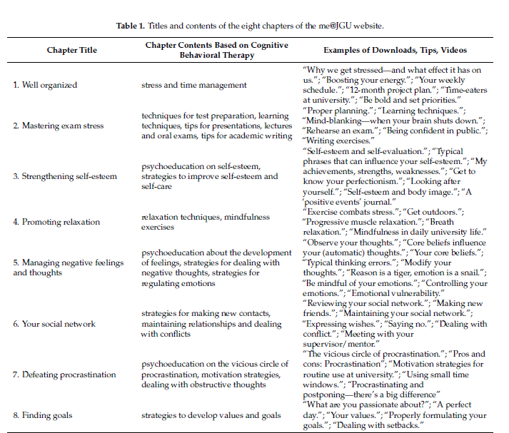

Slide 12
Methods: Development
Considering academic themes being the most often reported stressors for college students, three of chapters aimed directly at reducing stress in this area in order to promote the students’ mental well-being:
the chapter “mastering exam stress” provides psychoeducative information and skills to improve exam preparation and learning strategies.
the chapter “well organized” contains information on implementing time schedules throughout the semester and how to balance studies with other important parts of life.
the chapter “defeating procrastination” provides strategies on how to stay motivated during studies.

Slide 13
Methods: Development
In order to ease the transition to university and to improve the students’ relationships, the chapter “your social network” was compiled.
The chapters “strengthening self-esteem” and “finding goals” were developed in order to help students living up to their own expectations, and included information and strategies to reflect on their strengths and values.
An additional advantage of the chapter “strengthening self-esteem” is that increasing an individual’s self-esteem might also increase their ability to cope with stress.

Slide 14
Methods: Development
The two remaining chapters are meant to strengthen the students’ resilience to stress :
“promoting relaxation” targets with behavioral interventions the management of the physical stress reaction. (e.g., tension)
“managing negative feelings and thoughts” aims to assist individuals in identifying and modifying dysfunctional beliefs that influence response to stimuli and subsequent physiological and psychological distress as well as successfully regulating emotions.

Slide 15
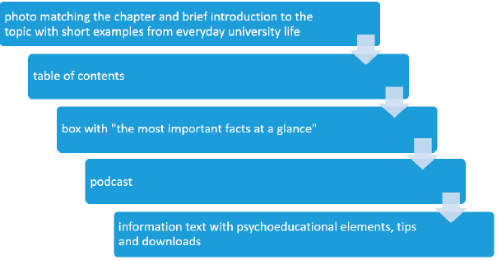
Each chapter is structured in the same way:

Slide 16
Methods: Implementing
On 24 October 2019, the Mental Health Services for Students of JGU participated in the World Mental Health Day with a day of action on campus to raise awareness of mental health issues students face.
Within this action day, also launched and promoted me@JGU.
advertising measures :
information mail to all students (approximately 31,300 enrolled students in winter semester 2019/2020)
an entry on JGU’s Facebook and Instagram channel
various university departments reported on their websites about the launch of me@JGU.
posters and bookmarks with short tips such as “do it today” or “set priorities” made, which were given to students
a short video teaser introducing the website was shot and shown on different occasions
an interview about the online portal was published in a local student newspaper

Slide 17
Methods: Evaluation
Early stage evaluations usually focus on usability, and subsequent testing includes issues such as engagement and efficacy analyses.
Website Usage
The usually collected data is:
number of log-ins
number of completed intervention components
Activity
time spent on the Portal

Slide 18
Short Survey
A short online survey regarding the attractiveness and the comprehensibility of the website was linked at the end of each chapter.
The questionnaire consisted of 13 questions on different topics:
which chapters the participants had read (“chapters read”; one item)
selection of topics (two items; “yes”/“no” answer format)
attractiveness of the website (five items)
comprehensibility of the website (one item)
impulses for action” (three items)
recommendation

Slide 19
One challenge of the online portal
its preventive character
The aim is to motivate students to reflect on their behavior or even change their (inappropriate) behavior although they may not have encountered any difficulties during their studie.

Slide 20
Results
Website Usage
From October 2019 to June 2020, the website was visited 5739 times
2357 of which were very short visits
average length of stay of 8 min and 18 s
The most frequently visited chapter is the chapter “well organized”, which is about time and stress management.
Short Survey
Selection of Topics
Attractiveness of the Website
Comprehensibility of the Website
Impulses for Action
Recommendation to Others

Slide 21
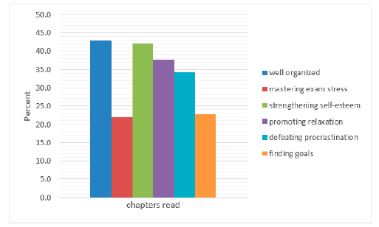
Results Chapters read

Slide 22
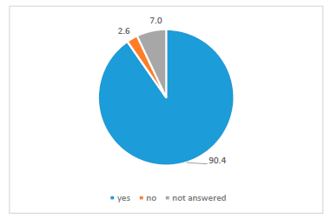
Results Selection of Topics

Slide 23
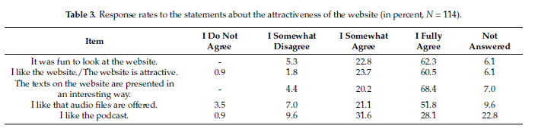
Results Attractiveness

Slide 24
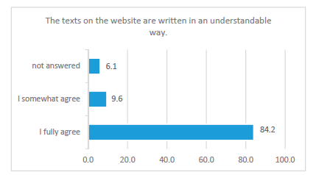
Results Comprehensibility
The answers concerning the comprehensibility of the texts and information are mostly positive and show that the language of the texts is understandable and appropriate for this age group.

Slide 25
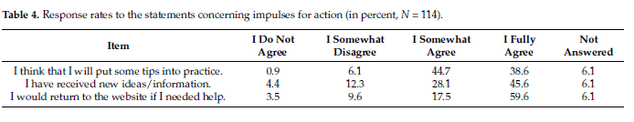
Results Impulses for Action

Slide 26
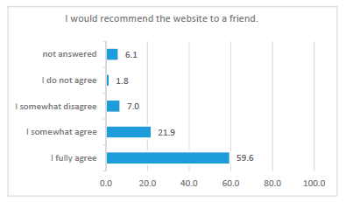
Results Recommendation to Others
In total, 81.6% of the respondents would recommend me@JGU.

Slide 27
Discussion
In this article, presented the development, implementation and an initial usability evaluation on the use of me@JGU, a website with information on dealing with common stressors and mental health promotion for students.
The results of the survey show that the website covers topics that concern and interest the students.
This, indicates that it was helpful to carry out a needs analysis in advance. The answers also show that the layout of the website is visually appealing and the students rate the website as attractive.
The students perceived the website as highly useful and highly user-friendly.

Slide 28
Conclusion Chronic stress in students:
mental health problems
provides impulses to engage with the website’s content
Negative impact on academic participation and outcomes.

Slide 29


