Slide 1


Smartphone apps for cancer: A content analysis of the digital health marketplace
ارائه دهنده : فائزه تقی زاده استاد راهنما: خانم دکتر سرباز
ایمیل ارائه دهنده:taghizadehf951@mums.ac.ir

Slide 2
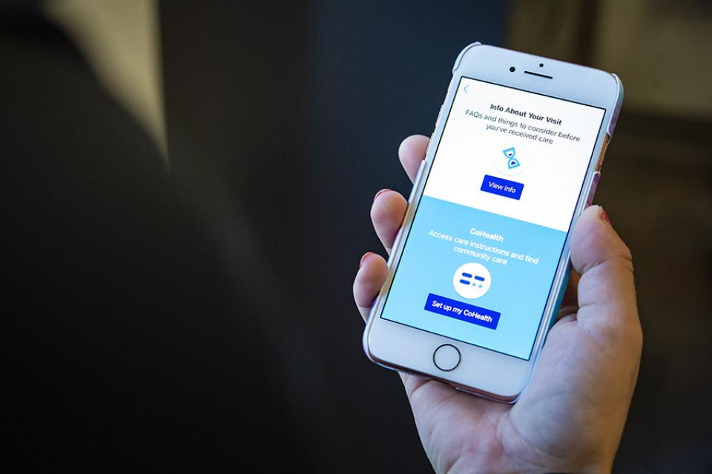

Digital Health
h-index: 8
Impact factor:3.495
Indexed in : Directory of Open Access Journals (DOAJ)
ProQuest
PubMed Central (PMC)
Scopus

Slide 3
Introduction
Health applications (apps) are increasingly being used for patient care in oncology. With the growing popularity of mobile devices, healthcare consumers have instant access to information about cancer prevention, detection, and treatment options on their handheld portable devices.
More specifically, health apps provide health-related services, interactive tools, and support via smartphones or tablet devices to cancer patients, their family members, and caregivers to manage life-altering cancer experiences.

Slide 4
Introduction
For instance, patients can play a more active role in managing their cancer care by using smartphone health apps to log medications, track treatments, monitor side effects, and schedule follow-up appointments.

Slide 5
Introduction
Indeed, health apps have the potential to positively influence self-efficacy, empowerment, and the self-management activities of patients.
In one study, half of the patients reported being willing to send data to their treating clinician via an app.

Slide 6
Introduction
Despite the promising advantages of health apps, consumers might have trouble identifying a trustworthy app and end up relying on faulty information.
Currently there are “no tools for cancer patients available to facilitate targeted searching of high-quality cancer apps.”

Slide 7
Introduction
To help address this gap, this study examined the state of cancer smartphone apps for the general public with a focus on their interactive features, content sources, app developer affiliations, and the level of health provider oversight of app content.
The present study contributes an updated analysis of the digital health marketplace to the existing literature.

Slide 8
Introduction
Previous reviews of cancer-focused apps
Previous reviews have characterized mobile apps for breast cancer, prostate cancer, skin monitoring and melanoma detection,and oncology patients’ medication adherence
.
In particular, studies show that cancer apps are not meeting patients’ needs.
Jupp et al. found that facilitating connections to support groups was not a common function of medication management apps.
In addition, many breast cancer apps did not define key terms for mobile users. .

Slide 9
Introduction
Collado-Borrell et al. also summarized 166 cancer apps for patients concluding that individual self-monitoring tools were limited, such as diaries or ways to track adverse effects and treatments.

Slide 10
Introduction
Other studies highlight that app content sources and developer affiliations are not well documented.
For instance, Bender et al. reported that a majority of cancer apps for the general public did not describe their organizational affiliation.
Bohme et al. concluded that cancer apps geared towards health professionals offered better documentation for information sources including scientific sources for app content.
However, these authors only analyzed apps available on one platform (Apple iTunes) and apps that were free of charge.

Slide 11
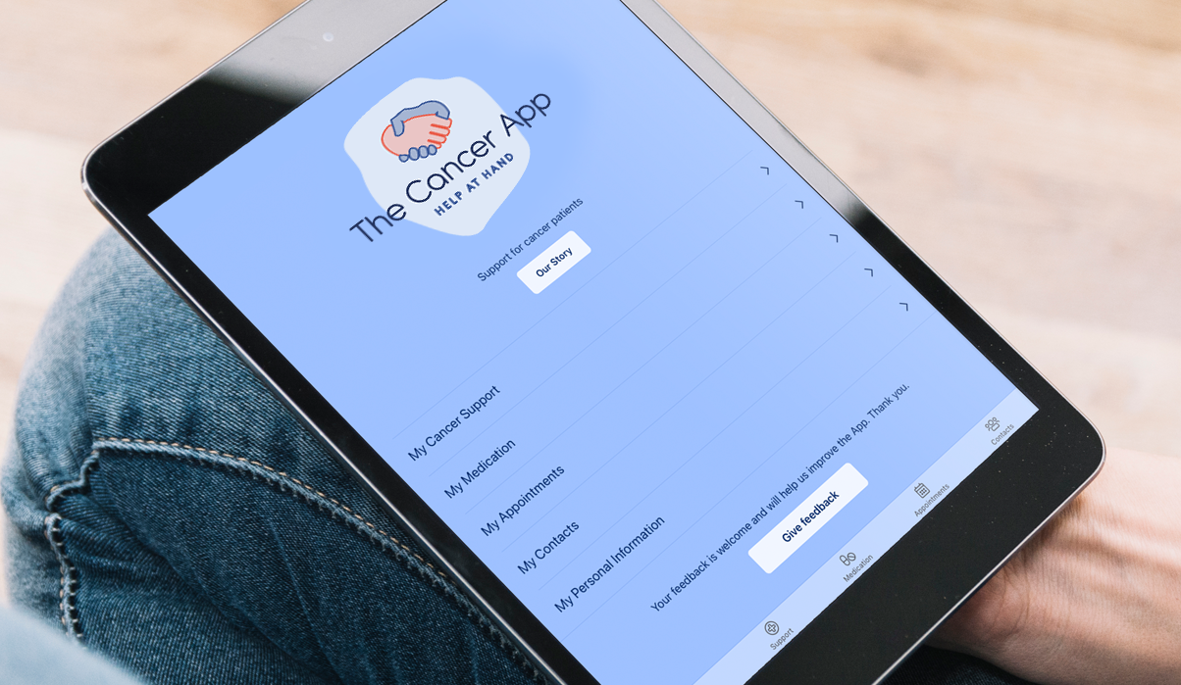
Introduction
Nevertheless, gaps concerning apps for cancer remain in the extant literature.
More research is needed to extend previous studies by analyzing a wider scope of cancer apps and platforms.
For instance, research is needed to examine content sources, interactive features, health provider oversight, free and fee-based smartphone cancer apps, and apps available on multiple platforms.
Therefore, the aim of this study was to assess these dimensions to characterize the state of smartphone apps for cancer on the digital health market.

Slide 12

Mobile app search
:
Method
To identify relevant cancer-focused apps for study inclusion, a search of Apple iTunes (iOS) and Google Play (Android) platforms was conducted.
Keyword searches for the terms “cancer” and “oncology” were used to locate apps from the two major mobile marketplaces.
.
In this study, the term cancer is used broadly for a collection of related diseases in which “abnormal cells divide without control and can invade nearby tissues.”

Slide 13

Selection criteria
:
Method
Relevant smartphone apps available on Google Play and Apple iTunes app stores were considered for inclusion.
Apps that were patient oriented and intended for health consumers were included in the study sample (i.e. general public as intended app users; this includes patients, families, caregivers).
Only smartphone apps available in the English language that been updated over a 3-year period (2015, 2016, and 2017) were included in the study sample. Both free apps (no cost) and apps for a fee were included. Apps intended for health providers and those not updated within the 3-year timeframe were excluded.

Slide 14
Selection criteria
:
Method
Google Play and iOS app store combined keyword searches identified an initial 481 potential apps (Apple iTunes = 294; Google Play = 187).
Out of these, 287 apps were deemed irrelevant and manually removed from the sample (i.e. keyword search for “cancer” retrieved astrological apps).
The remaining 194 apps were further screened. Another 71 apps were removed as duplicate versions with the same app name and developer that appeared across both platforms (Apple iTunes = 46; Google Play = 25).
A total of 123 unique apps met inclusion criteria and comprised the study sample (Apple iTunes = 40; Google Play = 83).

Slide 15

Data collection and analysis
:
Method
Text from app store descriptions was extracted from two leading app marketplaces (Google Play and Apple iTunes app stores) in December 2017.
Information was collected on the following variables from the app descriptions: app name, platform (Apple iTunes or Google Play), developer affiliation, cost, date of last update, and interactive features.
Ethical approval was not required because data were collected online from the two marketplaces in the public domain.
Data were recorded on a Microsoft Excel spreadsheet for analysis and a coding scheme guided content analysis.

Slide 16
Data collection and analysis
:
Method
The coding scheme for the primary function of the apps was adapted from the following seven categories of cancer apps identified by Bender and colleagues:
Educational: general information and tools to raise public recognition of cancer as a societal problem; includes descriptions and statistics.
Fundraising: tools to attract financial resources.
Prevention: information and practical tools to avoid cancer; including the recurrence of cancer.

Slide 17
Data collection and analysis
:
Method
4.Early detection: information and tools to assist in the identification of cancer before the emergence of symptoms or signs (i.e. breast self-examinations, mole/skin check apps).
5.Disease and treatment information: information about disease or treatment options.
6.Disease management: information and practical tools to deal with the medical, behavioral, or emotional aspects of cancer.
7.Support: access to peer or professional assistance, includes information/photo sharing.

Slide 18
Data collection and analysis
:
Method
Two researchers (DC and SH) coded the apps based on the narrative text within the online app store descriptions.
The established seven categories were applied to all 123 apps in the study to represent the primary function of the apps.
Any differences in the groupings of the apps into one of the seven categories were resolved by the two coders until agreement was achieved.
Likewise, the type of cancer and interactive features of the apps were also drawn from the text of app descriptions.

Slide 19
Data collection and analysis
:
Method
Coding for interactive features was based on capabilities reported in previous research, such as the ability to track medication usage, schedule appointments, share updates, and connect with health providers. Interactive features of the cancer-focused apps were then descriptively summarized.

Slide 20
Data collection and analysis
:
Method
App marketplace descriptions were checked for content sources and statements about how information was reviewed.
For example, any statements about health provider involvement or oversight of app content were captured.

Slide 21

Finding
A total of 123 apps were identified and comprised the study sample (Apple iTunes = 40; Google Play = 83). Approximately half of the apps in the study sample focused on cancer in general (50%, 62/123). This was followed by apps for breast cancer (15%, 19/123) and skin cancer (7%, 8/123).

Slide 22
Cost (free vs. fee)
Finding
Most of the cancer apps were free to download (93%, 115/123) whereas eight (7%, 8/123) required payment.
All eight apps for a fee were commercially available. The Apple iTunes store provided 35 apps for free and five apps had a fee (US$2.99–US$6.99).
Likewise, the Google Play store had 80 apps available for free of charge and three had costs ranging from US$3.99 to US$28.99.

Slide 23
Date of last update and
Primary function
Finding
Date of last update
The study examined apps that had been updated over a 3-year period. App content was last updated in 2017 (76%, 93/123), 2016 (19%, 23/123), and 2015 (6%, 7/123).
Primary function
The primary function of the cancer-focused apps could be summarized using seven key categories. Based on the classification scheme, educational apps were the most predominant (50%, 62/123). This was followed by apps for disease management (12%, 15/123), early detection (10%, 12/123), treatment information (9%, 11/123), support (7%, 9/123), fundraising (6%, 7/123), and prevention (6%, 7/123).

Slide 24
Interactive features:
Finding
Interactive features:
Cancer apps supported overall cancer management with the ability to monitor symptoms, side effects, treatments, and chronic pain (20%, 25/123).
A number of cancer apps had self-examinations and skin/mole tracking abilities (10%, 12/123). Apps also supported treatment and aftercare with the ability to track appointments (9%, 11/123).
few apps allowed mobile users to upload and share photos (4%, 5/123). The capabilities to share medical records via mobile devices (3%, 4/123) and to connect with health professionals (4%, 5/123) were further minimally supported.

Slide 25
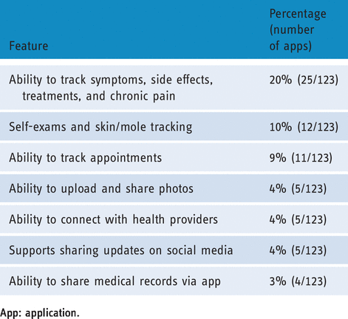
Interactive features:
Finding

Slide 26
Organizational affiliations and content sources
:
Finding
Organizational affiliations and content sources
Regarding organizational affiliations, most cancer apps were developed by commercial entities (90%, 111/123).
Pharmaceutical companies, private, and for-profit organizations were included in this group.
Only 10% of apps (12/123) identified organizational affiliations other than commercial companies.
Out of these, five apps (4%) were associated with medical institutions.
Another 4% of the apps (5/123) noted that content was based on the opinion of one individual. Finally, two apps (2%) were affiliated with medical societies. (i.e. the American Cancer Society and American Society of Clinical Oncology).

Slide 27
Health provider involvement
:
Finding
Health provider involvement
Few app descriptions stated if health providers were involved in screening or appraising app content.
Only 3% of the app descriptions (4/123) stated content had been developed or evaluated by health providers (i.e. working groups or multiple health providers).

Slide 28
Other features
Finding
Other features
Out of the 123 apps, 15% (19/123) claimed to offer advice about “cancer fighting foods” and nutrition. Additionally, 7% (9/123) of the apps furnished preventative tips. Another 3% of the apps (4/123) provided a glossary of terms for mobile users.

Slide 29
Discussion
The aim of this study was to assess the state of cancer-focused smartphone apps on the digital health market.
The investigation focused attention on interactive features, content sources, developer affiliations, and health provider oversight of app content. This study illuminated a number of important findings.

Slide 30
Discussion:
First
the interactive nature of smartphone apps offers the potential for users to upload photos, post updates, exchange information with peers or family members, and monitor treatment side effects.
It was surprising that a limited number of the cancer apps supported tracking appointments, medications, treatments, side effects, and chronic pain.

Slide 31
Discussion:
First
Likewise, the ability to post photos and share status updates on social media platforms was also limited.
Moreover, there is a need for more app features to support joint decision making as very few cancer apps in the study supported sharing medical records and connecting with a health provider.

Slide 32
Discussion
second
very few cancer apps stated that a glossary of terms was available for mobile users.
This feature can help define key terms for health consumers looking for cancer-related information and offers the potential to help individuals build their medical vocabulary, yet very few cancer apps provided this feature.
A glossary of cancer terms can be an instrumental resource for facilitating consistent information and for clarifying the language used in cancer research and oncology practice.

Slide 33
Discussion
Third
, most cancer apps did not identify organizational affiliations and content sources.
The credentials and qualifications of authors or organizations providing content are needed to help health consumers assess the reliability and authority of information.
Health information should also have proper attribution and be supported by clear references to scientific evidence.
To illustrate this point, it was observed that 15% of the cancer apps claimed to provide information about “cancer fighting foods” and nutrition, yet none of these apps provided scientific evidence to support the efficacy of these claims.
More transparency about content sources, organizational affiliations, and any financial support is needed to help users assess the quality of app content.
This raises a safety concern given that the apps. also advertise information for cancer prevention, screening, and treatment

Slide 34
Discussion
finally
Finally, there was a significant lack of critically appraised app content.
Given that very few app descriptions stated the level of health provider involvement in screening or evaluating app content, this gap could potentially present a challenge for health consumers to identify quality information from cancer apps.
One approach to ensure quality app content for healthcare consumers is to establish a peer-review process for content such as instituting an advisory board or scientific panel to evaluate app content. .
Overall, a greater focus on how apps are being used to promote cancer self-management, more indication about the reliability of information, and documentation about how app content is reviewed by health providers is needed.

Slide 35
Recommendations
there are a number of additional recommendations that could help enhance cancer smartphone apps:
Inadequate or insufficient online app store descriptions continue to plague the health app marketplace.
Some researchers have suggested that categorizing apps under the legislation for medical products may be one way to regulate and control app quality.
Without any regulations in place at the present time for health apps that provide education or monitor health, one important step would be to improve app store descriptions by providing better documentation about how app content is compiled and evaluated.

Slide 36
Recommendations
Mobile app marketplace descriptions could incorporate this guidance to more clearly state if health app content is based on research evidence and if content has been reviewed by health providers along with their credentials.
As noted above, one approach likely to result in more reliable and higher quality app content is to have a scientific board evaluate the content.

Slide 37
Recommendations
Further, cancer-related knowledge contributes to how individuals understand, appraise, and apply health information to make decisions regarding their healthcare.
Mobile apps that include a glossary of clearly defined cancer terms have the potential to help healthcare consumers build knowledge of new concepts and terminologies often used within the oncology community.
A final recommendation for app improvement includes more fully utilizing social networking and self-monitoring capabilities.

Slide 38
Recommendations
Smartphone apps that leverage social media to provide real-time social support and facilitate the sharing of health-related data with health providers or peers have been reported as key benefits of health apps by mobile users in previous studies.
Users have also reported that apps providing convenient tools to set goals found these self-tracking features interesting and insightful to monitor their progress

Slide 39
Limitations and future directions
This study had a few limitations. First, keyword searches for “cancer” and “oncology” were used to identify relevant apps for study inclusion. It is possible that other apps may be useful to individuals with cancer but were not located easily by using these search terms.
Analysis was also based on app marketplace descriptions and the study was restricted to the app descriptions provided in the two stores. In addition, the cancer apps were not downloaded and tested

Slide 40
Limitations and future directions
Future research could examine the usability of the apps and accuracy of medical content.
Focus groups could provide insight into navigation and other usability features of the cancer apps. Likewise, a panel of health experts could assess the quality of medical content for apps based on the best available clinical evidence.

Slide 41

The aim of this review was to characterize the state of cancer-focused smartphone apps for healthcare consumers.
Among the 123 apps for cancer, education was the largest category for the primary function of the targeted apps followed by disease management.
Interactive features of cancer apps included the ability to track appointments, share medical records, or connect with a health provider.
However, these interactive features were not fully utilized and there is room for more improvement in this regard to support self-monitoring functions.
Conclusions
Content sources were not consistently identified and very few cancer apps on the marketplace indicated health provider oversight of app content.
These findings have implications for information quality and supportive resources for cancer care.
To improve resources for smartphone users, more comprehensive information about both organizational affiliations and the level of health provider involvement or oversight would be enhancements to the digital health marketplace.

Slide 42
Thank you

