Slide 1


Optimized hybrid machine learning approach for smartphone based diabetic retinopathy detection
باسمه تعالی
امیر احمدی
دکتر خلیل کیمیافر
amir4002@mums.ac.ir

Slide 2
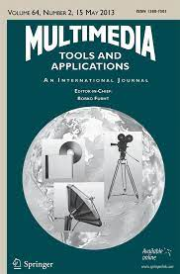
معرفی مجله
Multimedia Tools and Applications
Impact Facto : 2.757
H-Index: 70
Indexed in: ISI, Scopus
3 January 2022

Slide 3
فهرست
Introduction
Methodology
Results & discussions
Conclusion
My view

Slide 4
Introduction
Nearly 10% of adult peoples are suffering from diabetics
After cancer and heart disorder, diabetics is the third most deadly disease
Diabetic Retinopathy (DR) is defined as the Diabetes Mellitus difficulty that harms the blood vessels in the retina
It is also known as a silent disease and cause mild vision issues or no symptoms
It uses fundus cameras for capturing retinal images, but due to its size and cost, it is a troublesome for extensive screening
Automated system for detecting the DR will help the ophthalmologist to diagnose the patient easily in time rather than manual screening which takes enormous amount of time for screening and detection of DR

Slide 5
Objectives
Design the new DIY smartphone enabled camera using available materials for smartphone based DR detection
Design new optimized hybrid machine learning architecture for smartphone based DR classification

Slide 6
Proposed methodology

Slide 7
Proposed methodology
DIY smartphone enabled camera based retinal imaging systems
Preprocessing Data
Segmentation
Feature extraction
Feature selection using life choice-based optimizer
Hybrid NN-DCNN with SSD based DR classification

Slide 8
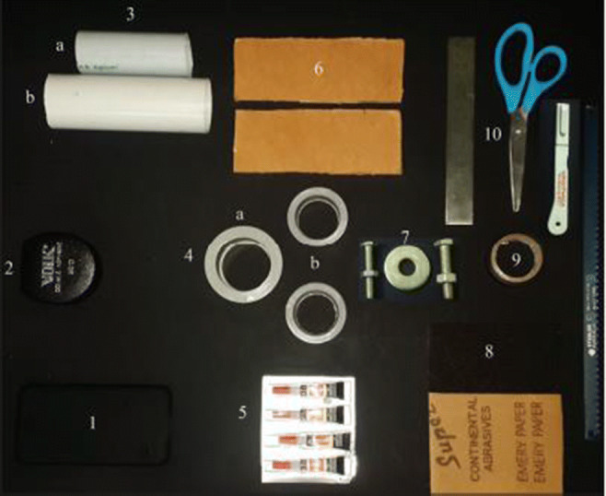
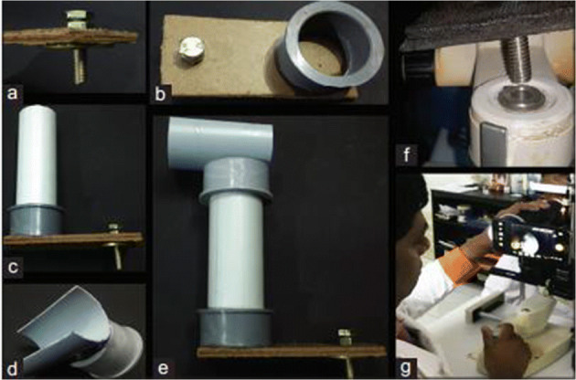
DIY smartphone enabled camera based retinal imaging systems
Assembling the DIY smartphone enabled camera
Assembling the slit lamp mount
Using the DIY smartphone enabled camera

Slide 9
DIY smartphone enabled camera based retinal imaging systems
However, there is no accessible real data captured by the DIY smartphone enabled camera device in the literature. Therefore, we generate retina images by simulating the field of view for a device using the retina images from APTOS-2019-Blindness-Detection, and EyePacs datasets.

Slide 10
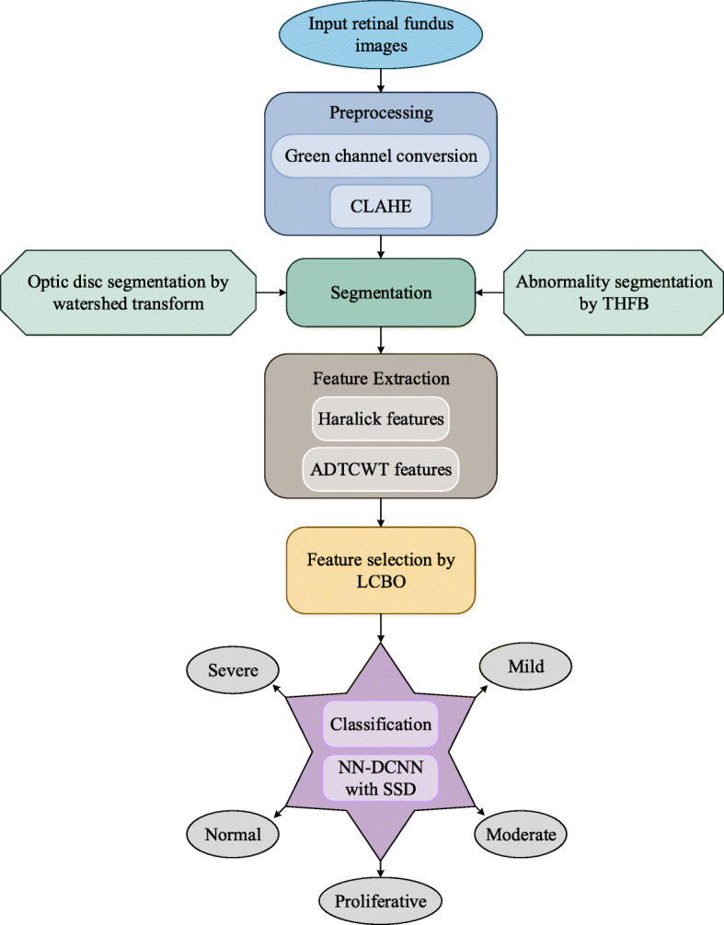
ارائه دهنده: امیر احمدی

Slide 11
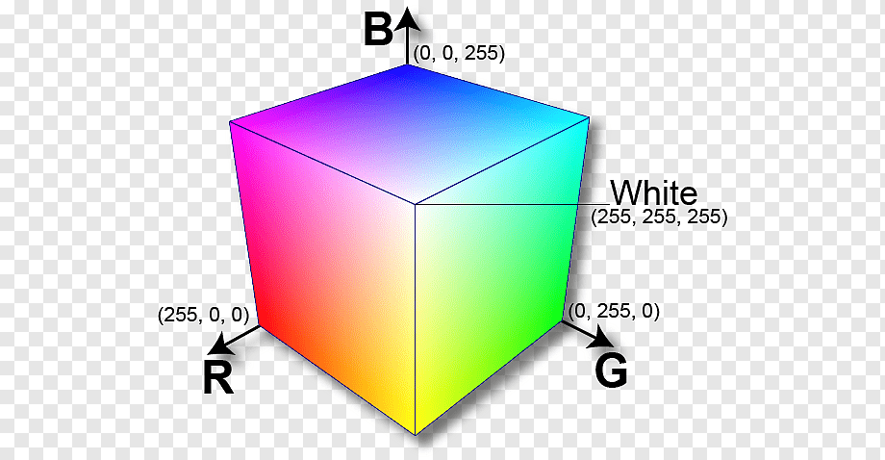
Preprocessing
Green Channel conversion
CLAHE
ارائه دهنده: امیر احمدی

Slide 12
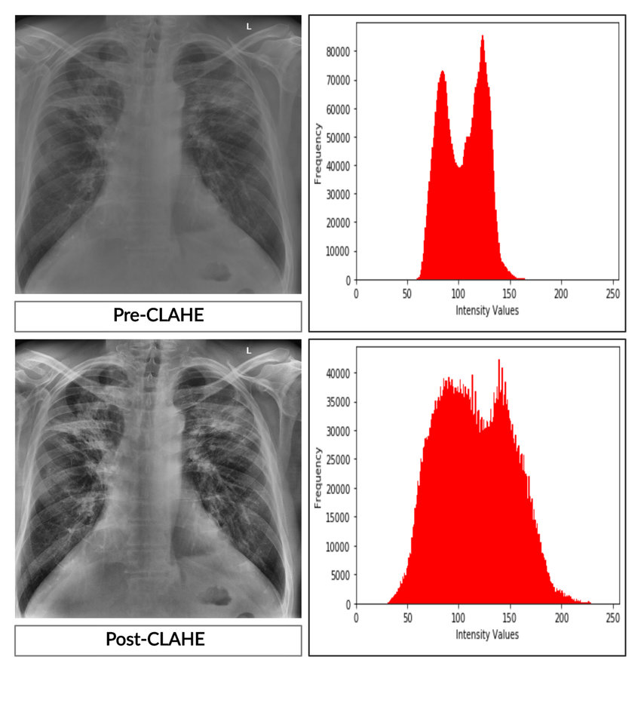
ارائه دهنده: امیر احمدی

Slide 13
Segmentation
Different elements like blood vessels, optic disc, fovea and macula are included in the retinal image
Optic disc segmentation using watershed transform
Abnormality segmentation using THFB
ارائه دهنده: امیر احمدی

Slide 14
Optic disc segmentation using watershed transform
Morphological gradient
Marker-controlled watershed segmentation
Erosion-based gray-scale image reconstruction
Dilation-based gray scale reconstruction
ارائه دهنده: امیر احمدی

Slide 15
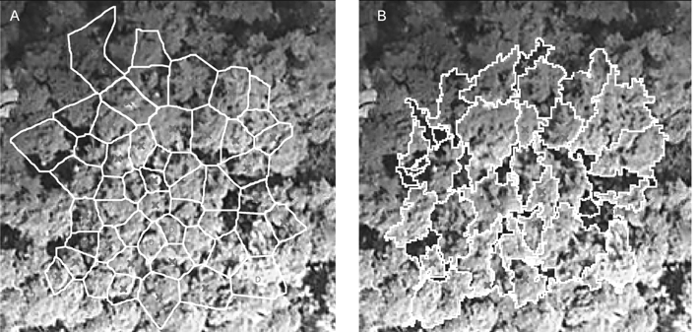
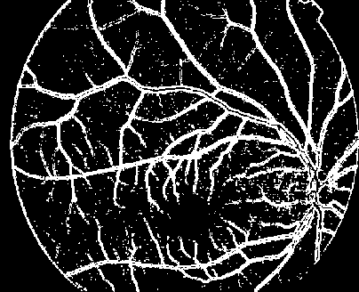
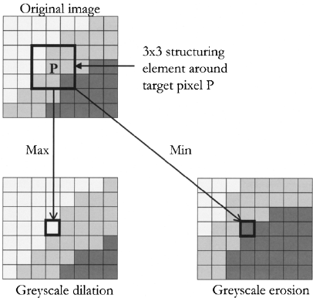
ارائه دهنده: امیر احمدی

Slide 16
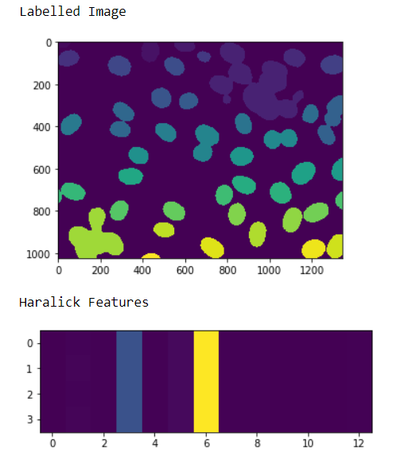
Feature extraction
Haralick features
ADTCWT features
ارائه دهنده: امیر احمدی

Slide 17
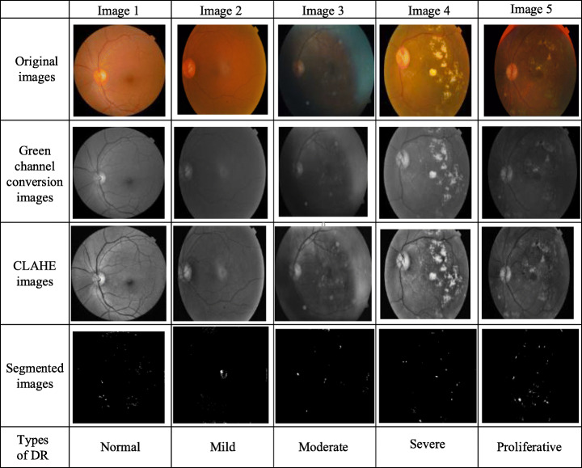
ارائه دهنده: امیر احمدی

Slide 18
Feature selection using life choice-based optimizer
Learning from the common best group
Knowing very next best
Reviewing mistakes
ارائه دهنده: امیر احمدی

Slide 19
Hybrid NN-DCNN with SSD based DR classification
Deep Convolutional Neural Network
Neural Network
Social Ski-Driver
ارائه دهنده: امیر احمدی

Slide 20
Results & discussions
ارائه دهنده: امیر احمدی

Slide 21
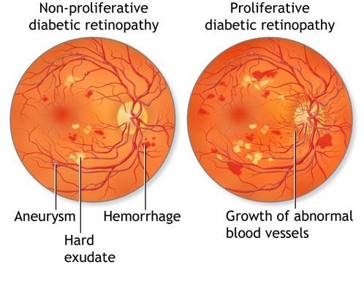
Dataset description
EyePacs and APTOS-2019-Blindness-Detection
70% images are employed for training process and 30% images for testing process
35,126 retina images EyePacs dataset
3648 high resolution fundus images APTOS-2019-Blindness-Detection
Five stages of DR or the severity
no DR indicated by 0
mild DR represented by 1
moderate DR is represented as label 2
severe DR is denoted by label 3
proliferate DR is represented as label 4
ارائه دهنده: امیر احمدی

Slide 22
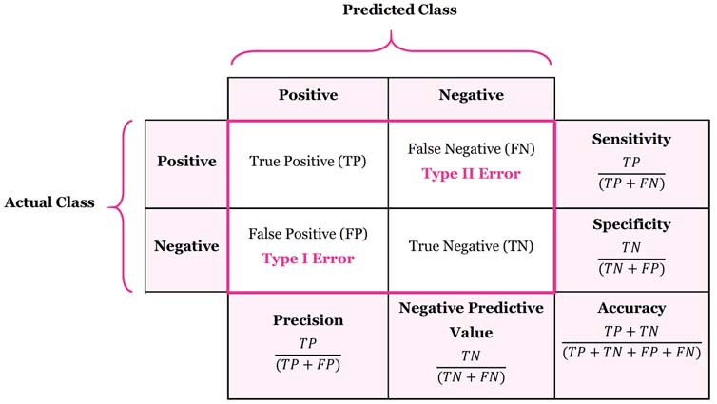

Performance metrics
ارائه دهنده: امیر احمدی

Slide 23
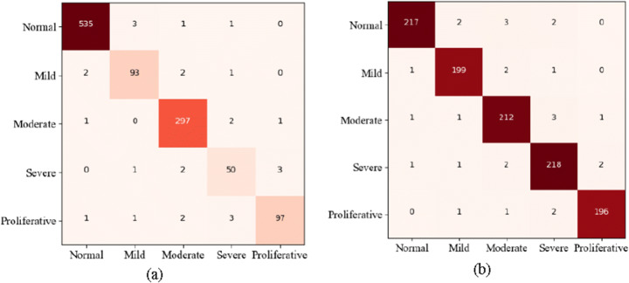
Performance analysis
ارائه دهنده: امیر احمدی

Slide 24
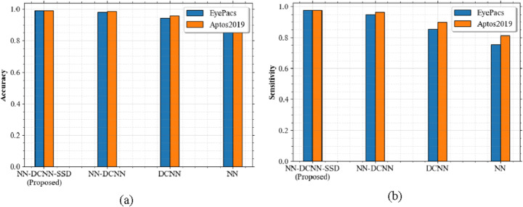
Performance analysis
ارائه دهنده: امیر احمدی

Slide 25
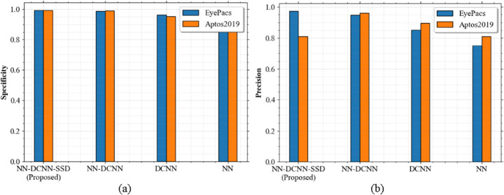
Performance analysis
ارائه دهنده: امیر احمدی

Slide 26
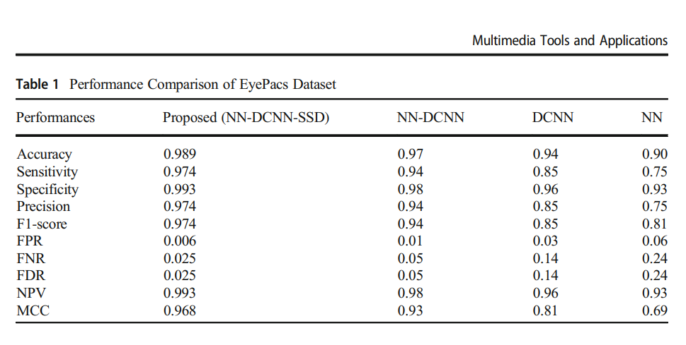
Performance analysis
ارائه دهنده: امیر احمدی

Slide 27
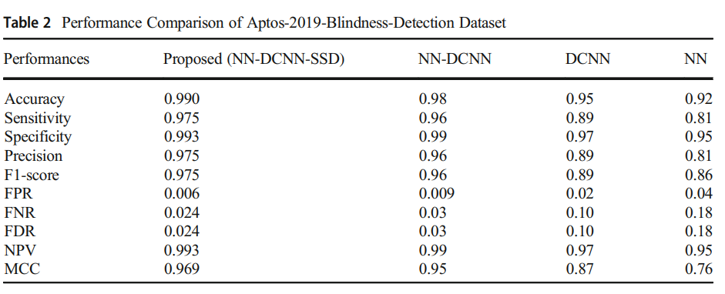
اسلاید شماره 27
ارائه دهنده: امیر احمدی

Slide 28
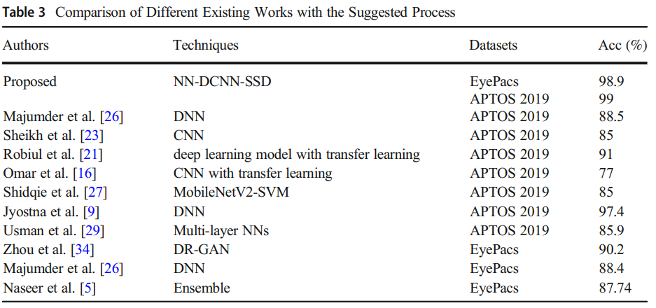
ارائه دهنده: امیر احمدی

Slide 29
Conclusion
ارائه دهنده: امیر احمدی

Slide 30
Conclusion
The simulation outcomes proved that the proposed system offers better performances for each dataset as related to other existing approaches
ارائه دهنده: امیر احمدی

Slide 31
My view
ارائه دهنده: امیر احمدی

Slide 32
عنوان ارائه
با تشکر از توجه شما
امیر احمدی
ahmadia4002@mums.ac.ir

