Slide 1


Health records as the basis of clinical coding: Is the quality adequate? A qualitative study of medical coders' perceptions
In the name of God
Mahdi Hasanvand
Hasanvandm4002@mums.ac.ir

Slide 2
Introduction
Clinical coding is the process of transforming the information about diseases or procedures recorded in the health records into numeric or alphanumeric codes, that is, it categorises health records information.
In Portugal, both types of health records (electronic and paper based) coexist and the International Classification of Diseases – Ninth Revision – Clinical Modification (ICD-9-CM) was used until the end of 2016 when the International Classification of Diseases – Tenth Revision – Clinical Modification/Procedure Classification System (ICD-10-CM/PCS) was introduced.
Unlike some other countries, the Portuguese medical coders are medical doctors.

Slide 3
Introduction
Health records are the basis of clinical coding. Hence, the quality of documented information affects the quality of coded data. If the documentation of healthcare is poor, the assigned clinical codes will not be the most appropriate.

Slide 4
Introduction
The aim of this exploratory study was to investigate the perceptions of medical coders regarding possible problems with health records that may affect the quality of the coded data.

Slide 5
Methods & Research design
Data analysis and reporting were conducted in accordance with the Consolidated Criteria for Reporting Qualitative Research (COREQ) guidelines.
We conducted four focus group sessions, in October and November 2017, to ascertain medical coders’ perceptions of coding problems, including problems with health records, which may impact coding quality.

Slide 6
Sample
Convenience samples of medical coders were involved in this study. Contact details were obtained through participation in meetings and through researchers’ contact lists, which allowed the collection of 54 medical coders’ email addresses from four public hospitals. These four hospitals represent an accessible sample of the 105 existing hospitals, including public and those in public–private partnerships.
The only inclusion criterion for study participation was to have had experience in clinical coding.

Slide 7
Data collection
The interview guide was developed based on problems already identified in the scientific literature and on the researchers’ expertise (questions concerning health records in Box 1).

Slide 8
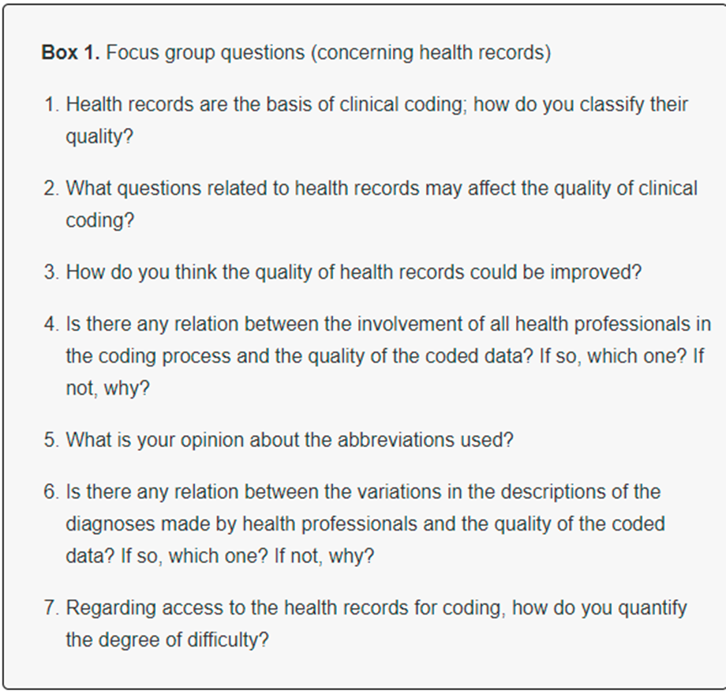

Slide 9
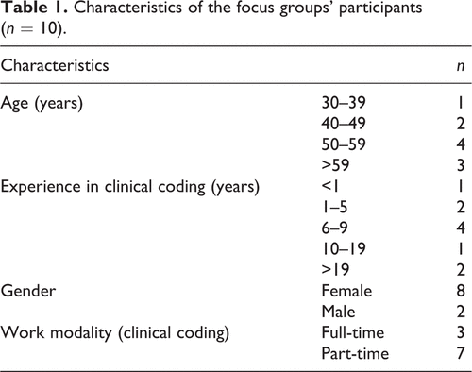
Results

Slide 10
Results
Four themes emerged from factors raised by medical coders as influencing health records’ quality and, consequently, the quality of coded data:
Incomplete/unclear documentation in health records
Variability in health records
PHRs compared to EHRs
Possible solutions to problems with health records

Slide 11
Incomplete/unclear documentation in health records
Participants stated that the absence of any element of the record and the lack of organisation were the main obstacles to good coding.
The following subthemes, these important documents were not consistently present in all records:
Incomplete/missing discharge note
Incomplete/missing surgical report
Use of abbreviations and acronyms

Slide 12
Possible solutions to problems with health records
Health records standards
Health records audits

Slide 13
Discussion
It is widely believed that health records and their quality have great importance, not only for the medical coding activity but also for further uses of the databases generated by the coded data (e.g. research). However, in order to achieve these purposes fully, complete health records with high data quality is essential. In this focus group study, we identified several problems recognised by Portuguese medical coders.

Slide 14
Discussion
Incomplete/unclear documentation in health records:
It is known that the quality of the coded data is compromised when health records do not have sufficient quality (DeAlmeida et al., 2014; Kurusz, 2015; Santos et al., 2008; Southern et al., 2016), which was corroborated by the medical coders participating in this study. In addition to the problem of health record quality, participants mentioned that sometimes there was a lack of information in certain elements of the record, such as the discharge note.

Slide 15
Discussion
In a similar study, one medical coder estimated that discharge notes were missing in 80% of charts (Tang et al., 2017). Similarly, the information required in the surgery report was already established (ACSS, 2011), but lack of information in the surgery report continued to be a problem.

Slide 16
Discussion
The use of abbreviations and acronyms was another problem highlighted by medical coders, which was also reported in a Canadian study involving medical coders (Lucyk et al., 2017).
It has been observed that abbreviations should be avoided to improve coding accuracy (Naran et al., 2014).
medical coders are not always familiar with the large number of abbreviations used (Farzandipour et al., 2010).

Slide 17
Discussion
Variability in health records
In the view of the participants the quality of the health records varied among institutions and specialties, which may have been influenced by different perceptions of the importance of health records.

Slide 18
Discussion
In our study, lack of specificity was considered a consequence of the lack of assertiveness of some physicians who, instead of interpreting exam reports and making a diagnosis, only transcribed exam reports.
In another study performed with medical coders, the lack of specificity in physician documentation was considered a major barrier to coding (Tang et al., 2017).
This lack of specificity may result in greater difficulty in identifying the main diagnosis, because it is not documented by the physician (O’Malley et al., 2005; Tang et al., 2017).

Slide 19
Discussion
PHRs compared to EHRs
The use of EHRs, allowing more structured data and eliminating the illegibility problem present in PHRs, has improved the quality of healthcare, the coding activity and the population health itself (Klein et al., 2012; Morrison et al., 2014; Robertson et al., 2015; Tang et al., 2017; Van Der Bij et al., 2017; Williams et al., 2017).
On the other hand, one of the disadvantages attributed to the EHR is that it allows “copy & paste” of previous records, duplicating information (Al Hadidi et al., 2017; Hartzband and Groopman, 2008; Heiman et al., 2014; Hirschtick, 2006; March et al., 2016; Shoolin et al., 2013).

Slide 20
Discussion
Possible solutions to problems with health records
Although the identified problems were similar to those already known in other countries (Bajaj et al., 2007; DeAlmeida et al., 2014; Haghighi et al., 2014; Lucyk et al., 2017; O’Malley et al., 2005; Tang et al., 2017), there is still a lack of investment in the necessary policies in Portugal.
The existence of official guidelines (with adequate monitoring/audits) to standardise the structure and content of health records is of major importance, complemented with the easy access and wide acceptance from medical doctors, with the ultimate aim of improving health record quality.

Slide 21
Discussion
Another solution for some of these problems could be the use of Systematized Nomenclature of Medicine – Clinical Terms (SNOMED-CT) in EHRs, a terminology that allows recording information in a standardised way, facilitating the clinical coding (SNOMED International, 2018; Spencer, 2016).

Slide 22
Discussion
Audits of health records
Participants described that, in the past, internal reviews of health records were performed for educational purposes and contributed to the improvement of health records.
In other countries, such as USA and Australia, clinical documentation improvement programmes were implemented to facilitate the accurate representation of a patient’s clinical status, and this also allows that the recorded information fits the medical coders’ needs (AHIMA, 2018; Breuer and Arquilla, 2011; Shepheard, 2018; Towers, 2013).
Similarly, in Spain, a career of specialist in admission and clinical documentation was created in 2001 (Martín-Vegue, 2000).

Slide 23
Discussion
The education and training for physicians on how to document in the health records could be another important point to solve these problems. In fact, documentation tends to be more complete after the training of health professionals (Rowlands et al., 2016; Spellberg et al., 2013; Van Der Bij et al., 2017).
The accreditation of hospitals is another factor that might improve health records as well as the quality of healthcare (Alkhenizan and Shaw, 2011; Schmaltz et al., 2011).

Slide 24
Limitations
The sample of medical coders was constructed out of convenience, consisting of medical coders who participated voluntarily in the study and who worked in only four hospitals in the north of the country.
Participants could not be selected randomly due to the low number of medical coders who showed willingness to participate, which may have produced a bias.
Another limitation is the possibility of some competitiveness between medical coders belonging to different hospitals, compromising the exposure of the whole reality of each institution.

Slide 25
عنوان ارائه
Thanks for Your Attention
Mahdi Hasanvand
Hasanvandm4002@mums.ac.ir

