Slide 1


Digital stress management in cancer: Testing Stress Proffen in a 12- month randomized controlled trial
باسمه تعالی
مرضیه راعی
خانم دکتر معصومه سرباز
Raeem4002@mums.ac.ir

Slide 2

معرفی مجله
Cancer
Impact Factor : 6.860
H-Index: 304
Indexed in: ISI, Scopus, PubMed, Embase
2 Dec 2021

Slide 3
Introduction
Materials and Methods
Results
Discussions
Conclusion
Limitations
Future Research

Slide 4
Introduction
Cancer diagnosis and treatment are associated with physical and psychosocial challenges, including discomfort, fatigue, pain, stress, distress, worry, anxiety, and depression. Quality of life (QOL) and the capacity to control or alter ( Ie , self- regulate) thoughts, feelings, and behavior are often also affected, and coping during and after cancer can be challenging.
Psychosocial interventions aiming to support stress management and coping have for decades been shown to promote well- being, including improved QOL and reduced stress, distress, anxiety, and depression for cancer survivors.
There are also some indications that the positive impact of such interventions may last for more than 10 years.

Slide 5
Introduction
Access barriers to in- person psychological interventions exist, however; they include availability, the geographical distance from the intervention site, costs/limited insurance coverage, and cancer survivors not feeling well enough or comfortable enough to participate in in- person sessions.
In light of continued findings that cancer survivors have many unmet needs, including needs for psychosocial support and care, health care delivery methods with higher accessibility and outreach are needed.

Slide 6
Digital Psychosocial Interventions for Stress Management in Cancer
Digital solutions in the form of electronic health (eHealth) interventions have the potential to enhance the delivery of health care and psychosocial support to cancer survivors.
In response to identified challenges with eHealth interventions in cancer, the current research team designed and developed Stress Proffen, an application (app)- based stress management intervention program in support of cancer survivors.
Stress Proffen combines elements from well- known cognitive- behavioral stress management strategies and was designed and developed according to user- centered design methods with close collaborations between researchers, cancer survivors, health care providers (eg, psychosocial oncologists), and eHealth experts.

Slide 7
a feasibility pilot study
Stress Proffen
significant pre- post between- group
differences, with cancer survivors who received Stress Proffen.
3month
decreased stress and improved HRQOL in comparison with usual- care controls.
also a decrease in anxiety and depression in intervention group,
although this was not statistically significant..
Effect sizes in the 3- month evaluation were generally small.
also large data variability,
  which may have contributed to this.

Slide 8
MATERIALS AND METHODS
The current study examined longer term results from the RCT and evaluated the efficacy of the Stress Proffen intervention program over a 12- month period. It was hypothesized that participants receiving the Stress Proffen intervention, compared with participants in a usual- care control group, would 6 and 12 months after the intervention.
Patients diagnosed with any type or stage of cancer were recruited at a major medical center in Northern Europe or through social media from June 2017 to July 2019.
Participants were encouraged to complete all 10 modules and to practice the content to become well acquainted with the material.
The follow- up phone calls were conducted by study personnel, structured, and included questions related to program impression and ease of use. follow up phone calls 2 to 3 and 6 to 7 weeks after the introduction session.

Slide 9
eligibility criteria
currently or recently receiving cancer treatment (Ie, ≤1 year after the completion of hospital treatment)
being 18 years old or older
being able to speak, read, and understand Norwegian
having access to a smartphone or tablet
being able and willing to attend 1 in- person introduction session

Slide 10
MATERIALS AND METHODS
Participants provided written informed consent and completed baseline study questionnaires/outcome measures before randomization. Computerized randomization allocated study arms on a 1:1 basis (block size, 10) with stratification by gender and diagnosis.

Slide 11
Stress Proffen
contains 10 modules with cognitive- behavioral and stress management educational material and exercises:
1) What is Stress?
2) Stress, QOL, and Planning
3) Thoughts, Feelings, and Self- Care
4) Mindfulness, Thought Challenging, and Guided Imagery
5) Stress and Coping
6) Social Support, Humor, and Meditation
7) Anger Management and Conflict Style Awareness
8) Assertiveness and Communication
9) Health Behaviors and Setting Goals
10) Review and Summary

Slide 12
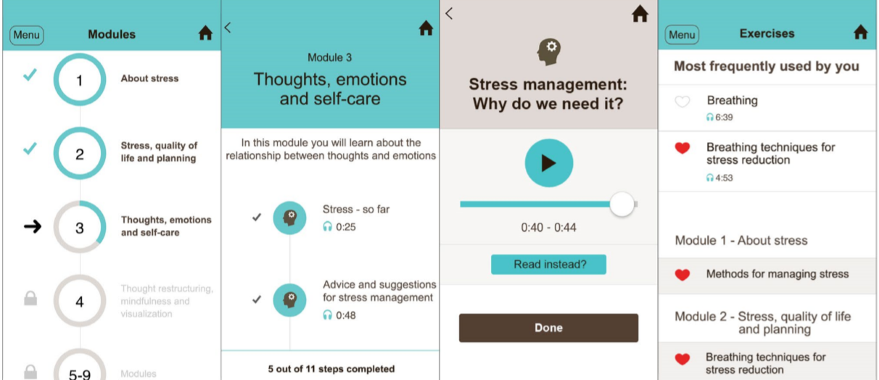
Stress Proffen

Slide 13
Psychosocial Outcome Measures
Primary outcome
Perceived stress was measured by the Scale, a 14- item scale measuring feelings and thoughts over the last month.
Items are rated on a 5- point Likert scale ranging from “never” (0) to “very often” .
Secondary outcomes
Anxiety and depression were measured with the Scale, a 14- item measure of anxiety and depression, with 7 items subscale.
Items are rated on a 4- point scale, Score ranges are <8 (nonclinical), 8 to 11 (indicating the presence of anxiety/ depression), and >11 (anxiety/depression).

Slide 14
Psychosocial Outcome Measures
Program Use
Data related to program use (ie, app progress/activity) were extracted from user logs automatically collected and stored on a secure research server.
Statistical Analyses
Participants completing at least 70% of the modules (7 of 10) were defined as program completers.
P values < .05 were considered statistically significant.
Statistical analyses were completed with the Statistical Package for the Social Sciences (release 27; SPSS, Inc, Chicago, Illinois) and Stata (version 16).

Slide 15
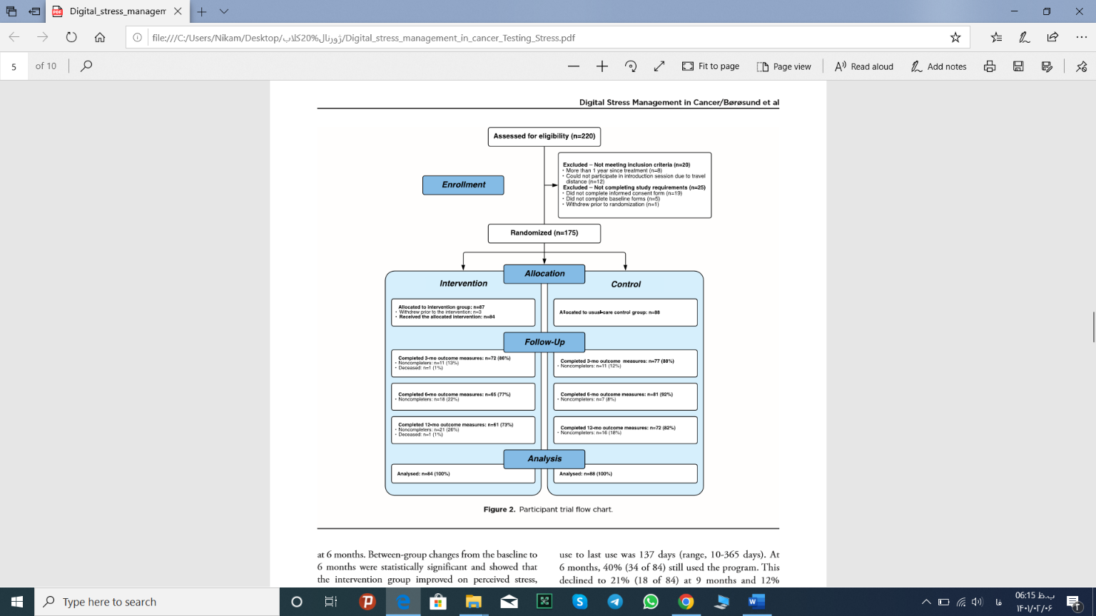
RESULTS
25نفر عدم تکمیل الزامات مطالعه:
رضایت آگاهانه(19)
فرم های پایه(5)
خروج قبل از تصادفی سازی(1)
20نفر واجد شرایط نبودند:
بیش از یکسال از درمان گذشته بود(8)
ناتوانی در جلسه معارفه به دلیل فاصله(12)
N=87
خروج قبل از مداخله=3
N=84
N=88
عدم تکمیل=11
فوت=1
N=72
عدم تکمیل=11
N=77
عدم تکمیل=18
N=65
عدم تکمیل=7
N=81
عدم تکمیل=21
فوت=1
N=61
عدم تکمیل=16
N=72

Slide 16
RESULTS
Among the 175 randomized participants, 3 intervention group assignees were unable to attend the in- person introduction session because of disease progression.
The size of the final study sample was, therefore, 172.
Most participants were recruited by medical center clinic staff (102 of 172; 59%); the remainder were recruited through social media.
The mean age at inclusion was 52 years (standard deviation, 11.3 years; range, 20- 78 years).
The most common cancer type reported was breast cancer (48%).
Most participants were female (82%), were married or cohabitating (70%),
reported having a university/college education (81%),
and were currently receiving sick leave/ disability benefits (70%).

Slide 17
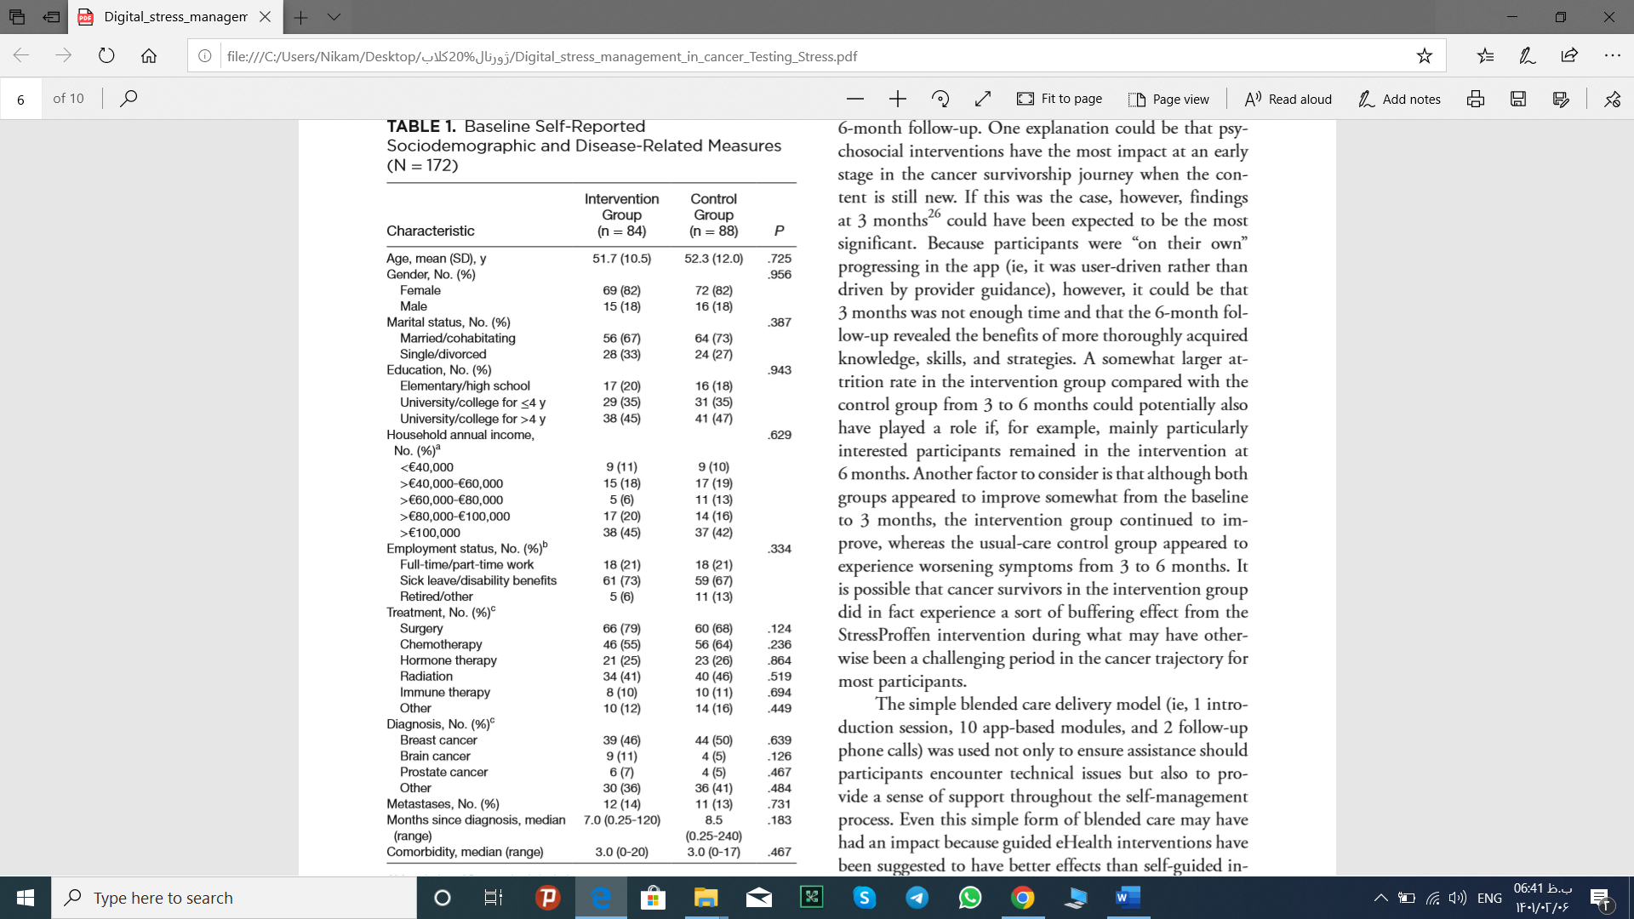
RESULTS

Slide 18
RESULTS
Between- group changes from the baseline to 6 months were statistically significant and showed that the intervention group improved on perceived stress, anxiety, depression, self- regulatory fatigue, HRQOL domains in comparison with the usual- care control group.
Of the 84 participants in the intervention group, 57 (68%) completed at least 7 of the 10 modules within the 12- month study period.
Thirty- nine (46%) completed all 10 modules. There were no significant differences in outcomes between intervention completers.

Slide 19
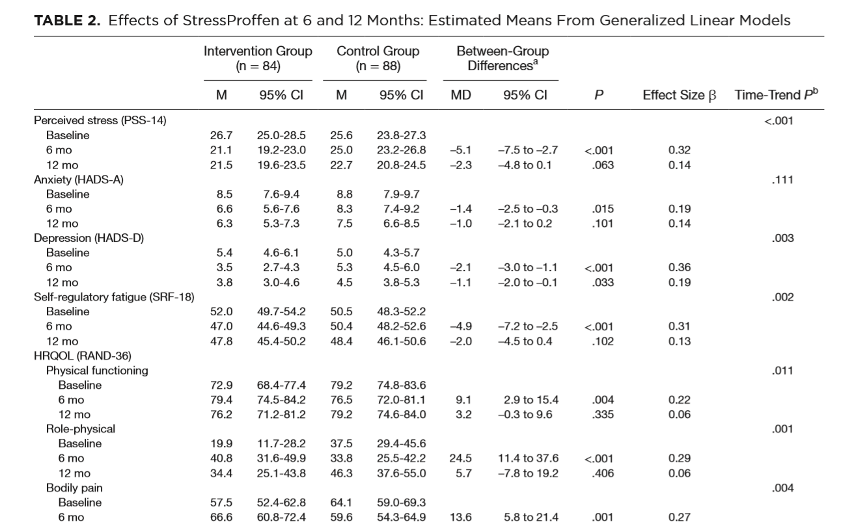
DISCUSSION

Slide 20
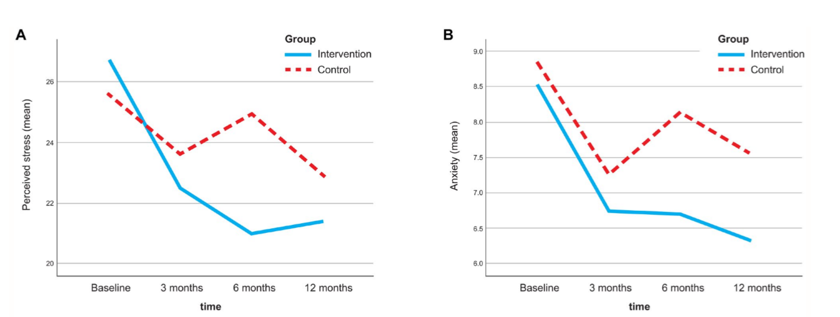
DISCUSSION

Slide 21
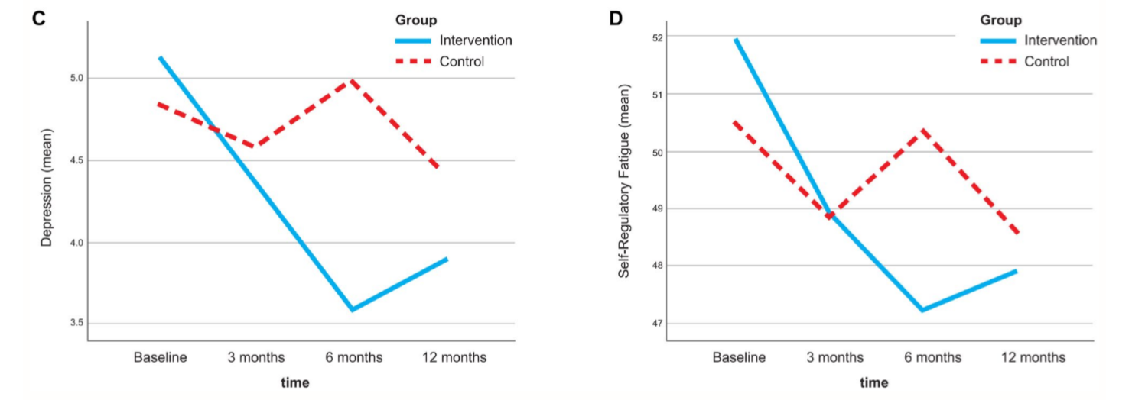
DISCUSSION

Slide 22
DISCUSSION
The findings demonstrate a significant positive impact for the intervention group compared with usual- care controls, with between- group differences assessed over 12 months showing significant reductions in perceived stress (ie, the primary outcome) and significant reductions in depression and self- regulatory fatigue and significant improvements in HRQOL (ie, the secondary outcomes).
Even though the findings were statistically significant over time, more research is needed to explore the potential reasons why the largest intervention effects appeared around the 6- month follow- up.

Slide 23
DISCUSSION
One explanation could be that psychosocial interventions have the most impact at an early stage in the cancer survivorship journey when the content is still new. If this was the case, however, findings at 3 months could have been expected to be the most significant. Because participants were “on their own” progressing in the app (ie, it was user- driven rather than driven by provider guidance), however, it could be that 3 months was not enough time and that the 6- month follow- up revealed the benefits of more thoroughly acquired knowledge, skills, and strategies.
Another factor to consider is that although both groups appeared to improve somewhat from the baseline to 3 months, the intervention group continued to improve, whereas the usual- care control group appeared to experience worsening symptoms from 3 to 6 months. It is possible that cancer survivors in the intervention group did in fact experience a sort of buffering effect from the Stress Proffen intervention during what may have otherwise been a challenging period in the cancer trajectory for most participants.

Slide 24
DISCUSSION
There was no follow- up contact between the research team and the participants between 6 and 12 months; if the simple blended care delivery induced a sense of guidance, this could have contributed to the more significant findings at 6 months.
Another reason could be that the impact decreased as time progressed.

Slide 25
Conclusion
The fact that such effect sizes can be achieved with even minimal cost and effort via a digital approach further highlights the significant potential for the outreach and impact of digital self- management interventions. In addition to the longstanding limited availability of and access to psychosocial interventions for cancer survivors, a failure to meet the psychosocial needs of cancer survivors during the recent coronavirus disease 2019 pandemic, has also been indicated. Digital stress management solutions such as Stress Proffen may contribute to solving, or at least limiting, these types of challenges by providing innovative options for the outreach of effective psychosocial interventions even during challenging times.

Slide 26
Limitations
First, recruitment allowed for cancer survivors to contact the research team if they were interested in participation, and it can be assumed that these participants (41%) were particularly motivated; this potentially affected study generalizability.
Second, disease status and treatment status were self- reported and could not be verified.
Third, although a wide variety of cancer diagnoses were included in the current study, participants were mainly female, with a majority being breast cancer survivors.
Fourth, baseline scores were low to moderate for the majority of the outcome measures in the current study. It is possible that enrolling cancer survivors with higher baseline distress levels could have resulted in even higher intervention benefits for the participants.
Finally, because of the access/not- access nature of the intervention, group allocation could not be blinded.

Slide 27
future research
although a wide variety of cancer diagnoses were included in the current study, participants were mainly female, with a majority being breast cancer survivors. To strengthen generalizability and clinical utility, future research should aim to improve the gender balance and include more heterogeneous cancer survivor populations.
Future research should explore the extent needed to achieve such an impact. Could 1 phone call, or a simple introduction by a health care provider, be enough?
Also, such explorations could determine whether completely user- driven digital self- management programs.

Slide 28
عنوان ارائه
با تشکر از توجه شما
مرضیه راعی
Raeem4002@gmail.com

