Slide 1


Childhood glaucoma registry in Germany: initial database, clinical care and research (pilot study)
باسمه تعالی
بهاره ظفرنژاد
دکتر سمیه فضائلی
zafarnb2@mums.ac.ir

Slide 2

معرفی مجله
BMC Emergency Medicine
H index : 36
Impact Score: 2.03
ISI ,Scopus, pubmed,embase,DOAJ

Slide 3
introduction
Childhood glaucoma is a varied group of rare serious diseases.
The incidence of this disorder differs regionally. Approximately one case occurs in 10,000–38,000 live births in Europe, North America, and Australia.
The highest prevalence can be found in slovakian gypsies (1:1250) , in Saudis (1:3030) , and in Southern India (1:3300).
Childhood glaucoma is responsible for more than 18% of childhood blindness worldwide.

Slide 4
introduction
To provide high quality clinical care for patients with childhood glaucoma in Germany, the Pediatric Glaucoma Center was inaugurated at the Department of Ophthalmology of the University Medical Center Mainz, Germany in June 2017.
The aim of this pilot study was to create an initial database of children with glaucoma referred and treated in our Center with maintenance of a national registry for childhood glaucoma (ReCG) in Germany that could be used by other hospitals worldwide.

Slide 5
Materials and methods
This pilot study included an initial dataset from 29 patients (58 eyes) with different types of childhood glaucoma or childhood glaucoma suspects, diagnosed and treated at the Children Glaucoma Center of the University Medical Center Mainz, Germany from December 2018 to December 2019.
A major aim of this pilot study was the development of forms and questionnaires to assess the feasibility and validity before building up a Germany-wide childhood glaucoma registry.
These forms and questionnaires were developed and used for acquisition and storage of epidemiological (social data, gestational history, family history) and clinical data of patients diagnosed with childhood glaucoma.

Slide 6

Materials and methods
The patient information was stored in a database table—electronic form designed as a registry.
All the demographic parameters were collected during outpatient examination; clinical parameters were obtained during ophthalmological outpatient examination or examination under general anesthesia.
In our analysis we used congenital glaucoma classification of the World Glaucoma Association , that categorizes primary congenital glaucoma (PCG) and the secondary childhood glaucoma (SCG) types, which are associated with other ocular and systemic findings.

Slide 7
Materials and methods
The health-related quality of life Questionnaires for children at age more than 3 years and adolescents up to 17 years of age (KINDL Questionnaires, Ravens-Sieberer & Bullinger, 2000) were obtained from all included children, depending on their age (from 3 to 6 years; 7–13 years and 14–17 years). The KINDL Questionnaires contained basic questions on age, sex, number of siblings, school education and questions about health-related issues, connected with the glaucoma disease.
Indication for surgery was made on a clinical basis under anesthesia, considering the presence of two or more criteria of newly diagnosed children glaucoma or the progression of known disease, according to a novel classification system proposed by the new Childhood Glaucoma Research Network (CGRN) International Childhood Glaucoma Registry.
ارائه دهنده:بهاره ظفرنژاد

Slide 8
Materials and methods
To better understand the role of inheritance we performed blood genetic testing of 25 (86.2%) registered children and their parents to identify one or more of the known 24 genes, associated with congenital glaucoma.
The blood is stored anonymously for up to 10 years according to the German law for biomaterial storage in university medical centers.
Besides, the genealogical tree was obtained for every case including special emphasis on consanguinity in the family (a blood relationship between the parents or grandparents).

Slide 9
Statistical analysis
Absolute and relative frequencies were computed for dichotomous data, continuous data are presented as mean±standard deviation. All statistical analysis was conducted with R (R Core Team 2020, R Foundation for Statistical Computing, Vienna, Austria).

Slide 10
Results The created forms and questionnaires included:
1- Agreement form from the parents to participate in the pilot study
- a separate agreement form for children younger or older than 12 years
2- Medical history form/sheet with medical and social history of the child, including patient registration number; birth date,…
3- Patient’s gestational history questionnaire

Slide 11
form2

Slide 12
Results The created forms and questionnaires included: form4
4- Form documenting the examination of the child under general anesthesia (GAEF)
Examination under anesthesia was performed in 23 (79%) patients. Fundus examination was difficult to perform in 29 (50%) eyes, because of poor view to the posterior segment due to opacity of ocular media.

Slide 13


Results The created forms and questionnaires included: form4

Slide 14
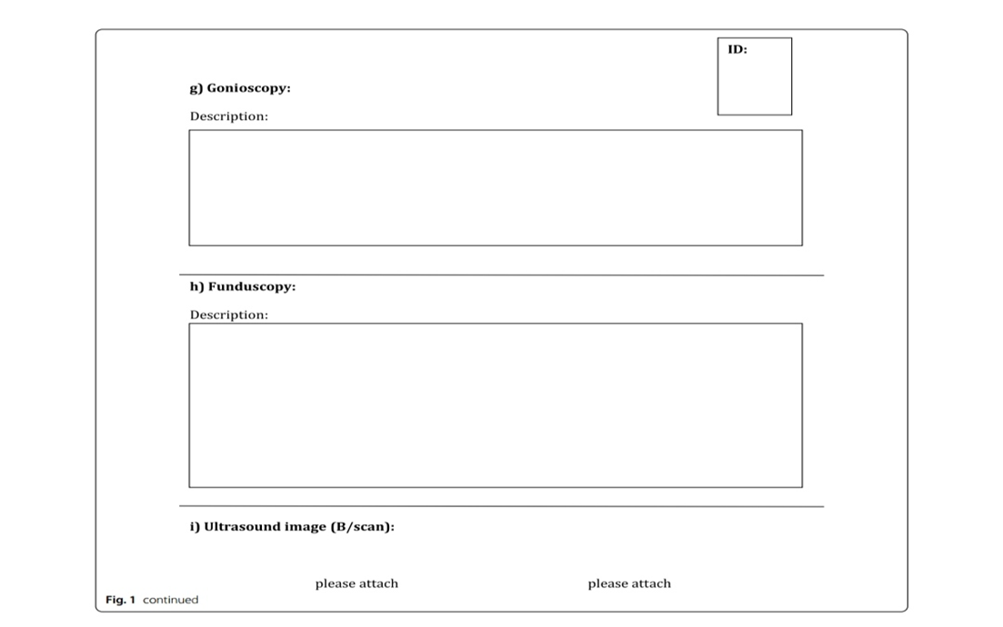
Results The created forms and questionnaires included: form4

Slide 15
Demographic and clinical data of all patients with diagnosed childhood glaucoma are shown in Tables1and 2. Childhood glaucoma diagnosis was confirmed by considering all ocular, associated ocular, and systemic anomalies. PCG and SCG were revealed in 11 (39%) and 17 (61%) childhood patients, respectively. Bilateral glaucoma was diagnosed in 9 (82%) and 10 (59%) patients with PCG and SCG, respectively. The most common cause of SCG was Peters anomaly (41%) (see Additional file4: Table S1).

Slide 17
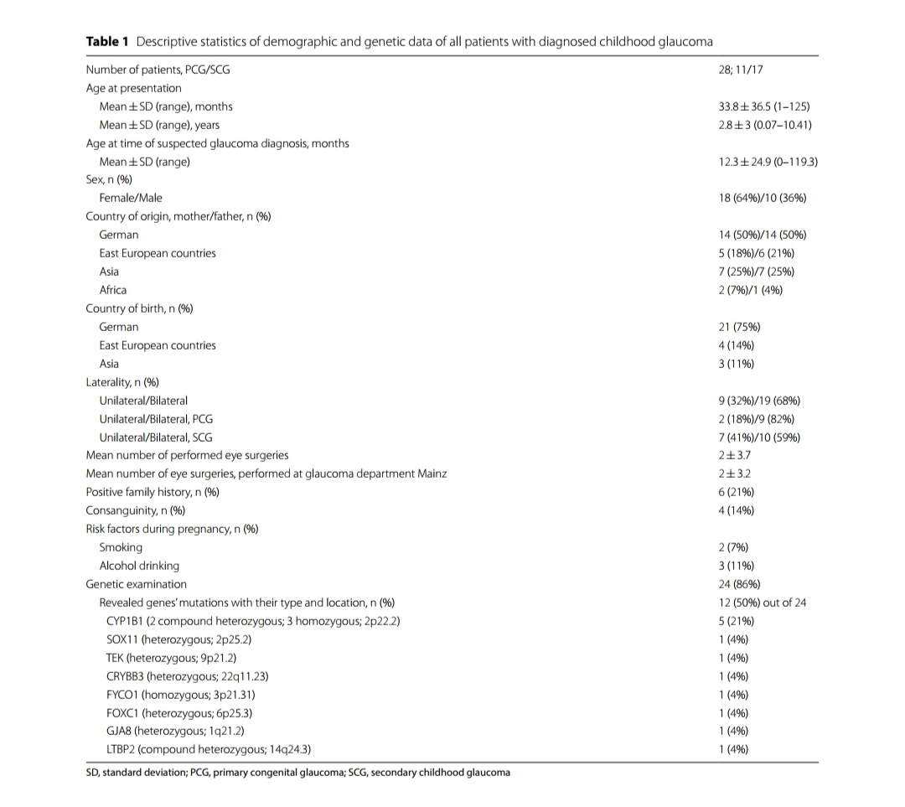
جدول1:

Slide 18
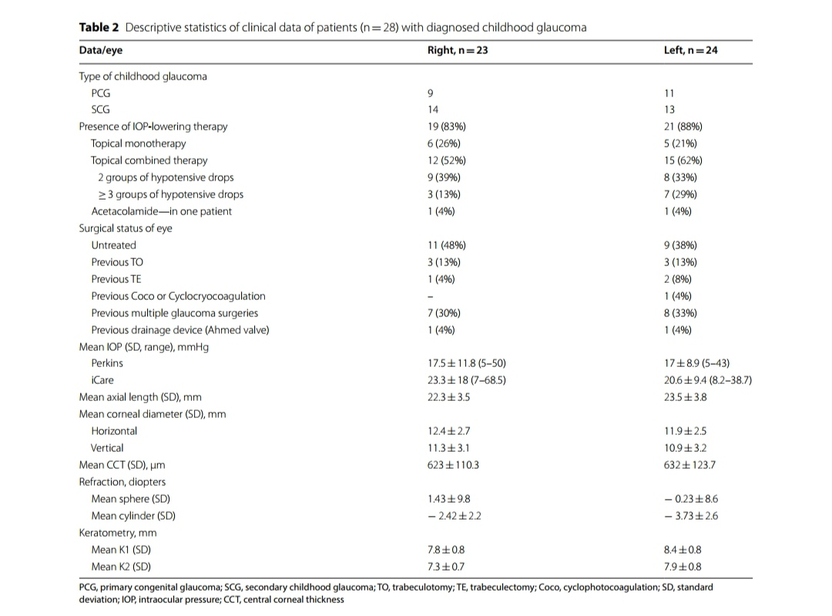
جدول2

Slide 19
Discussion
Lopes et al. designed an online form at the Department of Ophthalmology and Visual Sciences of the Federal University of São Paulo to create a registry of patients with congenital glaucoma. The pilot study included 72 children with childhood glaucoma, 61.5% with PCG, and 38.5% with secondary congenital glaucoma, respectively. Most patients with secondary congenital glaucoma were secondary to congenital cataract (61%) [3]. In contrast, most of our SCG patients had Peters anomaly.
Tau et al. presented a review of a new classification system for childhood glaucoma, its use to date, and its application for international research. Tis classification has become the first International Consensus Classification in 2013 and is used by the new Robison D. Harley, MD CGRN International Pediatric Glaucoma Registry. Tis registry attempts to overcome the inherent challenges of studies on rare disorders due to limited study size and acts as a centralized database for clinical data provided by sites across the globe to allow largescale studies on childhood glaucoma.

Slide 20
Discussion
Alanazi et al. determined the demographic and clinical distribution of primary and secondary congenital glaucoma in 180 patients with congenital glaucoma in the Middle East by using data from a registry at King Khaled Eye Specialist Hospital, collected between 2001 and 2003 (29 months). This registry excluded cases with acquired childhood glaucoma. According to their results, 30% of all patients had a positive family history and consanguinity was recognized among 58.9% patients .
Different from Arabic and Pakistani populations in which consanguineous marriages are the major contributing factors to the high incidence of recessively inherited PCG ,we found a much lower frequency of consanguinity in our study (21% of positive family history and 14% of presence of consanguineous marriages). These percentages are comparable to those, reported in the U.S. and Australia .In one third of included childhood glaucoma patients genetic testing identified one of the genes that are associated with congenital glaucoma, confirming the importance of genotyping this disease.

Slide 21
Discussion
Bilateral disease was present in our study in 82% patients with PCG and was higher than the incidence of bilateral PCG (58%), reported by Bayoumi .We observed unilateral disease more frequent in patients with SCG than in PCG, as previously reported .

Slide 22
Conclusions
In summary, this pilot study at the Children Glaucoma Center of the University Medical Center Mainz provided for the first time in Germany detailed baseline data and is aimed at a national registry on different types of childhood glaucoma.
The planned registry will allow to perform various types of registry-based analyses as well as a better understanding of the clinical course of the disease and identification of risk factors. Registered data can provide valuable information on epidemiology, clinical phenotypes and genetics in childhood glaucoma blindness in Germany.

Slide 23
Limitations
The limitation of this registry was the collection of medical history only by an interview with the child’s parents and not by review of their medical documentation which was not available in most cases.
Due to the lack of a documented description of previous surgical techniques, in most cases it was also impossible to confirm the use of certain surgical agents and conduct a detailed descriptive analysis of interventions performed.
We did not investigate differences in age, sex, and ethnical distribution in our study cohort, since it is a pilot study with a limited number of patients in both the PCG and SCG group.

Slide 24
عنوان ارائه
با تشکر از توجه شما
بهاره ظفرنژاد
zafarnb2@mums.ac.ir

