Slide 1


Slide 2


عنوان ارائه
Supervisor
Supervisor
Supervisor
Telemedicine Awareness, Knowledge, Attitude, and Skills of Health Care Workers in a Low-Resource Country During the COVID-19 Pandemic: Cross-sectional Study
Fatemeh Dahmardeh
Supervisor: Dr. Kimiafar
Dahmardehf4002@mums.ac.ir

Slide 3

.
            JORAL SPECIFICAON
Impact factor: 5.7
Publish: 2021
CiteScore : 6.40
H-Index : 142
Indexed in: ISI, Scopus,
Pubmed ,DOAJ
ISSN/ISBN: 1438-8871,
1439-4456
Author: Muhammed Elhadi; Ahmed Elhadi; Ahmad Bouhuwaish , Fatimah Bin Alshiteewi,…

Slide 4

.
list
Introduction
Methods
Results
Discussion
Conclusions
Limitations

Slide 5
.
Introduction
SARS-CoV-2 was identified as the cause of severe viral pneumonia in Wuhan, Hubei Province, China, in December 2019. The World Health Organization declared COVID-19, the disease caused by this virus, a pandemic in March 2020 . As of July 22, 2020, more than 15,000,000 COVID-19 cases and more than 617,000 COVID-19–related deaths have been recorded in 213 countries and territories.
Introduction
Methods
result
Discussion
conclutions
limitations

Slide 6
.
Introduction
Preventive measures have been implemented to reduce the potential exposure of individuals to the virus and to decrease the burden of COVID-19 transmission. These measures include hand washing, avoiding touching the face and eyes, cleaning and disinfecting surfaces and objects, wearing protective equipment including masks, and most importantly, social distancing by staying at home, avoiding close physical contact with others, and maintaining adequate interpersonal distance.

Slide 7
Introduction
Telemedicine and telehealth services are especially important for individuals without COVID-19 seeking medical treatment during the pandemic, especially those with chronic or acute illnesses. Several countries had begun increasing the use of telemedicine services even prior to the COVID-19 pandemic .Telemedicine was effective during previous outbreaks including those of the Ebola virus, Zika virus, and the severe acute respiratory syndrome coronavirus.

Slide 8
Definition of telemedicine
Definition of telemedicine
Telemedicine is defined as the use of web-based resources and electronic information along with advanced digital network technology to promote long-distance professional health services, disseminate medical safety reports, deliver health-related education to the public, and carry out public health monitoring.

Slide 9
Reason for doing this study
Since the onset of the COVID-19 pandemic, several health care service programs aiming to provide telemedicine services have been introduced in Libya. Even with their recent introduction, many physicians have used these services to provide care and advice to patients remotely. There is a need to assess the awareness, knowledge, attitude, and skills of physicians who use telemedicine services. The skilled use of telemedicine by physicians benefits patients, who can receive a wide range of health care services without the need to visit the clinic. Telemedicine services can reduce the risk of infection among populations by facilitating social distancing and decreasing the burden on the hospitals that provide care to individuals with COVID-19.

Slide 10
Study Design
characteristics
characteristics
Website implementation
Health care staff survey
At may 2020
Via message and email
Who were officially registered with Libyan hospitals during the COVID-19 pandemic and were involved in patient care
Introduction
Methods
Results
Discussion
Conclusions
limitations

Slide 11
Survey sections
Basic demographic information age, gender, years of experience,
employment status, department of work,
there were several, computer skills
general questions related to telemedicine experience
2.The second section contained a survey instrument that was previously
developed by Zayapragassarazan et al ,which contains four detailed subsections.
3. third section: Assessment of the Effect of COVID-19 on Telemedicine

Slide 12
.
Awareness Subsection 12 items 0=don’t know, 1=heard, 2=know
Knowledge Subsection 11 items 0=yes, 1=no
second section Attitude Subsection 11 items 0=disstrongly, 1=disagree,
2=undecided, 3=agree,4=strongly
Computer Skills Subsection 13 items (0=unskilled, 1=learner, 2=mediocre, 3=expert

Slide 13
Assessment of the Effect of COVID-19 on Telemedicine
the role of telemedicine in reducing in-person consultations
the time spent on practicing telemedicine
the usability of telemedicine based on local internet settings
the role of telemedicine in helping physicians avoid or decrease the risk of infection potentially resulting from internal conflicts in Libya.

Slide 14
Statistical Analysis
general demographic characteristics Descriptive statistics
determine significant differences between the two groups Mann-Whitney U test
compare groups with ≥3 independent variables Kruskal-Wallis H test
determine potential associations between the categorical groups chi-square test
questionnaire were converted to percentages and compared with other group variables.
considered scores of ≤49% as low, 50%-70% as average, and ≥71% as high
Introduction
methods
Results
Discussion
Conclusions
limitations

Slide 15
Ethical Consideration
The study procedures comply with the ethical standards of the relevant national and institutional committee on human experimentation, with the Helsinki Declaration of 1975, as revised in 2008. Ethical approval (approval# 109.3-2020) for this study was obtained from the Bioethics Committee at the Biotechnology Research Centre (Tripoli, Libya). The survey was conducted anonymously, and all participants provided written informed consent before participating in the study.

Slide 16
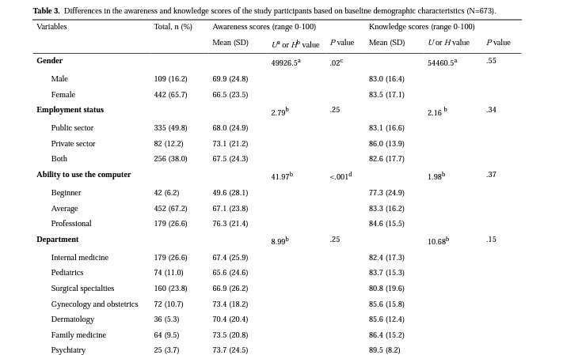

Slide 17
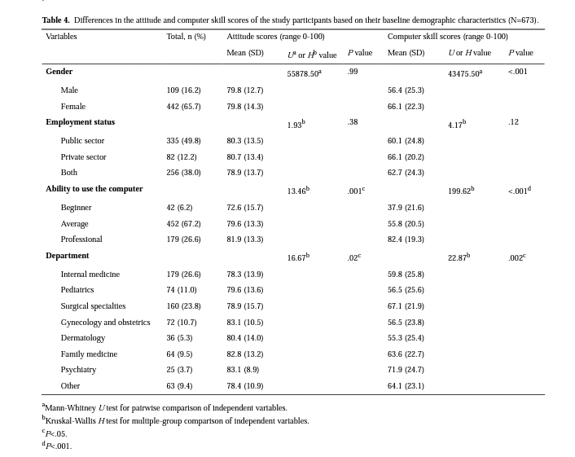
Results

Slide 18
result
Table. Different levels of awareness, knowledge, attitude, and skills among health care workers in Libya (N=673).
Degree | Awareness | Knowledge | Attitude | Skills
Low(> 49 %).n(%) | 132(19.6) | 28(4.2) | 16(2.4) | 226(33.6)
Average (50%70%).n(%) | 164(24.4) | 63(9.4) | 101(15.0) | 199(29.6)
High(>71%).n(%) | 377(56.0) | 582(86.5) | 556(82.6) | 248(36.8)

Slide 19
result
638 (94.8%) thought that telemedicine technology could be used to limit the spread of COVID-19.
630 (93.6%) participants thought that telemedicine could help reduce hospital visits to avoid COVID-19 transmission.
283 (42.1%) participants thought that telemedicine could replace traditional medical visits during the COVID-19 pandemic.
616(91.5%) participants thought that the telemedicine system could facilitate patient communication and cooperation with physicians during the COVID-19 pandemic.

Slide 20
result
622 (92.4%) participants thought that the use of telemedicine and remote health care systems saved a lot of time that was otherwise lost in hospitals and clinics and that these remote services could more rapidly provide medical advice.
121 (18%) participants thought that telemedicine could help physicians avoid the issues of conflict and civil war in Libya and decrease the risk of infection arising from these internal Conflicts.
575 (85.4%) participants thought that telemedicine could potentially prevent physicians who worked in unsafe environments from sensing insecurity during the civil war.
606 (90%) participants thought that telemedicine could help physicians avoid the risk of contracting and transmitting COVID-19.

Slide 21
Discussion
This remains yet another challenge for telemedicine service providers, requiring immediate attention from internet providers and telephone companies .Many patients have complained about the unavailability of these services owing to their high demand during the COVID-19 pandemic.
Most study participants (n=556, 82.6%) had higher attitude scores. This is important because attitude represents how telemedicine was perceived by health care workers .The attitude of health care workers is an important factor in understanding and accepting telemedicine technologies. For such acceptance, the program developer needs to train health care workers and make the telemedicine programs usable for them.
Introduction
methods
Results
Discussion
Discussion
limitations

Slide 22
Discussion
.
Knowledge and attitude are important for the acceptance of telemedicine by health care workers. In this study, 582 (86.5%) participants had high knowledge scores; this value is higher than that reported previously in Germany (where approximately 63% of individuals had some telemedicine knowledge)
Another study conducted in Lagos .reported that only 60.9% of participants had telemedicine knowledge.
study conducted in Pakistan reported an average level of telemedicine knowledge among health care workers

Slide 23
Conclusions
The consequences of the COVID-19 pandemic are expected to be long lasting. Hence, policy programs, such as telemedicine services, which aim to address obstacles to medical treatment owing to physical distancing measures, are also required to be provided over a long term .Therefore, there is a need to train and support health care workers and initiate government programs that provide adequate and supportive health care services to patients in transitional countries and to respond to issues regarding the access to these services, including internet access and advertisements, and social programs that help patients understand how to use these services.
Introduction
methods
Results
Discussion
conclusions
Limitations

Slide 24
1. Our study was limited to Libya.
2. the cross-sectional design of our study does not allow for drawing concrete conclusions establishing causation between variables.
3. our study does not provide details regarding the types of telemedicine technologies and how they can be implemented, along with patients' attitude toward telemedicine.
Limitations
Introduction
methods
Results
Discussion
conclusions
Limitations

Slide 25
.
Further research
studies on telemedicine are required to provide qualitative measures of health care services to patients, to assess the access to health care services in other transitional countries, and to determine whether these telemedicine adaptations benefit patients, especially those with chronic illnesses and psychiatric morbidities .
There is a need to determine the cost benefit of these services and whether modifications are required in these services.

Slide 26
عنوان ارائه
با تشکر از توجه شما
نام ارائه دهنده
ایمیل ارائه دهنده

Slide 27
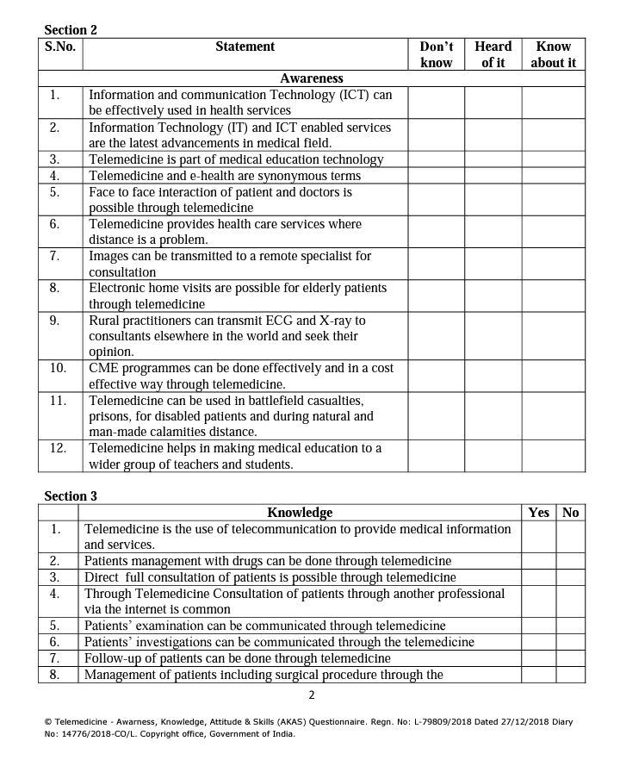
4 the second part of the question

Slide 28
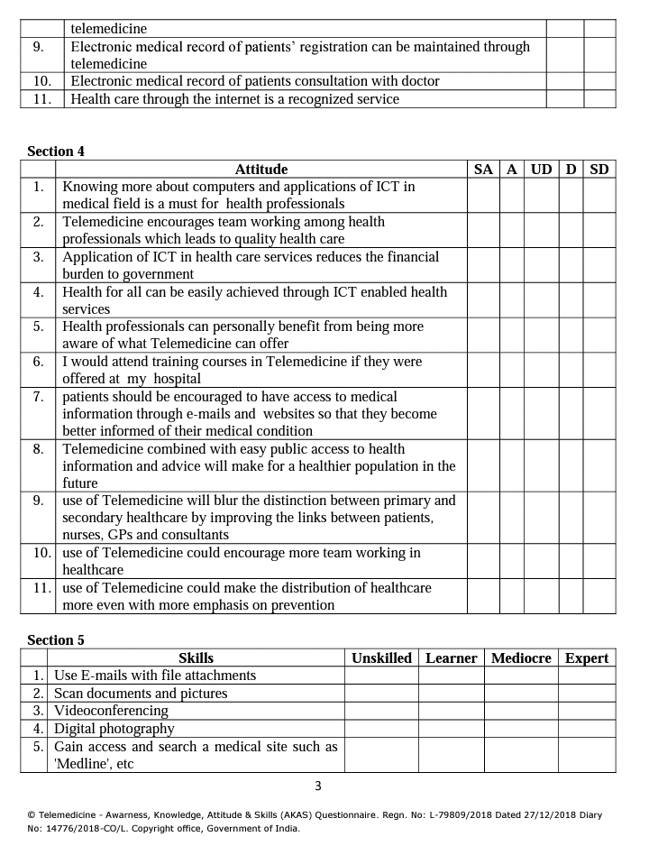

Slide 29
