Slide 1


Prediction of Poststroke Depression Based on the Outcomes of
Machine Learning Algorithms
باسمه تعالی
امیر احمدی
دکتر خلیل کیمیافر
amir4002@mums.ac.ir

Slide 2
معرفی مجله
Journal of Clinical Medicine
Impact Facto : 4.242
Indexed in: ISI, PubMed, Embase
18 April 2022

Slide 3
فهرست
Introduction
Subjects and Methods
Results
Discussion
Conclusion
My view

Slide 4
Introduction
Poststroke depression (PSD) is one of the most common psychiatric disorders in stroke patients
Its incidence ranges from 10 to 52% according to subject selection or diagnostic criteria
The relationship between PSD and cognitive impairment has already been widely investigated. Cognitive impairment, in fact, is known to be one of the major predictors of PSD
Machine learning (ML) algorithms are widely used in the medical field for the prediction of disease diagnosis and treatments. Some recent studies reported that the ML method is more effective in predicting stroke outcomes than statistical methods or scoring systems

Slide 5
Objectives
aimed to use various ML algorithms to predict the occurrence and prognosis of PSD in stroke patients based on their cognitive and functional status and evaluated whether ML algorithms are superior to statistical methods

Slide 6
Subjects and Methods

Slide 7
Subjects and Methods
Subjects
Measurements
  Neurological Assessment
  Psychological Assessment
  Cognitive Assessments
  Functional Assessments
ML Analysis
Statistics

Slide 8
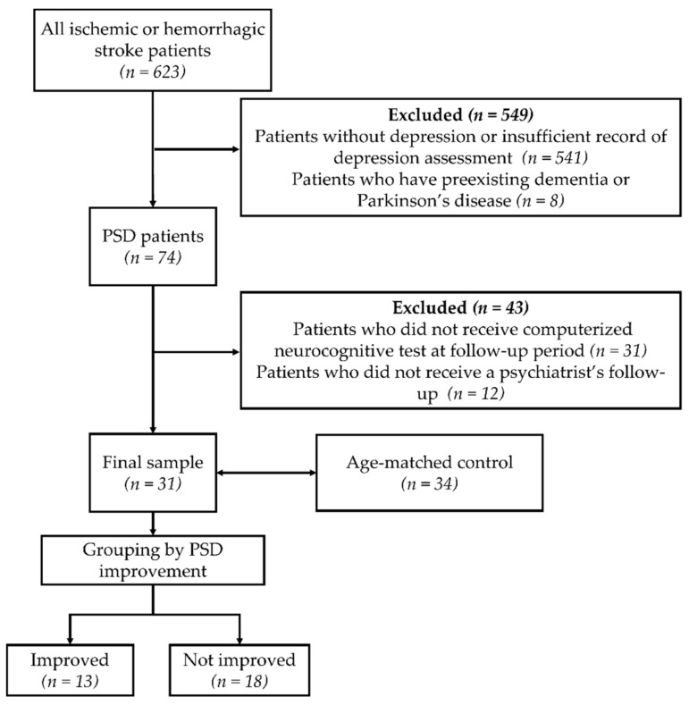

Diagnostic and Statistical Manual of Mental Disorders, fourth edition (DSM-IV)

Slide 9
Measurements
Neurological Assessment
  National Institutes of Health Stroke Scale
Psychological Assessment
  Hamilton Rating Scale for Depression
  DSM-IV
Cognitive Assessments
  Korean version of the Mini-Mental Status Examination (K-MMSE)
  Computerized neurocognitive test
Functional Assessments
  Korean version of the Modified Barthel index (K-MBI)
  Functional independence measure (FIM)

Slide 10
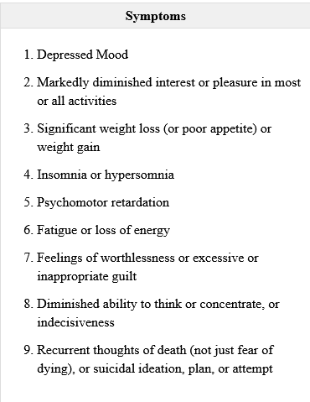
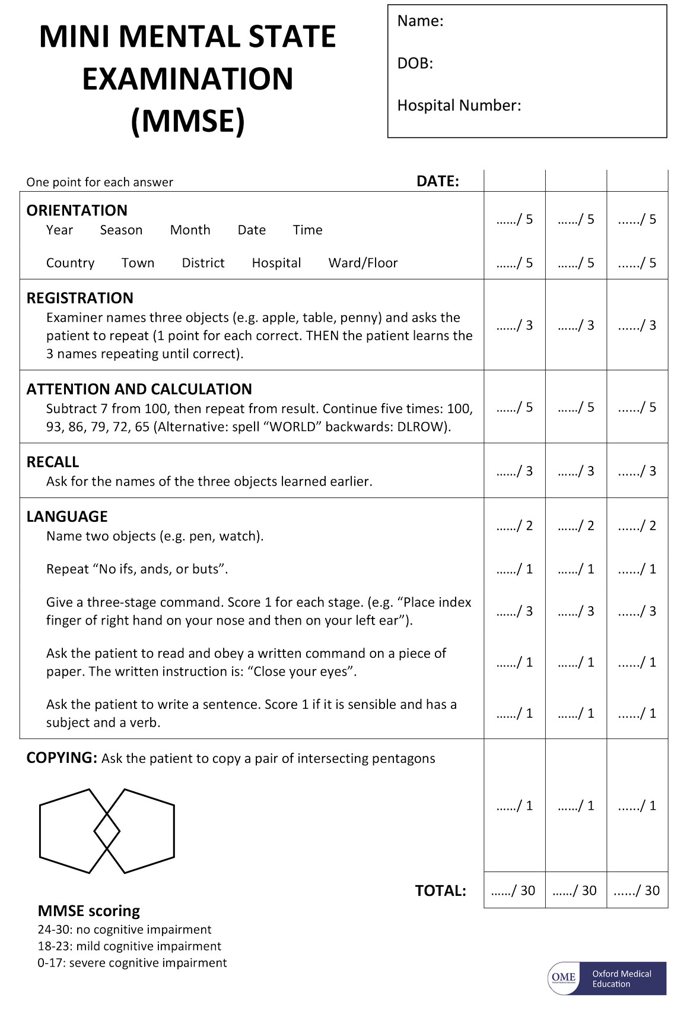
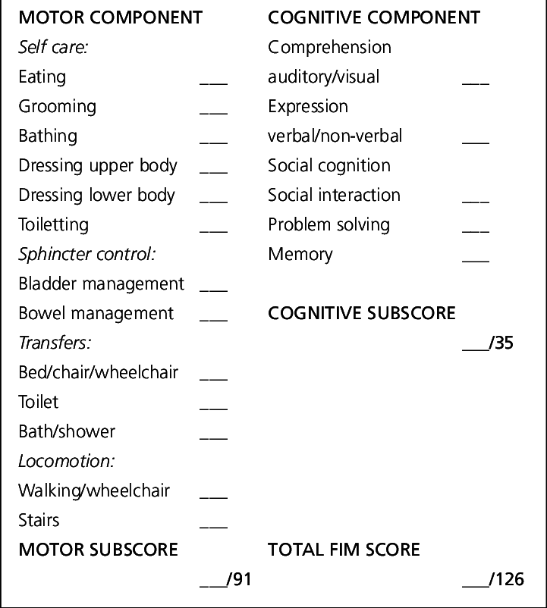
ارائه دهنده: امیر احمدی

Slide 11
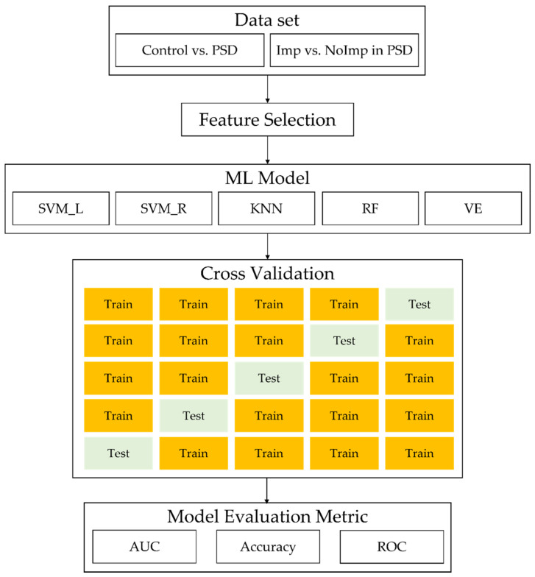
ML Analysis
ارائه دهنده: امیر احمدی

Slide 12
Statistics
PASW Statistics 18
The Shapiro–Wilk test was performed to assess the normal distribution of all numerical data from each group
Mann–Whitney U
ارائه دهنده: امیر احمدی

Slide 13
Results
ارائه دهنده: امیر احمدی

Slide 14
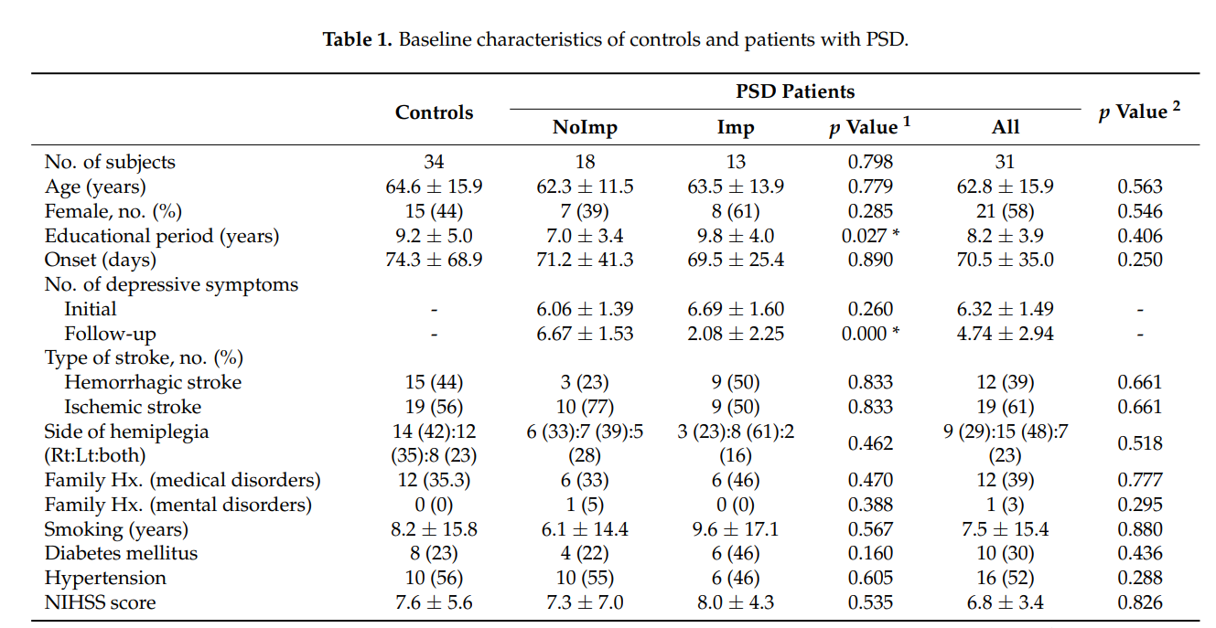
Baseline Characteristics
ارائه دهنده: امیر احمدی

Slide 15
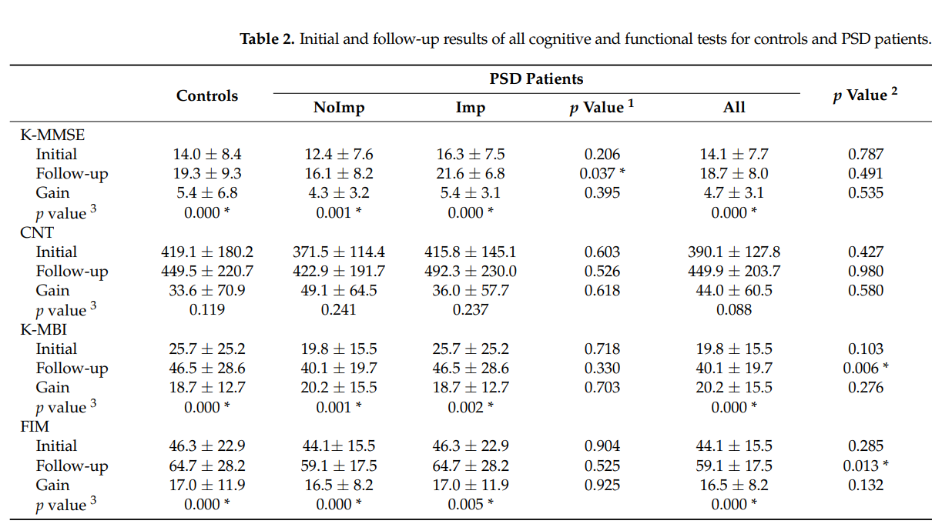
Cognitive and Functional Analysis Using Statistical Methods
ارائه دهنده: امیر احمدی

Slide 16
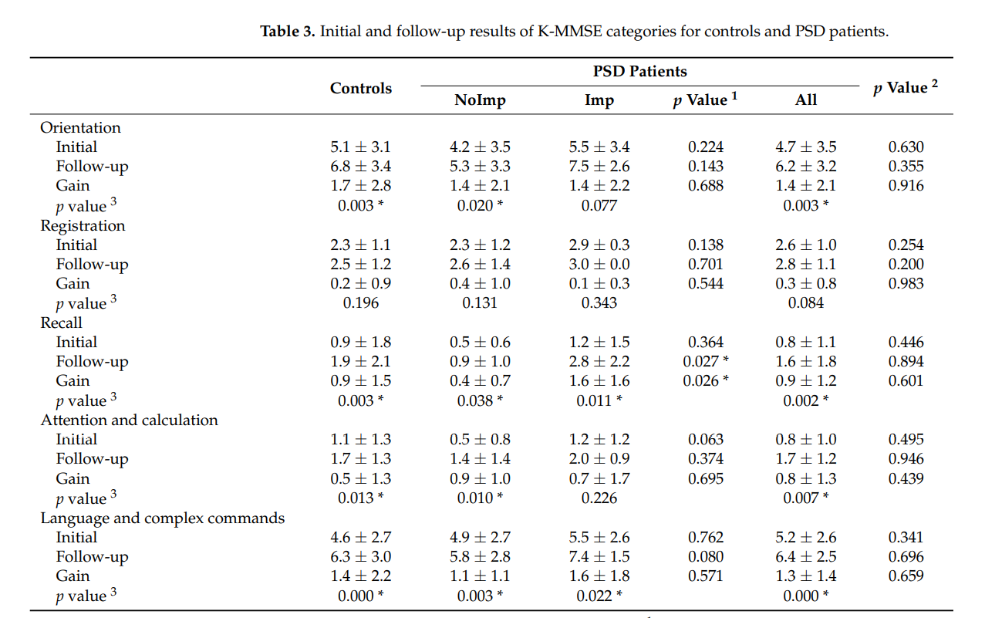
Cognitive and Functional Analysis Using Statistical Methods
ارائه دهنده: امیر احمدی

Slide 17
Cognitive and Functional Analysis Using Statistical Methods
Among the 12 subtests of the CNT, the initial visual attention omission error score of participants in the PSD group (30.5 ± 12.0) was lower than that of participants in the control group (38.2 ± 18.2)
The follow-up scores of most categories except auditory and visual attention omission error were improved for participants in the control group
the follow-up scores of only four subtests, such as digit span backward (DSB) language memory, auditory attention correct response, and commission error, and visual attention correct response, improved for participants in the PSD group
ارائه دهنده: امیر احمدی

Slide 18
Cognitive and Functional Analysis Using Statistical Methods
Among the 10 items of the K-MBI, the initial subscore of dressing was significantly lower for participants in the PSD group (2.0 ± 1.9) than for participants in the control group (3.4 ± 2.7)
In addition, follow-up subscores of bathing, toileting, stair-climbing, dressing, bladder control, transfer and ambulation, and gain subscores of bladder control were lower for participants in the PSD group than for participants in the control
ارائه دهنده: امیر احمدی

Slide 19
Cognitive and Functional Analysis Using Statistical Methods
Among the six areas in the FIM, the follow-up subscores of self-care, transfer, and locomotion were significantly lower for participants in the PSD group (17.8 ± 7.3, 8.3 ± 3.9, and 4.3 ± 3.3, respectively) than for participants in the control group (23.2 ± 10.2, 12.2 ± 5.5 and 5.9 ± 3.7, respectively)
ارائه دهنده: امیر احمدی

Slide 20
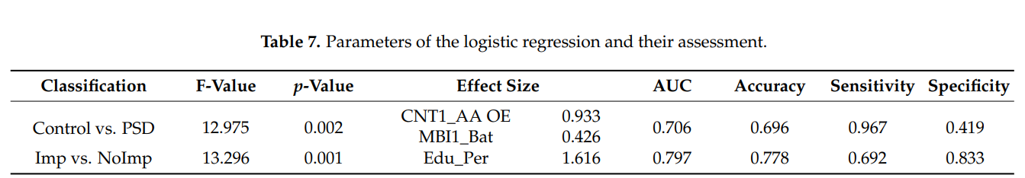
Cognitive and Functional Analysis Using Statistical Methods
ارائه دهنده: امیر احمدی

Slide 21
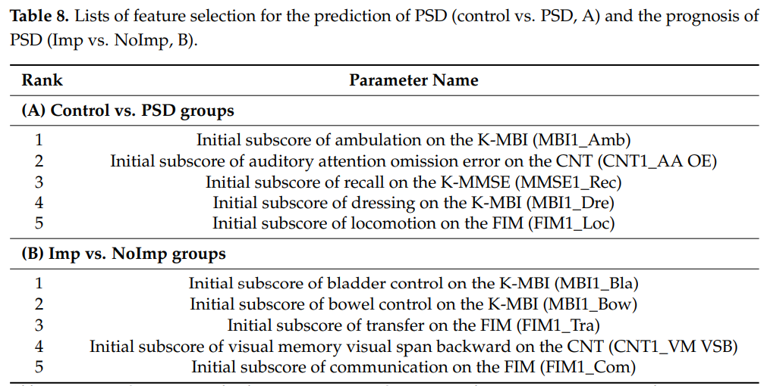
ML Analysis
ارائه دهنده: امیر احمدی

Slide 22
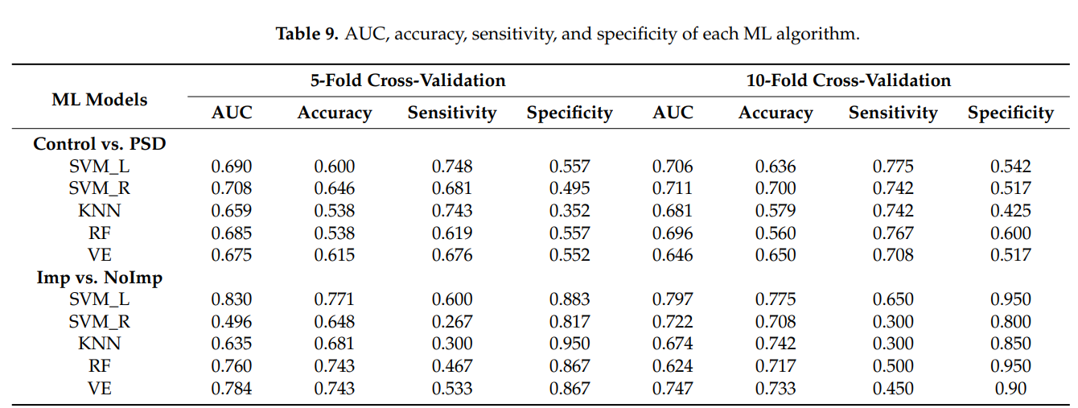
ML Analysis
ارائه دهنده: امیر احمدی

Slide 23
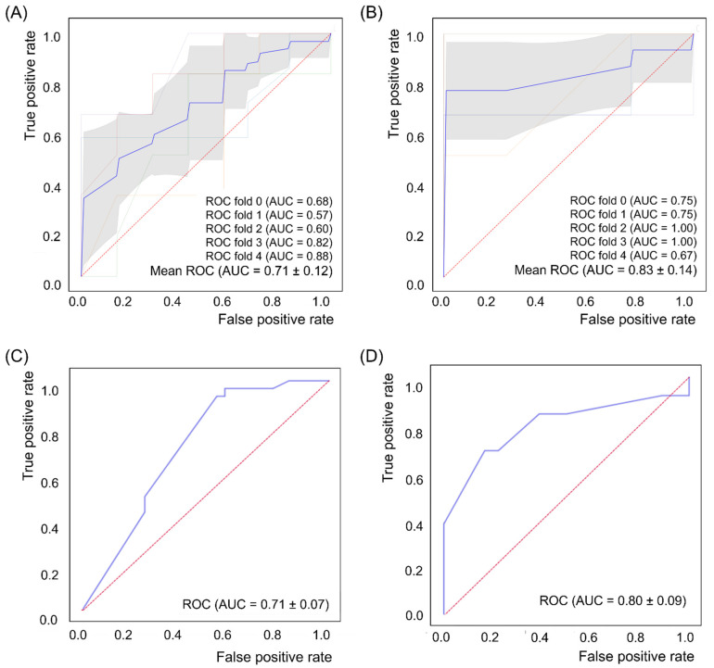
curve for support vector machine with radial basis function kernel function algorithm with 10-fold cross-validation in the prediction of poststroke depression (PSD) occurrence (control vs. PSD)
support vector machine linear algorithm with five-fold cross-validation in the prediction of PSD prognosis (improved vs. not improved)
ROC curve for logistic regression analysis in the prediction of PSD occurrence
PSD prognosis
ارائه دهنده: امیر احمدی

Slide 24
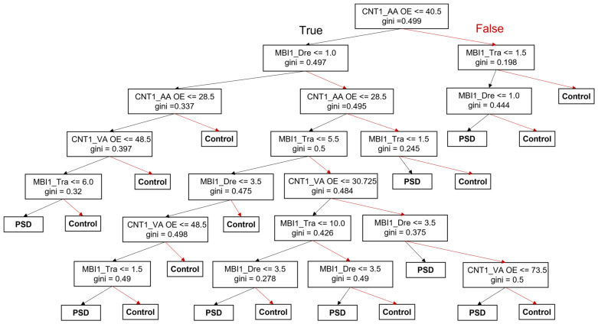
ارائه دهنده: امیر احمدی

Slide 25
discussions
ارائه دهنده: امیر احمدی

Slide 26
Discussion
In this study, used various ML algorithms to predict PSD occurrence and prognosis for the first time, and the SVM linear and SVM with an RBF kernel were optimal to develop a predictive model for PSD
The VE algorithm is the combination of all ML models that were used in this study to improve model performance; however, its AUC and accuracy were not higher than those of the SVM linear or SVM with the RBF kernel
used various ML algorithms to predict PSD occurrence and prognosis for the first time and showed better performance than the statistical method
ارائه دهنده: امیر احمدی

Slide 27
Conclusion
ارائه دهنده: امیر احمدی

Slide 28
Conclusion
We concluded that the occurrence and prognosis of PSD in stroke patients can be predicted effectively based on cognitive and functional status using ML algorithms.
ارائه دهنده: امیر احمدی

Slide 29
My view
ارائه دهنده: امیر احمدی

Slide 30
عنوان ارائه
با تشکر از توجه شما
امیر احمدی
ahmadia4002@mums.ac.ir

