Slide 1


A Mobile Game for Patients With Breast Cancer for Chemotherapy Self-Management and Quality-of-Life Improvement: Randomized Controlled Trial
باسمه تعالی
مرضیه راعی
خانم دکتر معصومه سرباز
Raeem4002@mums.ac.ir

Slide 2

معرفی مجله
Journal of Medical Internet Research (JMIR) Medical Internet Research
Impact Factor : 5.43
H-Index: 142
Indexed in: ISI, Scopus, PubMed, DOAJ

Slide 3
Introduction
Materials and Methods
Results
Discussions
Conclusion
Limitations
Future Research

Slide 4

Introduction
Playing console and Web-based games is a popular free-time activity among children, adolescents, and adults.
Game-based learning may be enjoyable, interesting and therefore, more effective than classical learning.
Recent studies with health-related internet games have shown positive effects, such as improving coping strategies for health problems, strengthening treatment compliance, and increasing motivation to overcome the difficult times during illness.
Patient education has shown to be effective in the management of patients with teenage cancer, diabetes, and asthma. However, there have been limited studies conducted in adults.

Slide 5
Introduction
Chemotherapy is the main treatment for breast cancer, which has proven to reduce the rate of recurrence and mortality in breast cancer patients.
Diarrhea, nausea, vomiting, hair loss, and mucositis are among the most common side effects.
These side effects may cause poor drug compliance, prohibiting successful anticancer treatment.
Chemotherapy is accompanied by significant side effects. Consequently, many cancer survivors experience physical and psychological symptoms that hamper their quality of life (QoL) and disrupt their daily living activities, family relationships, and work schedules .
Poor education is one of the main determinants of poor adherence to chemotherapy.
Therefore, proper education and sufficient communication are important to increase adherence, which may eventually contribute to improved clinical outcomes.

Slide 6
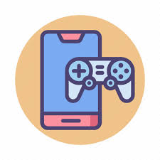
Introduction
An easily accessible, immersive, and interactive Web-based game (ILOVEBREAST) was developed for adult patients with metastatic breast cancer.
Although previous efforts using games were mostly focused on children, adolescents, or young adults, ILOVEBREAST is specifically designed for adult users.

Slide 7
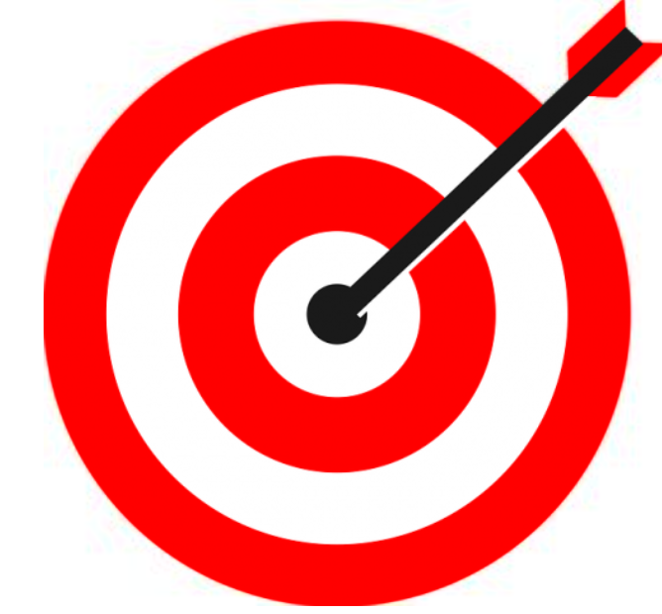

Aim and Hypothesis
This study was a proof-of-concept randomized controlled trial aimed at evaluating the benefits of smartphone-based mobile game use in breast cancer patients receiving cytotoxic chemotherapy.
We hypothesized that mobile gaming would lead to increased drug compliance, decreased physical side effects of chemotherapy, and improved psychological status among patients.

Slide 8


MATERIALS AND METHODS
Patients
Patients with pathologically proven, clinical stage IV breast cancer were enrolled in this study
at Chung-Ang University Hospital, Korea, from September 2013 to September 2014.
were screened with the research and the patient edition version of Structured Clinical Interview for Diagnostic and Statistical Manual of Mental Disorders.

Slide 9

Inclusion criteria
Females diagnosed with metastatic breast cancer .
Aged 18-65 years.
Use of at least third-line palliative chemotherapy treatment comprising taxanes, anthracyclines, capecitabine, and platinum compounds.
Ability to use a smartphone for the mobile game

Slide 10
Exclusion criteria
Current or history of uncontrolled medical diseases except for breast cancer.
Psychiatric diseases including major depressive disorder and anxiety disorders.
And history of substance abuse, including alcohol, nicotine, and drugs.
Major depressive disorder and anxiety disorder were diagnosed based on the Diagnostic and Statistical Manual of Mental Disorders, Fourth Edition, Text Revision, the authoritative guide to the diagnosis of mental disorders published by American Psychiatric Association.

Slide 11


MATERIALS AND METHODS
The Chung-Ang University Hospital Institutional Review Board approved the research protocol
for this study.
Informed consent was obtained from all patients during hospitalization for chemotherapy
after explaining the design, protocol, and consequences of the study.

Slide 12

Description of the Mobile Game
A mobile game, ILOVEBREAST (CLGAMES, Seoul, Korea), was developed with an intention to improve self-management and to reduce the side effects of chemotherapy drugs.
The ILOVEBREAST program used in this study was a 3-week program using typical multiplayer, social network, and platform-based features.
The game’s key pedagogical features were as follows:
education for preventing side effects of anticancer drugs,
support for the prevention of side effects of anticancer drugs including numbness, hair loss, and loss of appetite, encouragement of mood and activity, including exercise, pet walking, cooking, and social game playing, which may facilitate participation in such activities in real life.

Slide 13
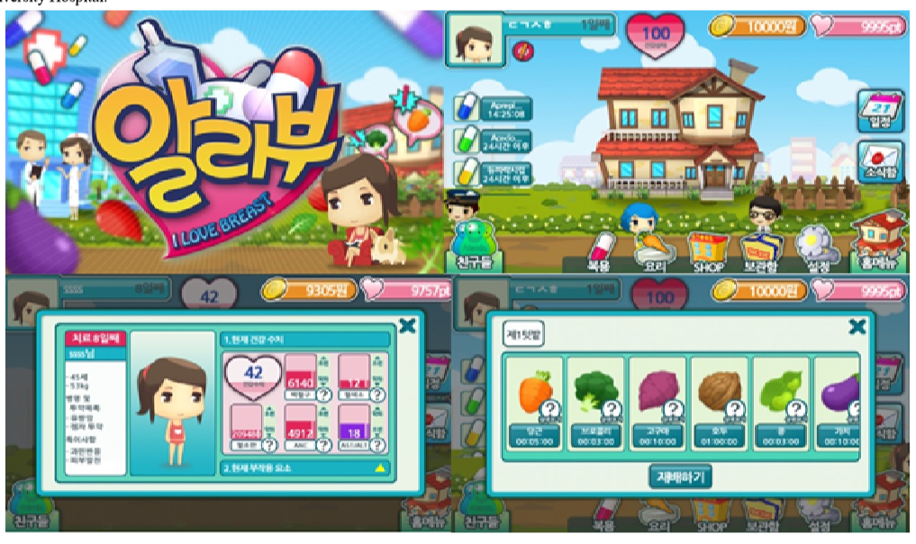

Slide 14
Description of the Mobile Game
At the start of game play, an avatar is generated based on the patient’s medical information including the status of blood components, general medical condition, and chemotherapeutic drugs.
Avatars are to visit their home, pharmacy, hospital, and gymnasium; make purchases from shops; and operate a farm to harvest ingredients for food.
Depending on the patient’s medication dosage, avatars can pursue a quest to minimize the side effects.
The quest consists of taking the medication at the right time, cooking a meal for oneself, exercising, going outside for a walk, and chatting with a friend.
An alarm alerts the avatar to take medications timely.
Each time the avatar accomplishes a quest, “heart coins” are rewarded. The greater the number of the coins the patient receives, the greater the improvement in the avatar’s health status. The avatar can then use these coins to purchase items. such as hats, gloves, and food ingredients.
Patients are asked to visit their doctor weekly to assess their health status.

Slide 15



Study Procedure
This study was a 3-week prospective trial.
All study participants received a combination of 4 chemotherapy drugs
(taxanes , anthracyclines , capecitabin e, and cisplatin).
Patients were randomly assigned to education using mobile game play (game group)
or conventional education (control group) utilizing an interactive Web randomization system.

Slide 16
Study Procedure
For patients in the game group, the study mobile game (ILOVEBREAST) was installed on the participants’ smartphones.
They were recommended to play the game for >30 minutes a day, 3 week.
They were interviewed every week via cell phone until the end of the study.
The patients in the game group were checked with the record of access to the ILOVEBREAST game.
The patients in the control group received routine care.
A brochure elaborating the coping strategies for the side effects of chemotherapy drugs was provided to the control group only.

Slide 17
Study Procedure
The page education material consisted of 2 parts.
Part 1 provided the overall guidelines relating to life patterns, definition and purpose of chemotherapy, and broad side effects of chemotherapy.
Part 2 contained individualized educational material comprising each patient’s purpose for chemotherapy, the name of the anticancer drugs, chemotherapy schedule, individualized management of side effects and symptoms, and guidance for daily life and mental attitude.
The subjects in the control group were recommended to read the material for >30 minutes a day, 3 week.

Slide 18

Study Procedure
The patients in the game group were requested to rate the level of satisfaction using the following 8 questions:
What percentage of game content do you use while playing the game?
Is the game difficult to play?
.Is the game fun?
Is the game helpful for taking your medication?
Does the game provide you with information about breast cancer and treatment?
Does the game decrease your unease with chemotherapy?
Do you plan to play ILOVEBREAST during your next chemotherapy session?
8. Would you recommend ILOVEBREAST to other patients with breast cancer?
The questions were assessed using a self-reported scale of 10 levels with 10 indicating “very bad” to 100 indicating “very good.”

Slide 19
OUTCOMES
Trial outcomes were measured in the following 4 domains:
time spent for education,
compliance to medication,
physical side effects,
psychological side effects including QoL.
The questionnaires for the presence and severity of side effects (ie, nausea, fatigue, decreased appetite, numbness on hand or foot, stomatitis, diarrhea or constipation, hair loss, and skin rash) were measured using a 5-point Likert scale.
psychological side effects were assessed at baseline and the end of the 3-week follow-up period using questionnaires.
Questionnaires for psychological assessment included the Beck Depression Inventory (BDI) with a Cronbach reliability alpha of 0.83.

Slide 20
Outcomes
BDI is one of the most widely used self-reported scales to assess the severity of depressive mood and consists of 21 multiple-choice questions.
the Spielberger State-Trait Anxiety Scale with alpha of 0.84.
The Spielberger State-Trait Anxiety Scale has 20 items each to measure trait anxiety and state anxiety.
The World Health Organization Quality of Life-BREF Scale is an abbreviated generic Quality of Life Scale developed through the World Health Organization and consists of 26 items in the following 4 domains: physical health, psychosocial health, social relationships, and environment.

Slide 21

Statistical Analyses
Statistical Analyses
Because this study was a proof-of-concept trial, the sample size calculation was done on a practical basis.
In the center where this study was undertaken, an average of 200 patients receives cytotoxic chemotherapy in a month.
We assumed approximately 30 patients a month would meet the inclusion and exclusion criteria of this study and planned to recruit 90 patients for 3 months.
Patient enrollment was slower than expected, and we decided to stop enrollment 1 year after the initiation of the study.
Continuous variables were presented as mean .
categorical variables were presented as counts and percentages.
Continuous variables were compared with independent t tests or Mann-Whitney U-tests as appropriate. The Chi-square test or Fisher’s exact test was used for dichotomous variables.
For all statistical analyses, the significance level alpha was set at 0/05, and all analyses were performed using SPSS.

Slide 22
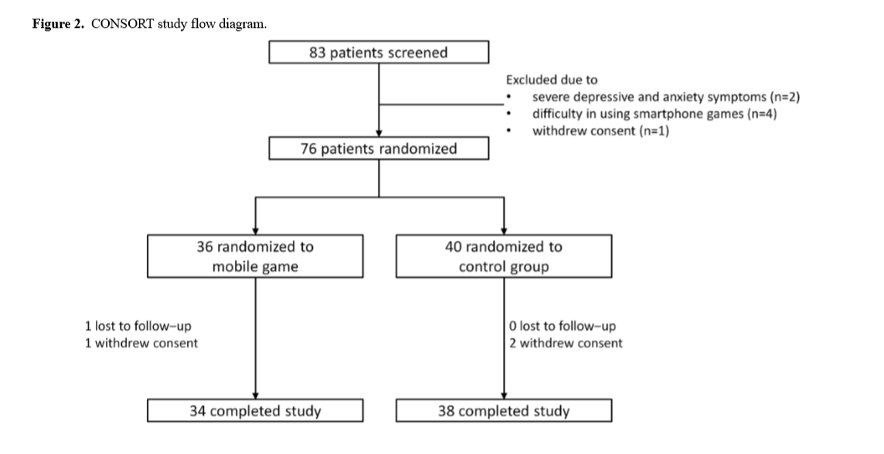
2 نفر به دلیل علائم شدید افسردگی و اضطراب
4 نفر به دلیل مشکل در استفاده از بازی موبایل
و 1 نفر به دلیل انصراف از رضایت به دلیل نامشخصی از مطالعه حذف شدند.
مداخله
کنترل
گمشده برای پیگیری=1
انصراف از رضایت =1
انصراف از رضایت=2

Slide 23
RESULTS
Demographic Characteristics
The mean age was 50.9 (SD 7.0) years,
All the patients were female.
There were no significant differences in demographics status and socioeconomic status, pathologic classification, and hormonal status between the 2 groups.

Slide 24
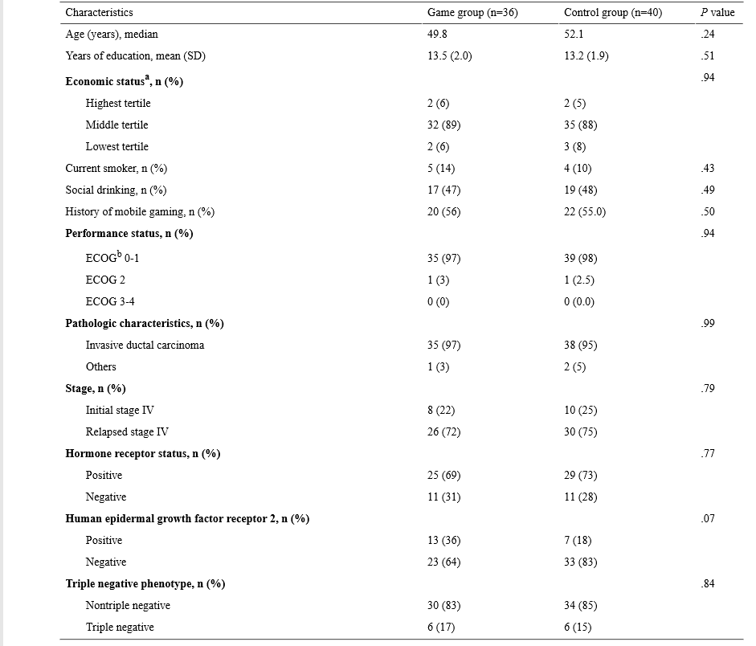
RESULTS

Slide 25

Overall Satisfaction
The patients in the game group were requested to assess their level of satisfaction with ILOVEBREAST.
Patients in the game group played 41% of the game contents, and more than half responded that it was difficult to use (56%).
However, 67% and 61% of the patients responded that the game was fun and helpful in taking their medications, respectively.
Approximately ¾ of patients responded positively in terms of acquisition of information (74.4%), usefulness in overcoming chemotherapy side effects (73.9%), and willingness to play again (72.2%).
Furthermore, approximately 81% reported they would recommend the game to other patients with breast cancer.

Slide 26
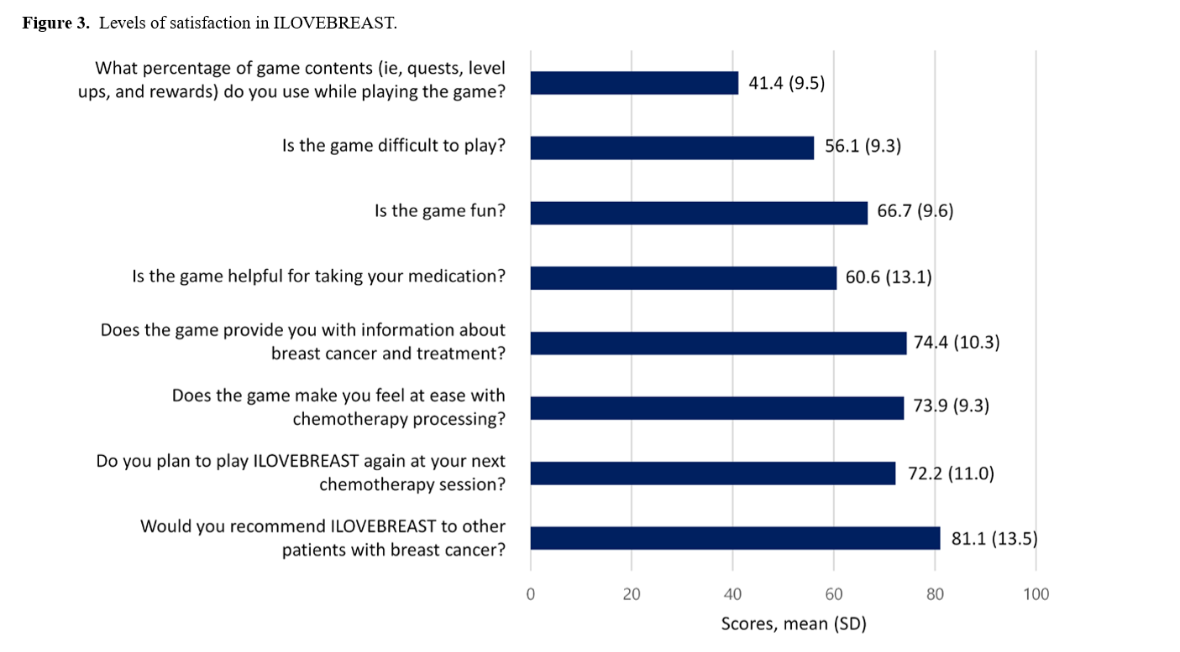
RESULT

Slide 27
STUDY Endpoints
The time spent on game playing in the mobile game group was higher than that spent for self-education in the control group.
The game group also showed improved compliance to medications compared with the control group .
The patients in the study group reported lower rates of physically adverse events, such as nausea (P=.02), fatigue (P=.02), and numbness in the hand or foot (P=.02).
After the study period of 3 weeks, the game group showed a higher QoL than in the control group.
The decrease in the QoL score was also significantly lower in the game group than in the control group (P=.01).

Slide 28
RESULTS
There were no significant differences in the BDI score or state anxiety scale between the 2 groups.
Regarding the subitems of QoL, the use of the mobile game was associated with lower decreases in physical health and environment but a higher decrease in psychological health than the usual care.

Slide 29
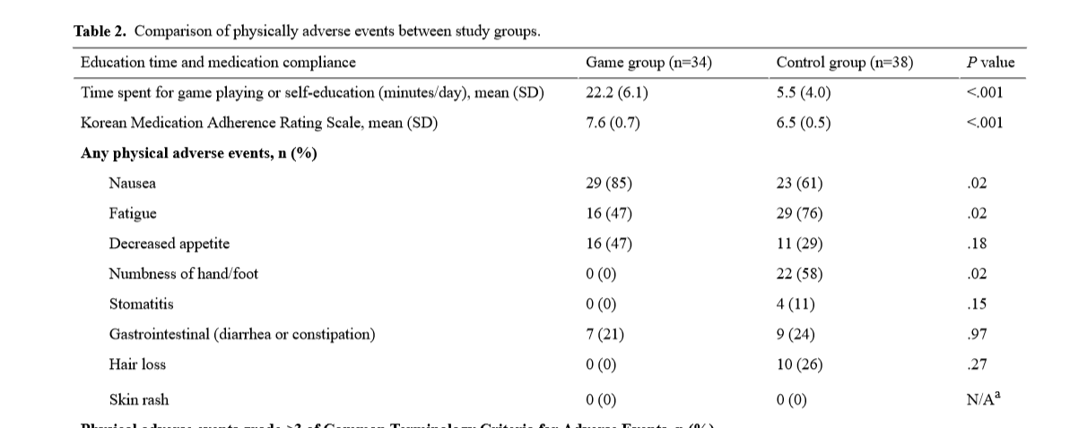

Slide 30
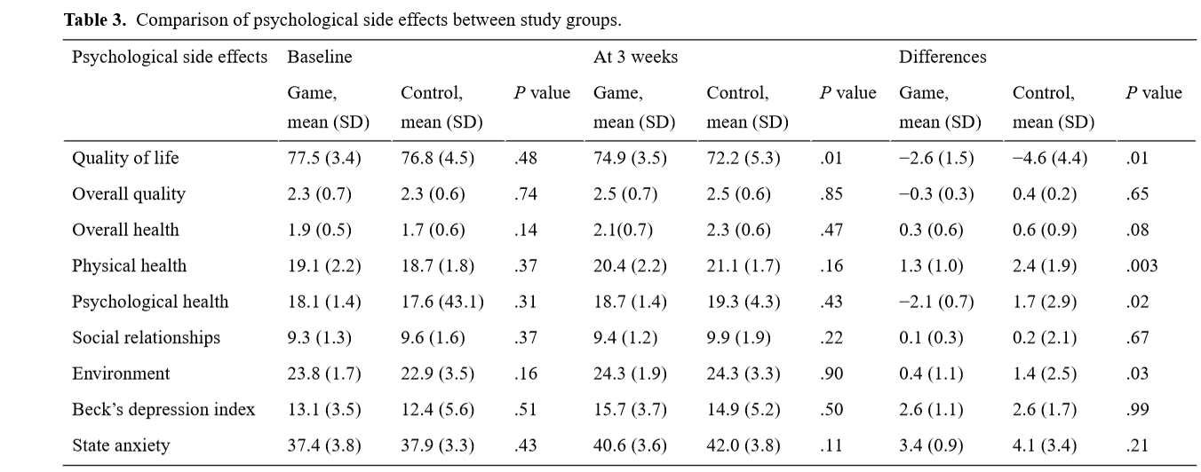

Slide 31
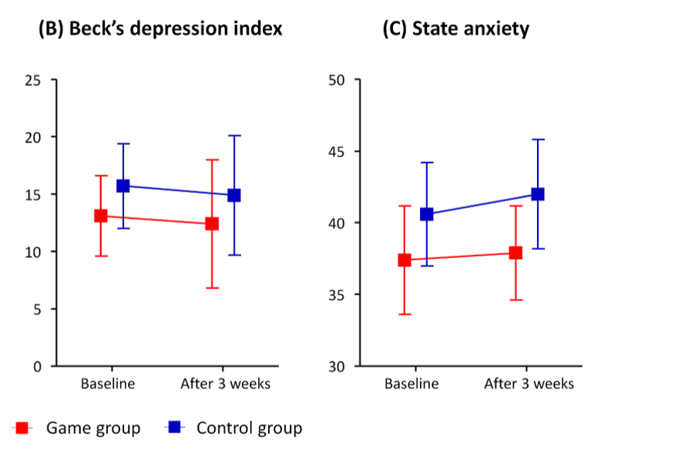

Slide 32

DISCUSSION
Principal Findings
The mobile game ILOVEBREAST was developed to help patients with advanced breast cancer learn more about the disease course, properties of medications, and expected adverse drug reactions. Adults users were generally satisfied with the game app.
The mobile game-based intervention improved patient compliance, decreased the prevalence of physical side effects, and maintained the patients’ QoL compared with the conventional care.
The use of the game had no impact on psychological side effects including mood and anxiety.
Improved Drug Compliance
Improved Drug Compliance The patients in the study group used approximately 40% of the game contents, and the overall satisfaction was acceptable. Notably, a high proportion of the patients expressed a willingness to play the game again at their next chemotherapy session and to recommend the game to other patients. In addition, education time and drug adherence were significantly higher in the game group than in the control group.

Slide 33
DISCUSSION
The quests for taking medication and reminder alarms in the game may have contributed to improving patients’ knowledge of the disease, medication, and adverse events. Previous studies have shown that knowledge about the disease course and adverse drug events is closely linked to patient drug adherence.
Since the release of the “Re-Mission” titles, which showed good adherence to treatments and easy access to knowledge, from HopeLab in California, the use of computer games in health education and physical health has been considered to have positive effects.

Slide 34
DISCUSSION
Some video games have also been used as vehicles to transmit health education regarding fire and street safety, and self-management of diabetes and asthma .
Although most health education games have focused on children, adolescents, and young adults, this study implies that adults can also utilize and benefit from game-based learning if the contents are specifically designed for them.

Slide 35
DISCUSSION
Physical Side Effects and Quality of Life
The ILOVEBREAST game presents an avatar that can prevent side effects of numbness and hair loss by purchasing gloves or hats.
The users are rewarded for continuous medication use,
and they can chat with other players who have the same disease and difficulties.
The player can buy food ingredients and learn how to cook and prepare healthy diets.
We assume that such activities resulted in decreased prevalence and severity of the physical side effects in the game group.
The Web-based game properties of attention-maintaining properties of stories, engaging properties of interactivity, and behavior-change technology may improve health-related behaviors and habits in patients with breast cancer.

Slide 36
DISCUSSION
The mobile game group in this study showed a higher QoL in various domains, including total health, physical health, psychological health, and environmental areas. Pompeu et al reported improved QoL in 7 patients with Parkinson disease by a game named Kinect Adventures.
Reichlin et al also reported an improvement in the QoL in 13 patients with localized prostate cancer after playing an interactive game, Time After Time (AMIGO, Gigamic, Piatnik, Playroom Entertainment, Germany).
However, we observed no improvement in the psychological effects in this study. Chen et al reported that pediatric patients with obesity who played educational games for about 10 weeks-2 years improved their psychosocial functions, including depression, self-efficacy, and self-esteem.
One possible explanation is the short study duration (ie, 3 weeks) of this research.
The age of the participants may be another factor. Unlike children and adolescents, older patients may have a lower propensity to have interest in playing a game.

Slide 37

Conclusion
A mobile game, ILOVEBREAST, was helpful in educating adult patients with breast cancer receiving cytotoxic chemotherapy. The game was associated with improved drug compliance, decreased prevalence rates of physical side effects, and better QoL. Patient education with smartphone mobile games can be used as an easy, fun, and effective measure to promote treatment adherence, which may potentially lead to improved survival.

Slide 38

Limitations
The major limitation of this study is the small sample size and the short study period.
Next, adverse events related to chemotherapy were assessed subjectively.
Objective assessments such as scales, blood tests, or laboratory tests may better describe the adverse effects of chemotherapy.
Also, this study reflects the difficulty when using games for adult patients. Although the patients generally expressed satisfaction,
the users experienced only a limited amount of the contents, and more than half had difficulty using the app.

Slide 39

future research
Future studies are needed to confirm which patients most benefit from the strategy using mobile games .
And whether the benefits may lead to an improvement in hard endpoints such as mortality or recurrence.

Slide 40
عنوان ارائه
با تشکر از توجه شما
مرضیه راعی
Raeem4002@mums.ac.ir

