Slide 1


Slide 2


عنوان ارائه
Supervisor
Supervisor
Supervisor
Women’s Attitudes Toward Self-Monitoring of Their Pregnancy
Using Noninvasive Electronic Devices: Cross-Sectional Multicenter
Study
Fatemeh Dahmardeh
Supervisor: Dr. Kimiafar
Dahmardehf4002@mums.ac.ir

Slide 3

.
JORAL SPECIFICAON
Impact factor: 5.7
Publish: 2019
CiteScore : 6.40
H-Index : 142
Indexed in: ISI, Scopus,
Pubmed ,DOAJ
ISSN/ISBN: 1438-8871,
1439-4456
Author: Katharina Schramm; Niklas Grassl, Juliane Nees,…

Slide 4

.
list
Introduction
Methods
Results
Discussion
Conclusions
Limitations

Slide 5
.
Introduction
Many companies offer personalized health trackers and market them as lifestyle products suitable for everyday application. Approximately 80% of women in their fertile period in the United States own a smartphone, and around 23% of female smartphone owners use mobile health apps.
However, no medically reliable, cost-effective wearable device is on the market for pregnancy self-monitoring. The use of such devices by pregnant women at home could enable closer observation, provide reassurance to concerned expectant mothers, and better identify high-risk patients. Such devices would constitute a milestone for obstetric care.
Introduction
Methods
result
Discussion
conclusions
limitations

Slide 6
.
Introduction
More generally, there is still a surprising lack of data surrounding eHealth and mobile health devices despite its widely recognized potential . Giving pregnant women the possibility to monitor their fetus at home does not only offer advantages for themselves but also for their physicians and midwives. In obstetrics as well as other medical disciplines, urgent and nonurgent emergency visits are increasing.
Concerns and worries about the unborn child are common reasons for emergency consultations in obstetrics. In these cases, it is often challenging for patients to judge whether a given condition is pathological or physiological, resulting in avoidable consultations. Several studies indicate that pregnant women are frequently dismissed upon entering the emergency room since no pathological finding was detected despite a high sense of urgency felt by the patient.

Slide 7
Introduction
Additional data from prolonged home monitoring could potentially add diagnostic value in such situations. It is also conceivable that in the future, the additional data might enable medical staff to reassure patients and their partners remotely. For this scenario to become a reality, evidence of the advantages of home monitoring would be required, and legal responsibilities would need to be clarified first.
Prolonged or even continuous monitoring of pregnancy with smart wearable devices that assess several fetal parameters could provide a very comprehensive picture of fetal well-being based on an extensive collection of data. Such recordings might, therefore, be of great value for observation and diagnostics. However, women’s willingness to use remote devices at home to monitor pregnancy has hardly been explored.

Slide 8
Survey Design and Questionnaire
Definition of telemedicine
Patients from 4 doctors were included in this prospective cross-sectional multicenter survey at the obstetric emergency departments (EDs) of the University Hospital Women’s Clinics in Heidelberg and Leipzig, Germany or cooperating obstetric outpatient clinics. German-speaking women, aged between 18 and 55 years, were eligible to contribute if they showed the capacity for consent and provided informed consent. Approximately 800 eligible patients were offered participation.
This accounts for approximately 10% of the obstetrics patients in the participating centers in the inclusion period, and this subset can be considered a random sample. The questionnaire was completed by 509 women, resulting in a participation rate of 63.9% (509/796).
Introduction
Methods
Results
Discussion
Conclusions
limitations

Slide 9
Survey Design and Questionnaire
The questionnaire consisted of 21 closed-ended questions to allow for quantitative statistical analysis. In addition, we also asked patients to provide their year of birth and their estimated due date. The questions were conceived by 2 experienced obstetricians and a clinical psychologist following a literature review and an interdisciplinary discussion with diverse members of the labor and delivery staff of the University Hospital in Heidelberg. The questionnaire was subsequently tested on 10 volunteers of our target population that were not part of the final study.

Slide 10
Survey Design and Questionnaire
The introductory questions captured characteristics of our study population such as their highest education degree, marital status, employment type, and health care plan. These questions were followed by an assessment of their current and previous pregnancies including the number of previous pregnancies deliveries, previous modes of delivery, planned mode of deliver in this pregnancy, complications in this pregnancy, whether conception was natural, and whether the current pregnancy was a multiple pregnancy. The remaining questions focused on eHealth devices for pregnancy monitoring.

Slide 11
Survey Design and Questionnaire
The description of the devices in question did not cover technical details but specified that they were noninvasive and that women would be able to put them on autonomously.
The first block of these questions inquired under which circumstances and how often the respondent was willing to engage in pregnancy monitoring at home, with possible responses like “if I felt my baby less...”
The second block focused on the expectations toward devices to monitor a pregnancy at home such as display of recordings, design, and functionality.

Slide 12
Study Population
The questionnaire was completed by 509 women, resulting in a participation rate of 63.9% (509/796) for all women that were offered participation
The completeness rate of these data was 96.3% (490/509). The sample is by and large representative of pregnant women in Germany.
Introduction
methods
Results
Discussion
Conclusions
limitations

Slide 13
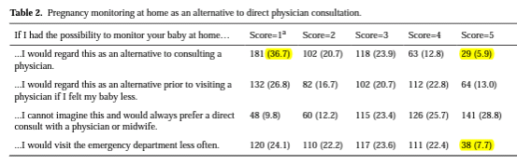
Perception of Telemedicine as Alternative to Physician Consult

Slide 14
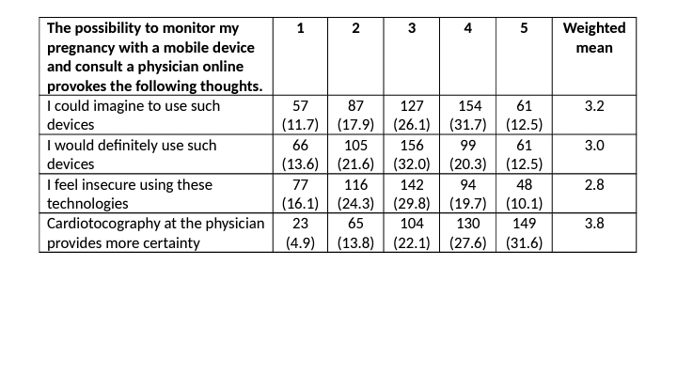

Slide 15
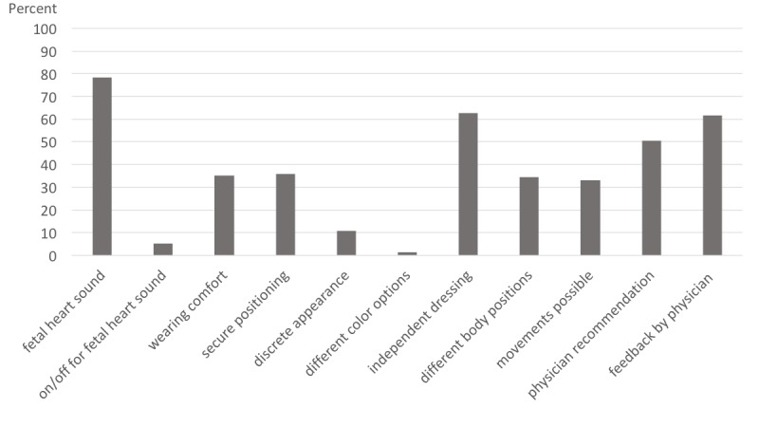
Patient preferences for features of mobile devices for pregnancy monitoring

Slide 16
we also addressed how frequently a mobile device for pregnancy self-monitoring would be used. Interestingly, 13.8% (65/471) of the participants indicated that they would perform pregnancy monitoring at home several times per day and 4.8% (23/471) even would use it “all the time if possible.” A frequency of once per day was preferred by 22.1% (104/471). The number of participants who were inclined to use it 1-4 times a week was 27.6% (130/471), and 31.6% (149/471) would use it less than once per week.
Among patients with a university degree, 37.1% (77/207) would have consulted their obstetrician less often if they had the chance to monitor their fetus at home compared with 23.1% (66/286) without a university degree (P=.001). At the same time.
The number of pregnancies did not have any impact on the willingness to use eHealth devices prior to seeing a physician (44% in first pregnancy vs 42% in women with previous pregnancies, P=.77).

Slide 17
Discussion
36.7% (181/493) of our cohort could imagine using eHealth devices prior to visiting their doctor if they felt fewer baby movements. It seems that a physician’s or midwife’s judgment is regarded as a lot more trustworthy than the reading of a monitoring device. However, it has been well established that face-to-face interactions are not superior to telemedical interactions on professional practice and health care outcomes in several medical specialties.
High trust in the opinion of a health care professional is also reflected in the features of pregnancy monitoring devices that are most important to patients. Recommendation by a physician or midwife and their feedback about the proper use of the device are found to be very important
Introduction
methods
Results
Discussion
Discussion
limitations

Slide 18
Discussion
.
Only the ability to record the fetal heart rate and to apply the device independently was discovered to be more essential to patients. All in all, the functionality of such devices is the key to patients compared with design aspects like different color options or discrete appearance.
More women with university degrees prefer a detailed over a binary readout of such devices compared with nonacademics. In general, this seems to be the population that feels most inclined to engage in pregnancy monitoring at home. A possible explanation might be that women with a university degree feel more comfortable about autonomous fetal monitoring or expect greater benefits from the use of new technologies. Of note, the proportion of participants with university degrees in our study was 40.8% compared with 14.8% in the general population .

Slide 19
.
Limitations
The study population was by and large representative of pregnant women in Germany, with a slight overrepresentation of academics and high-risk pregnancies due to the fact that participants were mainly seen at university hospitals with a maximal level perinatal care.
this study was carried out by only a few doctors in service. Therefore, not all possible women meeting the inclusion criteria were reached but rather a random cross-section thereof. Hence, we expect selection bias to be limited, especially as this was a bicentric study.
Introduction
methods
Results
Discussion
Limitations
conclusions

Slide 20
The study is an account of attitudes toward telemedicine in obstetrics at a time when telemedicine is barely used. In interpreting the findings of this study, one has to bear in mind that all study participants had no prior experience with remote pregnancy monitoring. Thus, the application of eHealth devices and telemedicine was left to women´s imagination. Consequently, our study focuses on intent rather than actual behavior. Previous studies suggest that knowledge of telemedicine in the general population is limited, and people who are not familiar with it tend to reject it .We assume that the experience and more widespread use of such devices will have a profound impact on those attitudes.

Slide 21
.
The fact that almost 20% of women would be willing to wear devices for pregnancy monitoring all the time or several times daily highlights the desire of some women to closely monitor their pregnancy. In fact, monitoring frequencies of once per week or more—preferred by 2-thirds of our participants—seem only practical using self-monitoring devices. Hence, these responses highlight pregnant women’s desire to get frequent updates on fetal well-being and their self-evolvement. The desired monitoring frequencies require the new devices to be handy and noninvasive.
Outlook for Pregnancy Self-monitoring

Slide 22
Conclusions
Our study provides a first comprehensive picture of the attitudes of women toward pregnancy self-monitoring at a time when the use of such technology is not established in Germany. The majority of study participants seem reserved toward any form of pregnancy monitoring that does not involve close interactions with health care professionals. However, at the same time, a vast majority expressed interest in frequent fetal monitoring if reliable and easy-to-use devices were available. This suggests that devices for fetal self-monitoring could become a valuable supplement to physicians’ and midwives’ obstetrics care and ought to be investigated in clinical studies soon.
Introduction
methods
Results
Discussion
Limitations
conclusions

Slide 23
عنوان ارائه
با تشکر از توجه شما
نام ارائه دهنده
ایمیل ارائه دهنده

Slide 24

QUESTION

Slide 25
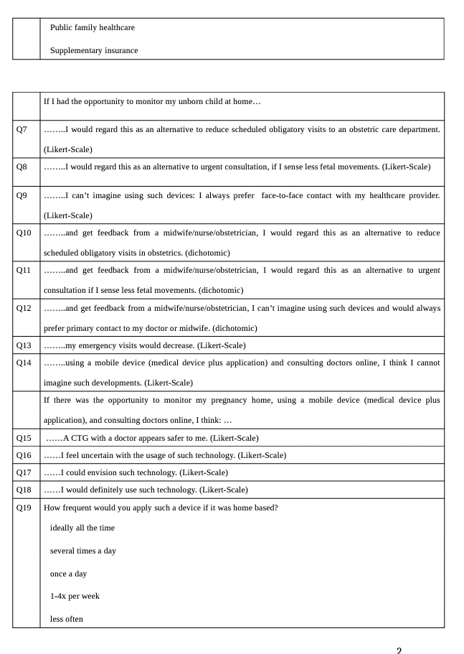

Slide 26
