Slide 1


Improved Outcomes in Patients with Retinal Detachment after Implementation of a Silicone Oil Registry and Phone Call Reminder System
باسمه تعالی
بهاره ظفرنژاد
دکتر سمیه فضایلی
zafarnb2@mums.ac.ir

Slide 2
journal : ophthalmology retina
H Index: 18
Impact factor : 14/27
Index in scopus , PubMed ,Embase

Slide 3
introduction
Complex retinal detachment (RD) associated with proliferative vitreoretinopathy, giant retinal tear, proliferative diabetic retinopathy, ocular trauma, and other causes can lead to significant vision loss and even legal blindness.
Since it was first described in 1962,1 silicone oil (SO) has been demonstrated to be an effective intraocular tamponade and has become part of the standard technique for complex RD repair, a frequent choice for vitreous replacement after pars plana vitrectomy (PPV) in these complex cases..
However, it is still not a perfect or ideal permanent vitreous replacement because of its possible complications, such as keratopathy, glaucoma, and cataracts, due to long-term exposure.

Slide 4
introduction
regular follow-up appointments are needed to allow the clinician to observe the patient and adjust the timing of intervention as needed.
Most SO-related complications relate to emulsification. Keratopathy, glaucoma, and cataracts are the main complications of concern.
The main risk factor for emulsification is duration of SO tamponade, with occurrence from 5 to 24 months after SO injection; in most cases, emulsification is detectable within the first year.
Because of the variability in time to emulsification, regular follow-up is the key to balancing the anatomic and functional status of the eye and complications due to SO emulsification. Missed appointments at the surgeon’s office can lead to delay in treatment and unexpected complications

Slide 5
Although many factors interfere with patient follow-up,11 the most common reason for missed appointments is that the patient simply forgets.
Thus, there are various strategies, including e-mail, phone calls, letters, and text messages, that have been used as reminders to reduce missed appointments.
To the best of our knowledge, no study has evaluated the efficacy of a registry and phone call intervention to improve the rates of adherence and treatment outcomes in patients with complicated RD receiving SO tamponade.

Slide 6
Methods
After approval by the Human Research Protection Program at the University of California, San Francisco and Zuckerberg San Francisco General Hospital and Trauma Center (ZSFG), we conducted a retrospective review of a prospectively collected cohort of patients with complex RD who underwent PPV with SO injection at ZSFG between 2006 and 2017.

Slide 7
Methods
Partway through that time period, in 2014, the Department of Ophthalmology at ZSFG implemented a phone call follow-up appointment reminder system for patients receiving SO injection.
Clinic staff created a prospective registry of all patients receiving SO injection. Once the 6- month duration of SO implantation was reached, staff tracked whether the patient attended his/her 6-month appointment and whether the SO removal surgery was scheduled and completed.
This was in addition to standard call-backs for individual missed clinic appointments , as is used widely in our practice and in others.
In the event that the patient did not attend follow-up visits, staff persisted to contact the patient by phone multiple times to reschedule the appointment and confirm attendance.
Staff also actively communicated with surgeons to ensure that SO removal was arranged and completed

Slide 8
Methods
For the retrospective review conducted in this study, patients with complex RD who underwent PPV with SO injection between 2006 and 2017 and maintained an attached retina for more than 3 months were included.
Patients were divided into 2 groups according to the date on which the surgery was performed.
The control group consisted of patients who underwent the procedure before 2014, before the implementation of the registry and phone call reminder system; the treatment group consisted of patients whose surgery was in 2014 or later, with the new system in use.

Slide 9
Methods
Parameters analyzed for the study included age, gender, indication for surgery, duration before SO removal, time to follow-up, occurrence of keratopathy, no-show rate in treatment group, and intraocular pressure (IOP) at the last visit before SO removal.
The loss to follow-up rate was calculated and relates to patients who underwent PPV with SO injection who disappeared from follow-up for more than 6 months and did not return for SO removal at all throughout the entire study period (to the end of 2017).
A no-show was defined as a patient who missed a scheduled appointment without having canceled it ahead of time. Because there was no intentional tracking of the scheduled appointments in the control group, the no-show rate was only calculated for the treatment group.

Slide 10
Methods
Using SPSS software (version 21, IBM, Armonk, NY) for statistical analysis.
An independent t test was used to compare age and the duration before SO removal between the 2 groups.
The Wilcoxon ManneWhitney test was used to compare the gender of the 2 groups.
Results were considered significant at P < 0.05.

Slide 11
Results
48 were included in the control group (no phone call reminder) and 39 were included in the treatment group (with phone call reminder).
There was no significant difference in age and gender between the 2 groups.
The median age was 54.4 (45.0e59.9) years in the control group and 55.0 (42.5e60.2) years in the treatment group.
The control group consisted of 36 men and 12 women, whereas there were 27 men and 12 women in the treatment group.
The number of patients with complex RD associated with proliferative vitreoretinopathy, proliferative diabetic retinopathy, ocular trauma, giant retinal tear, and other causes was 14, 12, 7, 5, and 9,respectively,
in the control group, and 20, 9, 7, 3, and 0, respectively, in the treatment group.

Slide 12
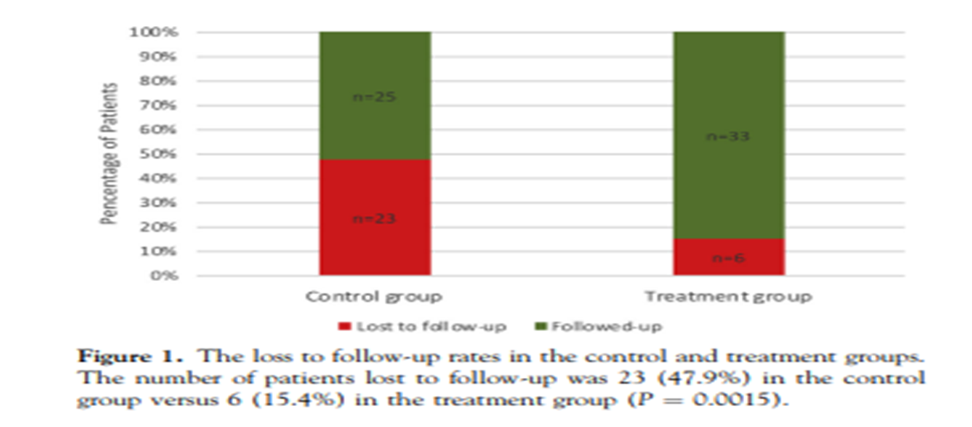
Results
With regard to the primary outcome measure, the number of patients lost to follow-up was 23 (47.9%) in the control group versus 6 (15.4%) in the treatment group (P ¼ 0.0015). (P ¼ 0.0015) (Fig 1)

Slide 13
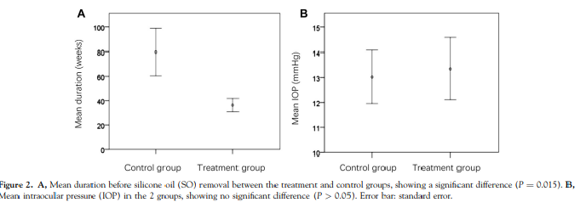
Results
The remainder in each group (25 controls and 33 treatment eyes) underwent SO removal. The mean duration of SO in the eye before removal was 79.691.7 weeks in the control group and 36.331.5 weeks in the treatment group (meanstandard deviation [SD]) (P ¼ 0.015) (Fig 2A).

Slide 14
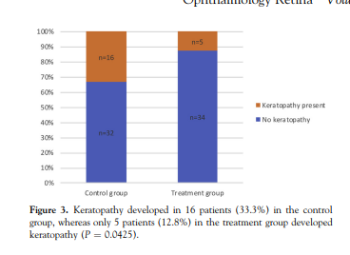
Results
Mean IOP was 13.05.2 mmHg (meanSD) at the last visit before SO removal in the control group and 13.37 mmHg (meanSD) in the treatment group (P > 0.05) (Fig 2B). There were 16 patients (33.3%) in the control group who developed keratopathy, whereas only 5 patients (12.8%) in the treatment group did (P ¼ 0.0425) (Fig 3).

Slide 15
Results
Within the control group, there was a trend toward longer duration of SO tamponade correlating with the development of keratopathy as an independent variable:
The mean duration of SO tamponade was 118.2 weeks in eyes developing keratopathy versus 60.1 weeks in eyes without keratopathy (P ¼ 0.09);
in the treatment group, the mean duration of SO was 28.2 weeks in eyes with keratopathy and 32.2 weeks in eyes without keratopathy (P ¼ 0.96).
In the treatment group, the number of appointments kept was 232, whereas the number of no-show visits was 30, yielding a no-show rate of 11.5% (30/262). Finally, 100% of patients in the treatment group were able to be examined or reached by phone at least once during the postoperative period.

Slide 16
Discussion
This study found that the number of patients lost to follow-up markedly decreased after implementation of the registry and reminder system, from 23 (47.9%) to 6 (15.4%). Loss to follow-up may represent a broader problem in the management of vitreoretinal disease, as a recent study showed that the rate exceeded 20% after antivascular endothelial growth factor injections.
The results of the present study indicate that a phone call reminder call system can be an effective means of improving patient compliance with follow-up examinations and surgical treatment. These findings are supported by previous studies demonstrating that a personal phone call appointment reminder can improve adherence to follow-up appointments, despite the fact that there are various reasons for patients not adhering to a schedule of follow-up appointments.

Slide 17
Discussion
In this series, reducing the loss to follow-up rate improved patient safety and outcomes, largely by shortening the time that SO remained in the patients’ eyes.
Indeed, duration of SO tamponade has been shown to be the greatest risk factor for SO emulsification, which can lead to keratopathy, glaucoma, and cataracts.
Keratopathy as one of the complications of SO tamponade declined significantly after implementation of the registry and reminder system, in conjunction with the reduced duration of SO in the eye in the treatment group.
The IOP was not significantly different between the groups, possibly because it was able to be controlled with eye drops in both groups.
Cataract formation was not analyzed as an outcome measure in this study for 2 reasons. First, unlike keratopathy or glaucoma, cataract formation does not lead to a permanently poor outcome, because it can be addressed surgically at any point; second, many patients had cataract removal in combination with their RD repair or SO removal procedures.

Slide 18
Discussion
In this study, we also determined the no-show rate in the treatment group. This may be an important index in that it represents not only the care of the patients in question but also the experience of the clinic population in general because of the negative impacts that no-shows have on clinic efficiency.
The no-show rate of 11.5% achieved in the treatment group is similar to the goal of 10% that is often established as a target for efficiency and to avoid disruption of clinic operations.
This reinforces the added value to clinic efficiency brought about by the SO registry and reminder system and is consistent with prior reports showing that reminders can improve ophthalmic follow-up adherence.

Slide 19
Study Limitations
One is that the study describes a retrospective cohort without randomization.
In addition, the study is limited by its small sample size and the fact that the assessment takes place at only 1 center.
Another limitation is in the scope of patient parameters analyzed, because they relate to follow-up compliance.

Slide 20
Conclusions
In this study, we found that a patient registry and phone call follow-up appointment reminder system for patients receiving SO tamponade significantly improved attendance at follow-up appointments and reduced the duration of SO in patients’ eyes.
Patient outcomes were improved, most concretely by a reduction in the rate of keratopathy with the use of the registry.
Further studies are indicated to evaluate the generalizability of these results to other patient populations.

Slide 21
عنوان ارائه
با تشکر از توجه شما
نام ارائه دهنده :بهاره ظفرنژاد
zafarnb2@mums.ac.ir

