Slide 1


بسمه تعالی
Improving Diagnostic Classification of Stillbirths and Neonatal Deaths Using ICD-PM (International Classification of Diseases for Perinatal Mortality) Codes: Validation Study
نام ارائه دهنده : معصومه جعفری
استاد راهنما : دکتر مرضیه معراجی
jafarim982@mums.ac.ir

Slide 2


Slide 3
Introduction
Methods
Results
Discussion
Conclusions
More than 5 million perinatal deaths occur globally each year, and this largely silent epidemic significantly impacts and burdens families. Despite this, perinatal deaths have long been frequently invisible and poorly recorded worldwide. A large proportion of stillbirth and neonatal death cases take place in less developed countries. Classification methods used in these countries can be obscure. The numbers of skilled medical personnel are often inadequate, which contributes to less than comprehensive recording of clinical data at the time of stillbirth and neonatal deaths.

Slide 4
In contrast, stillbirth affects proportionally fewer births in high-income countries, and data related to these deaths tend to be comprehensively recorded. Many high-income countries have developed their own classification systems for perinatal deaths; for example, the United Kingdom uses the Codac system, Sweden has the Stockholm system, Australia and New Zealand use the Perinatal Society of Australia and New Zealand perinatal death classification system, and the Netherlands uses the Tulip classification system. In the United States, the Stillbirth Collaborative Research Network developed the initial causes of fetal death system.
While we see an annual reduction in the rate in stillbirth globally, this trend differs widely among high- and low- income countries.

Slide 5
An internationally recognized classification system of perinatal mortality would be invaluable so that the data could easily be compared between different countries to facilitate classification and research in driving programs to reduce the overall perinatal mortality.
Based on the International Statistical Classification of Diseases and Related Health Problems, 10th Revision (ICD-10), the International Classification of Diseases for Perinatal Mortality (ICD-PM) was released by the World Health Organization in August 2016.
It is the first perinatal death classification system developed to be used worldwide. This system links the cause of perinatal death, using ICD-10 codes, separated by timing of death, with the maternal conditions that contribute to perinatal death.

Slide 6
Currently, in Hong Kong under the Hospital Authority, the coding system (for stillbirths only) used is a direct one (ie, if the cause of the stillbirth could be identified, it would be stated directly such as congenital abnormalities, pregnancy-induced hypertension, cord accident, antepartum hemorrhage, maternal disease). The remaining cases would be placed in the categories unclassified, unexplained, and miscellaneous/uninvestigated, which essentially refer to unknown causes.
The problem is that up to 92.8% (800/862) of stillbirths from 2012 to 2018 were classified under these 3 categories. This phenomenon has significantly impaired the potential of using this perinatal database to further study and design programs to reduce perinatal mortality.

Slide 7
We hypothesized that by using a globally applicable classification system such as ICD-PM that recognizes stillbirths and neonatal deaths together with the contributing maternal conditions, coding of stillbirth and neonatal death could be significantly improved. Therefore, a validation study was performed to apply the ICD-PM coding system to our stillbirths and neonatal death cases.

Slide 8
The primary outcome was the reduction in unknown causes for stillbirth and neonatal death after applying the ICD-PM coding system
Outcome
The secondary outcome was the percentage agreement with expert (EA) in applying ICD-PM codes.

Slide 9
Introduction
Methods
Results
Discussion
Conclusions
The ICD-PM system, the World Health Organization application of the ICD-10 to deaths during the perinatal period, was applied to existing perinatal death data from May 1, 2012, to April 30, 2019, in Kwong Wah Hospital, a regional public hospital with 34,920 deliveries during the 7-year study period.

Slide 10
Inclusion criteria
• Stillbirth cases diagnosed after 24 completed weeks gestation
• Neonatal death cases within 28 days of birth
Selection Criteria
Exclusion criteria
• Miscarriage at less than 24 completed weeks of gestation
• Termination of pregnancy due to fetal anomalies or maternal abnormal medical conditions

Slide 11
Diagnostic Classification
In our department, every case of stillbirth and neonatal death is discussed in our monthly perinatal meetings attended by consultants, specialists, trainees, and senior labor ward midwives and senior nurses from the departments of obstetrics and gynecology and pediatrics. A detailed case summary is presented by the resident trainee directly involved in the clinical management of that particular case. Diagnosis of the cause of stillbirth and neonatal death is based on the clinical findings and investigation results.

Slide 12
Our validation study started in 2017 and was divided into two parts:
Retrospective Validation Study (Five Years)
May 1, 2012, to April 30, 2017
Prospective Validation Study (Two Years)
May 1, 2017, to April 30, 2019

Slide 13
Statistical Analysis
All frequency data were analyzed by summary statistics. SPSS Statistics version 25.0 (IBM Corporation) was used for the analysis. The Pearson chi-square test was used where appropriate, such as to determine whether there was a significant difference between the frequency of unknown causes of death classified in our original Hospital Authority coding system and the newly applied ICD-PM coding system.

Slide 14
Introduction
Methods
Results
Discussion
Conclusions
34,920 deliveries
119 cases
Retrospective ICD-PM codes total 85 cases
Prospective ICD-PM codes total 34 cases

Slide 15
EA verified every single one of the 119 stillbirth and neonatal death cases during the study period. The overall agreement rate of our codes using ICD-10 and then ICD-PM was 93.2% (111/119 cases) with EA: 92% (78/85 cases) for the 5 years of retrospective cases and 97% (33/34 cases) for the 2 years of prospective cases (P=.44).

Slide 16
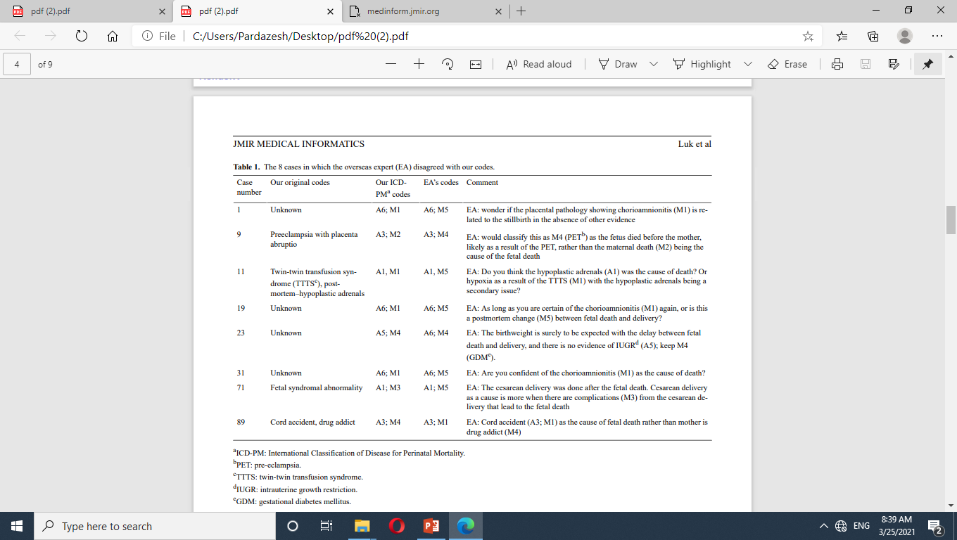

Slide 17
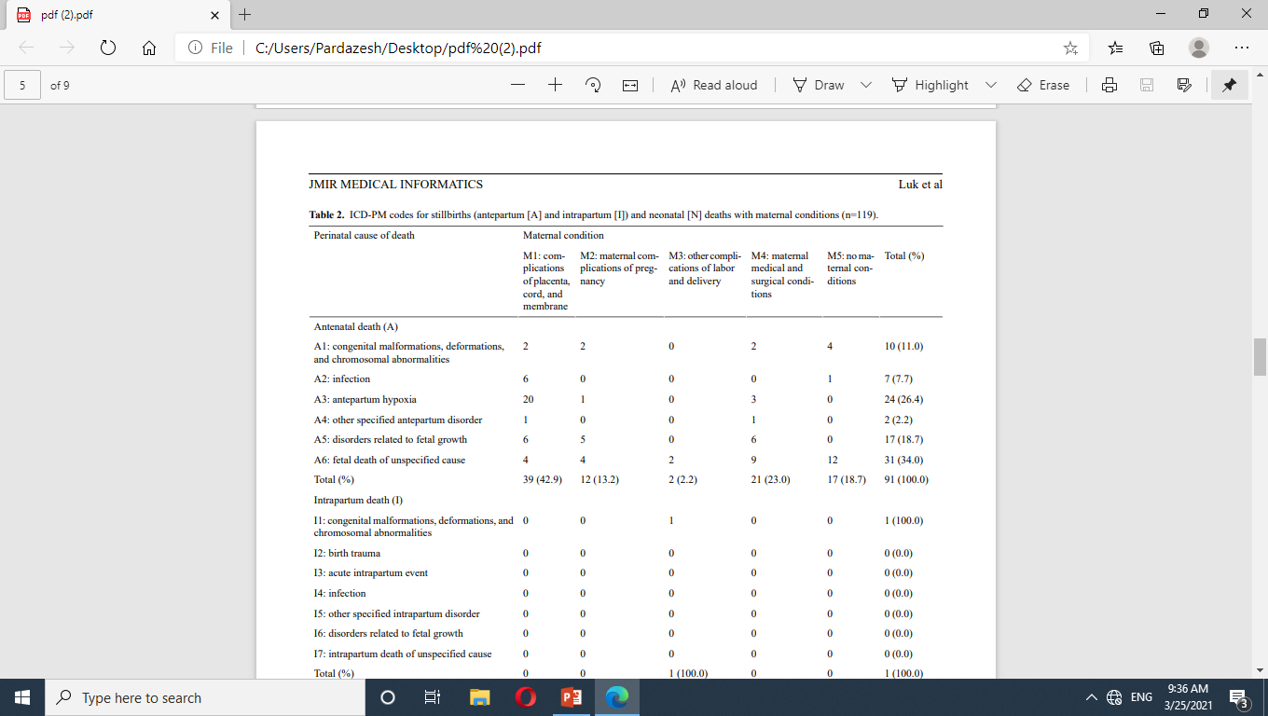

Slide 18


Slide 19
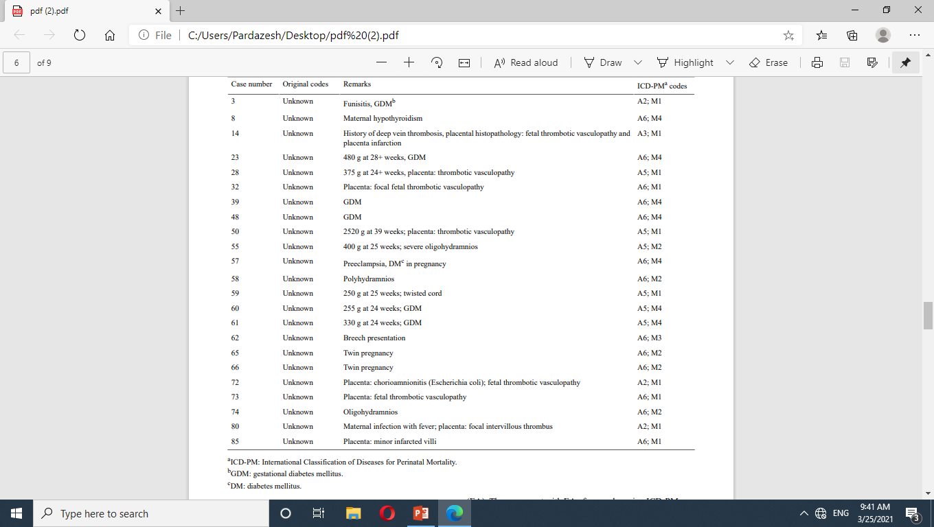

Slide 20
unknown causes of stillbirths and neonatal deaths
application of the ICD-PM coding system
Before
After
34.5% (41/119)
10.1% (12/119)

Slide 21
Introduction
Methods
Results
Discussion
Conclusions
Perinatal deaths remain problematic worldwide. Before the advent of the ICD-PM, there were several independent systems in high-income countries and few systems in low- and middleincome countries, causing significant disparity in perinatal death data recorded among countries. The classification system used in Hong Kong Hospital Authority obstetrics units is no better, with 92.8% of cases having unknown causes.It seems that we were somehow reluctant to give a specific diagnosis under the original coding system unless the cause was crystal clear. Hence detailed and accurate information that can be retrieved from our original classification of perinatal mortality cases was scarce The ICD-PM is the first system that addresses the issue internationally.

Slide 22
ICD-10 and ICD-PM are user-friendly as shown by the high level of agreement (93.2% overall) between our codes with that by the international expert (EA). The agreement with EA of our codes using ICD-PM was even higher, reaching 97.1% for the 2 years of prospective cases compared with 91.8% for the 5 years of retrospective cases, although not statistically significant (P=.44).
This further supports our observation that the final consensus code made during perinatal meetings with multidisciplinary discussion on the perinatal death cases gives the most accurate answer, although our principal investigator (HML) had already done a good job with the 5-year retrospective codes.

Slide 23
The ICD-PM is designed to be used for classifying stillbirths and neonatal deaths at three levels
time of death
antepartum (before the onset of labor)
intrapartum (during labor but before delivery)
neonatal
it is multilayered such that the depth of classification can reflect the locally available intensity of investigation.
links the contributing maternal condition, if any, with perinatal death

Slide 24
classification at all three levels allows easy identification of where a program intervention should be targeted in order to improve the perinatal outcomes.

Slide 25
The main benefit of using ICD-10 and ICD-PM codes was to have a better understanding of the perinatal deaths in terms of the timing of death, the depth of investigations, and any contributing maternal conditions.
We also consider the ICD-PM code to be user-friendly for changing an existing local perinatal death classification to one that is global and can be compared with international data.
Using the ICD-PM code can lead to better classification of perinatal deaths, reduce the proportion of unknown diagnoses, and clearly link the maternal conditions with these perinatal deaths.
There are some countries such as the United Kingdom, South Africa, India, and Colombia .using the ICD-PM to interpret the perinatal mortality data which showed that the ICD-PM classification was feasible and enabling the characterization of perinatal mortality. This is the first validation study demonstrating the application of the ICD-PM coding system in Hong Kong.

Slide 26
Limitations
However, there are limitations to our study. The study was focused on one hospital only, so the sample size was small. The improvement in coding might be related to the enthusiastic principal investigator (HML) as the coder in the retrospective validation study; the code in the prospective validation study was done during our monthly perinatal meetings with multidisciplinary input from various stakeholders, which is our usual practice before and after the study. Whether there is an overall Hawthorne effect (improving performance of coding during the study period) could be seen by continuous monitoring of the diagnostic classification of stillbirths and neonatal deaths after the ICD-PM is formally used for coding from 2020 onward. Further study can be performed in all Hong Kong Hospital Authority obstetrics units using the ICD-10 and ICD-PM so as to draw an overall picture of perinatal mortality across the territory.

Slide 27
Introduction
Methods
Results
Discussion
Conclusions
The ICD-PM is a user-friendly system that can enhance the understanding of data. Using the ICD-PM coding system could lead to a more comprehensive classification of perinatal deaths, reduce the proportion of unknown causes as well as providing better linkage to maternal conditions in these perinatal deaths. The ICD-PM classifications are more extensive in covering diagnostic categories, with more specific details. Implementing this new coding system in Hong Kong Hospital Authority obstetrics units will be of great help in improving clinical practice and reducing perinatal mortality in the long run.

Slide 28
عنوان ارائه
با تشکر از توجه شما

