Slide 1


Development And Usability Testing Of Riyadh Mother And Baby Multi-center Cohort Study Registry
باسمه تعالی
Fatemeh Shafiee
Dr. Kimayafar
shafieemf981@mums.ac.ir

Slide 2

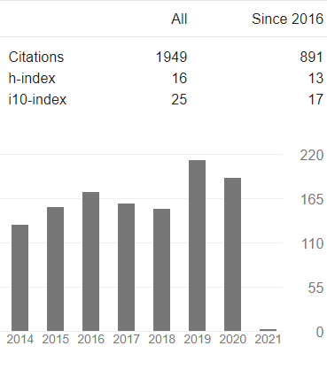
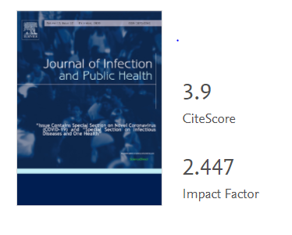
Source details
Nasriah Zakaria
journal of Infection and Public Health
Development And Usability Testing Of Riyadh Mother And Baby Multi-center Cohort Study Registry
Fatemeh Shafiee

Slide 3
Strength & limitations
Introduction
Conclusion
Discussion
Methods
Results
The use of information technology in healthcare is an integral part to the reform of health systems in many countries.
Although, many health systems are yet to incorporate more sophisticated applications in different aspects of patients’ care and health research, the implementation of such technology may prove to be challenging to the users.
Development And Usability Testing Of Riyadh Mother And Baby Multi-center Cohort Study Registry
Fatemeh Shafiee

Slide 4
Strength & limitations
Introduction
Conclusion
Discussion
Methods
Results
Based on failures of adoption of some high-cost national electronic systems, early usability testing and sharing of technology with end-users and stakeholders is of paramount importance and may prove to be vital in overcoming challenges and barriers.
Development And Usability Testing Of Riyadh Mother And Baby Multi-center Cohort Study Registry
Fatemeh Shafiee

Slide 5
Strength & limitations
Introduction
Conclusion
Discussion
Methods
Results
Registries are software programs that collect and store data and serve as a recording tool. A registry is a type of clinical research informatics (CRI) system, defined as a health information technology intervention, that enables the computerized collection, storage, a processing of data specifically for clinical research. Registries in medical research help to explain the history of a disease, to inform the clinical and cost effectiveness, and to determine the risk factors and measure health outcomes
Development And Usability Testing Of Riyadh Mother And Baby Multi-center Cohort Study Registry
Fatemeh Shafiee

Slide 6
Strength & limitations
Introduction
Conclusion
Discussion
Methods
Results
Such features are important especially for longitudinal studies, which investigate the effects of exposure in more than one generation of the population.
Furthermore, registries can be used as audit tools for improving the quality of healthcare.
A user-centered approach is employed to measure human interaction with computer in work settings. Usability testing examines HOW users interact with
a system in the work environment
and evaluates the capacity, performance
and ease of use of the system
Development And Usability Testing Of Riyadh Mother And Baby Multi-center Cohort Study Registry
Fatemeh Shafiee

Slide 7
Strength & limitations
Introduction
Conclusion
Discussion
Methods
Results
Users are included during the early design phases and an iterative development process is employed to ensure the final system will be well suited to the users’ needs.
Multiple data collection methods, such as “think aloud” and focus groups, are used in user-centered approach.
Development And Usability Testing Of Riyadh Mother And Baby Multi-center Cohort Study Registry
Fatemeh Shafiee

Slide 8
Strength & limitations
Introduction
Conclusion
Discussion
Methods
Results
They enable triangulation and inform the iterative process so that users’ needs and opinions could be incorporate throughout the development process. Usability attributes that can be measured through user-centered approach include:
Efficiency
Learnability
Memorability
error rate
and satisfaction
Development And Usability Testing Of Riyadh Mother And Baby Multi-center Cohort Study Registry
Fatemeh Shafiee

Slide 9
Strength & limitations
Introduction
Conclusion
Discussion
Methods
Results
In Saudi Arabia, there is still a gap in medical research technology development thus understanding how registries can be used for research is an innovation. A recent work on registry in biomedical devices was published in the past year to show there are efforts in registry development in Saudi Arabia.
The objective of this study is to test the usability of the cohort
registry developed for clinical research and service improvement.
Development And Usability Testing Of Riyadh Mother And Baby Multi-center Cohort Study Registry
Fatemeh Shafiee

Slide 10
Strength & limitations
Introduction
Conclusion
Discussion
Methods
Results
RAHMA registry development
The subject of this registry is Riyadh Mother and Baby Multicenter (RAHMA) Cohort Study which was conducted in three major hospitals in Riyadh, the capital city of Saudi Arabia, to investigate the effects of maternal non-communicable diseases on newborn and child. The study recruited more than 14,000 participants using paper-based data collection.
The participants will be followed for several decades to come. The study had noticeable impact on clinical practice as analysis of the data from the study was used as an audit tool to improve screening and management of pregnant women for gestational and pre-gestational diabetes
Development And Usability Testing Of Riyadh Mother And Baby Multi-center Cohort Study Registry
Fatemeh Shafiee

Slide 11
Strength & limitations
Introduction
Conclusion
Discussion
Methods
Results
RAHMA registry was custom-made to overcome medical research challenges specific to Saudi Arabia, such as difficulties in recalling participants due to duplication of family names, insufficient contact information and lack of national medical records.
RAHMA registry was developed in-house to reduce the cost of data collection. It was designed and developed using Visual Basic and ASP.NET. The database underlying the system is Microsoft SQL Server 2005.
There are four sections in the registry:
Development And Usability Testing Of Riyadh Mother And Baby Multi-center Cohort Study Registry
Fatemeh Shafiee

Slide 12
Strength & limitations
Introduction
Conclusion
Discussion
Methods
Results
Dashboard:
dashboard where users can access specific patient record in the registry, log management and user management.
User management section which can be accessed through the dashboard from where administrator can create access for users for clinicians and researchers.
Development And Usability Testing Of Riyadh Mother And Baby Multi-center Cohort Study Registry
Fatemeh Shafiee

Slide 13
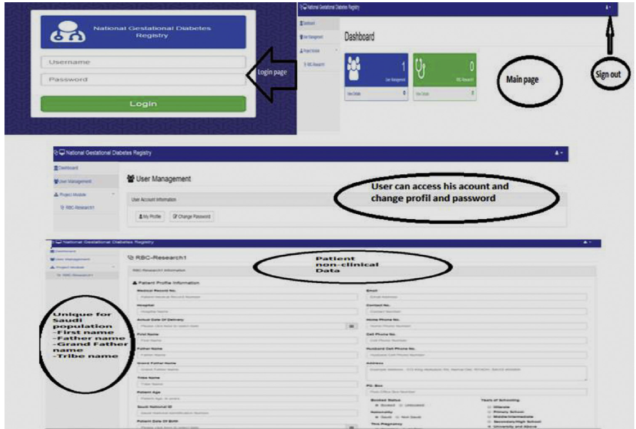
Strength & limitations
Introduction
Conclusion
Discussion
Methods
Results
Appendix A.
Screenshot of login, dashboard and login information
Development And Usability Testing Of Riyadh Mother And Baby Multi-center Cohort Study Registry
Fatemeh Shafiee

Slide 14
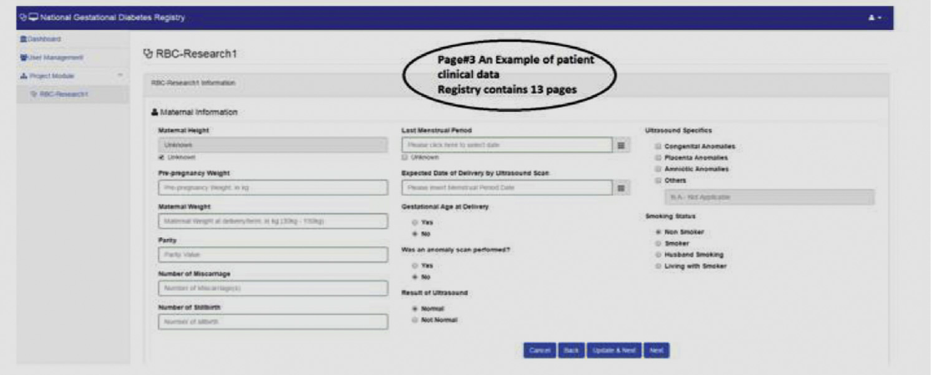
Strength & limitations
Introduction
Conclusion
Discussion
Methods
Results
Development And Usability Testing Of Riyadh Mother And Baby Multi-center Cohort Study Registry
Fatemeh Shafiee

Slide 15
Strength & limitations
Introduction
Conclusion
Discussion
Methods
Results
RAHMA Registry data collection section:
contains 13 forms with a total of 256 fields to collect all maternity and newborn clinical information.
The forms allow data to be collected longitudinally through pregnancy and postpartum period.
To reduce duplication and the possibility of errors when entering participants’ names, the system offers fields for all Arabic name components
(first name, last name, grandfather’s name and tribe name)
Development And Usability Testing Of Riyadh Mother And Baby Multi-center Cohort Study Registry
Fatemeh Shafiee

Slide 16
Strength & limitations
Introduction
Conclusion
Discussion
Methods
Results
For contact information, both cell and home phone numbers for the participants and husbands were included.
In addition, the system incorporates automated features such as calculation of BMI, expected delivery date, and validates data entered into fields as being the correct range and type (numerical vs. text).
The user can navigate from one form to another using the quick link menu.
Users can export data into text (csv) or spreadsheet (Excel) format for data analysis purposes.
Development And Usability Testing Of Riyadh Mother And Baby Multi-center Cohort Study Registry
Fatemeh Shafiee

Slide 17
Strength & limitations
Introduction
Conclusion
Discussion
Methods
Results
Log management section:
allows users to view and track all system-related activities, such as the latest accessed records and changes made to records.
Development And Usability Testing Of Riyadh Mother And Baby Multi-center Cohort Study Registry
Fatemeh Shafiee

Slide 18
Strength & limitations
Introduction
Conclusion
Discussion
Methods
Results
Setting and participants
We adopted a user-centered approach; where users were part of the early stages of system design and their feedback was elicited during development of the system through think aloud sessions and focus groups. The feedback directly resulted in changes to the registry followed by re-testing (iterative approach).
Development And Usability Testing Of Riyadh Mother And Baby Multi-center Cohort Study Registry
Fatemeh Shafiee

Slide 19
Strength & limitations
Introduction
Conclusion
Discussion
Methods
Results
The qualitative research study was conducted at King Khalid University Hospital (KKUH) which is part of King Saud University medical city. The hospital was one of the centers where the cohort study was conducted. Data collection was conducted between April and May 2015.
Purposive sampling technique was used where we recruited participants who were researchers or potential researchers including; nurses, physicians and researchers working in the maternity or pediatric departments in addition to public health and family medicine specialists. Based on user interaction experts, 85% of the usability problems can be discovered by 4 or 5 participants while 100% of usability problems can discovered by 15 users. Thus, in this study, we recruited 15 participants.
Development And Usability Testing Of Riyadh Mother And Baby Multi-center Cohort Study Registry
Fatemeh Shafiee

Slide 20
Strength & limitations
Introduction
Conclusion
Discussion
Methods
Results
All participants signed a consent form and agreed to be tape-recorded during data collection. The sessions were conducted in computer laboratories, offices or clinics that were equipped with internet access computer and offered a quiet and private environment conducive for think aloud and focus group session.
Development And Usability Testing Of Riyadh Mother And Baby Multi-center Cohort Study Registry
Fatemeh Shafiee

Slide 21
Strength & limitations
Introduction
Conclusion
Discussion
Methods
Results
Qualitative research: Think Aloud and focus group
A qualitative design was employed to explore users’ experience in depth. This method was chosen to elicit the shortcomings of the registry design and to improve the contents and design of the registry.
For triangulation, we employed two data collection methods which were, think aloud and focus group
Development And Usability Testing Of Riyadh Mother And Baby Multi-center Cohort Study Registry
Fatemeh Shafiee

Slide 22
Strength & limitations
Introduction
Conclusion
Discussion
Methods
Results
Think aloud is a qualitative data collection method where participants think and talk out loud while performing usability testing of software.
A few studies in healthcare, employed think aloud technique to capture user’s thoughts, and also behavior of interaction with a bed side systems and one study for a nursing scheduling system explained how think aloud provide an insight how user behave when using the system.
Development And Usability Testing Of Riyadh Mother And Baby Multi-center Cohort Study Registry
Fatemeh Shafiee

Slide 23
Strength & limitations
Introduction
Conclusion
Discussion
Methods
Results
In this study, before the think aloud sessions, participants were
briefed on usability testing of the registry then each participant was
asked to perform specific tasks using RAHMA registry based on the
protocol (Appendix B.1 and B.2). One of the authors observed the
participant’s interactions with the system and audio recorded the
process which was later transcribed for data analysis. A total of 15
participants took part in the study; four physicians, four researchers
and seven nurses. Ten were females and three were males. Participants
came from different departments in KKUH.
Development And Usability Testing Of Riyadh Mother And Baby Multi-center Cohort Study Registry
Fatemeh Shafiee

Slide 24
Strength & limitations
Introduction
Conclusion
Discussion
Methods
Results
Appendix B
B.1 Think aloud questions
Task Questions
Login: please log-in to the system using your username and password as given Doctor1
Abc123
User management: please click on user management icon
a. Change your name and update
b. Change your password and update c. Logout and re-login with
your new password
Development And Usability Testing Of Riyadh Mother And Baby Multi-center Cohort Study Registry
Fatemeh Shafiee

Slide 25
Strength & limitations
Introduction
Conclusion
Discussion
Methods
Results
Creating new record:
a. Please go back to the dashboard and click on RAHMA Registry data collection form icon then create a new record
a. Fill up Page 1–3
b. Check each page by clicking “Back”.
Development And Usability Testing Of Riyadh Mother And Baby Multi-center Cohort Study Registry
Fatemeh Shafiee

Slide 26
Strength & limitations
Introduction
Conclusion
Discussion
Methods
Results
Data retrieval from patient medical record:
a. Please go back to the dashboard and click on the RAHMA Registry data collection form icon. Go to medical record 12345, change Age, Years of Schooling and Update
b. Put characters only in Cell phone field and update
c. Double check by going back to RAHMA Registry data collection form, and find and verify medical record 12345
Development And Usability Testing Of Riyadh Mother And Baby Multi-center Cohort Study Registry
Fatemeh Shafiee

Slide 27
Strength & limitations
Introduction
Conclusion
Discussion
Methods
Results
a. How easy were you to access the main page?
b. How fast were you able to access the page?
c. What do you feel when you accessed the main page?
d. Do you think that your username and password is safe when you accessed the page?
e. What do you think should we add or delete to improve the main page?
Development And Usability Testing Of Riyadh Mother And Baby Multi-center Cohort Study Registry
Fatemeh Shafiee

Slide 28
Strength & limitations
Introduction
Conclusion
Discussion
Methods
Results
a. How easy was it to navigate from the main page to the user profile page?
b. What can you say about the way you were directed from the main page to the user registration page?
c. Do you think that you can access the user page easily the next time you log-in?
d. What can you say about the complexity or simplicity of the program for a user like you?
e. Are you satisfied with the way the program is set-up for you?
Development And Usability Testing Of Riyadh Mother And Baby Multi-center Cohort Study Registry
Fatemeh Shafiee

Slide 29
Strength & limitations
Introduction
Conclusion
Discussion
Methods
Results
Following the think aloud sessions, a focus group was conducted. From the 15 participants participated, 11 of participants attended the focus group session. The purpose of the focus group was to stimulate group discussion about the registry and reach a consensus on its usability attributes. Three facilitators were present
to run the session, which lasted for 70 min. Questions on specific usability attributes were used to stimulate the discussion based on the focus group guide (Appendix B.2). RAHMA registry was projected on the screen during these sessions so that participants could refer to the actual system while discussing design and functionality
issues. During the focus groups we observed agreements and disagreements among participants. For this study, we tested the following usability attributes:
Development And Usability Testing Of Riyadh Mother And Baby Multi-center Cohort Study Registry
Fatemeh Shafiee

Slide 30
Strength & limitations
Introduction
Conclusion
Discussion
Methods
Results
B.2 Focus group protocol
Interviewer Questions
Introduction Could you please introduce yourself? Briefing of the participant Background questions Have you ever been involved in any research work or data collection? (Paper based)
What was your role?
Do you enjoy the process?
Do you have experience using computer at your workplace, please tell me what are the advantages and disadvantages of using computer instead of paper?
Development And Usability Testing Of Riyadh Mother And Baby Multi-center Cohort Study Registry
Fatemeh Shafiee

Slide 31
Strength & limitations
Introduction
Conclusion
Discussion
Methods
Results
Remind the participants that they had logged-in, change name and password, filled- up three pages of the form, updated some information on the system, checked updates and logged-out Main questions:
(a) What is your first impression about the system design? Interface, color?
(b) Is the language, clear and easy to understand?
(c) Are you satisfied with the design of the program?
(d) Do you have any suggestions to improve system design?
(e) Do you think this program is useful for you as a data collection tool?
(f) How did you find the comfort and ease of using the program?
(g) How easy to navigate from one page to the next?
(h) Does the system help you to learn how to use it?
(i) What are the problems you faced in using the program?
Development And Usability Testing Of Riyadh Mother And Baby Multi-center Cohort Study Registry
Fatemeh Shafiee

Slide 32
Strength & limitations
Introduction
Conclusion
Discussion
Methods
Results
Learnability, how quickly users become comfortable working with the system) is an important factor in measuring the usability of health information technology which explains the relationship between humans and computer.
Efficiency is a broader aspect of usability meaning that the product is easy to use and not annoying.
Development And Usability Testing Of Riyadh Mother And Baby Multi-center Cohort Study Registry
Fatemeh Shafiee

Slide 33
Strength & limitations
Introduction
Conclusion
Discussion
Methods
Results
Error rate is defined in terms of the accuracy of data entered, calculated as the number of mistakes committed when users use the health registry program.
Memorability is defined as how easily the user can remember the features of the program.
5. Satisfaction is the only usability component that is subjective and pertains to the fulfillment of the user’s expectations derived from using the program.
Besides the common usability attributes above, we anticipated that other new usability issues would emerge from the data.
Development And Usability Testing Of Riyadh Mother And Baby Multi-center Cohort Study Registry
Fatemeh Shafiee

Slide 34
Strength & limitations
Introduction
Conclusion
Discussion
Methods
Results
Data management and analysis
All data, including think aloud and focus group recordings, were stored in the researchers’ computers which were password protected. Audio recordings were transcribed and analyzed using Atlas.ti, Mac version 7.
Validity of data and analysis was confirmed by discussion among researchers. Each theme and sub-theme was supported by meaningful quotations (verbatim). Reliability was achieved by researchers’ agreements on themes and sub-themes for consistency. Credibility is reached by member checking process where participants themselves confirm their response during focus group sessions. After the focus group, we confirmed all data were able to support each sub-themes and saturation is achieved.
Development And Usability Testing Of Riyadh Mother And Baby Multi-center Cohort Study Registry
Fatemeh Shafiee

Slide 35
Strength & limitations
Introduction
Conclusion
Discussion
Methods
Results
Thematic analysis of the think aloud data yielded five sub themes:
Efficiency
Learnability
Memorability
Coping with errors
Satisfaction
Development And Usability Testing Of Riyadh Mother And Baby Multi-center Cohort Study Registry
Fatemeh Shafiee

Slide 36
Strength & limitations
Introduction
Conclusion
Discussion
Methods
Results
Efficiency
The first usability measurement, efficiency indicates that the prototype is easy to use and not cumbersome to the users. All of the participants reported that RAHMA registry was easy to use for all tasks that they were asked to perform. For example, this physician find the registry is easy and straightforward to use where he said:
“I think using with this program was easy although it was my first time it. I don’t think it was complicated”
(Doctor 1).
Development And Usability Testing Of Riyadh Mother And Baby Multi-center Cohort Study Registry
Fatemeh Shafiee

Slide 37
Strength & limitations
Introduction
Conclusion
Discussion
Methods
Results
Learnability
Learnability measurement can help to show the learning behaviors among participants. Many participants agreed that the system was easy to learn and straightforward in terms of guiding them to put the right information in the right place. They were able to follow the instructions easily without asking for help. The system has a function that highlights any empty required fields in gray to guide the users to the required.
Development And Usability Testing Of Riyadh Mother And Baby Multi-center Cohort Study Registry
Fatemeh Shafiee

Slide 38
Strength & limitations
Introduction
Conclusion
Discussion
Methods
Results
“I think the example written in “gray” inside the boxes are very useful to show what kind of information is needed.” (Doctor 2).
However, one participant could not figure out how to change her password:
“I cannot change my password, I tried many times to change it, it keeps telling me the old password was wrong” (Researcher 1)
Development And Usability Testing Of Riyadh Mother And Baby Multi-center Cohort Study Registry
Fatemeh Shafiee

Slide 39
Strength & limitations
Introduction
Conclusion
Discussion
Methods
Results
Memorability
A few of the tasks during the think aloud require participants to repeat some task in order to measure the memorability dimension. The phrase “easy to remember” how to navigate were repeatedly mentioned by many participants, reflecting positive memorability of the system. They also mentioned that they would remember how to navigate between system pages next time they used it.
Development And Usability Testing Of Riyadh Mother And Baby Multi-center Cohort Study Registry
Fatemeh Shafiee

Slide 40
Strength & limitations
Introduction
Conclusion
Discussion
Methods
Results
“It is easy for me to look for the page that I would like to find.”
(Nurse 1)
However, one participant mentioned that it took her some time to find her name when she wanted to edit her profile:
“It took a while to find where I should go to find my name”
(Doctor 3)
Development And Usability Testing Of Riyadh Mother And Baby Multi-center Cohort Study Registry
Fatemeh Shafiee

Slide 41
Strength & limitations
Introduction
Conclusion
Discussion
Methods
Results
Coping with errors
Participants reported very minimal errors when using the registry and they praised the accuracy of the system. The majority mentioned that the registry was accurate when they found that the patient’s data matched the patient’s name.
“I didn’t encounter any errors.” (Nurse 2)
Development And Usability Testing Of Riyadh Mother And Baby Multi-center Cohort Study Registry
Fatemeh Shafiee

Slide 42
Strength & limitations
Introduction
Conclusion
Discussion
Methods
Results
One particular feature of the registry is that it validates numeric entries carefully.
“The registry will only accept digits within the correct range. It did not accept when I entered mother’s weight to be 170 kg instead 70kg” (Nurse 3)
Only one participant mentioned making errors while using the system:
“The system is complicated and it caused me to commit many errors and I spent a long time completing one form, I keep having errors”. (Nurse 3)
Development And Usability Testing Of Riyadh Mother And Baby Multi-center Cohort Study Registry
Fatemeh Shafiee

Slide 43
Strength & limitations
Introduction
Conclusion
Discussion
Methods
Results
Satisfaction
Many participants expressed satisfaction with the system. For example:
“Overall, I found it user friendly and I am pleased to use it”. (Nurse 3)
Participants also felt that the program contained enough information about the patient:
“I think the patient information is very comprehensive” (Nurse 4)
However, the data also revealed that some of the participants found the form of the registry too lengthy to complete.
“Although most of the information is useful, it so much information to fill up and takes a lot of time to complete.” (Nurse 5)
Development And Usability Testing Of Riyadh Mother And Baby Multi-center Cohort Study Registry
Fatemeh Shafiee

Slide 44
Strength & limitations
Introduction
Conclusion
Discussion
Methods
Results
Design
The design sub-theme was elicited inductively through evidence that describes the overall design and functionality during the focus group. The majority of the participants agreed that the design was acceptable:
“I think the program as a whole is unique and very easy to use; the access was easy and I hope it would work.” (Doctor 1)
Development And Usability Testing Of Riyadh Mother And Baby Multi-center Cohort Study Registry
Fatemeh Shafiee

Slide 45
Strength & limitations
Introduction
Conclusion
Discussion
Methods
Results
Benefits
Many of the participants said that the system was beneficial for use in research.
“This system can help for easy information retrieval for research
purposes.” (Nurse 5)
One participant said,
“I think if we immediately enter the data into a system like this, it will be much better than the paper-based data collection” (Doctor 1)
Development And Usability Testing Of Riyadh Mother And Baby Multi-center Cohort Study Registry
Fatemeh Shafiee

Slide 46
Strength & limitations
Introduction
Conclusion
Discussion
Methods
Results
Major improvements
A few design suggestions were discussed during the focus group and major improvements were made where necessary.
Font size of logout button was enlarged so it would be more visible to users.
“I could not see the logout button on the dashboard page, but after exploring the page, I could see the logout button was at the far-right corner, but the size is not visible” (Nurse 3)
Development And Usability Testing Of Riyadh Mother And Baby Multi-center Cohort Study Registry
Fatemeh Shafiee

Slide 47
Strength & limitations
Introduction
Conclusion
Discussion
Methods
Results
Often times, some field cannot be filled up as information cannot be completed at the point of patient recall.
We decided to add a “Not applicable” button to some fields to
allow users to skip some fields or text box.
“Sometimes, I do not have information for some fields in the form, it would be nice that
if the registry can allow us to ignore the field and go to the next form” (Nurse 2)
Added a calculator for expected delivery date and body mass index.
“I wish the registry can automatically calculate the BMI and expected delivery date based on the information given in the form, i.e. weight, height and last day of period” (Doctor 2)
Development And Usability Testing Of Riyadh Mother And Baby Multi-center Cohort Study Registry
Fatemeh Shafiee

Slide 48
Strength & limitations
Introduction
Conclusion
Discussion
Methods
Results
Added the option to choose “Save” or “Save and next” for those who want to continue to the next page.
“It will be great if a user can choose to save and go to the next form or return to the dashboard if needed” (Nurse 3)
There was a feedback on navigating from one form to another form in the registry. For an example, one participant mentioned this
“There are many forms need to be filled in the registry, it would be nice if we can skip some form and go to the form that we want” (Doctor 1)
Development And Usability Testing Of Riyadh Mother And Baby Multi-center Cohort Study Registry
Fatemeh Shafiee

Slide 49
Strength & limitations
Introduction
Conclusion
Discussion
Methods
Results
Our team decided not to address this feedback as the forms in the registry are arranged based on the natural history of pregnancy with childbirth and postpartum period. We could not introduce the feature of skipping some forms to avoid risking the possibility of incomplete data in the registry
Development And Usability Testing Of Riyadh Mother And Baby Multi-center Cohort Study Registry
Fatemeh Shafiee

Slide 50
Strength & limitations
Introduction
Conclusion
Discussion
Methods
Results
The results of this study showed that participants found the RAHMA registry usable in terms of; efficiency, satisfaction, learnability, memorability, error reduction, and overall design.
The usability factors and subthemes found in this research enable us to improve the usability of RAHMA registry to be deployed in clinical settings. Usability testing is an economical way to improve a system before it is placed into general use. Past studies indicated that a single cycle of evaluation results in a tenfold reduction in usability problem. In this study, we made improvements to the registry while the usability testing was conducted based on a user-centered approach
Development And Usability Testing Of Riyadh Mother And Baby Multi-center Cohort Study Registry
Fatemeh Shafiee

Slide 51
Strength & limitations
Introduction
Conclusion
Discussion
Methods
Results
In addition, by using triangulation we ensured an iterative design process using multiple data collection techniques. The use of the think aloud technique gave us an in depth understanding of the participants’ responses to and feelings about the registry, while the focus group made it possible to get confirmation and consensus from the participants regarding how the registry could be further improved.
Development And Usability Testing Of Riyadh Mother And Baby Multi-center Cohort Study Registry
Fatemeh Shafiee

Slide 52
Strength & limitations
Introduction
Conclusion
Discussion
Methods
Results
The use of information technology (IT) in the medical field to share and coordinate data is still in its infancy in the Middle East. Only a handful of health organizations are using electronic health records (EHR) to collect and store data in Saudi Arabia, which is a problem because EHR can be a powerful vehicle for clinical care and research. In the capital city of Riyadh, only two hospitals have achieved Stage 7/Meaningful Use of Electronic Health Record.
Development And Usability Testing Of Riyadh Mother And Baby Multi-center Cohort Study Registry
Fatemeh Shafiee

Slide 53
Strength & limitations
Introduction
Conclusion
Discussion
Methods
Results
Although many developed nations have been using EHR for years, the literature indicates that IT is not regularly used to link clinical care with research.
Many institutions even in developed countries are still struggling to integrate clinical care with research from the data model perspective.
RAHMA registry is one of the examples of a clinical research informatics.
The registry provides data warehousing, data management, participant recruitment, collaborative teamwork, and integrative data mechanisms.
Development And Usability Testing Of Riyadh Mother And Baby Multi-center Cohort Study Registry
Fatemeh Shafiee

Slide 54
Strength & limitations
Introduction
Conclusion
Discussion
Methods
Results
The registry was custom made to be used in the same environment in which data collection took place. Health researchers/clinicians often resist complex systems as they are working in a busy environment with limited time to learn new systems.
In addition, the research culture is still new in the Middle East including Saudi Arabia, thus a system that is simple and easy to use will encourage and promote research by saving time, effort, and cost
Development And Usability Testing Of Riyadh Mother And Baby Multi-center Cohort Study Registry
Fatemeh Shafiee

Slide 55
Strength & limitations
Introduction
Conclusion
Discussion
Methods
Results
RAHMA registry has a great potential as source of valuable information to improve maternity services in the hospital and in the Kingdom if implemented as a national registry, however such implementation faces few challenges.
One of the most important challenges is to link the registry to the hospital electronic or the national health record, which will save staff time and efforts in dual entry of clinical data, furthermore it will improve the healthcare quality by providing regular reports which can feed into key performance indicators (KPI).
Development And Usability Testing Of Riyadh Mother And Baby Multi-center Cohort Study Registry
Fatemeh Shafiee

Slide 56
Strength & limitations
Introduction
Conclusion
Discussion
Methods
Results
Longitudinal cohort registry requires patient contact information to be accurate and complete in order for patient recall process to be done in a timely and orderly manner to avoid large dropout of patients and invalid data for follow up. Maintaining the contacts with the patients’ in the registry may prove to be another challenge because the postal addresses of many patients are inaccurate and change frequently as well as their telephone numbers.
To overcome this problem, the registry was designed to require users to identify patients with their first and last name (the father’s and grandfather’s names), the husband full name and the tribe name. In addition to the mobile phone numbers for the mother and her husband and the email addresses if available.
Development And Usability Testing Of Riyadh Mother And Baby Multi-center Cohort Study Registry
Fatemeh Shafiee

Slide 57
Strength & limitations
Introduction
Conclusion
Discussion
Methods
Results
RAHMA registry is a new health informatics innovation in Saudi Arabia created in a teaching hospital to provide clinical data for research. The research in this study has evaluated the usability aspect of the registry which can be of value for researchers and policy makers.
RAHMA registry will have significant impact on the maternity clinical services, research and teaching. The information collected by the registry can be used to improve the quality of healthcare provide by red-flagging and bench-marking the rate interventions such as cesarean section delivery rate in addition to vital statistics such as preterm birth and perinatal mortality rate.
Development And Usability Testing Of Riyadh Mother And Baby Multi-center Cohort Study Registry
Fatemeh Shafiee

Slide 58
Strength & limitations
Introduction
Conclusion
Discussion
Methods
Results
The registry is a valuable data for research on the immediate effects of many maternity problems such as pre-gestational and gestational diabetes on the newborn and the mother as well as the future child and adult.
The integration of the registry in the hospital IT system will provide a valuable subject for teaching undergraduate and postgraduate students the importance of registry as source of data for research and clinical practice.
RAHMA registry will have significant impact on the maternity clinical services, research and teaching.
Development And Usability Testing Of Riyadh Mother And Baby Multi-center Cohort Study Registry
Fatemeh Shafiee

Slide 59
Strength & limitations
Introduction
Conclusion
Discussion
Methods
Results
We acknowledge the limitations of this study including all participants were from one center despite the fact this cohort study itself is a multi-center study. Other participants from other centers were not able to join the study, thus we may have missed some valuable feedback.
Another limitation was that we did not include the opinion of other end-users such as statisticians and senior researchers due to time constrain to develop the registry.
Development And Usability Testing Of Riyadh Mother And Baby Multi-center Cohort Study Registry
Fatemeh Shafiee

Slide 60
Strength & limitations
Introduction
Conclusion
Discussion
Methods
Results
In-house built cohort registry was found to be users friendly, learnable and efficient by the participants.
The employment of the user-centered approached in the evaluation of RAHMA registry was proven to efficient and cost effective.
Development And Usability Testing Of Riyadh Mother And Baby Multi-center Cohort Study Registry
Fatemeh Shafiee

Slide 61
عنوان ارائه
با تشکر از توجه شما
Fatemeh Shafiee
shafieemf981@mums.ac.ir

