Slide 1


A coordinated PCP-cardiologist telemedicine model (PCTM) in china’s community hypertension care: study protocol for A randomized controlled trial
In the name of God
Fatemeh shakeri
shakerif3@mums.ac.ir

Slide 2

background
Methods
Discussion
1- Hypertension is one of the major causes of death globally and affects more than 20% of the adult population in China, according to the latest statistics.
2- In China, the majority of hypertension care is provided by primary care physicians (PCPs) in community practices. The imbalance between the small number of available PCPs and the vast number of patients has limited the average PCP visit to less than 9 minutes.
3- Hypertension specific assessments such as reviewing BP trends, ocular exams, and renal function tests are not often performed, and education about medication adherence and behavioral changes may not be provided as necessary.

Slide 3
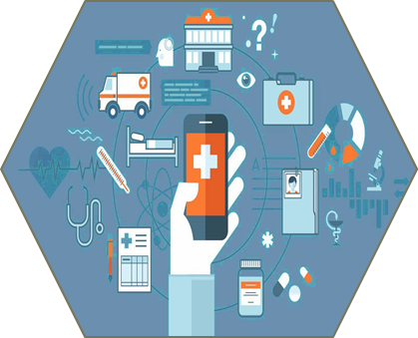
background
Methods
Discussion
4- The advent of mobile healthcare technologies and telemedicine systems has demonstrated tremendous potential to improve the effect of chronic disease management of hypertension, diabetes, cardiac disorders, and respiratory diseases.
5- A recent meta-analysis indicated that blood pressure telemonitoring could reduce systolic blood pressure (SBP) by 4.7 mm Hg and diastolic blood pressure (DBP) by 2.5 mm Hg, with an increased hypertension control rate.
6- It is therefore conceivable that broader implementation of telemedicine systems may help restore the balance of supply and demand in community hypertension care services by mobilizing patient involvement and improving provider’s efficiency.

Slide 4

background
Methods
Discussion
7- PCP-Cardiologist Telemedicine Model (PCTM).
8-The present paper describes a three-arm randomized controlled trial.
9- By comparing the BP control outcomes of (1) usual care, (2) patient self-management using telemedicine tools, and (3) the PCTM, which includes the coordinated cardiologist services plus the same set of telemedicine tools, we will be able to draw more precise conclusions about this PCTM in hypertension management and determine whether a similar model should be developed for other chronic conditions.

Slide 5
background
Methods
Discussion
1-study design:
participants receive usual care (UC) that complies with China’s Hypertension Prevention and Treatment Guideline 2010 (the national guideline)
patients additionally receive a BP telemedicine system including a BP telemonitor and a mobile app.
participants receive all of the above plus coordinated services jointly provided by their PCPs and a designated team of cardiologists who have access to the secure CareLinker websiteand review patient data with PCPs once every 3 months.
A total of 330 enrolled patients will be randomized to each group in a 1:1:1 allocation ratio, and all outcome measures will be assessed at baselin (T1), 6 months (T2), and 12 months (T3) throughout the study duration. We hypothesize that timely healthcare information exchange and closer collaboration between PCPs and cardiologists will improve community BP control.
Group 1
Group 2
Group 3

Slide 6
background
Methods
Discussion
2- setting:
This study will be taking place in the XuHui District in Shanghai, China. The four participating community healthcare centers (CHCs) are classified as tier 1 clinics; each has approximately 30–40 practicing PCPs, and they provide a full range of primary care services to nearly 330,000 reside. Cardiologists are mainly recruited from Shanghai Chest Hospital, which is located in the same district and is one of the largest chest specialty hospitals in the nation. Potentially eligible patients are identified and referred by PCPs from CHCs, where all data collection will be conducted including baseline and follow-up tests, except for home-based BP telemonitoring.

Slide 7
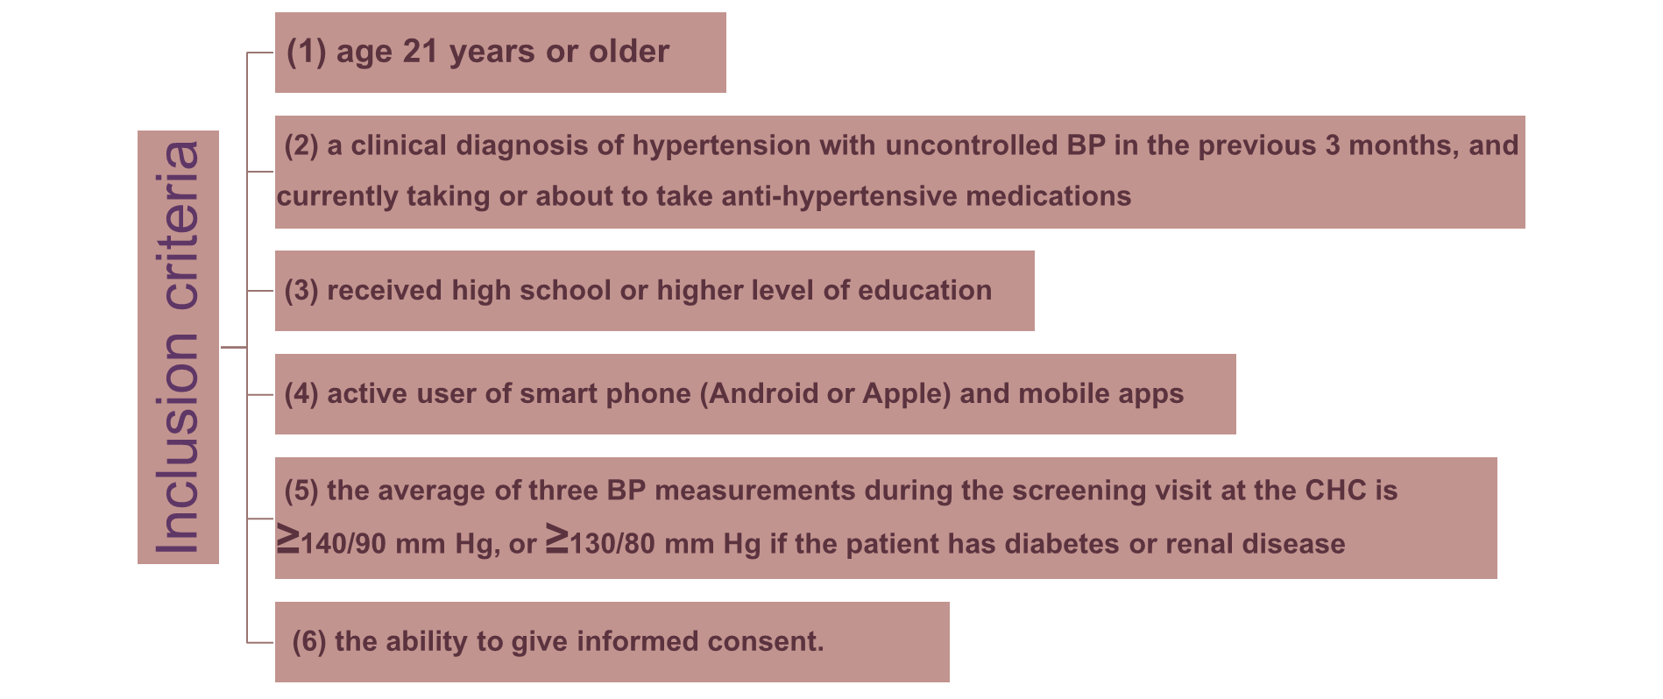
background
Methods
Discussion
3-Eligibility: inclusion and exclusion criteria for patients

Slide 8
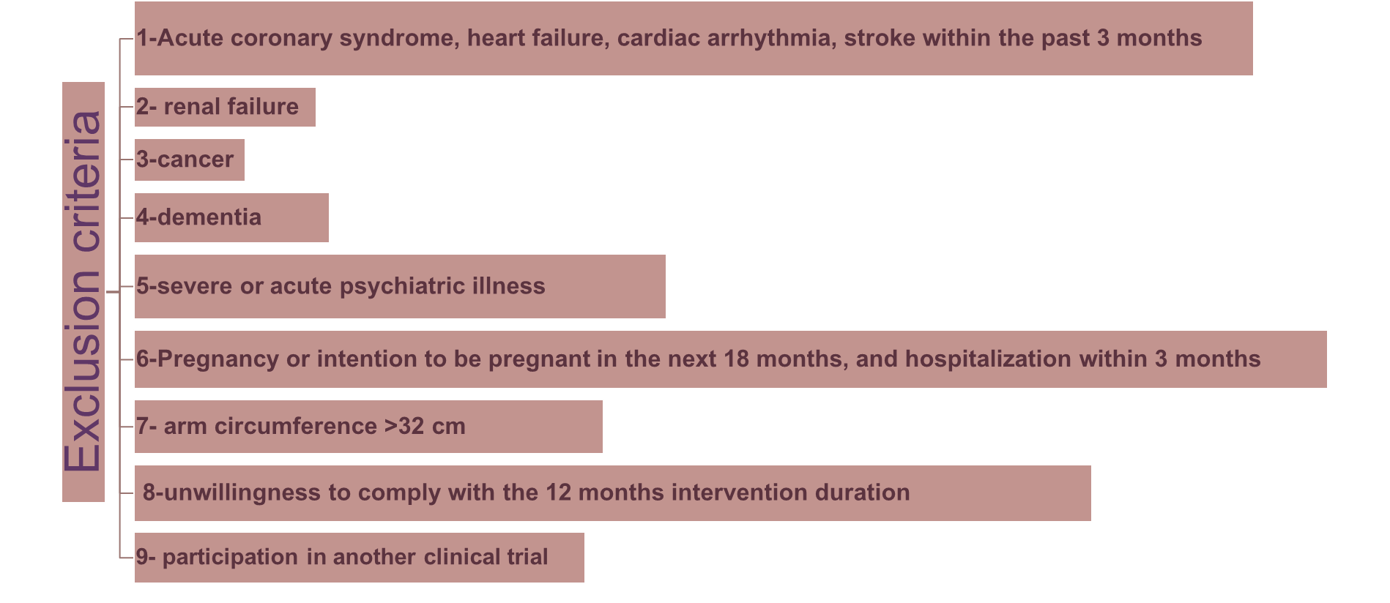
background
Methods
Discussion
3-Eligibility: inclusion and exclusion criteria for patients

Slide 9
background
Methods
Discussion
Withdrawal criteria include the following
(1) the participant intends to drop out of the study
(2) the participant is unwilling to follow the study protocol such as not visiting the clinic as scheduled or having the lab tests performed
(3) the participant is withdrawn due to critical medical reasons. For patients who withdraw from the
study
4- Withdrawal

Slide 10
background
Methods
Discussion
5- Participant recruitment
Those who remain eligible are invited to their registered CHC to attend the screening sessions with at least two PCPs and one research electronic engineer who instructs participants on the use of the BP tele-monitor and ensures that participants have the appropriate Android or Apple smart phone to download and use the CareLinker app.
If the participant has uncontrolled BP, as defined in the above inclusion criterion 5, during the screening visit and signs the consent, the research nurse will continue the procedure by collecting baseline laboratory tests and study questionnaires. The eligible patients will be randomized to the control or to one of the two intervention groups. The recruitment process is expected to take 12 months to complete from September 2016 to September 2017.

Slide 11
background
Methods
Discussion
5- Participant recruitment
Those who remain eligible are invited to their registered CHC to attend the screening sessions with at least two PCPs and one research electronic engineer who instructs participants on the use of the BP tele-monitor and ensures that participants have the appropriate Android or Apple smart phone to download and use the CareLinker app.
If the participant has uncontrolled BP, as defined in the above inclusion criterion 5, during the screening visit and signs the consent, the research nurse will continue the procedure by collecting baseline laboratory tests and study questionnaires. The eligible patients will be randomized to the control or to one of the two intervention groups. The recruitment process is expected to take 12 months to complete from September 2016 to September 2017.

Slide 12
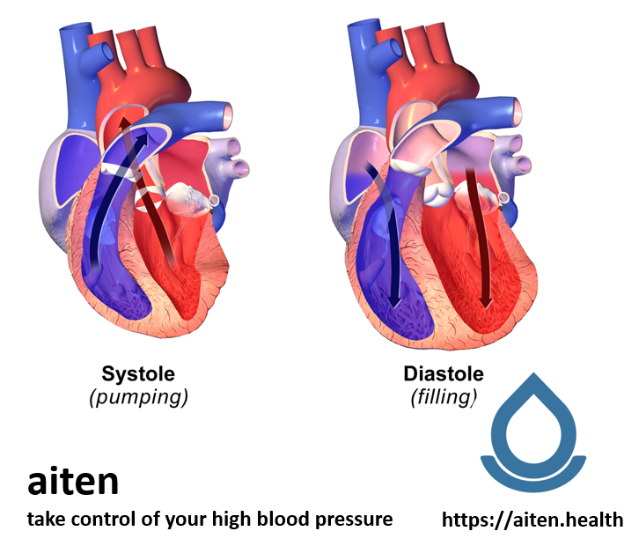
background
Methods
Discussion
6- Outcomes:
Primary outcome measures:
changes in mean SBP from baseline (T1) to 12 months (T3) measured using the BP telemonitor
The 12 months BP readings will be determined by taking the average of three BP measurements at the follow-up visit to the CHC.
All BP data are collected and uploaded simultaneously
to the trial database.

Slide 13

background
Methods
Discussion
6- Outcomes:
Secondary outcomes:
changes in mean DBP and hypertension control rate defined as BP <140/90 mm Hg or <130/80 mm Hg (for patients with diabetes or renal diseases)
changes in measures related to hypertension complications (HbA1C, body mass index (BMI), and lipid levels) from baseline (T1) to 6 months (T2) and 12 months (T3).
anti-hypertensive medication adherence, which is assessed by the self-reported, eight-item Morisky Medication Adherence Scale (MMAS)

Slide 14
background
Methods
Discussion
7-sample size and power calculation
The sample size required for this RCT is 330 patients.
We assume that the standard deviation for difference in SBP from baseline to 12 months is 16.5 mm Hg and the difference in DBP from baseline to 12 months is 11.5 mm Hg. Using a two-sample comparison of the mean change between Group 1 and Group 3,
a sample size of 88 patients per group is required to have 80% power at the 95% confidence level. This number is further adjusted to 110 per group to account for an estimated dropout rate of 20% during the 12 months follow-up.
To reduce this potential dropout ,we will provide all participants an additional 2 years of free health consultation services from PCPs and cardiologists as an incentive after they complete the trial. All analyses will be performed according to the intention-to-treat (ITT) principle.

Slide 15
background
Methods
Discussion
1
patients are managed by their PCPs at the registered CHCs as usual .The healthcare services offered to them comply with the national guideline and include designated follow-ups by PCPs once every 1–3 months for stage 1 (≥140/90 mm Hg) hypertension patients, once every 1 month for stage 2 (≥160/100 mm Hg), and once every 2 weeks for stage 3 (≥180/110 mm Hg) patients.
2
The standard basic measures include blood pressure, fasting blood glucose, serum blood lipids, electrocardiogram (EKG), renal function, weight, and BMI. Patients receiving UC are encouraged to use a logbook to record home BP measurements and present the results during the CHC visit.
8-groups:
group 1:usual care

Slide 16
background
Methods
Discussion
In addition to medication adjustment or prescription refill, PCPs will review BP trend according to the logbook records or history data in the EHR, provide lifestyle coaching such as dietary, weight management, and physical activity advice, prescribe necessary lab tests, and make referrals to specialists for further treatment of hypertension or comorbidities.
3
4
PCPs are also responsible for promoting national and regional hypertension management guidelines during each patient encounter. Similar to the intervention groups, UC patients will have three study visits, at baseline (T1), 6 months (T2), and 12 months (T3), to complete study tests and questionnaires.
8-groups:
group 1:usual care

Slide 17
background
Methods
Discussion
8-groups:
Group 2: Intervention, self-management using the telemedicine tool
Patients randomly assigned to this group receive a BP telemedicine system developed by CareLinker Inc. (Shanghai, China) to facilitate BP self-management in addition to all the usual care components.
1
2
In brief, the system consists of (1) a BP telemonitor with embedded GSM module that can upload BP readings to the cloud database immediately after the self-measurement;
(2) a mobile app that allows patients to manually input healthcare data, display history BP measurements and lab test results, receive personalized lifestyle coaching contents and medication reminders, and communicate with PCPs about hypertension-related health concerns through text messaging.

Slide 18
background
Methods
Discussion
8-groups:
Group 3: Intervention, managed in the PCP-Cardiologist Telemedicine Model (PCTM)
Group 3 participants receive all the interventions described above for Groups 1 and 2. In addition, PCPs and cardiologists are provided access to the secure CareLinker website where they can review patient healthcare data including all BP measurements, lab test results, medications in use, and comorbidities if any. They can also use the auto analytics tools of the website to view the BP average, BP trend, and the risk score of each patient developing cardiovascular disease (CVD). The CVD risk scoring was developed according to the published data
1
2
Text message alerts of abnormal BP variability detected by the cloud engine will be pushed to the PCPs’ app when they occur, and proactive interventions including phone consultations, medication dosage adjustments, or referrals can be offered to patients

Slide 19
background
Methods
Discussion
8-groups:
Group 3: Intervention, managed in the PCP-Cardiologist Telemedicine Model (PCTM)
A joint case review session will be set once every 1–2 months for PCPs and partnering cardiologists to exam patients’ disease progresses to determine if further medical treatments need to be administered.
3
4
The proprietary web-based analytic module also produces automated medication recommendations to PCPs based on each patient’s disease condition.
5
All patients in Groups 2 and 3 receive proficiency training in using the BP telemonitor and mobile app. PCPs and cardiologists in Group 3 receive training on access and use of the password-protected CareLinker website.

Slide 20

background
Methods
Discussion
9-data collection and management
The processes of data collection, storage, analysis, display, and delivery are achieved through the interplay of the web server, web application software, General Packet Radio Service (GPRS)-enabled BP telemonitor, and userend applications (apps) for patients or physicians. All these components are deployed on computer server owned by and located within CareLinker and operated behind the company firewall.

Slide 21
background
Methods
Discussion
9-data collection and management
Patients’ blood pressures are self-measured using the BP telemonitor (Bliss, Shenzhen China), and the readings are encrypted with the GEA4 algorithm and autosent to the web server through the mobile network GPRS protocol. The GEA4 is a widely used encryption algorithm published by the European Telecommunications Standards Institute (ETSI).
Each BP telemonitor has its unique device ID bound to one patient ID.
Auto-submitted BP measures by the BP telemonitor help avoid errors or bias that may otherwise occur in the manual input process.
Lab tests of HbA1C and blood lipids are performed at baseline and at each follow-up visit, and the blood samples will not be stored. The test results and other medical information are manually recorded into the patient app by research nurses, and error-checked with format, range, and logic rules built into the app before being sent to the web server. An additional designated research staff will proofread all patients’ health information by comparing with the original reports.

Slide 22
background
Methods
Discussion
9-data collection and management
The user-end apps use Hypertext Transfer Protocol over Secure Socket Layer (HTTPS) to communicate data with the web server.
At the receiver side, the received data are decrypted and their checksum is calculated. Only when the checksum of the received data equals to the received checksum, indicating that the data are not modified during the communication and the integrity is verified, are the received data accepted by the receiver.
At the sender side, the checksum of the data is calculated by the Message-Digest Algorithm (MD5), encrypted by the Data Encryption Standard (DES) algorithm, and sent out through HTTPS.
data
The HTTPS, MD5, and DES are commonly used communication protocols or encryption algorithms for Internet security. Both apps can be operated on mobile devices running Android 3.0/+ or iOS 7.0/+.

Slide 23
background
Methods
Discussion
9-data collection and management
The open-source Java Servlet Container Apache Tomcat 8.0 (Apache Software Foundation, Forest Hill, MD, USA) is used as the web server, and the web application software is developed on the base of Spring Framework, which is an open-source application framework and inversion of control container for the Java platform. The database uses MySQL 5.7, an open-source relational database management system (RDBMS). Two instances of MySQL configured as master and slave are running simultaneously. The data are automatically synchronized from the master to the slave, and the slave can be autoswitched to perform as the master if the original master fails. Regular backups are carried out to prevent accidental data loss. All patients, PCPs, and cardiologists have their unique IDs, and their login passwords are encrypted and kept anonymous to the database administrator. The database is also password protected, with access only to the administrator and staff members whose IPs have been previously registered in a white list. The research staffs is only provided with read permission to the database.

Slide 24
background
Methods
Discussion
A steering committee has been established to serve as the main governing body of this study. It is composed of cardiologists and clinical research scientists from Shanghai Chest Hospital and epidemiologists from Shanghai JiaoTong University, School of Medicine.
The major responsibility of the steering committee is to evaluate, advise on, and approve the study protocol with modifications, communicate with the Ethics Committee, and supervise the practice of community hypertension care in accordance with China’s national hypertension management guideline.
10- study management

Slide 25
background
Methods
Discussion
The sponsor of the project is Shanghai Chest Hospital, which is indemnified for any harms as the result of trial participation. A project management team consisting of the principal investigator and the clinical trial operation director has been formed to manage the everyday operation of the study.
An independent, external monitor will carry out onsite monitoring.
10- study management

Slide 26
background
Methods
Discussion
An Independent Data Monitoring and Safety Committee, consisting of physicians and bioethicists from Shanghai Chest Hospital and statisticians from Shanghai JiaoTong University, School of Medicine, has been established for the trial.
10- study management

Slide 27

background
Methods
Discussion
11-Statistical hypothesis, methods, and analyses:
1-formal null hypothesis
2-alternative hypothesis

Slide 28
background
Methods
Discussion
We will conduct the primary statistical analysis on an ITT basis with full endeavor to acquire a complete dataset of every patient.
The collected trial data will be coded and entered into MATLAB version 2014a and SPSS version 22 for statistical analysis.
A fully specified Statistical Analysis Plan (SAP) that includes detailed analytics of the trial datasets will be prepared and completed before locking the database.
11-Statistical hypothesis, methods, and analyses:

Slide 29
background
Methods
Discussion
F tests
Pearson’s chi-square tests for categorical variables to assess the difference of baseline characteristics among the three groups.
linear mixed model to identify the effectiveness while adjusting the baseline using the following covariates as appropriate: baseline SBP, age, gender, BMI, education levels, exercise, drinking patterns, tobacco use, and CHCs.
Fisher’s protected least significant difference (LSD) method to protect against multiple comparisons, followed by pairwise comparisons between study groups only if the overall F test is significant.
11-Statistical hypothesis, methods, and analyses:

Slide 30
background
Methods
Discussion
Missing data ⇨multiple imputation
Subgroup:
BMI (<24, ≥24), hypertension stage (stage1, stage 2, and stage 3), education level (non-college, college, or above), presence of one or more comorbidities, and self-reported medication adherence.
11-Statistical hypothesis, methods, and analyses:

Slide 31
background
Methods
Discussion
These events include
1-hospitalization longer than 24 hours,
2-emergency room visits,
3-and other potentially relevant adverse cases of death, acute cerebro-cardiovascular accident, and kidney failure.
12- Adverse events reporting

Slide 32
background
Methods
Discussion
traditional model of physiciancentered physiciancentered clinic visit.
PCPs may not have sufficient experience to identify and manage hypertension-relevant CVD complications in time.
Three types of interventional models:
1-patient-centered care delivery.
2-provider-centered care delivery.
3-combination of both models

Slide 33
background
Methods
Discussion
Impacts of study if successful:
1-this model can be replicated to apply to the management of other chronic conditions
2-provides the feasibility and acceptability evidence of employing mobile technologies
Limitation :
1- open-label trial
2-the recruited patients may reflect only a subpopulation who are frequent users of smart phones and mobile apps.

Slide 34
عنوان ارائه
Thanks for Your Attention
Fatemeh shakeri
shakerif3@mums.ac.ir

