Slide 1


Clinical decision support system for end-stage kidney disease risk estimation in IgA nephropathy patients
به نام حضرت دوست
Lecturer Name : Mahboobeh Tashakkori
Supervisor Name : Dr.Marzie Meraji
Email Address : Tashakkorim2@mums.ac.ir

Slide 2

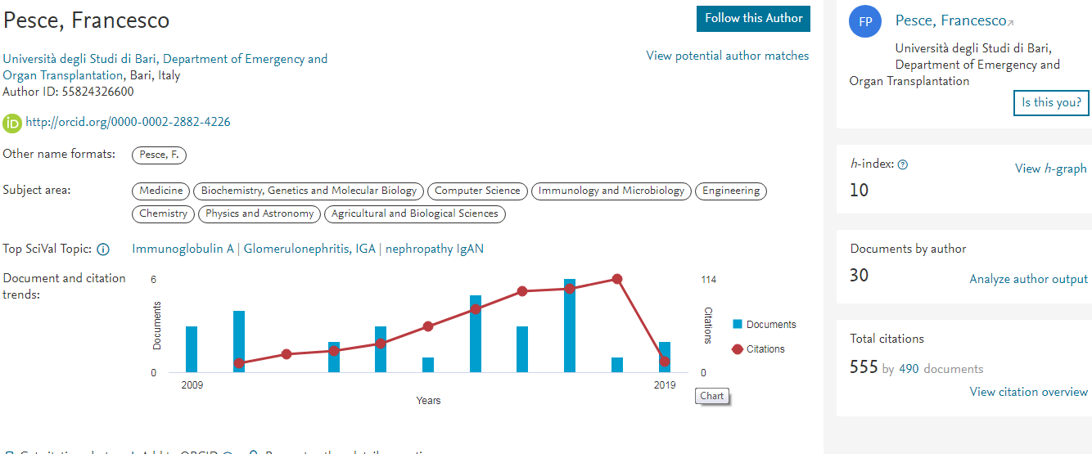
author

Slide 3

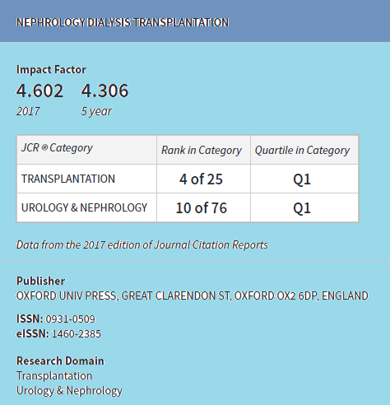

journal

Slide 4
Introduction
IgA nephropathy (IgAN) is the commonest form of glomerulonephritis worldwide.
The hallmark of this disease is the deposition of IgA in the glomerular mesangium. Episodes of macroscopic haematuria, concomitant with upper respiratory tract infections are present at 30–40% of cases.
The same percentage of patients manifests asymptomatic microscopic haematuria.
High degrees of proteinuria, renal impairment and hypertension at the onset might complicate the disease.

Slide 5
Introduction
The diagnosis relies on renal biopsy. Up to 40% of the patients develop end-stage kidney disease (ESKD) within 20 years of the biopsy-proven diagnosis. The importance of risk stratification in IgAN, to identify ‘high-risk’ patients.
The glomerular filtration rate (eGFR) and histologic grading indicate the severity of the disease.
The artificial neural network (ANN) as a nonlinear statistical approach for pattern recognition in order to weight all the relationships between input and output variables.

Slide 6
Introduction
The ANNs are inspired by biological neural networks. An artificial neurone is a processing unit, which receives signals from other neurones, performs a simple computation and provides an output.
Our aim was to develop an effective and advanced clinical decision support system (CDSS) easily accessible by clinicians to provide additional quantitative information at the time of renal biopsy.

Slide 7
MATERIALS AND METHODS Study cohorts
We evaluated data from 677 biopsy-proven IgAN patients enrolled in the Renal, Dialysis and Transplant Unit at the University of Bari, Italy, between May 1972 and June 2010. Renal biopsy was performed on the basis of the following indications: asymptomatic urinary abnormalities such as microscopic haematuria and/or mild-to-moderate proteinuria, macroscopic haematuria, nephrotic syndrome, acute renal failure or chronic kidney disease. The diagnosis of IgAN was based on the findings of predominant mesangial deposits of IgA by immunofluorescence after exclusion of lupus nephritis, Henoch Schönlein purpura and liver cirrhosis.

Slide 8
MATERIALS AND METHODS Study cohorts
We also included two cohorts from different populations, 441 Norwegian and 53 Japanese biopsy-proven IgAN patients. The Norwegian IgAN cohort was identified in the Norwegian Kidney Biopsy Registry. All primary IgAN patients diagnosed 1988–2004 were included. Cases with ESKD during follow-up through June 2013 were identified by record linkage of the study cohort with the Norwegian Renal Registry using the unique Norwegian 11-digit social security number.

Slide 9
MATERIALS AND METHODS Study cohorts
A cohort of 53 IgAN patients was collected at Juntendo University hospital , Japan , from 1974 to 2013. This study was approved by the localmedical ethics committees and conducted in accordance with the guidelines of the Declaration of Helsinki. Due to the retrospective nature of the study , written informed consent was waived from patients.

Slide 10
MATERIALS AND METHODS Investigated parameters
Demographic data, clinical and laboratory findings were obtained from patients’ medical records at the time of renal biopsy and stored in an electronic database in Excel format, regularly updated during the follow-up. Data used as input included gender, age, histological grading, serum creatinine (sCr) , 24-h proteinuria, hypertension status defined as arterial blood pressure over 140/90 mmHg.
who reported three grades (G) : G1 (mild) , G2 (moderate) and G3(severe) in individuals with sclerotic lesions and advanced chronic glomerulonephritis . ESKD was defined as the need for renal replacement therapy by dialysis treatment or kidney transplantation.

Slide 11
MATERIALS AND METHODS Investigated parameters
The time from renal biopsy to the start of renal replacement therapy was calculated in years and then categorized into three variables: ≤3 years, between >3 and 8 years and over 8 years.
we attributed an absolute renal risk (ARR) of dialysis to each patient. The estimated glomerular filtration rate (eGFR) was calculated using the CKD-EPI (Chronic Kidney Disease Epidemiology Collaboration) formula.
GFR = 141 * min( Scr /κ,1)α * max( Scr /κ, 1)-1.209 * 0.993Age * 1.018 [if female] * 1.159 [if black]
cr is serum creatinine (mg/ dL ), κ is 0.7 for females and 0.9 for males, α is -0.329 for females and -0.411 for males, min indicates the minimum of Scr /κ or 1, and max indicates the maximum of Scr/κ or 1.

Slide 12
MATERIALS AND METHODS Statistical analyses
A P-value of <0.05 was considered statistically significant. Two separate ANNs, predicting the ESKD status and time to ESKD, were initially trained and then validated in each cohort separately.
The performance of the final classifier was described in terms of true positives, false positives, true negatives and false negatives,accuracy, precision, recall(also known as sensitivity) and f-measure(also F-score) is a measure of a test's accuracy and is the average of the precision and recall, where reaches its best value at 1 (perfect precision and recall) and worst at 0.
In addition, the area under the ROC curve (AUC) was used as a measure of aggregated classification performance.

Slide 13
MATERIALS AND METHODS Statistical analyses
The performance indicators for the classification performed by five experienced nephrologists were computed individually for each nephrologist and then averaged to summarize the category.
The final version of the classifier was then translated into Java code and incorporated in the CDSS (Online Methods) available at www.igan.net and http://dee020.poliba.it/migan/

Slide 14
RESULTS Characteristics of the study population
total of 546 Italian IgAN patients, out of 677 biopsy proven IgAN, were available for analysis because 131 patients were excluded as they had one or more missing parameters. Nineteen percent (N = 104) of them reached ESKD within a median time of 5 years. The patients were receiving no medication at the time of renal biopsy.
We also studied additional cohorts of 441 biopsy-proven IgAN patients from Norway and 53 from Japan. In the Norwegian population, 134 patients reached ESKD (30%) within a median time of 6 years whereas among the Japanese IgAN patients, 3 patients (5%) did (median time to ESKD of 3 years). Altogether 241 (23%) patients reached ESKD. Table 1 shows the demographic and clinical features of each cohort at time of renal biopsy.

Slide 15
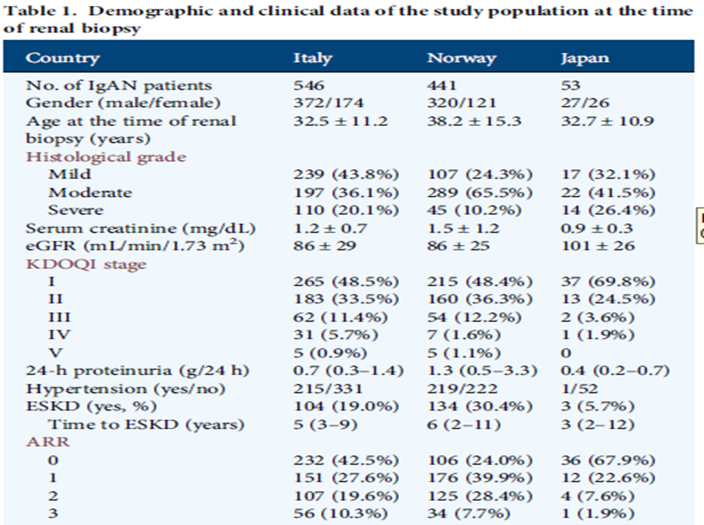
RESULTS Characteristics of the study population
The male/female ratio was 2.1 in the Italian cohort; it was higher in the Norwegian (2.6) whereas in the Japanese, there was approximately the same proportion of male and female.
The mean age at renal biopsy was higher in the Norwegian(38.2 years) and comparable in the Italian and Japanese (32.5 and 32.7, respectively) group.
A higher proportion of patients with moderate histological lesions was observed in the Norwegian(65%) and Japanese group (41%), whereas patients with mild lesions were prominent in the Italian group (44%).
Kidney Disease Outcomes Quality Initiative

Slide 16
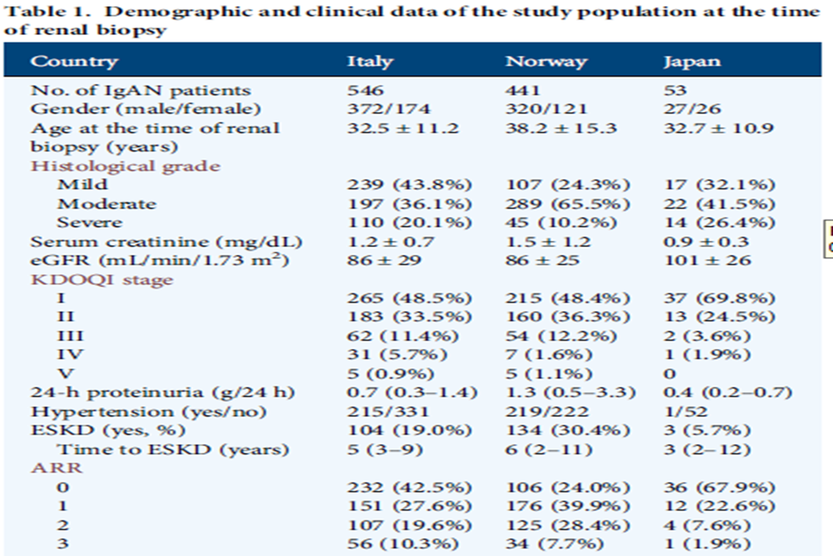

RESULTS Characteristics of the study population
Most patients were categorized as KDOQI stage I.
70% in the Japanese had eGFR = 101 mL/min.
The mean sCr was higher in the Norwegian.
Proteinuria was not heavy but was higher in the Norwegian.
Hypertension was observed in 50% of Norwegian, 39% of Italian and 2% of Japanese .
Using hypertension status, proteinuria of ≥1 g/24 h and severe degree of renal lesions (G3) as risk factors, we attributed an ARR of dialysis to each patient. The score ranges from 0 to 3 based on the presence of any one or two of these factor.

Slide 17
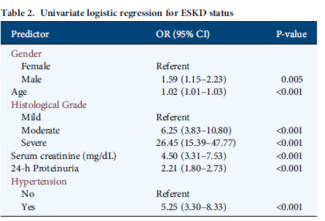
RESULTS ESKD predictors as input for the ANNs
In order to identify significant predictors of ESKD to be used as input for the ANN, we first assessed their importance by logistic regression.
Univariate analysis, illustrated in Table 2, showed that gender, age, histological grade, serum creatinine,Proteinuria and hypertension evaluated at the time of renal biopsy, had a significant impact on ESKD in our data sets.
The largest effect was observed in patients with severe histological grade. We used these independent parameters resulted significant at the univariate analysis as inputs for the ANNs.

Slide 18
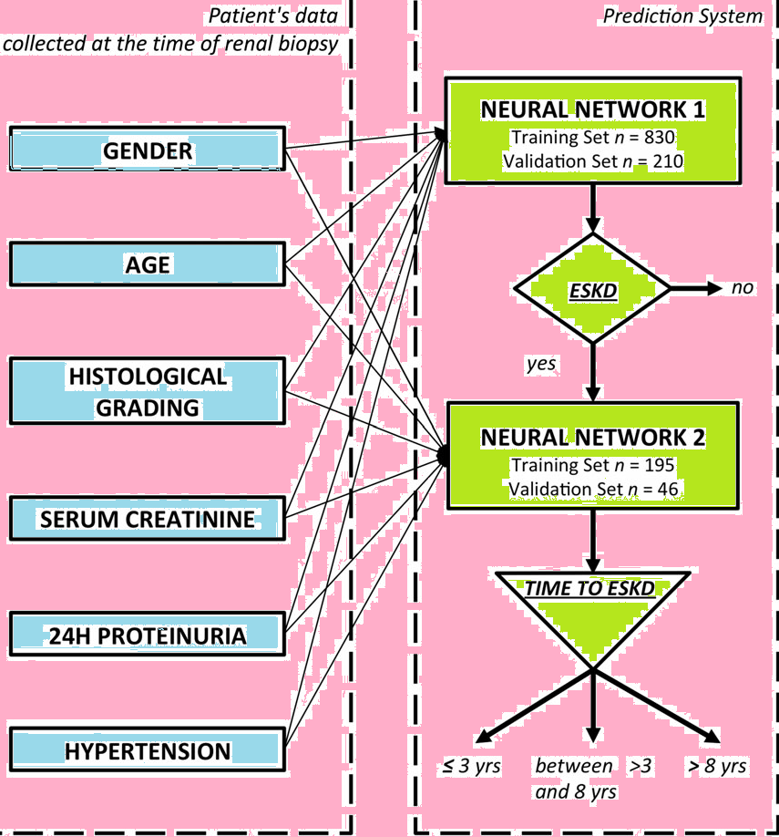
RESULTS Performance of the ANNs
with the aim to provide a complete CDSS,we concatenated the two ANNs, so if the first ANN classified the patients as ESKD then the second ANN performed the prediction of the time to ESKD (Figure 1). prediction of time to ESKD categorized as follows: (i) within 3 years, (ii) between >3 years and 8 years and (iii) after 8 years.

Slide 19
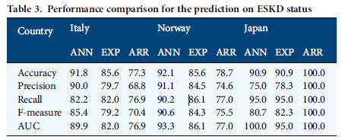
RESULTS ESKD status prediction
The total data set, including 1040 patients, was split into two groups : 830 patients for the training and 210 for the validation study of the ANNs predicting the ESKD Status.
In the first place, the validation group was used to assess the performance of our ANN in predicting the ESKD and to compare it with an established scoring system such as the ARR.
Although the ARR was reliable,showing an AUC of 76.9% in the Italian, 77.0% in the Norwegian and 100% in the Japanese cohort, it was outperformed by our ANN in the two largest data sets (89.9% for the Italian and 93.3% for the Norwegian).
In addition, we presented the validation data set to five experienced nephrologists asking the question: ‘Given these parameters, do you feel this patient will reach ESKD in the next decade?’ We then evaluated the performance of their prediction with the same metrics applied to the ANN and ARR.

Slide 20
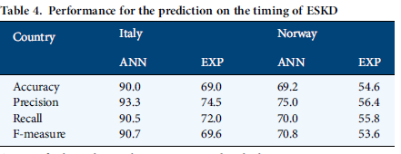

RESULTS eSKD timing prediction
For the second ANN, predicting ESKD timing in three categories, 241 patients were available for analyses: 195 of them were used for the training study and 46 (20 Italian and 26 Norwegian IgAN patients) for the validation study.
Given the low number of patients reaching ESKD in the Japanese cohort (3 of 53), we did not use this data set for the analysis. Again here, the set of indicators showed a good performance of the ANN, with an f-measure of 90.7 and 70.8% in the Italian and Norwegian cohort. We also found a considerable better performance of our ANN compared with the prediction of five experienced nephrologists (Table 4).
We presented the validation data set with the 46 patients asking them, ‘This patient had these parameters at the time of renal biopsy and reached ESKD’. Do you think this happened within 3 years, between 3 and 8 years or after 8 years from diagnosis?

Slide 21
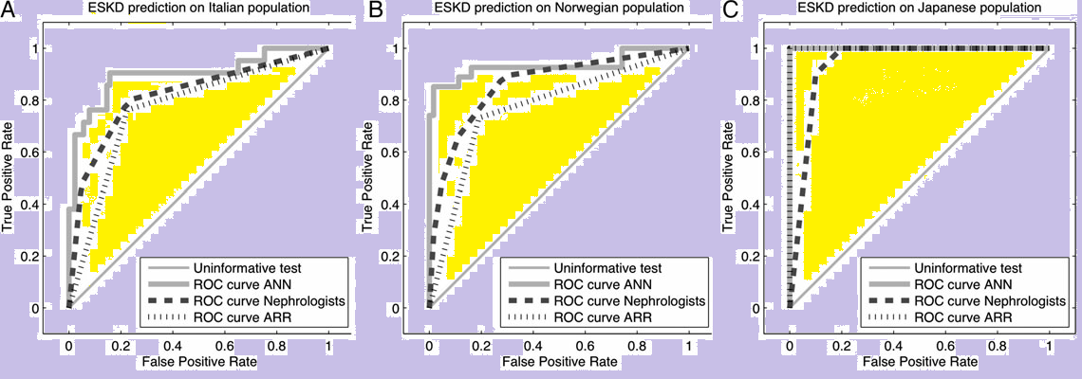
RESULTS

Slide 22
RESULTS Online clinical decision support system

Slide 23
DISCUSSION
In this study, we further refined the architecture of the ANN and implemented the final CDSS in the setting of a large clinical study with long-term follow-up in three different populations. The main advantage is that such a system is based on non-parametric machine-learning algorithms, which allow us to evaluate and weight the nonlinearities of the significant clinical variables at the time of renal biopsy ultimately returning a quantitative risk assessment of ESKD.
The CDSS showed an excellent performance in two European cohorts and also in Asian IgAN patients .

Slide 24
DISCUSSION
In these cohorts , we confirmed the efficacy of the ARR score but we demonstrated a better performance of our ANN for the prediction of ESKD.
It is noteworthy that in this study we adopted a simple histological classification based on a grading system that classifies the tissue pathology according to the overall severity of the lesions found in each tissue. The Classification which is based on the scoring of four lesions (mesangial hypercellularity, segmental glomerulosclerosis, endocapillary hypercellularity and tubular atrophy/interstitial fibrosis).

Slide 25
conclusion limitation
In fact, the early years after diagnosis are those more likely to be effective in preventing irreversible damage with therapeutic interventions.
In conclusion, this CDSS is an easy and valuable tool for clinical practice to estimate the risk of ESKD and its timing in IgAN patients.
A limitation is that the Japanese cohort is smaller than the Norwegian and Italian one. generalizability to an Asian population might need further validation in a larger data set.

Slide 26


