Slide 1


A systematic review of the use of the electronic health record for patient identification, communication, and clinical support in palliative care
In the name of God
Lecturer Name :faezeh farasatpour
Supervisor Name :Dr.masoumeh sarbaz
Email Address : farasatpourf1@mums.ac.ir

Slide 2
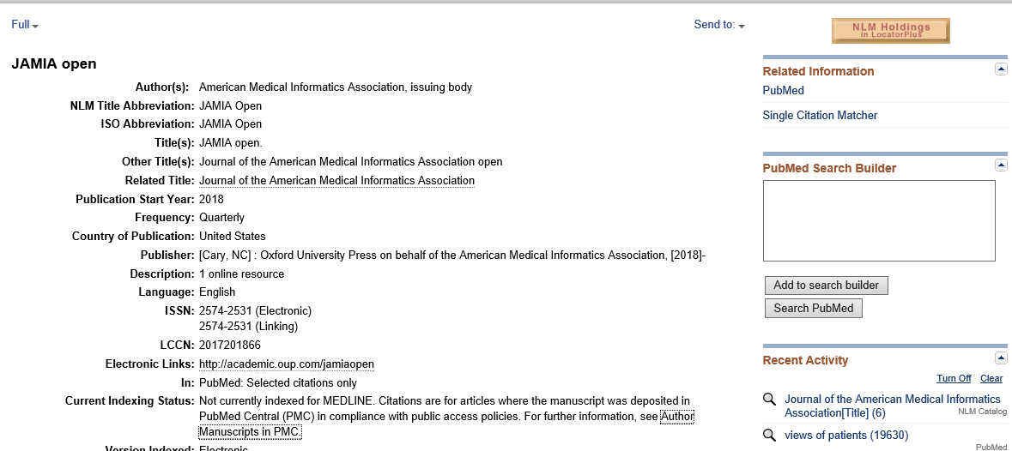
ABOUT THE JOURNAL

Slide 3
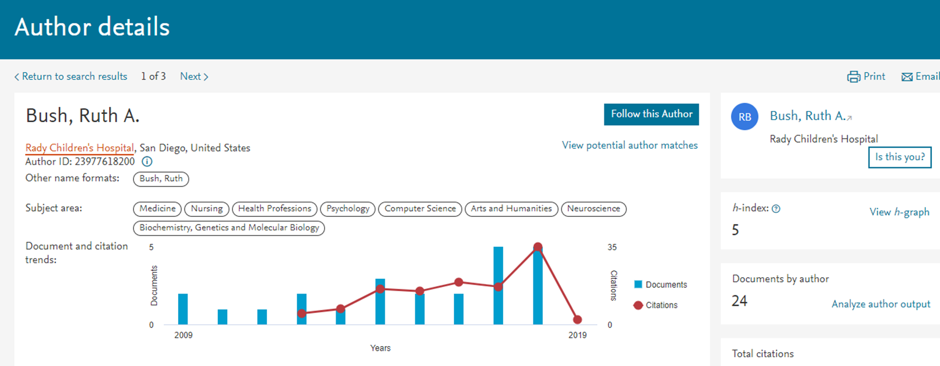
ABOUT AUTHORS

Slide 4
INTRODUCTION
The World Health Organization defines palliative care (PC) as “an approach that improves the quality of life of patients and their families facing the problem associated with life-threatening illness, through the prevention and relief of suffering by means of early identification and impeccable assessment and treatment of pain and other problems, physical, psychosocial and spiritual.

Slide 5
INTRODUCTION (CONTINUE)
The electronic health record (EHR) incorporates clinical decision support (CDS) to provide clinicians, staff, patients, and other individuals with knowledge and person-specific information, intelligently filtered or presented at appropriate times, to enhance health and health care.

Slide 6
INTRODUCTION (CONTINUE)
Examples of enhancements include alerts, reminders; clinical guidelines, order sets, data reports, and summaries, document templates, and decision support.
While using CDS can benefit all healthcare disciplines, CDS is especially helpful for PC patients who are undergoing intensive, interdisciplinary chronic treatment with symptom management, cross-team communication, and patient education with diverse and intensive data capture, including patient reported data if desired.
Using the EHR to support PC demonstrates the ideal interdisciplinary support envisioned but not always seen with the implementation of the EHR .

Slide 7
INTRODUCTION (CONTINUE)
To our knowledge, no systematic review specifically focused on the use of EHRs and CDS with PC research has been published.
This study’s goals were to :
(1) identify studies describing the active incorporation of the EHR and CDS in PC clinical work flows;
(2) report study findings including patient, caregiver, and healthcare provider feedback;
(3) identify PC facilitation and barriers in current EHRs and related CDS support structure to identify current knowledge gaps and highlight areas for future research.

Slide 8
METHODS
This systematic review used guidelines outlined in Reporting Items for Systematic Reviews and Meta-Analysis (PRISMA).
We conducted a comprehensive and broad search of four online databases (National Library of Medicine PubMed access to MEDLINE, CINAHL [Cumulative Index to Nursing and Allied Health Literature], EBSCOhost, and Academic Search Premier) for peer-reviewed literature published between 1999 and September 2017 (see Table 1)

Slide 9
METHODS
Search Terms
Terms
Palliative and ehealth
Palliative and EHR
Palliative and EMR
Palliative and electronic decision support
Palliative and electronic health record
Palliative and electronic medical record
Palliative care and ehealth
Palliative care and EHR

Slide 10
METHODS
Palliative care and EMR
Palliative care electronic decision support
Palliative care electronic health record
Palliative care and electronic medical record
Palliative medicine and ehealth
Palliative medicine and EHR
Palliative medicine and EMR
Palliative medicine and electronic decision support
Palliative medicine and electronic health record
Palliative medicine and electronic medical recordEHR:electronic health record; EMR: electronic medical record

Slide 11
METHODS
In order to capture any pertinent article, we included the terms electronic decision support; electronic medical record; electronic health record and eHealth in combination with the terms palliative, palliative care, and palliative medicine. The selection of articles is outlined in Figure 1.

Slide 12
PRISMA FLOW DIAGRAM

Slide 13
METHODS
Citations and abstracts were imported into a Microsoft Access® database. After removing duplicates, two reviewers evaluated abstracts of the 430 unique articles for inclusion using the following criteria: studied humans; peer-reviewed; published journal; printed in English; and included original research and data analysis of PC EHR use .

Slide 14
METHODS
In the second round, two reviewers reviewed the full text of the 191 documents to determine final eligibility based on inclusion criteria. If after a full-text analysis the eligibility of an article was still uncertain, a third reviewer undertook a full text review. Reviewers resolved discrepancies through discussion and documented exclusion reasons. Overall, 30 studies were included.

Slide 15
RESULTS
Five significant themes emerged after compiling, synthesizing, and reviewing the results.
The most frequent incorporation of PC CDS in the EHR was to identify individuals who should be screened for PC, using an alert or creating a report, or to support a document template to electronically capture advanced care planning (ACP) directions.
Additional themes included using the EHR to capture patient-reported outcomes (PROMs) such as rapid, real-time pain feedback; augmenting the EHR to capture needed PC data elements; and enhancing interdisciplinary communication and care.

Slide 16
RESULTS
Using the EHR to identify individuals for PC—Healthcare systems explored CDS use and related electronic algorithms as a way to alert clinicians and trigger a PC assessment based on patient symptomatology. Highlights of the eight studies (Table 2) exploring CDS to identify individuals for PC include feasibility, symptomatology algorithms development, end-user testing, and data marker refinement to increase patient identification sensitivity. Although CDS-supported alert sensitivity is still maturing, a key finding was that clinicians appreciate the objective CDS structure.

Slide 17
Characteristics of the Studies
Most studies were conducted in large medical centers after EHR implementation, facilitating incorporation of data from multiple units or even multiple hospitals within their healthcare system.
The length of studies ranged from 6 weeks to 9 years of retrospective analysis.

Slide 18
Characteristics of the Studies
Sample size ranged from 11 patients to 53,124 patients and 225 clinicians.
Studies explored the feasibility of automatically capturing patient symptoms (i.e. pain, fatigue, system failure) for EHR decision support.
The biggest barriers to CDS were not having the needed or appropriate data and workflow challenges.

Slide 19
Characteristics of the Studies
It is difficult to capture needed qualitative information such as anxiety or family distress in the EHR in a standardized methodology.
A common physician-identified barrier after using CDS was additional time required to review the results and to discuss an action plan, which clinicians felt diverted focus from other healthcare activities involving a larger percentage of their patients.
All studies recommended additional refinement of algorithms and workflows.

Slide 20
Characteristics of the Studies
Integrating Patient Reporting into the EHR—Conceptually, the EHR’s patient portal provides the means for patients to report their condition, needs, and concerns, electronically, in real time to their healthcare providers.
These data can be used for reminder alerts and data reports specific to PC and patient care.
Patients were most likely to use electronic communication for ACP, to establish a Palliative Care Summaries (PCS), and to report pain.

Slide 21
ACP and PCS
The ACP (and PCS) discussion process allows an individual, family members, and caregivers to communicate wishes and preference for future care and provides an opportunity for patients to have their medical care wishes evolve over time.
An ACP may include specific treatment preferences for life-sustaining treatment and legal documentation such as physician orders for life sustaining treatment (POLST).

Slide 22
ACP and PCS
Two studies examined whether clinicians could easily find ACP documentation in the EHR.
Three studies were in large hospitals; one in a health maintenance organization; one in the Veterans’ Administration (VA) Healthcare system, two in a nationalized system, and the remainder in specialty oncology facilities. Participants were 30 oncology patients, a review of 113,309 patient, and 70 physicians.

Slide 23
ACP and PCS
The participants reported that although they thought the documentation was important, the idea of completing it made them anxious.
Primary care physicians were more likely to document than specialists.

Slide 24
ACP and PCS
Primary care physicians report ACP documentation is accessible while specialist believe interoperability between the hospital and the outpatient EHR systems introduce confusion.
Even when individuals have completed ACPs or other end-of-life (EOL) documentation, this documentation may not be readily found in the EHR.

Slide 25
ACP and PCS
Clinicians’ inability to always find the ACP information in the EHR is another barrier to honoring patient preferences.
Hall et al. found clinicians thought the PCS was a good idea, but they were not completing the summaries because of time barriers and the lack of computer technology skills.

Slide 26
Patient-Reported Outcomes
Four studies addressed PROMs-employed qualitative, mixed methods, feasibility, and retrospective analysis methodology.
Patient samples ranged from 107 to 5837.
All studies took place within large healthcare systems, including one study in the VA Healthcare System in the USA.
Romaro et al. reported an innovative study in which patient-reported data, including current symptoms, were incorporated in the EHR and could be used by providers for clinical symptom management and EOL decision making.

Slide 27
Enhancing the EHR for PC
The fourth area of investigation examined existing EHR enhancements designed to support PC or to identify needed enhancements.
These five studies were geographically diverse, conducted in Malawi; Uganda; the UK; and the USA.
Two were feasibility studies, two qualitative, and one mixed methods. Study size ranged from 15 community healthcare professionals to 455 PC patients.

Slide 28
Enhancing the EHR for PC
One feasibility study focused on whether healthcare workers could find and enter data in the system.
Another study also noted methods to record pain data varied by profession and different groups were not only using different electronic systems, but some were still recording on paper.

Slide 29
Communication
A study conducted in the USA described development and integration of a specialty PC module into the EHR in 2006 to capture additional demographic information, patient tracking, and patient provider communication.
Other enhancements focused on incorporating additional family information and communications; psycho-social assessment; and consult services referrals.

Slide 30
Communication
The implementation was a success and the more than 20 clinical staff, ranging from physicians to nurse educators to chaplains, reported they had the needed tools and effectively and effortlessly captured an enormous amount of data.
Of note, many of the capabilities of the specialty module are now common features of current EHRs, but were not available 10 years ago when this project began.

Slide 31
Communication
One study, published in 2017 also in the USA, employed patient and family engagement, as well as provider feedback to identify barriers to capturing PC communication resulting in a family meeting template in the EHR.
The EHR then evolved so that a specialty model was no longer needed; similar information was standard.

Slide 32
DISCUSSION
To our knowledge, this is the first published systematic review of active EHR use with PC research. Feedback from patients, caregivers, and healthcare providers highlight the need to enhance interoperability among disciplines.
Strengths of this review included using established PRISMA guidelines, which guided a comprehensive search reviewing almost 400 articles and incorporating research from Asia, Australia, Africa, Denmark, the UK, and the USA.

Slide 33
DISCUSSION
The criteria of requiring publication in English limited the international scope of the review. Additionally, the terms palliative care and hospice are not used uniformly internationally with overlap depending on clinical setting and the term PC can be used in some context to refer to EOL care.
The use of ACP (or PCS) is, to date, more specific to the USA, the UK, and Australia.

Slide 34
DISCUSSION
Future studies research should be focused on using markers in the EHR to identify specific symptoms of patient already in EOL care to improve their comfort and the quality of care.
Other suggestions included adding additional diagnosis codes to the alert system to identify specific symptoms in patients who are not yet in need of PC, but can benefit from a change in treatment course or to alleviate discomfort.

Slide 35
DISCUSSION
The studies in this review demonstrated integration of patient-reported outcomes related to PC within the EHR is possible and the EHR system framework should support tracking patients, a reduction in service duplication, enhanced patient monitoring, and provide a platform for applied data analysis.

Slide 36
DISCUSSION
The patients studied were largely unrepresentative of general populations. For example, studies in the US were largely in academic medical systems and participants also tended to be white, have health insurance, and where reported, to be of higher education and income levels.

Slide 37
DISCUSSION
Many of the studies focused on using the EHR as either a screening approach to help healthcare providers identify patients who would benefit from PC or identify patients who had already recorded their ACPs.
While effective PC is associated with overall healthcare savings, which may be realized in the longer term, in the short term, implementation is costly.

Slide 38
CONCLUSIONS
The results of these studies presented in this system review contributed to the relevant understanding of the importance of early patient identification for PC, patient reporting, PCS, ACP, communication, and EHR enhancement for PC.
The variation of methodology used in these studies resulted in one common and consistent theme, which is the EHR has yet to be optimized for its potential contributions to PC.

Slide 39
CONCLUSIONS
Patient-reported outcomes, such as pain levels and discomfort benefit the care team, helping to change treatment course and improve patient comfort.
Earlier and more effective PC identification can also help providers, patients, and families to discuss EOL options to match with the best type of care according to patient goals and EOL stage, improving comfort care and allowing provider to focus on offering the best intervention.

Slide 40
عنوان ارائه
Thanks for Your Attention
Faezeh farasatpour
farasatpourf1@mums.ac.ir

